Slide 1

A06: Strong interactions beyond the neutron dripline
Principal Investigators
Thomas Aumann
Dominic Rossi (since 09/2016)
Stefanos Paschalis (until 08/2016)
March 27th 2019
SFB workshop Darmstadt

Slide 2
A06:
Strong interactions beyond the neutron dripline
DFG funding for A06:
1 postdoctoral researcher (⁴n: Fabia Schindler, since Feb 2019 Meytal Duer)
1 doctroral researcher (^{29,30}F: Julian Kahlbow)
Construction: Si Telescope Tracking Detector System, 178.0 kEuro
Experiment Travels: 78.9 kEuro
Experiments:
⁴n: Si tracking system build, experiment successfully performed; analysis in progress
  ²n: calibration for ⁴n; test case for nn scattering-length experiment (Marco Knösel Master thesis)
²⁸O: experiment successfully performed; ²⁸O ground-state resonance observed; first observation of ³⁰F ground state; ²⁹F unbound excited states; analysis close to be completed
Additional new project:
Lifetime measurement for the 2n emitter ²⁶O: Method developed and successfully implemented; experiment performed; data analysis in progress
  Sonja Storck (Master thesis; since June 2018 doctoral researcher)

Slide 3
A06: Publications
S. Leblond, F. M. Marqués, et al., First Observation of 20B and 21B, Phys.Rev. Lett. 121, 262502 (2018)
A. Revel et al., Strong Neutron Pairing in core + 4n Nuclei, Phys. Rev. Lett. 120, 152504 (2018).
G. Ribeiro et al., Structure of 13Be studied in proton knockout from 14B, Phys. Rev. C 98, 24603 (2018).
J. Kahlbow, C. Caesar, T. Aumann, V. Panin, S. Paschalis, H. Scheit and H. Simon, Neutron radioactivity - Lifetime measurements of neutron-unbound states, Nucl. Instr. Meth. Phys. Res. A 866, 265 (2017).
T. Aumann, C. A. Bertulani, F. Schindler, and S. Typel, Peeling Off Neutron Skins from Neutron-Rich Nuclei: Constraints on the Symmetry Energy from Neutron-Removal Cross Sections, Phys. Rev. Lett. 119, 262501 (2017).
J.W Hwang, S. Kim, Y.Satou, N. A. Orr, et al., Single-neutron knockout from 20C and the structure of 19C, Phys. Lett. B 769 503-508 (2017)
P. Doornenbal, H. Scheit, et al., Low-Z shore of the “island of inversion” and the reduced neutron magicity toward 28O, Phys. Rev. C 96, 034328(2017)
Y. Kondo, T. Nakamura, et al., Nucleus 26O: A Barely Unbound System beyond the Drip Line, Phys.Rev.Lett. 116 102503 (2016)

Slide 4
Workshops and Awards
Workshop and conference organization:
INPC 2019, Glasgow, Sessions on Nuclear Reactions
Gordon Conference 2019, Session on Symmetry Energy
ANPC 2019 Workshop on Pygmy Resonances, South Africa
4th Int. Workshop on Quasi-Free Scattering with Radioactive-Ion Beams 2019, Brazil
EMMI Task Force Direct reactions and nuclear structure: the need of a consistent theoretical treatment of structure and reactions, 2018, Darmstadt
... 2018
… 2017
… 2016 to be completed
Awards:
Fabia Schindler, Giersch Award for Outstanding Doctoral Thesis 2017
Julian Kahlbow, SFB travel award for best publication
Julian Kahlbow, GSI-FAIR Young Scientist Poster Prize for „Physics with R3B NeuLAND at RIBF“

Slide 5
At and beyond the drip lines knockout reactions using high-energy beams
¹⁵Ne
unbound
¹⁶Ne
unbound
¹⁷Ne
²⁹Ne
³¹Ne
A06
Physics
Limits of nuclear stability
Most extreme N-Z
Weak binding
Low density
Continuum
Correlations, clustering
Enhanced effect of 3-body forces
3 Neutron force
α knockout
^{6,8}He (p,pα)^{2,4}n
²n
³n
⁴n
A06

Slide 6
Invariant-Mass Spectroscopy at SAMURAI

Slide 7
Preliminary decay energy spectra
(subsystems, 1n/2n coincidence)
Courtesy of Y. Kondo

Slide 8
Analysis of 2n coincidence events
Courtesy of Y. Kondo

Slide 9
First Spectroscopy of ³⁰F
Courtesy of J. Kahlbow

Slide 10
Invariant-Mass Spectroscopy at the low-Z shore of the Island of Inversion
Courtesy of J. Kahlbow

Slide 11
Three-Body Decay of ²⁹F*
Courtesy of J. Kahlbow

Slide 12
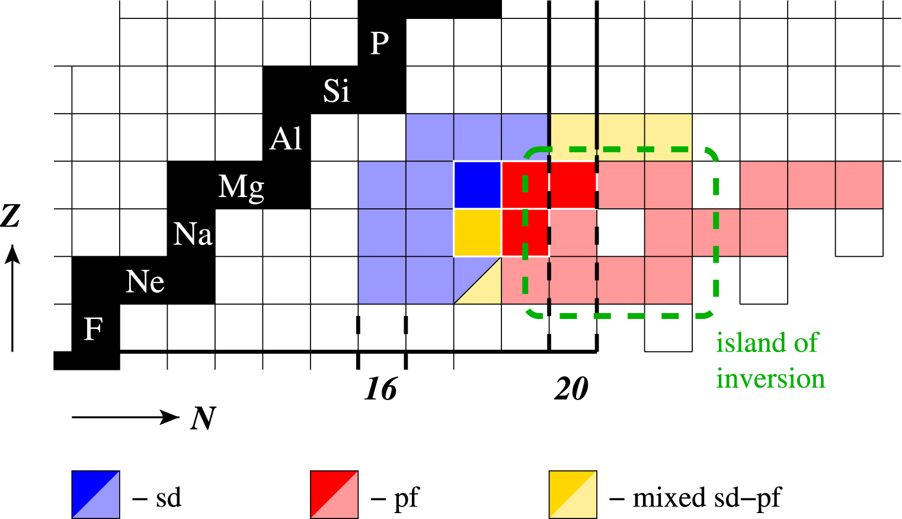
Invariant-mass spectroscopy of neutron-rich fluorine isotopes ²⁸F, ²⁹F & ³⁰F at SAMURAI with NeuLAND
2n sequential decay of ²⁹F*
pf-shell intruder: neutron-rich Z=9 isotopes show characteristica of Island of Inversion
Courtesy of J. Kahlbow

Slide 13
History of ³n and ⁴n measurements
Quasi-free α-knockout ⁸H(p,pα)⁴n
Rossi, Aumann et al.
Courtesy of Fabia Schindler
Currently under analysis
⁷H decay ⁸He(p,2p)⁷H ⁷H→ t+⁴n
Marques et al.
Double charge exchange ⁴He(⁸He,⁸Be)⁴n
Shimoura et al.
Possible ⁴n candidates found!
¹⁴Be→ ¹⁰Be+⁴n breakup
Marques et al.
Start of ab initio theories
including continuum
π double charge exchange (on ³He and ⁴He)
No evidence for a bound
or resonant
⁴n system
Multinucleon transfer
π⁻ Absorption: π⁻+⁷Li → ⁴n+³H
Fission
time
1960
1970
1980
1990
2000
2010
2020

Slide 14
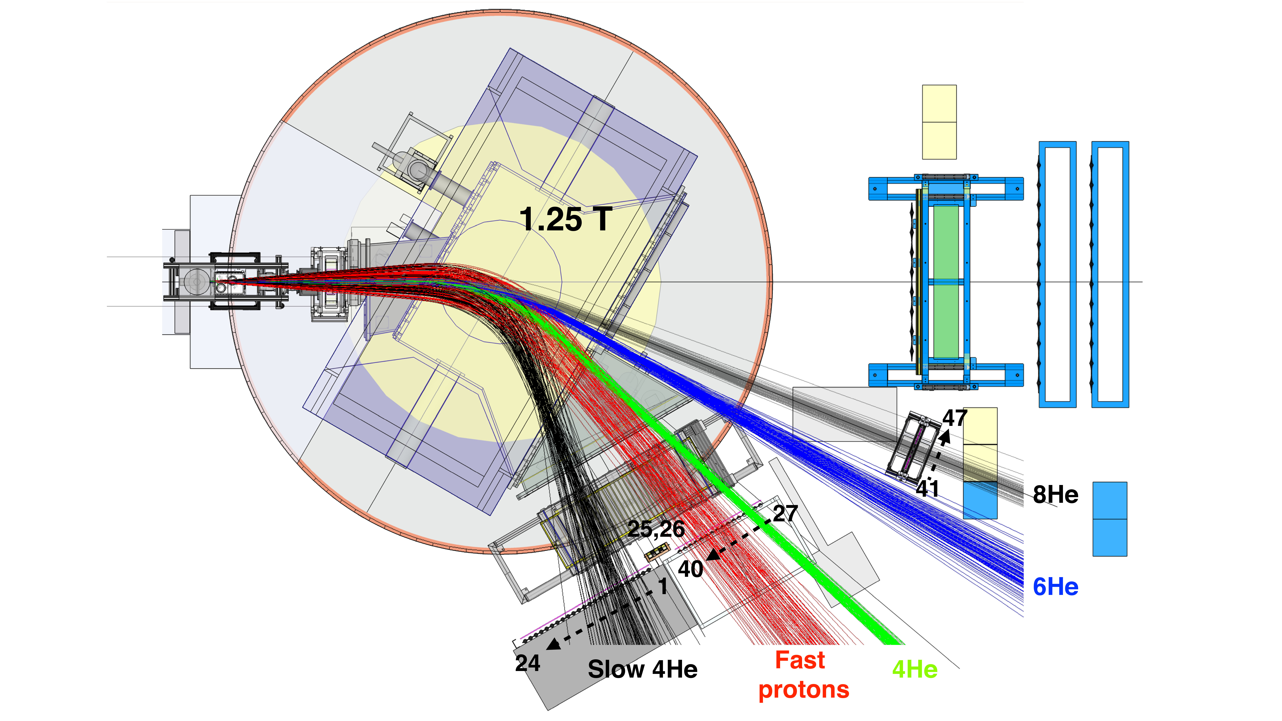
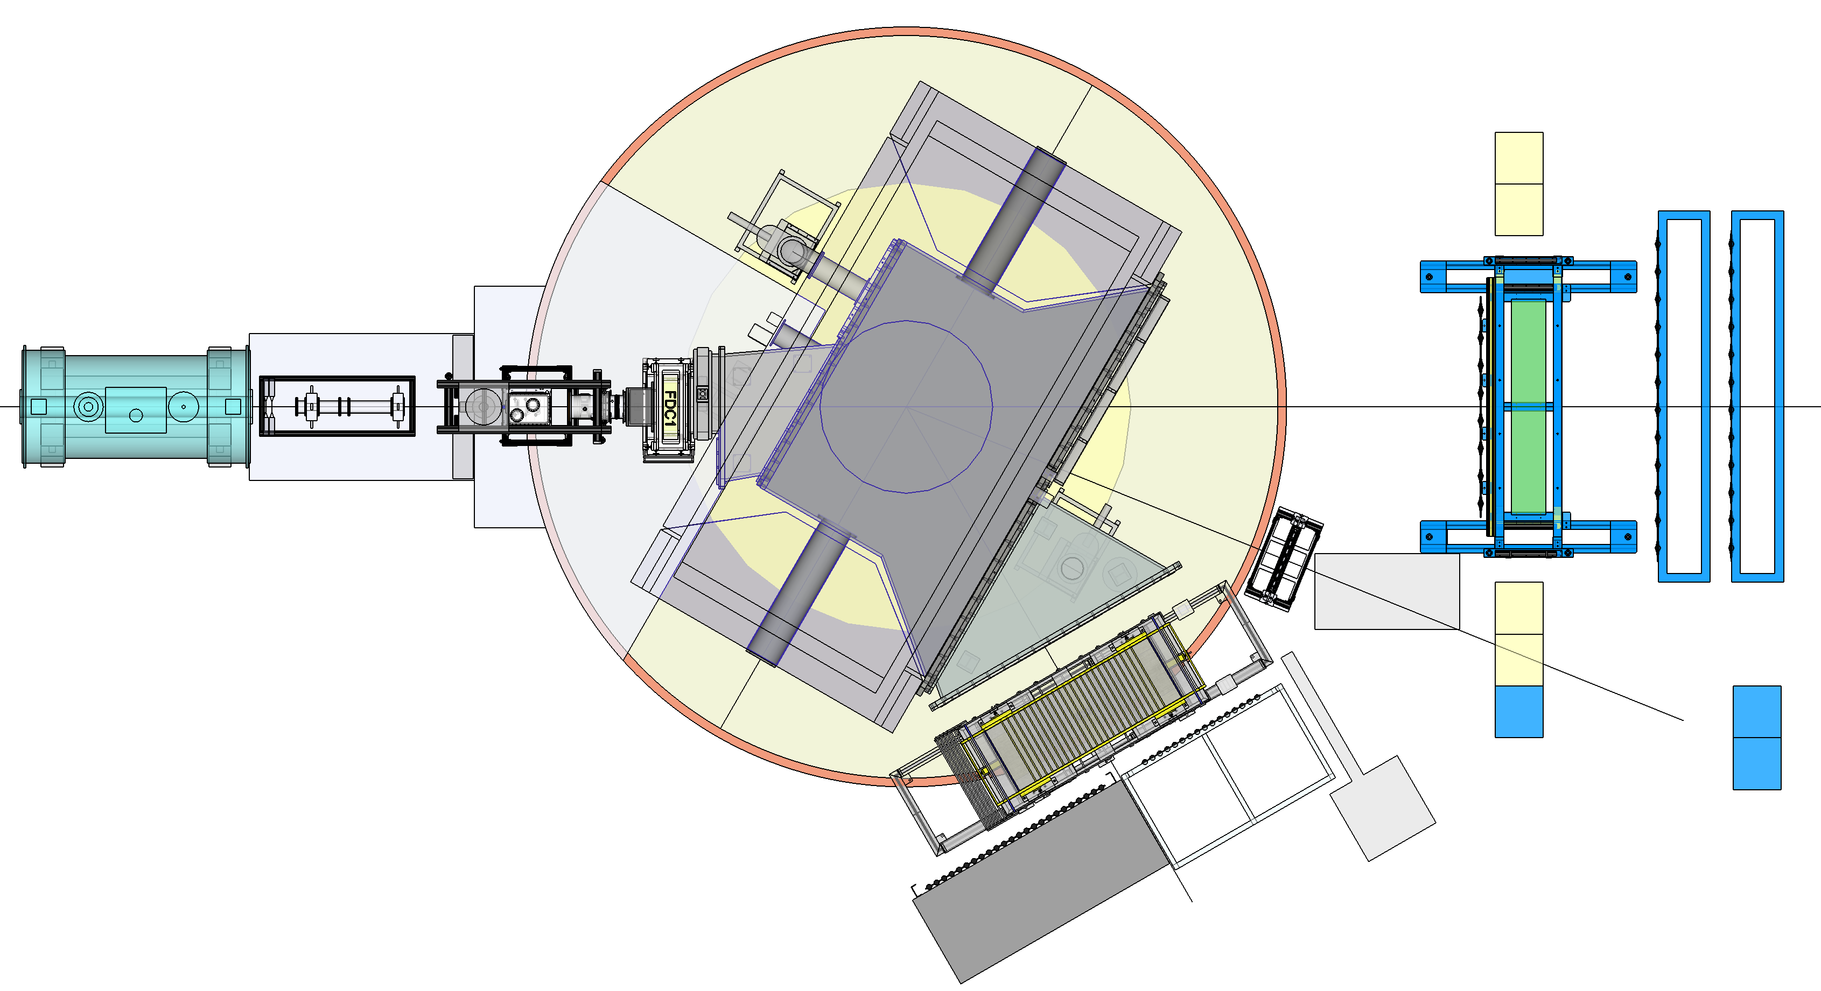
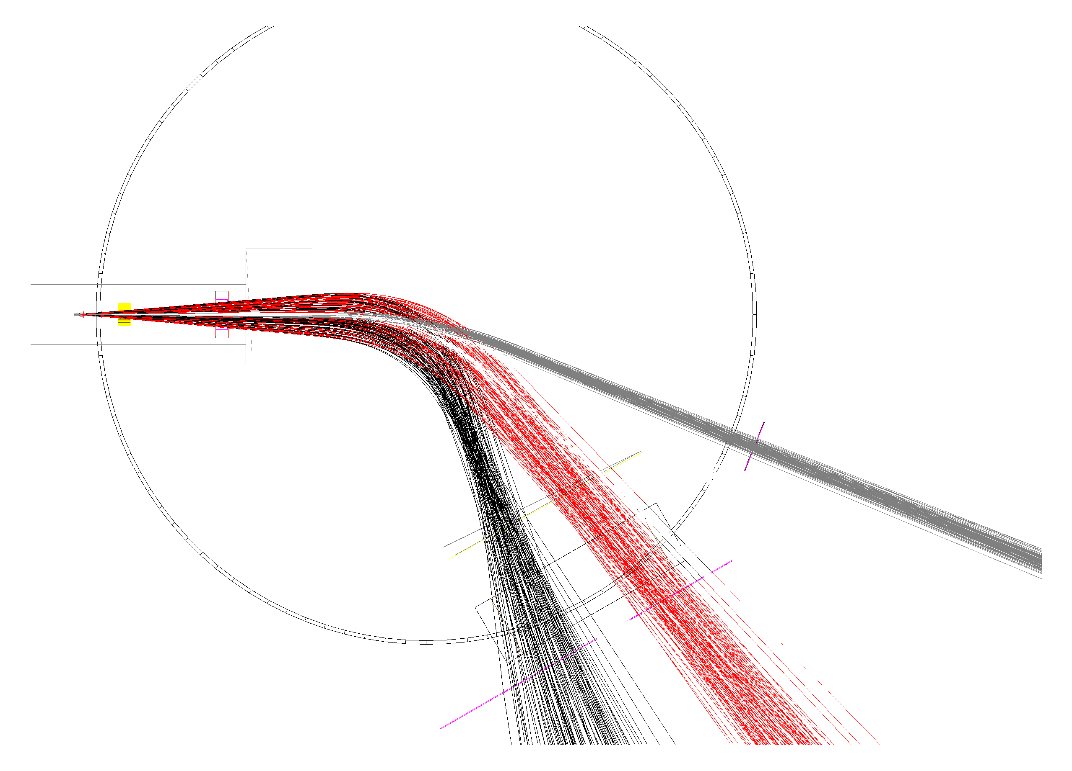
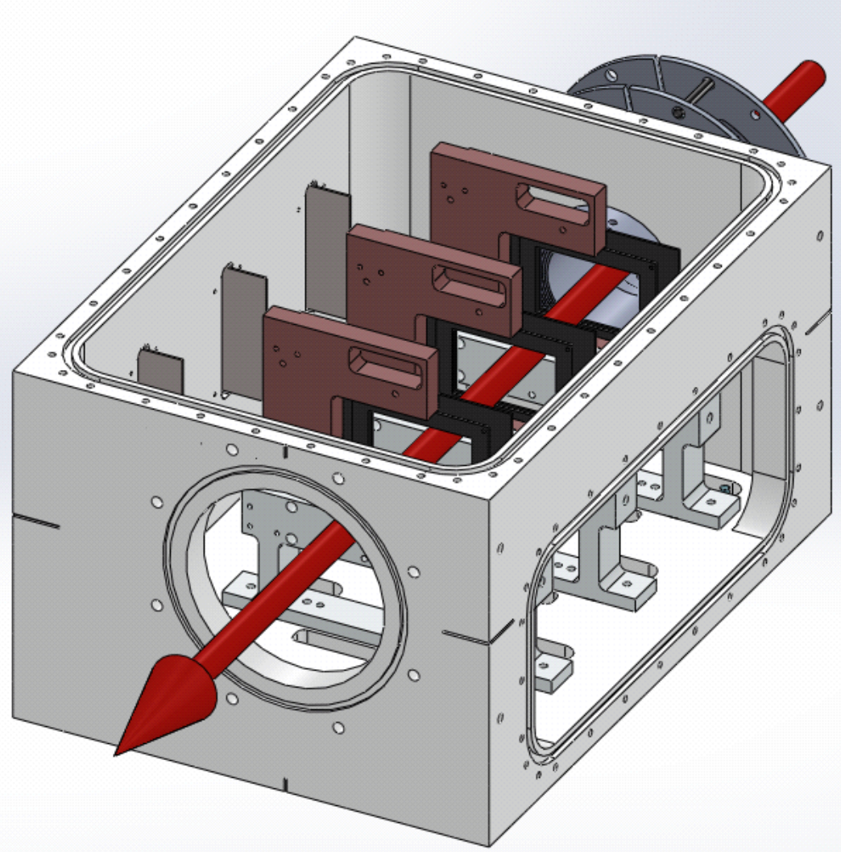
Setup: SAMURAI at RIKEN
Upstream detectors:
Plastic scintillators
Drift chambers
Target: MINOS
Liquid hydrogen
d=5cm
t=357.5 mg/cm²
Neutron detectors:
NeuLAND (R³B)
NEBULA
Incoming ⁸He
E=156 AMeV
⁴n
E=156 MeV
B=1.25 T
Silicon tracker:
T
Thick target
Precise vertex reconstruction
needed
Drift chamber
Unreacted ⁸He
E=156 MeV
Bρ=7.5 Tm
Slow ⁴He
E=55 AMeV
Bρ=2.2 Tm
Fast protons
E=400 MeV
Bρ=3.2 Tm
Plastic wall
Courtesy of Fabia Schindler

Slide 15
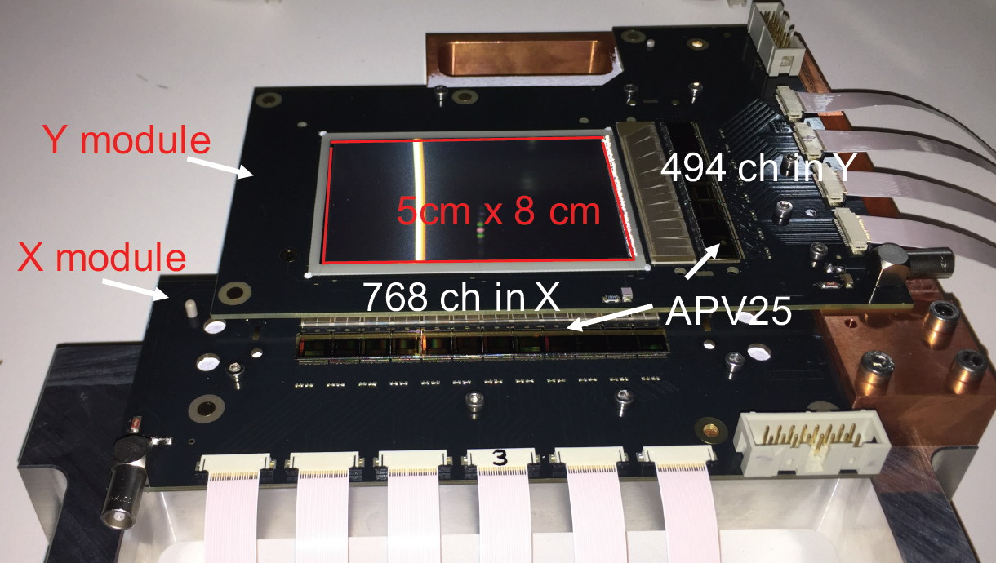
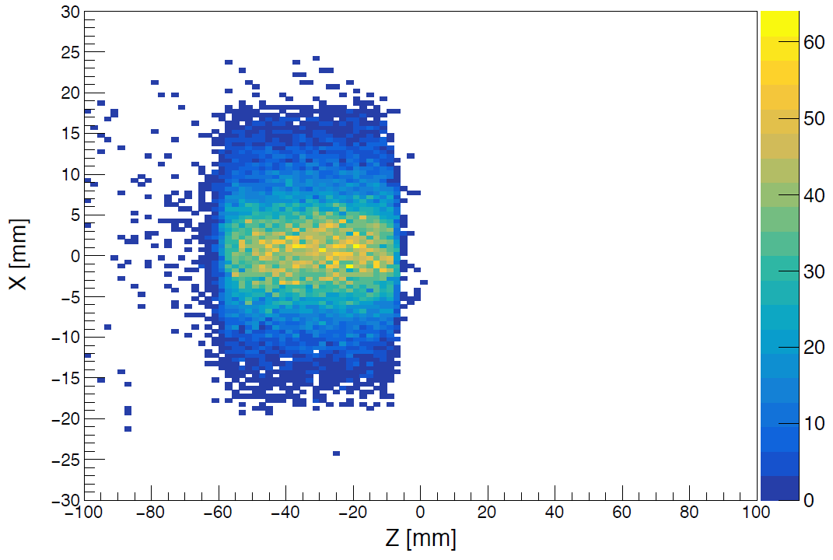
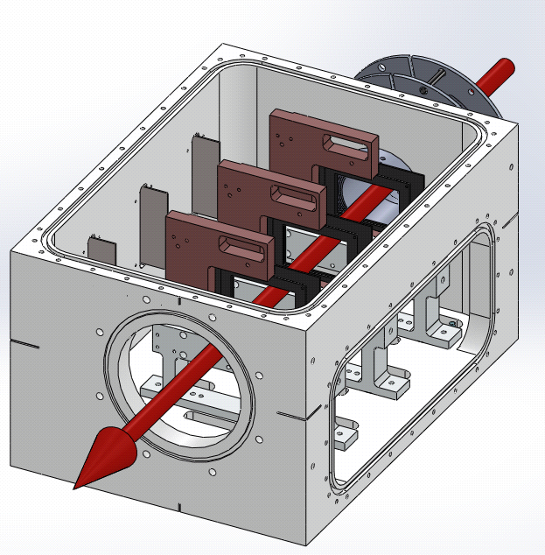

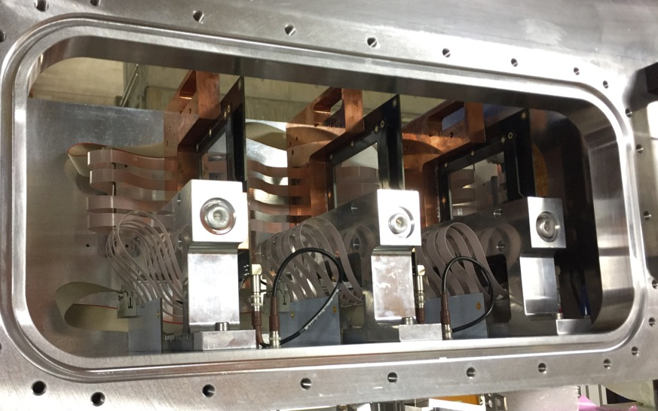


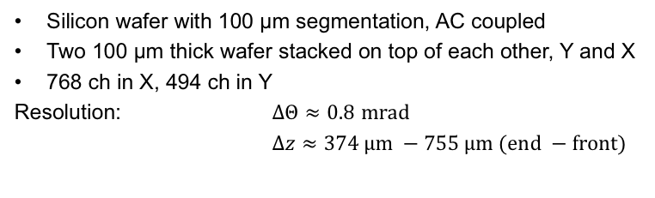
A dedicated Si vertex tracker
Beam image (defocused beam)
Drift chamber
exit window
Silicon wafer with 100 μm segmentation, AC coupled
Two 100 μm thick wafer stacked on top of each other, Y and X
768 ch in X, 494 ch in Y
Resolution: $ΔΘ≈0.8$ $mrad$
$Δz≈374 μm −755 μm (end −front)$
Collaboration:
Courtesy of F. Schindler, V. Wagner

Slide 16
Charged particles identification
Courtesy of Meytal Duer

Slide 17
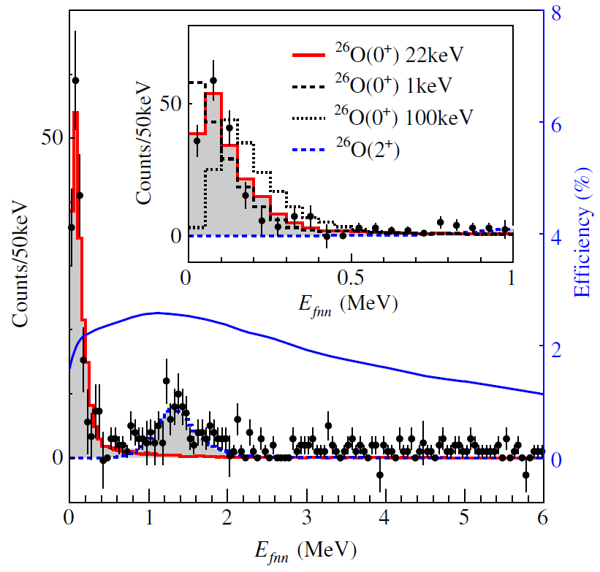
Lifetime of ²⁶O
Invariant mass experiment of ²⁶O by Kondo et. al.:
$$E_{decay}=18±3\left(stat\right)±4 \left(syst\right) keV$$
$$E_{decay}\left(2+\right)=1.28+0.11 −0.08 MeV$$
Ground state of ²⁵O:
$$E_{decay}=749±10 keV$$
²⁶O is a true 2n emitter
Y. Kondo, T. Nakamura et al., PRL 116:102503, Mar 2016.
²⁵O
X
²⁶O
$$E_{26O}<E_{25O}$$
²⁴O
Courtesy of Sonja Storck

Slide 18
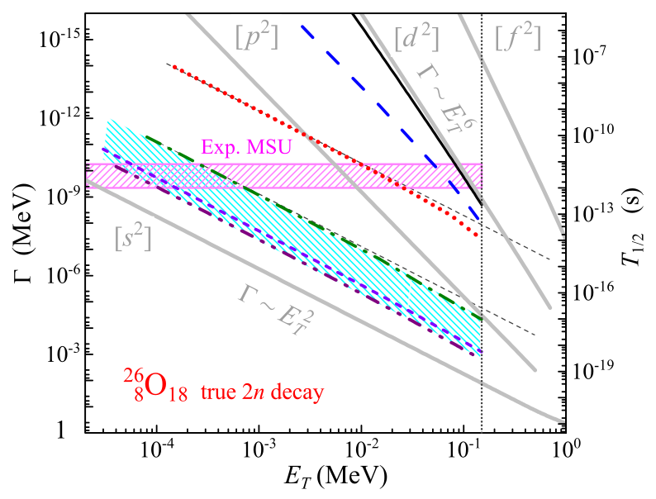
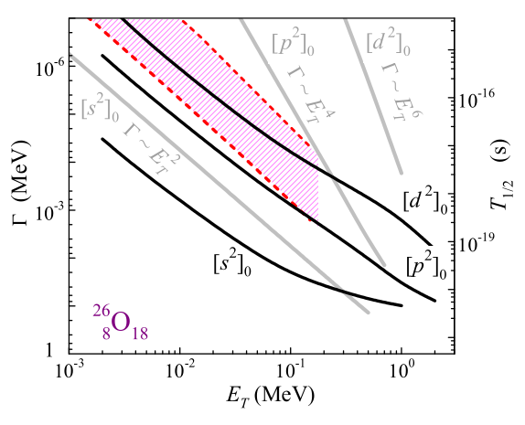
Motivation
Promising candidate for neutron radioactivity:
Experimentally accessible
  Existing angular barrier increases lifetime
L. Grigorenko et al., PRL, 111:042501, July 2013
Experiment by Kohley et al. (MSU):
  $T_{1/{2 }}={4.5}_{−1.5}^{+1.1}\left(stat\right)±3\left(syst\right) ps$ ($τ=6.5 \text{ps}$)
  First case of two-neutron radioactivity, if value is confirmed
L. Grigorenko et al., PRC, 97:034625, March 2018
Z. Kohley et al., PRL, 110:152501, Apr 2013.
Courtesy of Sonja Storck

Slide 19
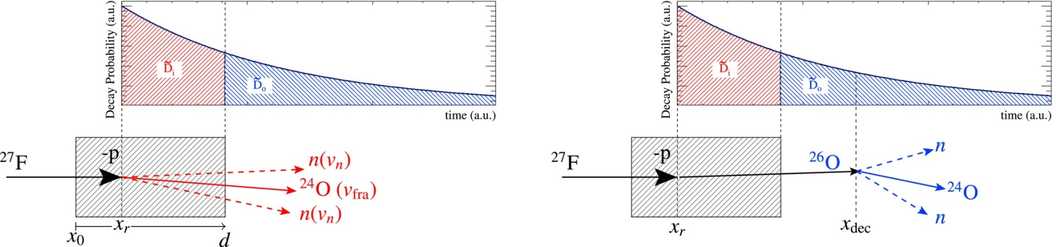
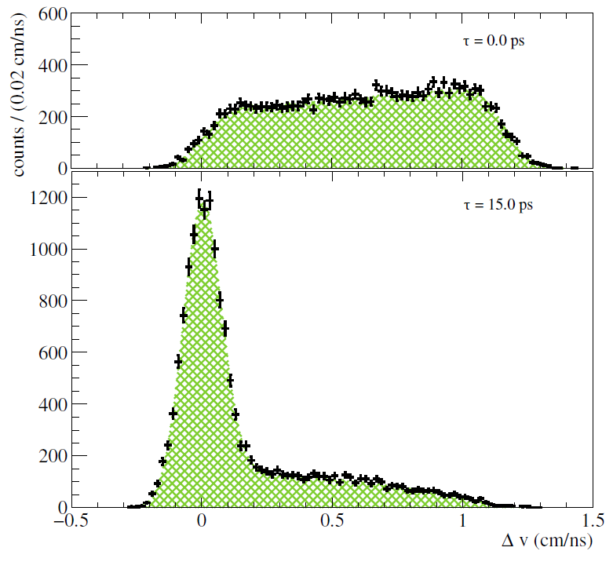
Measurement Method
J. Kahlbow et al., NIM. A: Vol. 866, 2017, Pages 265-271
$$Δν=ν_{n}−ν_{F}$$
Courtesy of Sonja Storck

Slide 20
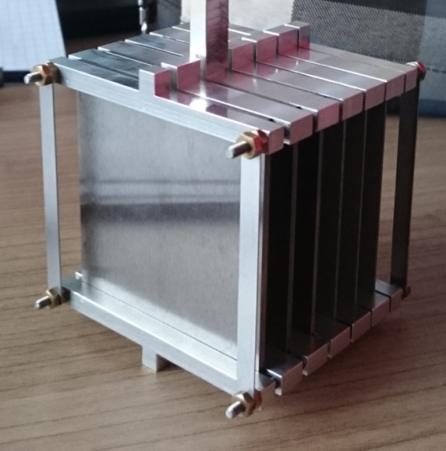
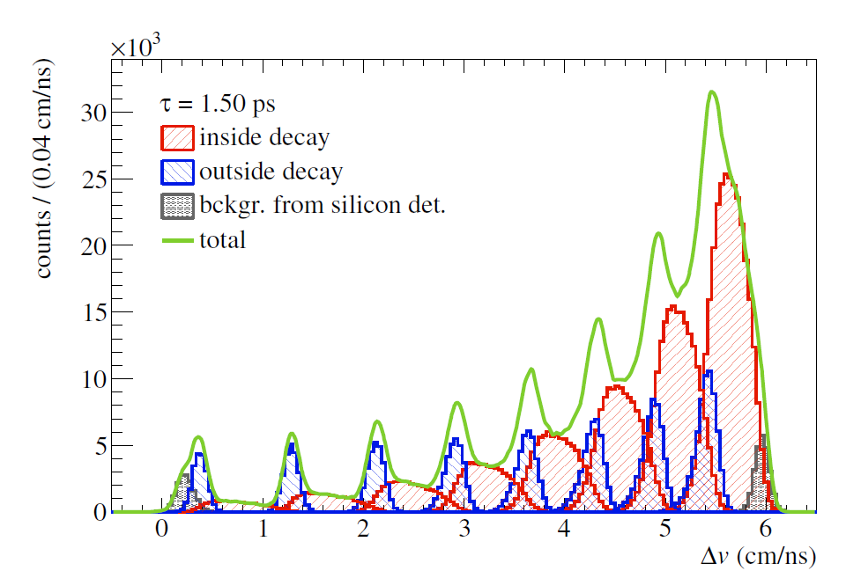
Measurement Method
J. Kahlbow et al., NIM. A: Vol. 866, 2017, Pages 265-271
$$Δν=ν_{n}−ν_{F}$$
Courtesy of Sonja Storck

Slide 21
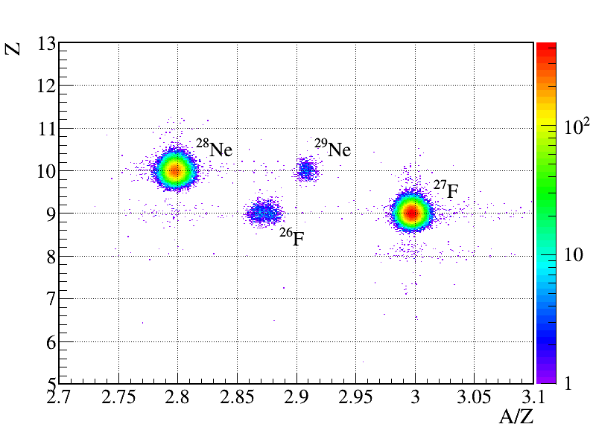
Experimental Setup
Courtesy of Sonja Storck
Notes:
Position calibration F5 plastic
BDC calibration: tracked on target
A/Z from ToF F7 to F13, X on F5
Z from ICB

Slide 22
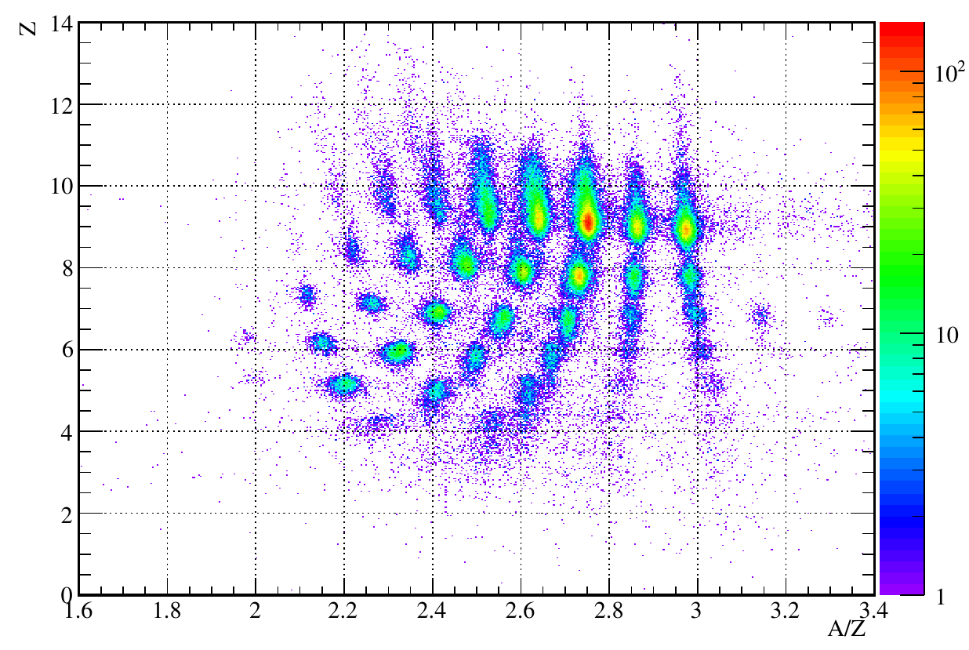
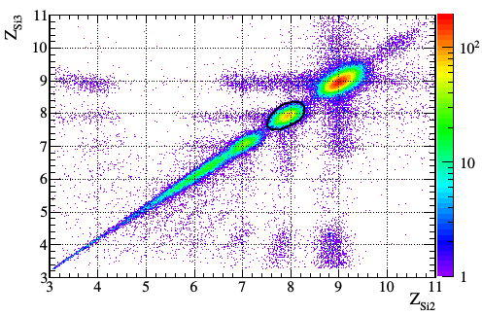
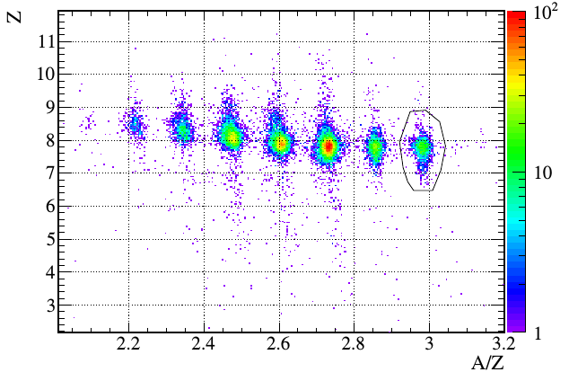
Fragment ID
²⁴O
With cut on Silicons after the target
Courtesy of Sonja Storck

Slide 23
A06: New Projects
The ground-state structure of ²⁹F
➔ Experiment will clarify the valence-neutron shell structure
Electromagnetic excitation
+ 1n,2n decay
➠ B(E1)
+
Nuclear excitation
➠ Excited states
+
Knockout reaction
²⁹F→²⁸F→²⁷F+n
Angular correlation
(p_{28F} vs. p_{n}) sensitive to
quantum numbers
➠ Structure of ²⁹F
Invariant-mass method

Slide 24
A06: New Projects
Di-neutron correlations (²⁶O decay)
Challenge: E_{decay}=18(5) keV
Needs high resolution to measure
nn angular correlation
Prediction
Hagino and Sagawa, Phys. Rev. C 93, 034330 (2016)
HIME
⇒ Construction proposal
HIME (HIgh resolution detector array for Multi neutron Events)
Will be used also in A05 to measure nn scattering length

