Slide 1
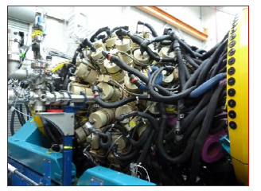
Report on A03
Electromagnetic Structure of Light to Medium-Mass Nuclei
Laser Spectroscopy: Wilfried Nörtershäuser
M. Mathy,
Sebastian Heil,
Juan Saiz Lomas,
Ina Syndikus
M. Petri
γ-Spectroscopy 2018-2019: Alexandre Obertelli

Slide 2
A03: Regions of Interest
Key experiments on electromagnetic observables
A02
A04
Laser spectroscopy
Charge radii and nuclear moments
52,53,55Fe shell evolution around N = 28
109-119Pd shell evolution around Z = 50
A01
109-119Pd
52,53,55Fe
Electromagnetic matrix elements of ^{12,14,16}C through EM probes and ray spectroscopy
A01
A07
12,14,16C

Slide 3
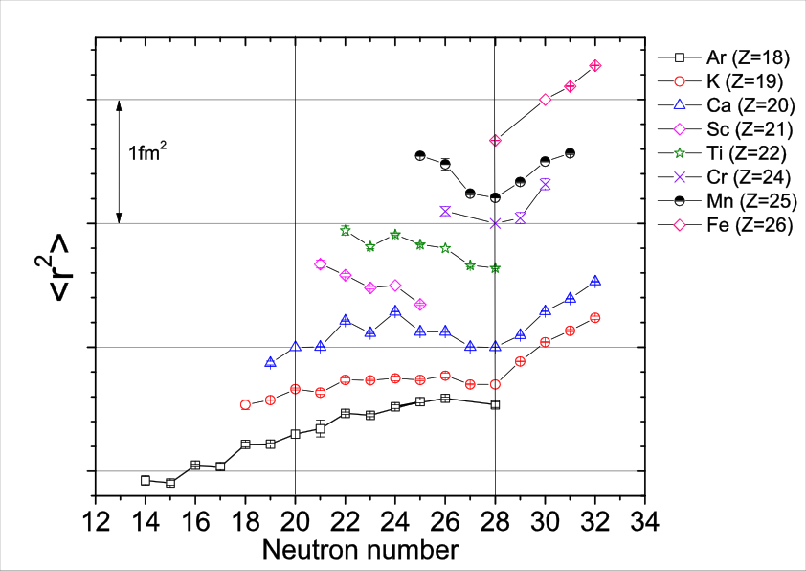
Charge Radii in the Ca-Ni Region in 2015
S_{2n} signature of shell closure at N = 28 disappears at Z = 24
Z-dependence of the N = 28 shell closure
52,53,55Fe at BECOLA/NSCL

Slide 4
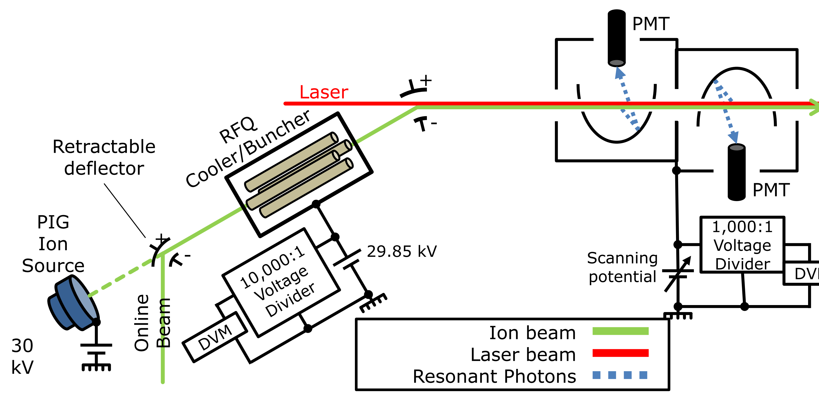
Laser Spectroscopy in A03
BECOLA = Beam Cooling and Laser Spectroscopy
Deliverables:
Laser Spectroscopy at NSCL/MSU: ^{52,53}Fe
Laser Spectroscopy at CARIBU: Pd

Slide 5
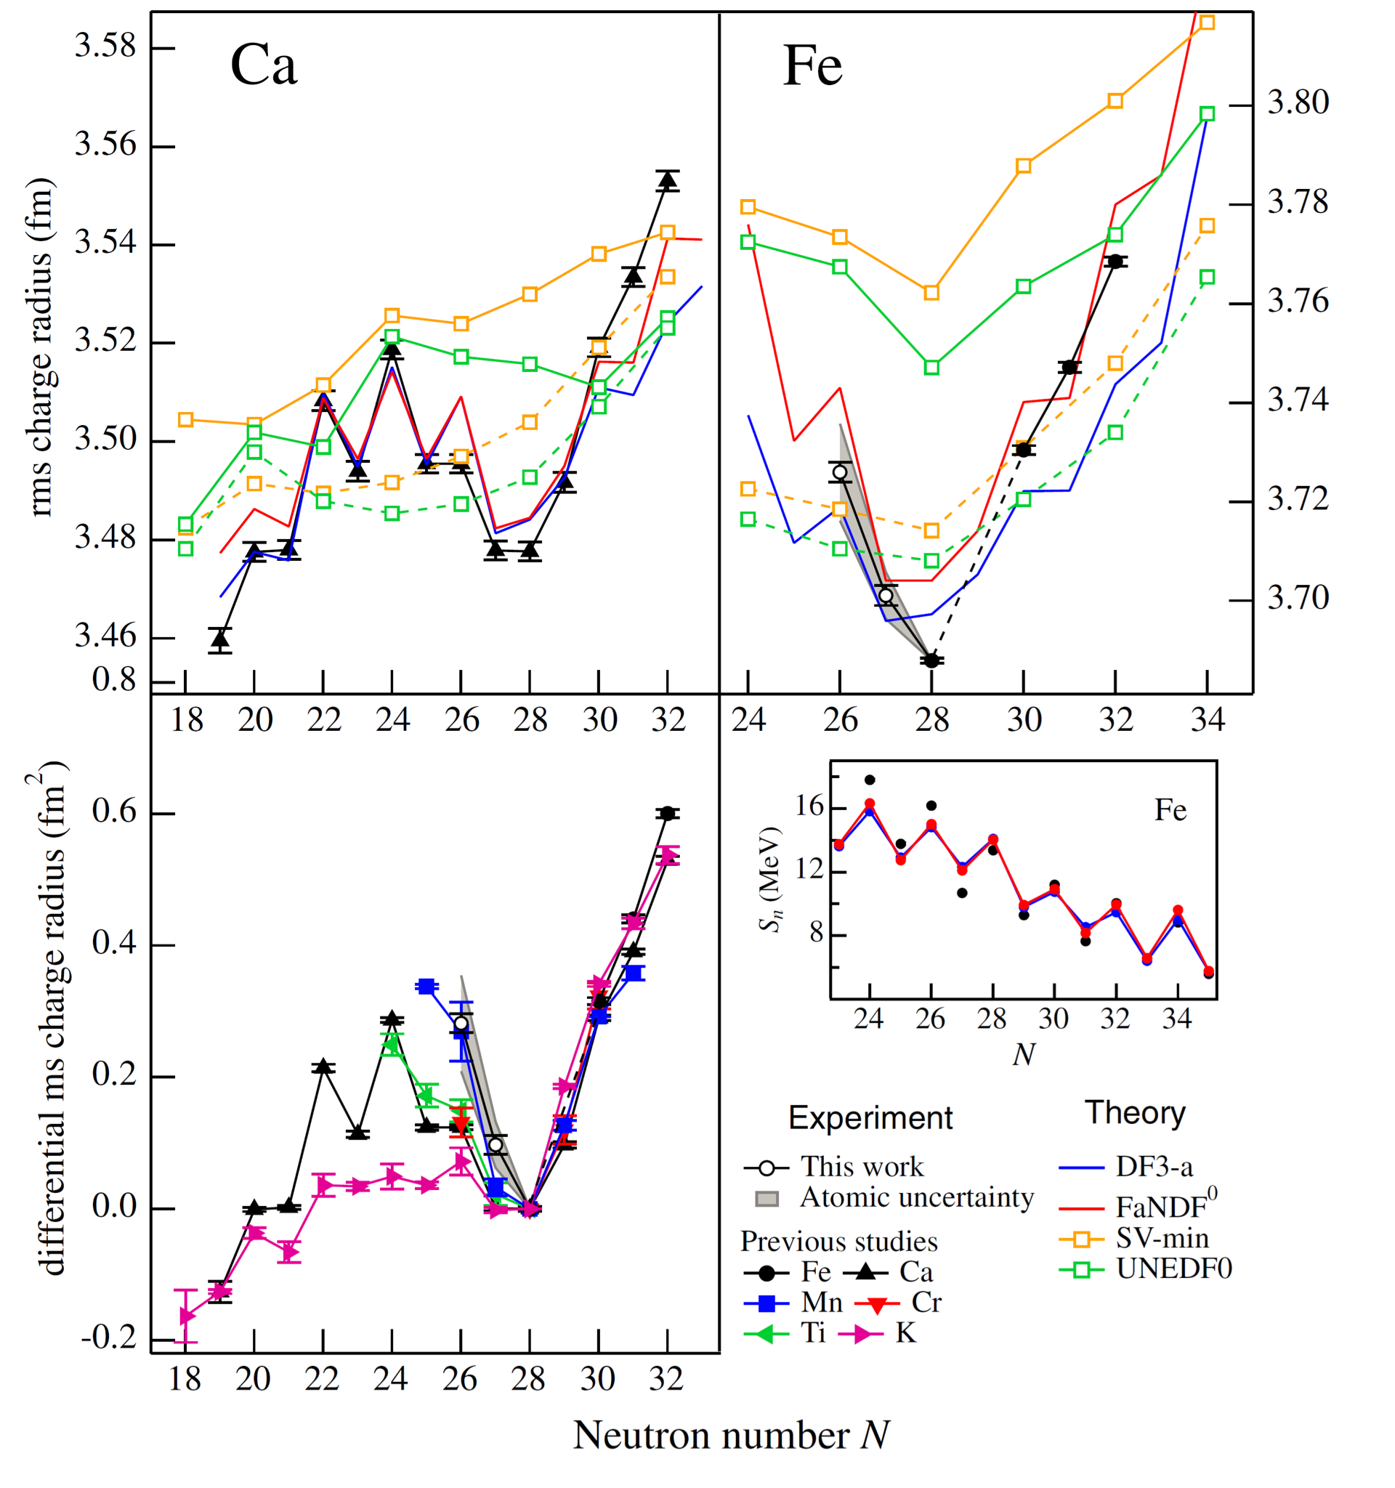
Deliverable: Spectroscopy of ^{52,53}Fe
Sharp kink of charge radii at N=28 in Fe established
Good agreement with charge radii from nuclear EDF with a Fayans functional
Similar kink as in ⁴⁸Ca but different mechanism
Next period: ^{50,51}Fe (deformation)
Required: higher sensitivity
Spectroscopy on Fe⁺ (using FHG)
Test @ COALA
Deformed Fayans Functional under development
benchmark nuclear EDFT & ab initio (A04)
K. Minamisono et al., PRL 117, 252501 (2016)

Slide 6
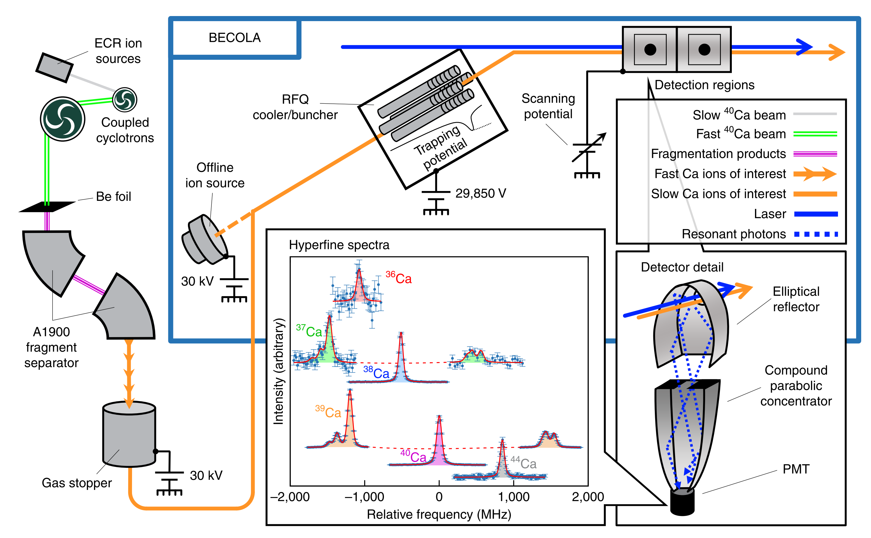
On Top: Spectroscopy of ³⁶⁻³⁹Ca
Travel Prize Talk by Bernhard Maaß
A. Miller, … B. Maaß et al., Nature Physics (2019)

Slide 7
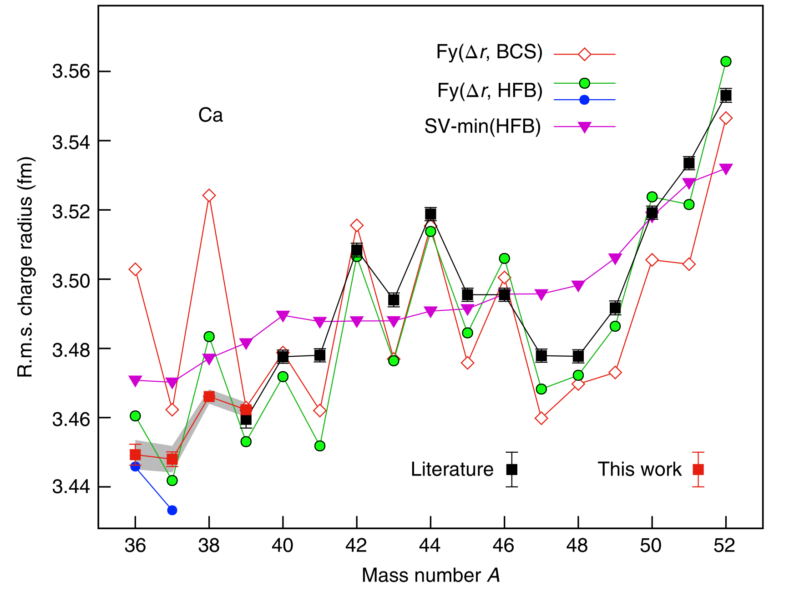
Calcium Charge Radii
A. Miller, … B. Maaß et al., Nature Physics (2019)

Slide 8
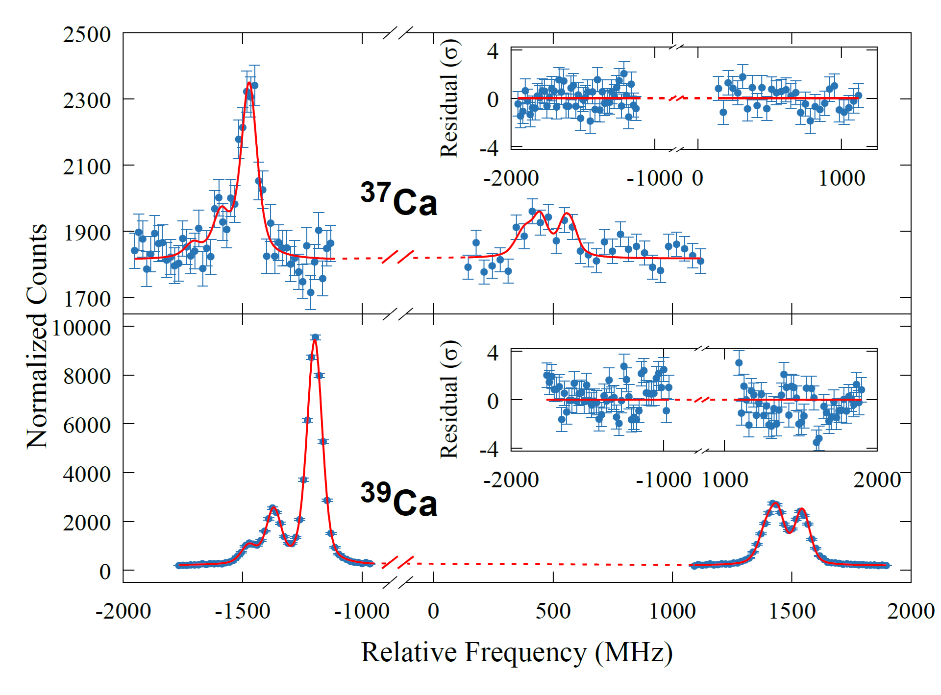
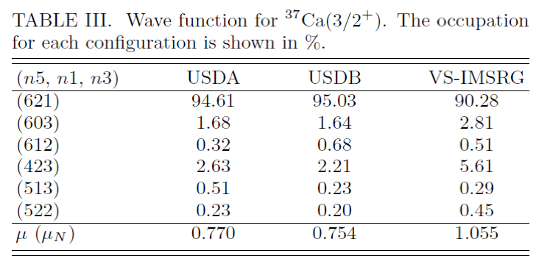
Moments of ^{37,39}Ca
relevant for magnetic moment
A. Klose et al. under review @ Phys. Rev. Lett.,
A03 + A04
sub-shell closure @ N=16 in ³⁷Ca is stronger
than the shell-closure at N=20 in ³⁹Ca

Slide 9
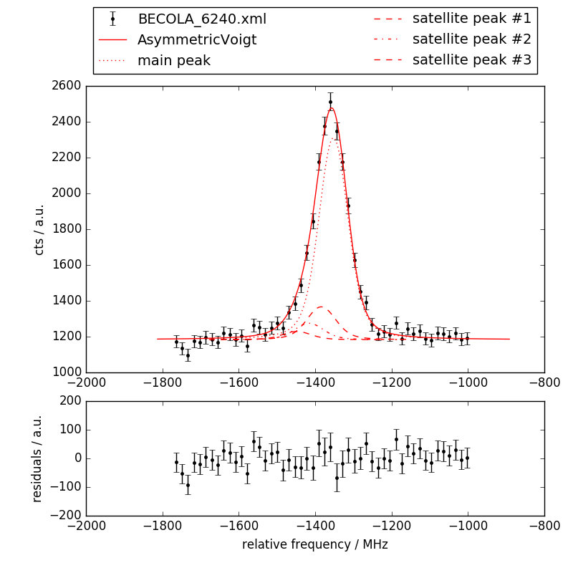
On Top: ⁵⁶Ni
First laser spectroscopy of ⁵⁶Ni
→ under analysis
→ charge radii with N2LO_{Sat}
some information (few lines) on ⁵⁵Ni
→ needs to be improved
Next period: ^{54,55}Ni
establish kink at ⁵⁶Ni
mirror nuclei ⁵⁴Ni ⬄ ⁵⁴Fe
→ neutron-skin information
Spokesperson: Dominic Rossi, Proposal accepted
F. Sommer, to be published (A03 + A04)

Slide 10
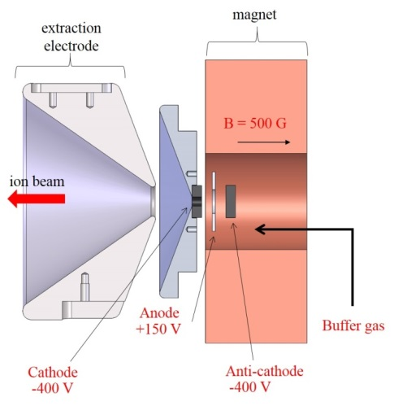
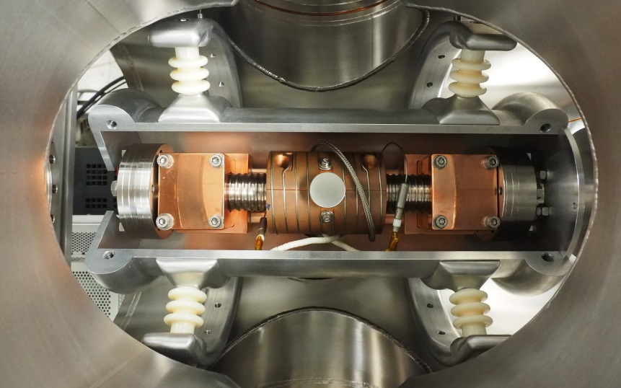
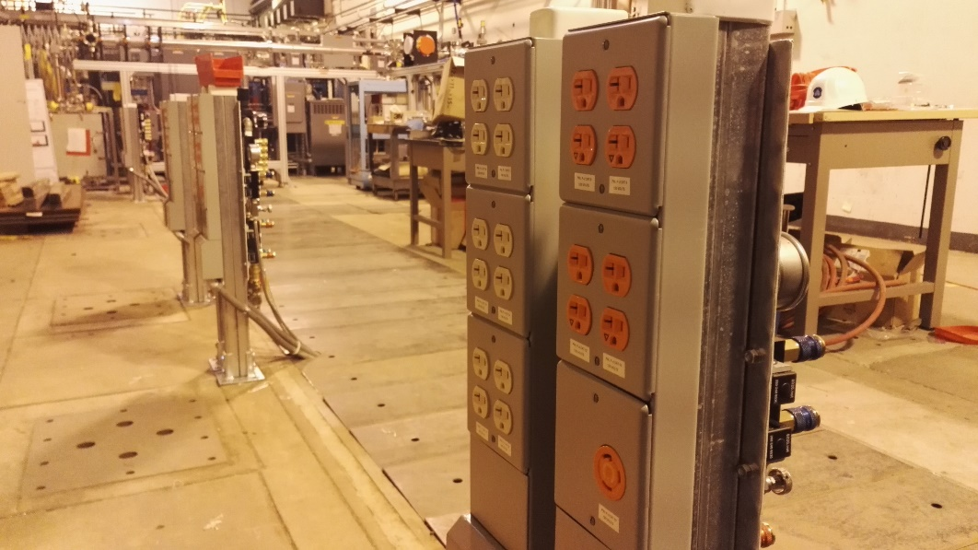
Palladium @ CARIBU
Beamline transferred from Mainz to Argonne → A01
Low energy experimental area in preparation
Commissioning of new charge exchange cell ongoing
Pd off-line ion source and spectroscopy tests with PIG source at MSU currently ongoing.

Slide 11
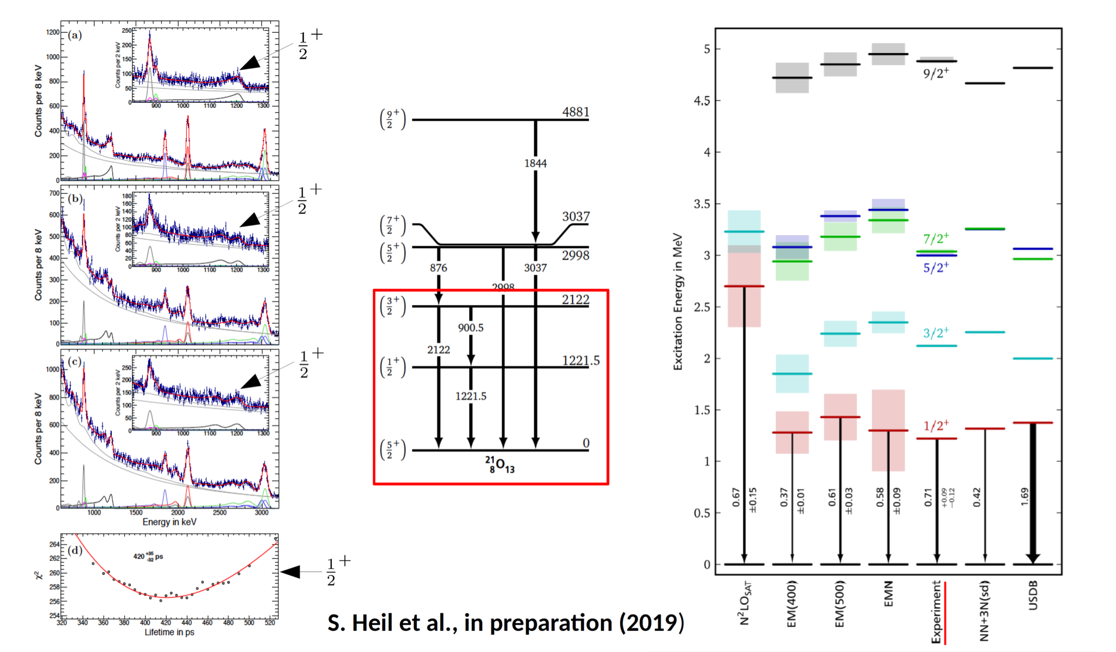
Oxygen-21 at
Notes:
Goal: Measure electromagnetic properties in O-21: Use the plunger method to measure the
lifetime of the first excited state and the branching ratios for the second excited state.
• The sketch in the middle shows: Known level scheme of O-21. We are interested in the first
½ and the first 3/2 state.
• The left plots show the experimental results: We see the gamma-ray spectra for different
distances between target and degrader. The lines are results from GEANT simulation with
the final lifetime and branching ratio. The sum of all transition is fitted to the measured
spectrum. This is done for many different lifetimes and branching ratios. In the left bottom
we see the chi^2 minimization for the first ½ sate for different lifetimes. The result is 420 ps.
• The right plot shows: Comparison of the transition strengths between experiment and
several theoretical models. In terms of the transition strength the closest result is given by
EM(500) (This theory uses a new 3N force which is refitted to reproduce the beta decay
half-life of triton).
• Status: Phd Thesis finished. Paper in preparation

Slide 12
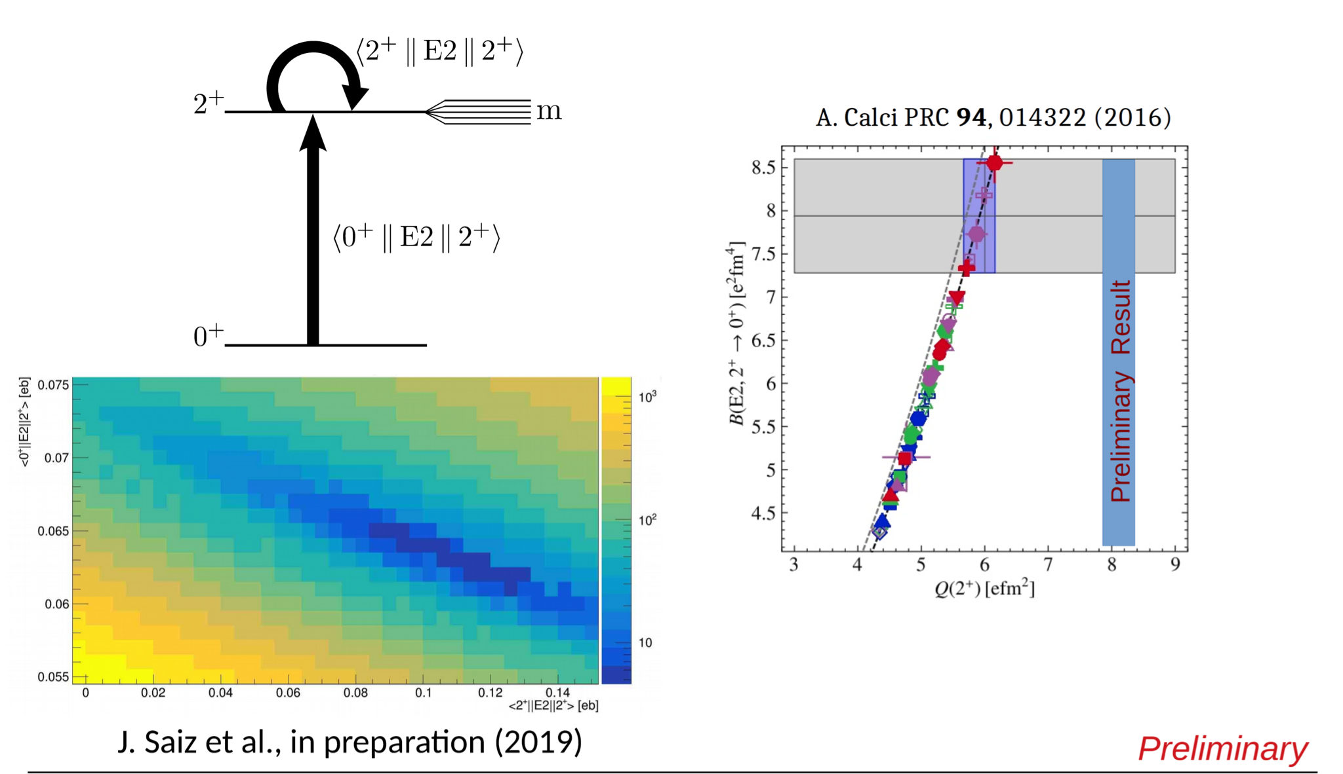
Carbon-12 at
Notes:
C-12 (scattering on Pb-208):
• Goal: Measure the quadrupolmoment of C-12 first excited state using coulomb excitation.
• We shot C-12 beam on a lead target and measure the angular distribution of the scattered C-
12 isotopes.
• The top left picture shows the measurement idea: coulomb excitation probes both
transitional matrix element and diagonal matrix element (the one we want) due to the
reorientation effect of the m_J substates.
• The bottom left plot shows an analysis step: We see the correlation between the B(E2) and
the quadrupole moment for our experimentally obtained angular distribution. The
minimization of this gives us the quadrupole moment (since we know the B(E2) with a 5%
accuracy.) This plot is calculated with the GOSIA coulomb excitation code which needs the
C-12 angular distribution and several other information about the experiment as input.
• The plot on the right shows preliminary results: The gray box is the old value by A. Calci et
al. with a 50% uncertainty. The blue band shows the new result at around 8.1 efm^2 with a
much smaller statistical uncertainty.

Slide 13
Carbon-16 at
Notes:
C-16 (Be-9+Be-9 → C-16+2p):
• Measure Lifetimes with the Doppler shift attenuation method for three excited States
(2_2^+, 3+, 4+) in C-16
• Top part shows:
◦ 2D Plot: Gamma ray energy vs radiation angle for a 2 proton cut. The 2p cut should
favor the C-12 decays. The seen slopes for some transitions are directly sensitive to the
mean decay beta of the transition which is sensitive to the lifetime.
◦ The C-16 4+ has no slope →The particles are not moving while they decay → All
particles are stopped in the degrader while the decay happens → Lifetime is larger than
2.6 ps. From Petri et al. We know that the lifetime should be smaller than 4 ps.
◦ The C-16 3+ interferes with a 5/2+ state of N-15 (Be-9+Be-9→N-15+1p2n) → The N-
15 State dominates → No Lifetime extraction possible.
◦ The C-16 2_2^+ state is not visible.◦ The seen Ne-22 state (Be9+O-16(thin Oxidation layer on target)→Ne-22+2p1n) is used
as a benchmark to check the method. The results are very satisfying!
• Bottom part shows:
◦ We also see Ne-23 (Be9+O-16(Oxidation layer on target)→Ne-23+2p) in the data. Here
the lifetimes of many state are not known yet.
◦ We measured the lifetime for 2 States (1701 keV and 2516 KeV State) for the first time!
Results on the slides.
◦ The picture shows the correlation between lifetime and mean decay beta for simulations.
The mean decay beta is extracted from the experiment and then transformed into a
lifetime using these simulation results.
• Status: Analysis is nearly finished / We are now working with NCSM (Roth et al) to
interpret the result for both C and Ne.

Slide 14
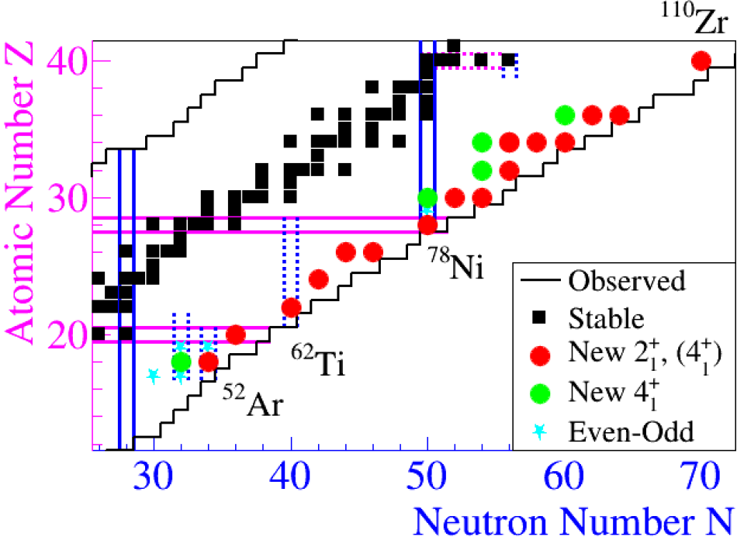
78Ni, 52Ar: Milestone Nuclei
RIBF : >100 more intensities than anywhere else
Opened new opportunities in the recent years
SEASTAR: spectroscopy program at RIKEN
(data taking: 2014-2017)
SEASTAR publications so far:
Cr, Fe: C. Santamaria et al., PRL115 (2015)
110Zr: N. Paul et al., PRL 118 (2017)
98,100Kr: F. Flavigny et al., PRL 118 (2017)
79Cu: L. Olivier et al., PRL 119 (2017)
Zn: C. Shand et al., PLB 773 (2017)
Se: S. Chen et al., PRC 95 (2017)
Ge: M. Lettman et al., PRC 96 (2017)
Mn: X. Liu et al., PLB 785 (2018)
76Ni: Z. Elekes et al., PRC 99 (2019)
List of publications (A03, SFB):
78Ni: R. Taniuchi et al., accepted in Nature (2019)
52Ar: H. N. Liu et al., PRL 122, 072502 (2019)
N. Paul et al., accepted in PRL (2019)
Ongoing analysis:
Two-nucleon removal: A. Frotscher PhD thesis (work ongoing)
27.03.2019 l A03, SFB workshop | A. Obertelli l TU Darmstadt l 2

Slide 15
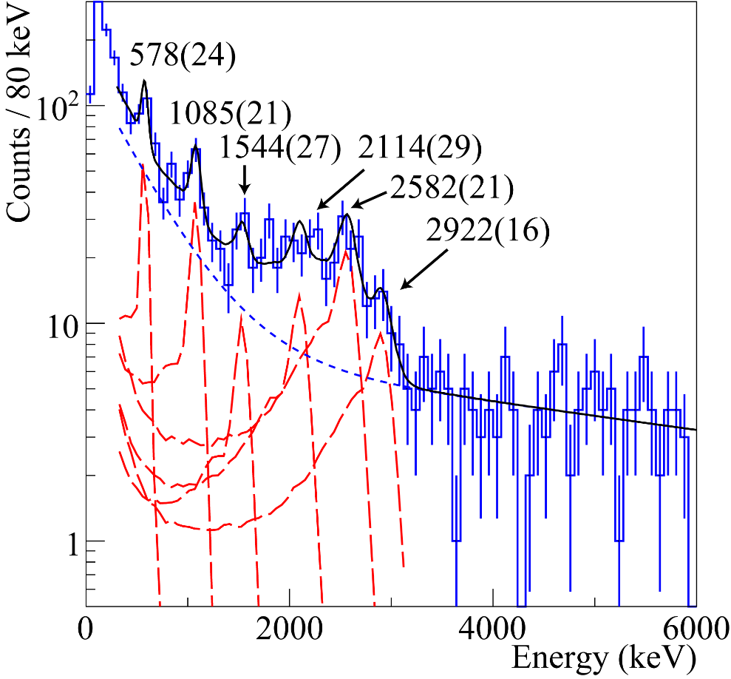
Highlight: ⁷⁸Ni, doubly magic but…
R. Taniuchi et al., accepted in Nature (2019)
spectroscopy of ⁷⁸Ni from (p,2p) and (p,3p)
collaboration with A04 (IM-SRG, Schwenk)
press release in preparation at RIKEN, CEA,
and TU Darmstadt
publication expected in May 2019
80Zn(p,3p)
2560(30)
2560(30)
2920(40)
« intruder »
deformed
« normal »
spherical
2₂⁺
2₁⁺
0+1
2.6 MeV
2.9 MeV
0₁⁺
First indication for a possible disappearance of the N=50 major shell closure “beyond” ⁷⁸Ni
In agreement with predictions from F. Nowacki et al., PRL 117 (2016)
27.03.2019 l A03, SFB workshop | A. Obertelli l TU Darmstadt l 3

Slide 16
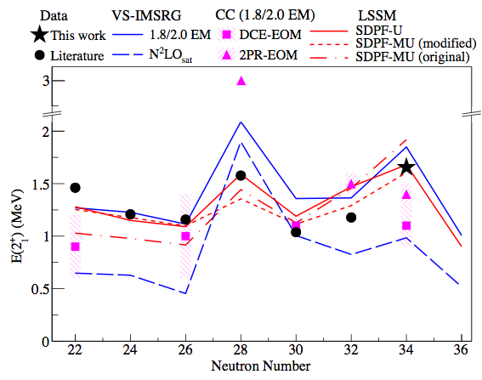
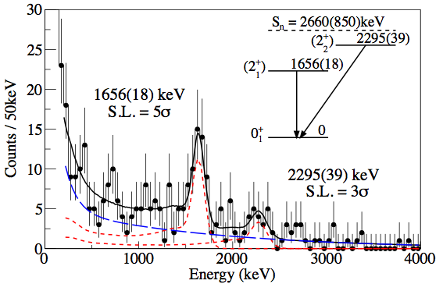
Highlight: ⁵²Ar, shell closure at N=34
⁵³K(p,2p)⁵²Ar at 210 MeV/nucleon, 1.0 pps
Local maximum 2⁺ energy for ⁵²Ar, confirmation of N=34 magic character
Large prediction spread from theory
collaboration with A04 (Schwenk)
Published in February 2019: H. Liu et al., Physical Review Letters 122, 072502 (2019)
27.03.2019 l A03, SFB workshop | A. Obertelli l TU Darmstadt l 4

Slide 17
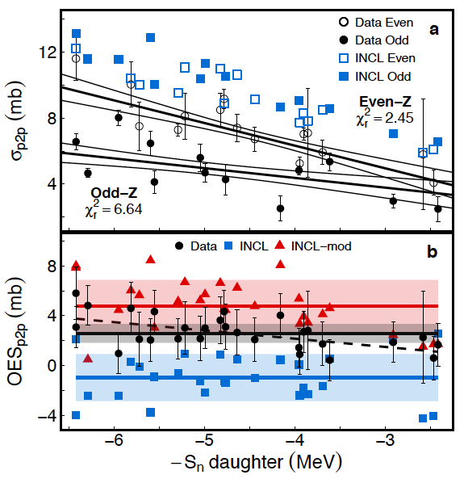
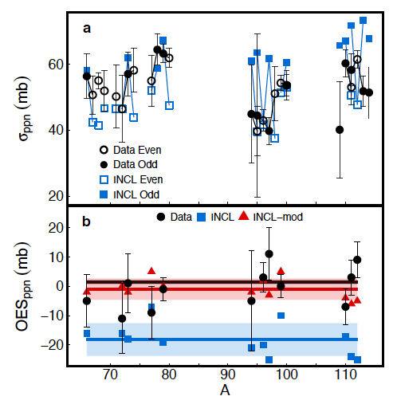
Highlight: pairing in (p,2p), (p,pn) cross sections
one-proton and one-neutron removal cross sections at about 200 MeV/nucleon
55 new inclusive cross sections
odd-even effects observed in both (p,2p), no staggering in (p,pn)
comparison to intra-nuclear cascade model (INCL)
prominent role of pairing correlations evidenced
Accepted in March 2019: N. Paul, AO et al., PRL (2019)
27.03.2019 l A03, SFB workshop | A. Obertelli l TU Darmstadt l 5

Slide 18
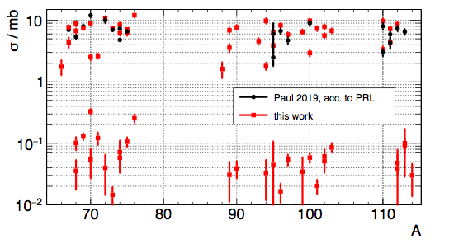
Two-nucleon removal mechanism
Understand the (p,3p) reaction mechanism
PhD thesis of Axel Frotscher
Seastar 1 &2 with MINOS: a unique data set
New Humboldt postdoctoral fellow from May 2019 (2 years): Dr. Mario Gomez (University of Sevilla)
Courtesy A. Frotscher
27.03.2019 l A03, SFB workshop | A. Obertelli l TU Darmstadt l 6

Slide 19
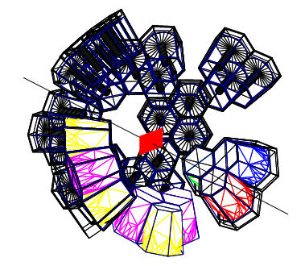
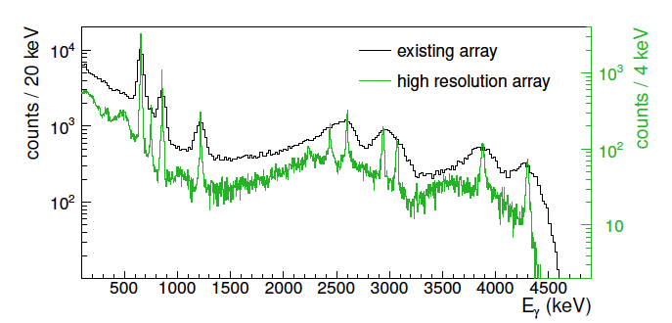
High resolution with Miniball at the RIBF
Two paths to follow after SEASTAR (MINOS + DALI2):
- high resolution (A03)
particle + gamma spectroscopy (A08)
Miniball high-resolution array to be hosted at the RIBF in 2020-21 + GRETINA-like modules
- Energy resolution 2-5 % (sigma) compared to 10% for DALI2
Photo peak efficiency about 10% compared to 30% for DALI2
Broad physics case from the collaboration
OUR interest within the SFB: high resolution spectroscopy of ⁷⁸Ni, ⁷⁹Cu and neighbours
27.03.2019 l A03, SFB workshop | A. Obertelli l TU Darmstadt l 7

Slide 20
High resolution with Miniball at the RIBF
Main investigators: P. Doornenbal (RIKEN), K. Wimmer (Univ. Tokyo), Miniball collaboration
Official documents for Science / Techniques / Support:
- Construction proposal submitted to RIBF PAC committee in December 2018
- Support letter from PAC: positively received (December 2018)
- Proposal submitted to the Miniball collaboration board in November 2018
- Support letter from Miniball collaboration (spokesperson T. Kröll): positive (December 2018)
Agenda:
- 10-12 April 2019: workshop at TU Darmstadt (Organizers: P. Doornenbal, T. Kröll, K. Wimmer)
- Dec. 2019: individual proposals to RIBF PAC
- Campaign(s): 2020-2021
Investments:
beam, transport taken care of by RIKEN Nishina Center
Digital electronics, trigger modules, cables to be acquired
request to SFB (A03): 13 keuros for contribution to trigger modules
27.03.2019 l A03, SFB workshop | A. Obertelli l TU Darmstadt l 8

Slide 21
A03: Publications
1 Nature
1 Nat. Phys.
4 Phys. Rev. Lett.
3 Phys Rev A,C
1 EPJA x
10 Publications
A. J. Miller, K. Minamisono, A. Klose, D. Garand, C. Kujawa, J. D. Lantis, Y. Liu, B. Maaß, P. F. Mantica, W. Nazarewicz, W. Nörtershäuser, S. V. Pineda, P.-G. Reinhard, D. M. Rossi, F. Sommer, C. Sumithrarachchi, A. Teigelhöfer & J. Watkins, Proton superfluidity and charge radii in proton-rich calcium isotopes, Nat. Phys. (2019).
C. Loelius, N. Kobayashi, H. Iwasaki, D. Bazin, J. Belarge, P. C. Bender, B. A. Brown, R. Elder, B. Elman, A. Gade, M. Grinder, S. Heil, A. Hufnagel, B. Longfellow, E. Lunderberg, M. Mathy, T. Otsuka, M. Petri, I. Syndikus, N. Tsunoda, D. Weisshaar, and K. Whitmore, Enhanced Electric Dipole Strength for the Weakly Bound States in Ne27, Phys. Rev. Lett. 121, 262501 (2018).
78Ni: R. Taniuchi et al., accepted in Nature (2019)

Slide 23
A03: Publications
A. J. Miller, K. Minamisono, A. Klose, D. Garand, C. Kujawa, J. D. Lantis, Y. Liu, B. Maaß, P. F. Mantica, W. Nazarewicz, W. Nörtershäuser, S. V. Pineda, P.-G. Reinhard, D. M. Rossi, F. Sommer, C. Sumithrarachchi, A. Teigelhöfer & J. Watkins, Proton superfluidity and charge radii in proton-rich calcium isotopes, Nat. Phys. (2019).
Phillip Imgram, Kristian König, Jörg Krämer, Tim Ratajczyk, Robert A. Müller, Andrey Surzhykov, Wilfried Nörtershäuser, Collinear laser spectroscopy at ion-trap accuracy: Transition frequencies and isotope shifts in the 6s ²S_{1/2} → 6p ²P_{1/2,3/2} transitions in Ba⁺, Phys. Rev. A 99, 12511 (2019).
C. Loelius, N. Kobayashi, H. Iwasaki, D. Bazin, J. Belarge, P. C. Bender, B. A. Brown, R. Elder, B. Elman, A. Gade, M. Grinder, S. Heil, A. Hufnagel, B. Longfellow, E. Lunderberg, M. Mathy, T. Otsuka, M. Petri, I. Syndikus, N. Tsunoda, D. Weisshaar, and K. Whitmore, Enhanced Electric Dipole Strength for the Weakly Bound States in Ne27, Phys. Rev. Lett. 121, 262501 (2018).
S. Heil, S. Paschalis, and M. Petri, On the self-calibration capabilities of γ -ray energy tracking arrays, Eur. Phys. J. A 54, 172 (2018).
Wilfried Nörtershäuser, Schnelle Ionen im Laserlicht, Physik Journal 17, 33 (2018).
A. J. Miller, K. Minamisono, D. M. Rossi, R. Beerwerth, B. A. Brown, S. Fritzsche, D. Garand, A. Klose, Y. Liu, B. Maaß, P. F. Mantica, P. Müller, W. Nörtershäuser, M. R. Pearson, and C. Sumithrarachchi, First determination of ground state electromagnetic moments of ⁵³Fe, Phys. Rev. C 96, 54314 (2017).
K. Minamisono, D. M. Rossi, R. Beerwerth, S. Fritzsche, D. Garand, A. Klose, Y. Liu, B. Maaß, P. F. Mantica, A. J. Miller, P. Müller, W. Nazarewicz, W. Nörtershäuser, E. Olsen, M. R. Pearson, P.-G. Reinhard, E. E. Saperstein, C. Sumithrarachchi, and S. V. Tolokonnikov, Charge Radii of Neutron Deficient ^{52,53}Fe Produced by Projectile Fragmentation, Phys. Rev. Lett. 117, 252501 (2016).
M. Mathy, J. Birkhan, H. Matsubara, P. von Neumann-Cosel, N. Pietralla, V.Yu. Ponomarev, A. Richter, and A. Tamii, Search for Weak M1 Transitions in 48Ca with Inelastic Proton Scatttering, Phys. Rev. C 95, 54316 (2017).

Slide 24
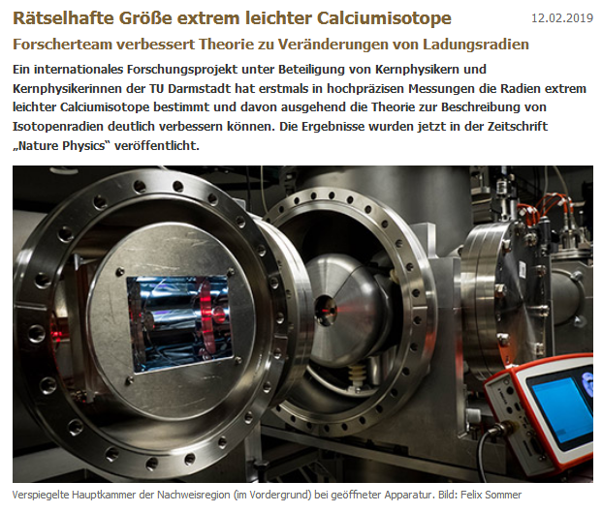
A03: Press Releases

Slide 25
Publication and Talks (M. Petri et al.)

Slide 27
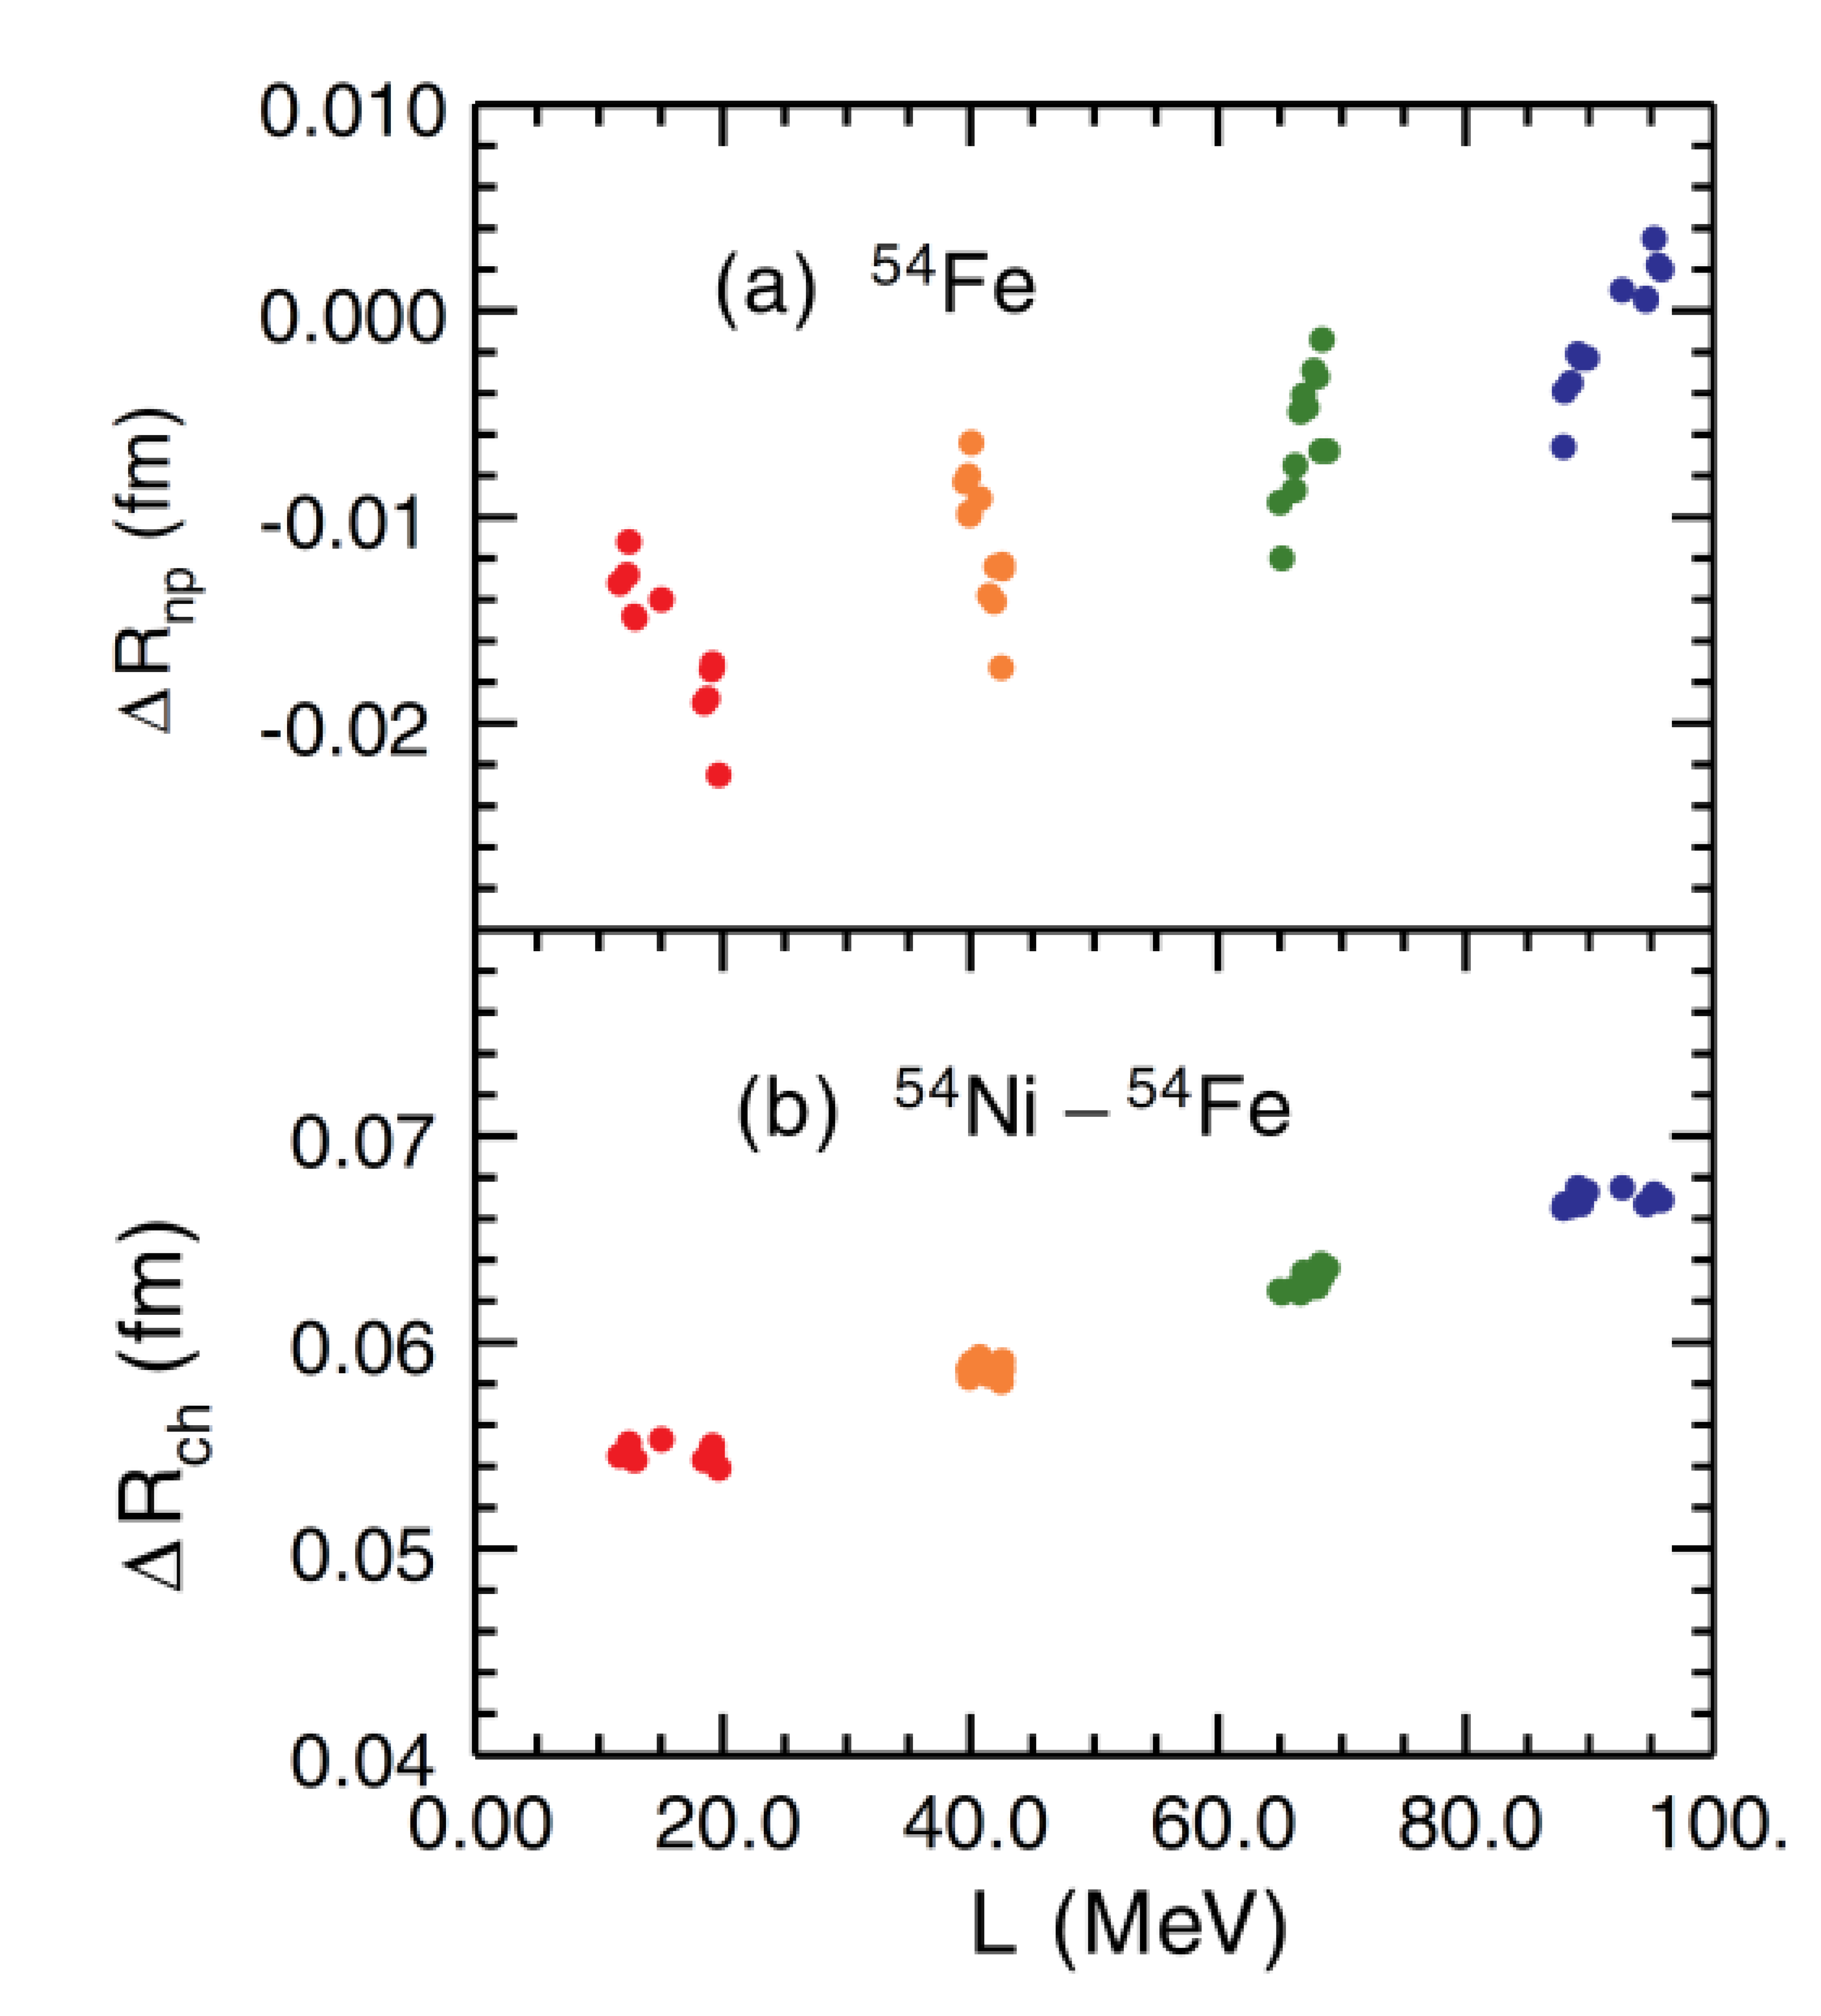
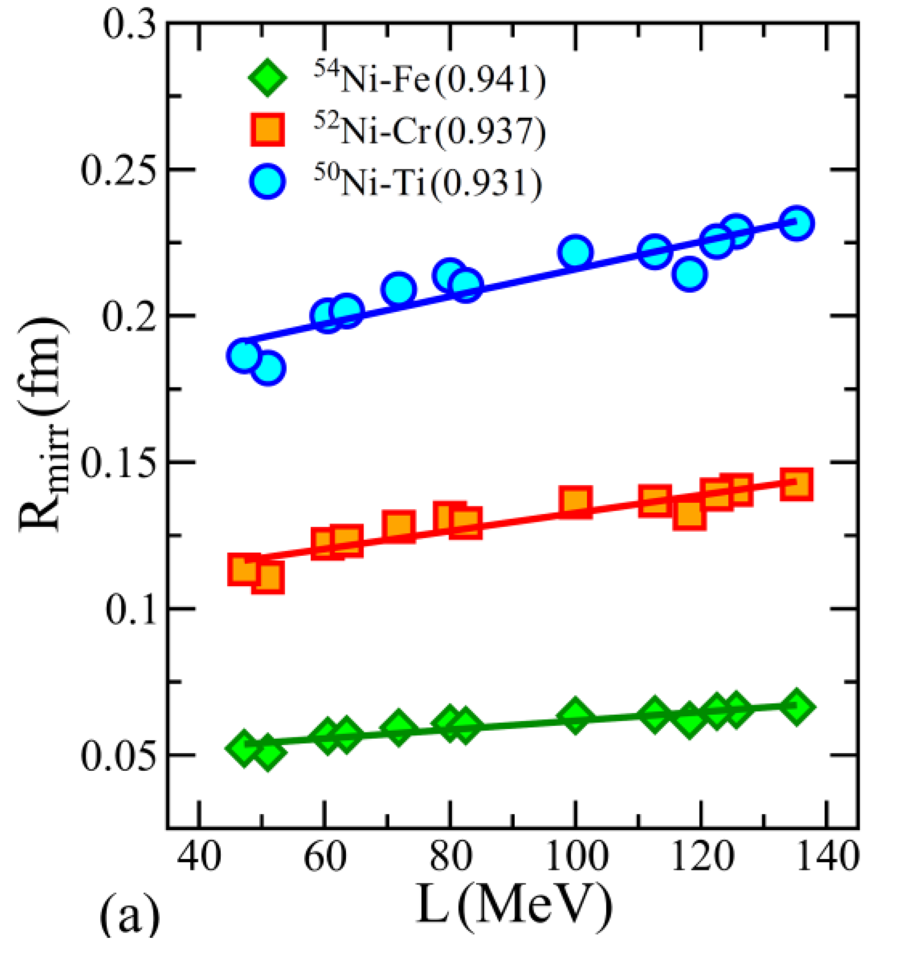
Motivation: ⁵⁴Ni

Slide 28
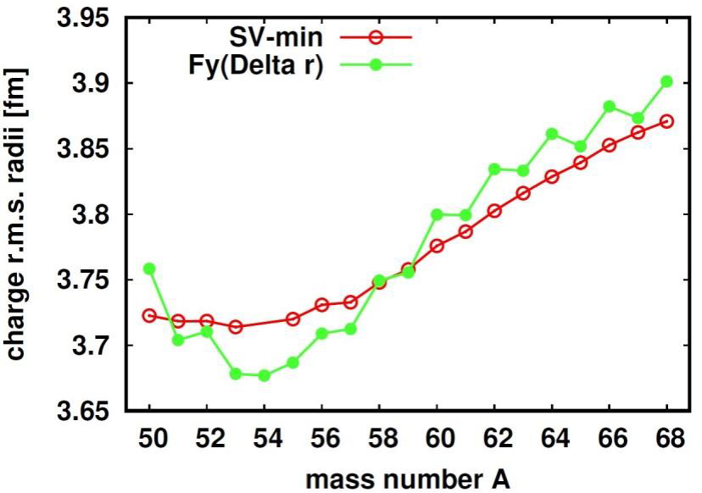
Motivation: ^{50,51}Fe
Deformation expected towards ⁵⁰Fe
Current prediction by spherical Fayans
„deformed Fayans“ under development

