Slide 1
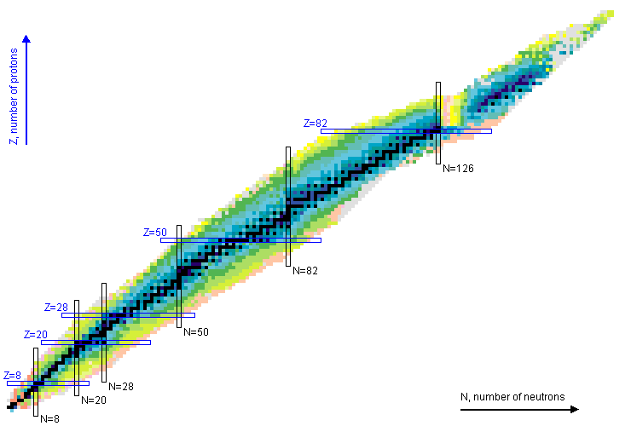
Report on A01
Precision Structure of Light Nuclei
Thanks to
Udo Gayer,
Michaela Hilcker &
Bernhard Maaß,
for preparing slides

Slide 2
⁶Li – Nexus of theory and experiment on electromagnetic (EM) transitions
Predominant decay modes of excited states of known A ≤ 6 nuclei
⁶Be
no excited state
particle emission
³Li
⁴Li
⁵Li
⁶Li
particle + γ emission
³He
⁴He
⁵He
⁶He
⁶Li(3.562 MeV) is the lightest system that decays via EM interaction
B(M1; 0⁺ → 1⁺) one of the strongest known M1 transitions
ideal testing ground for ab initio nuclear theory
¹H
²H
³H
⁴H
⁵H
⁶H
n
Decay data from: https://www.nndc.bnl.gov/ (03/25/2019)
U. Gayer

Slide 3
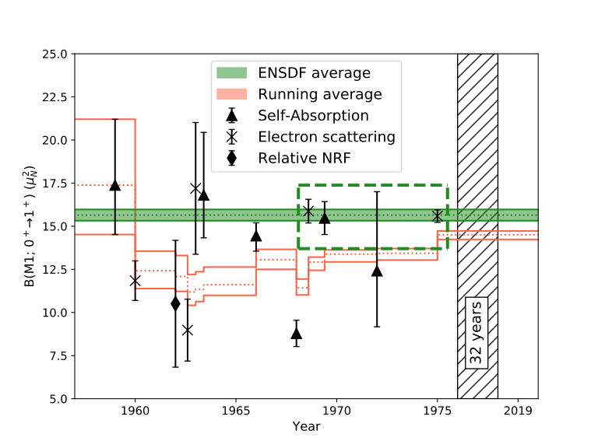
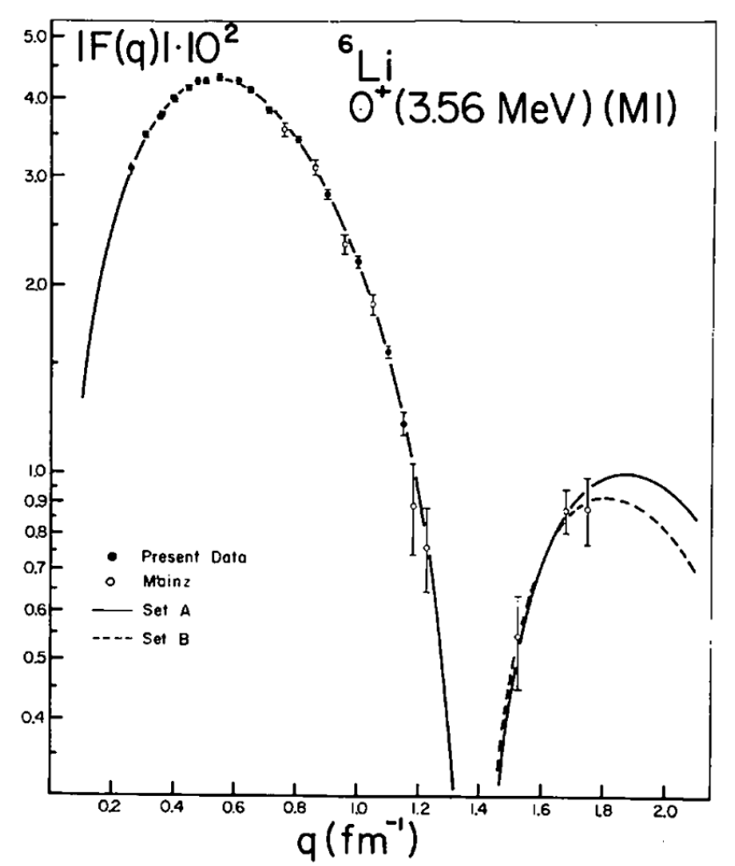
⁶Li, 0⁺ state @ 3.562 MeV:
Status experiments
Most precise value of B(M1) = 15.6(4) μ_{N}² from extrapolation of (e,e‘) form factor
Model dependent !
Current ENSDF literature value only based on three selected experiments, in conflict with global average
D.R. Tilley et al., Nucl. Phys. A708 (2002)
J.C. Bergstrom, I.P. Auer, R.S. Hicks, Nucl. Phys. A251 (1975)
U. Gayer

Slide 4
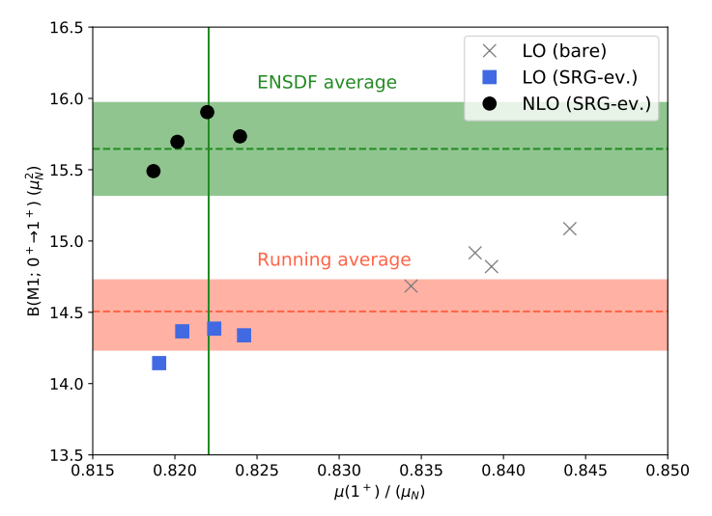
⁶Li, 0⁺ state @ 3.562 MeV:
Status ab initio theory
Recent progress in the consistent SRG evolution of EM operators (B01, A02)
First-time inclusion of NLO-M1 operator (B01, A02), emergence of two-body currents
Excellent agreement with ground-state magnetic moment
Experimental data on
B(M1; 0⁺→1⁺)
too ambiguous to assess
influence of two-body currents
No-core shell model calculations of magnetic observables using NLO-M1 operator by collaboration of CRC 1245 theory groups
U. Gayer

Slide 5
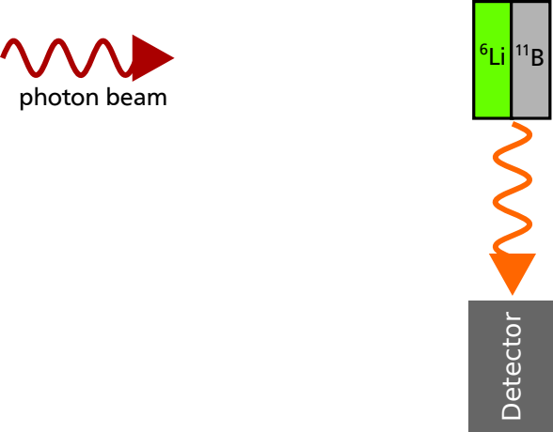
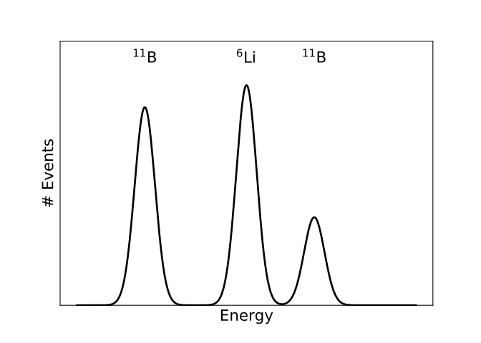
Precision test of magnetic dipole excitations:
Relative self-absorption technique
Self-absorption (SA) method based on nuclear resonance fluorescence
Relative self-absorption (RSA) uses ‚monitor target‘ to correct for nonresonant absorption in the absorber target
High degree of model-independence
F.R. Metzger, Prog. Nucl. Phys. 7 (1959)
C. Romig et al., Phys. Lett. B 744 (2015)
C. Romig, dissertation, TU Darmstadt (2015)
U. Gayer

Slide 6
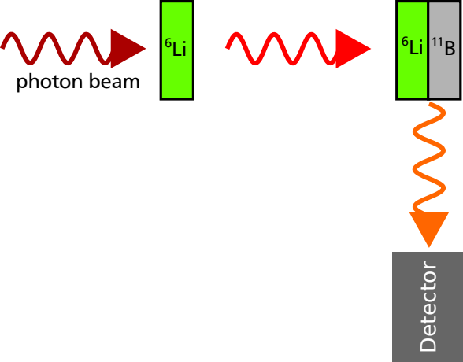
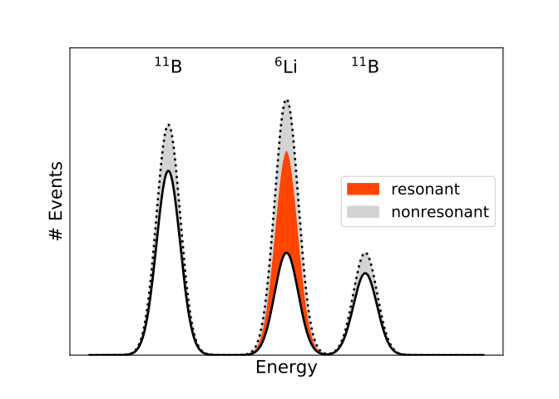
Precision test of magnetic dipole excitations:
Relative self-absorption technique
Self-absorption (SA) method based on nuclear resonance fluorescence
Relative self-absorption (RSA) uses ‚monitor target‘ to correct for nonresonant absorption in the absorber target
High degree of model-independence
F.R. Metzger, Prog. Nucl. Phys. 7 (1959)
C. Romig et al., Phys. Lett. B 744 (2015)
C. Romig, dissertation, TU Darmstadt (2015)
U. Gayer

Slide 7
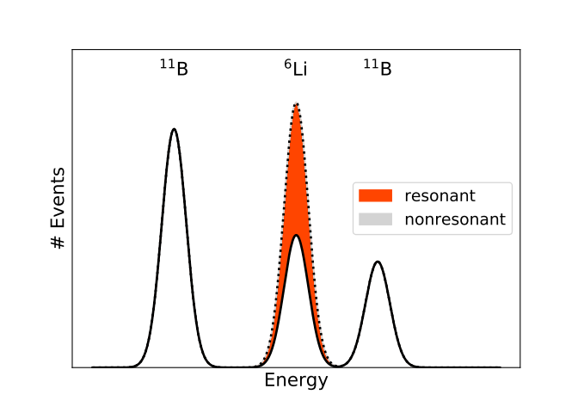
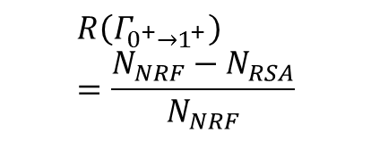
Precision test of magnetic dipole excitations:
Relative self-absorption technique
Self-absorption (SA) method based on nuclear resonance fluorescence
Relative self-absorption (RSA) uses ‚monitor target‘ to correct for nonresonant absorption in the absorber target
High degree of model-independence
F.R. Metzger, Prog. Nucl. Phys. 7 (1959)
C. Romig et al., Phys. Lett. B 744 (2015)
C. Romig, dissertation, TU Darmstadt (2015)
$$R\left(Γ_{0^{+}→1^{+}}\right)=\frac{N_{NRF}−N_{RSA}}{N_{NRF}}$$
U. Gayer

Slide 8
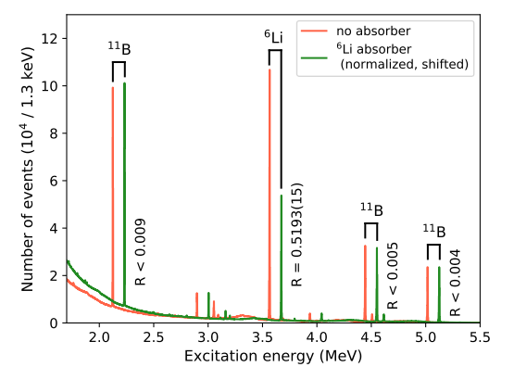
Precision test of magnetic dipole excitations:
Relative self-absorption technique
Self-absorption (SA) method based on nuclear resonance fluorescence
Relative self-absorption (RSA) uses ‚monitor target‘ to correct for nonresonant absorption in the absorber target
High degree of model-independence
F.R. Metzger, Prog. Nucl. Phys. 7 (1959)
C. Romig et al., Phys. Lett. B 744 (2015)
C. Romig, dissertation, TU Darmstadt (2015)
$$R\left(Γ_{0^{+}→1^{+}}\right)=\frac{N_{NRF}−N_{RSA}}{N_{NRF}}$$
Statistical uncertainty of 0.3% achieved in R!
U. Gayer

Slide 9
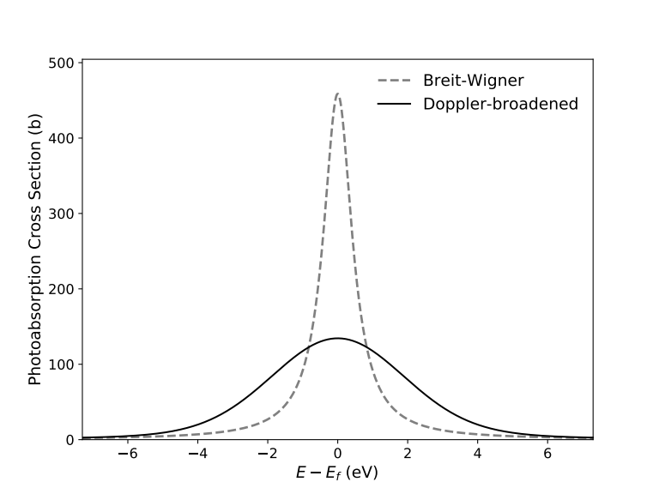
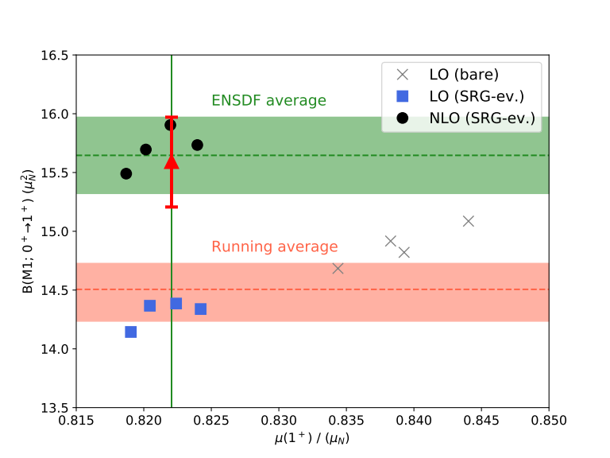
⁶Li, 0+ state @ 3.562 MeV:
Results for the M1 reduced transition strength
Result:
B(M1; 0⁺ → 1⁺) =
15.6 ± 0.18(stat.) ± 0.22(syst.) μ_{N}²
First measurement of this quantity with controlled systematic uncertainty
Confirms predictions of ab-initio theory
Calculation of Doppler-broadened level width in Li₂CO₃ compound introduces quantifiable systematic uncertainty
K. Albe, J. Rohrer, Fachgebiet Materialmodellierung, TU Darmstadt
U. Gayer

Slide 10
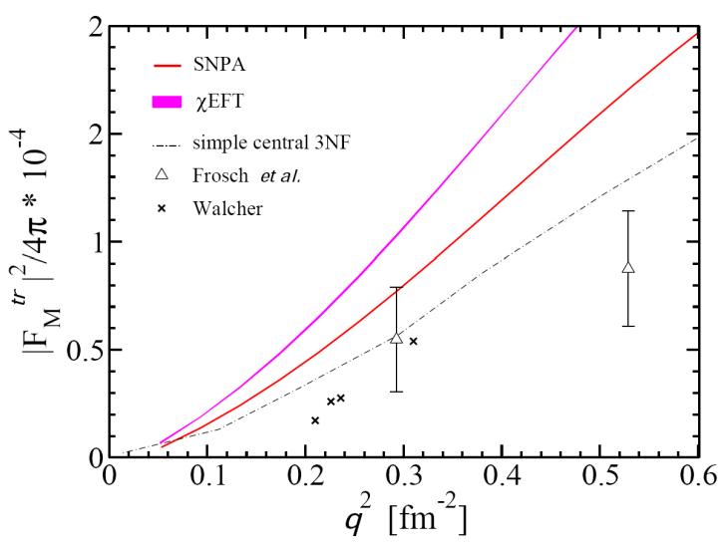
ab initio calculation of ⁴He
S. Bacca et al., Phys. Rev. Lett 110 (2013)
M. Hilcker

Slide 11
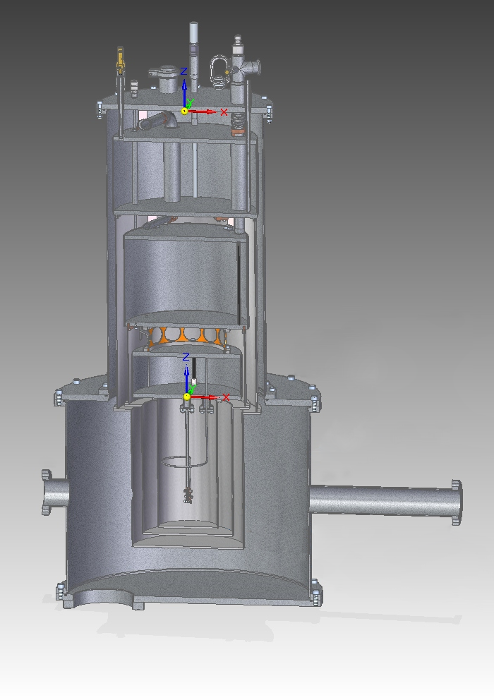
Requirements on Target Chamber
Superfluid liquid helium
No boiling-bubbles → control of target thickness
Scattering chamber including cryogenic system for superfluid liquid helium
Pumping unit for cooling below 2 K
Vacuum system
Cryogenic monitoring system
CryoVac (2017)
M. Hilcker

Slide 12
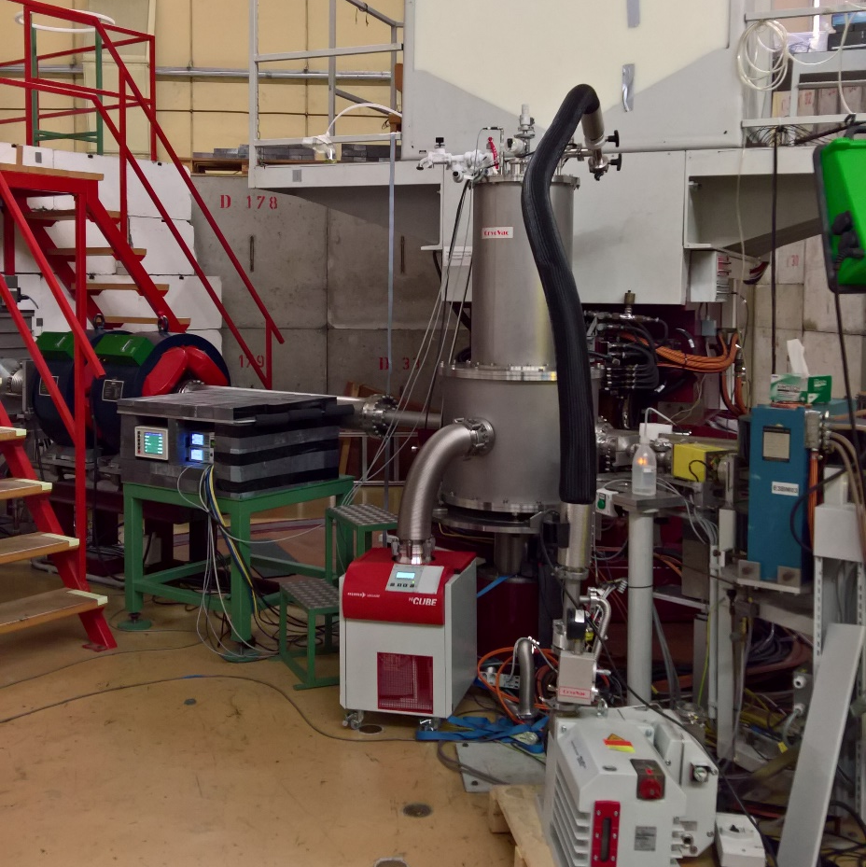
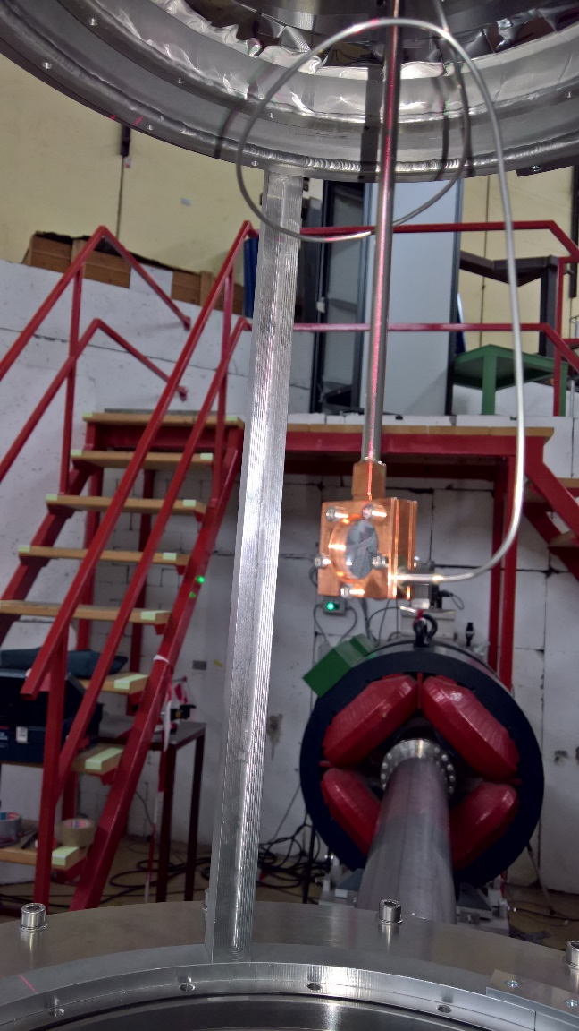
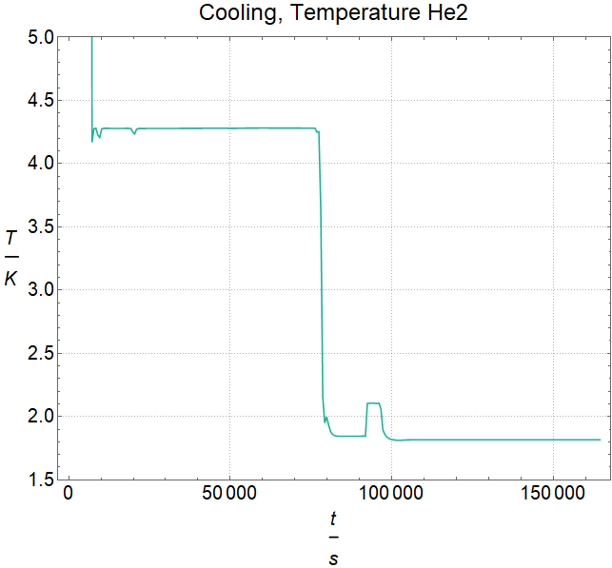
Target test at QClam
liquid in tank
Needle valve opened
stable temperature
superfluidity
M. Hilcker

Slide 13
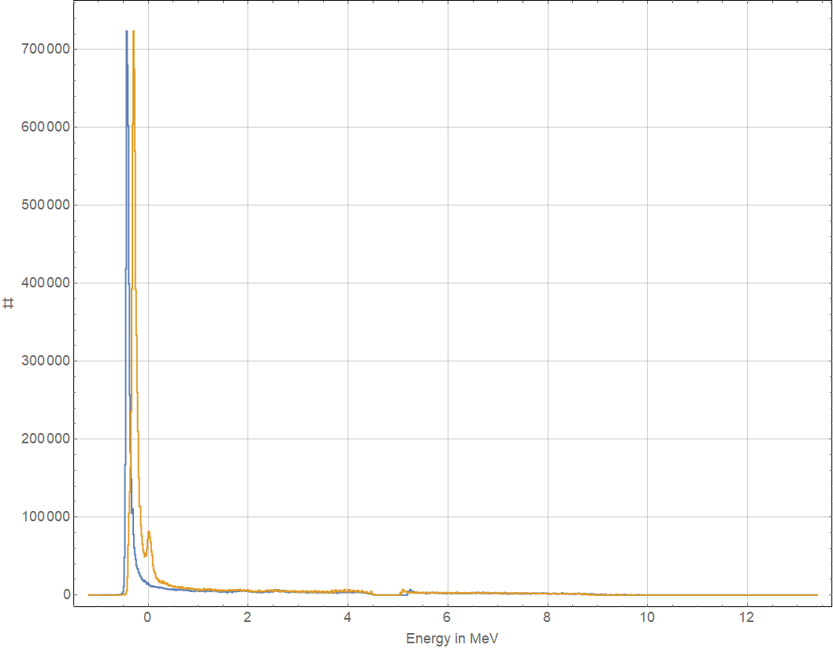
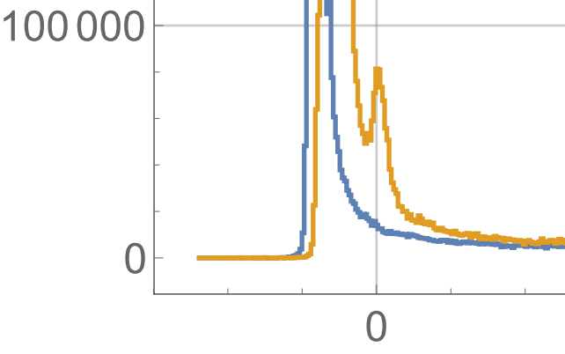
Commissioning Beamtime Fall 2018
19.09.: Beam tuning to warm target including change of target windows and geometry
29.09.: Cooling procedure
02.10.: Measuring cold target (empty-target background and helium)
10.10.: End of beamtime
⁴He
M. Hilcker

Slide 14
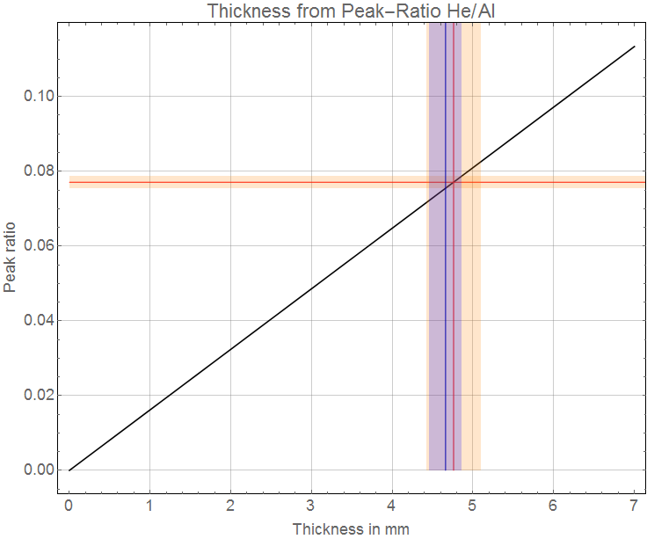
Control of Target Thickness
expected
peak-ratio He/Al
Next Period:
Completion of monopole form factor of 0⁺₂ in He
RSA Measurements on
¹¹B, ¹²C
Search for Hoyle-like α-cluster states in ¹²C and ¹⁶O
Expected and measured target thickness agree
→ No bubbles thanks to superfluid helium
M. Hilcker

Slide 15
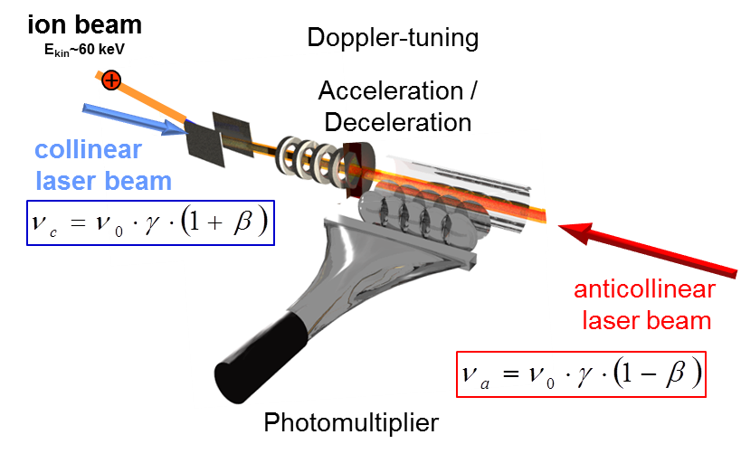
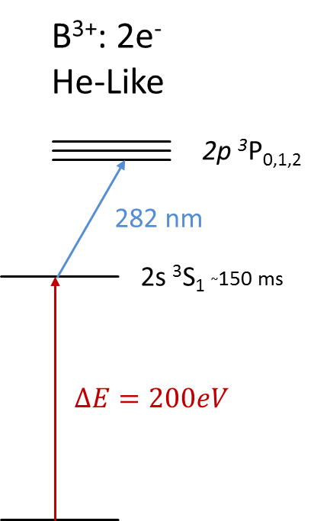
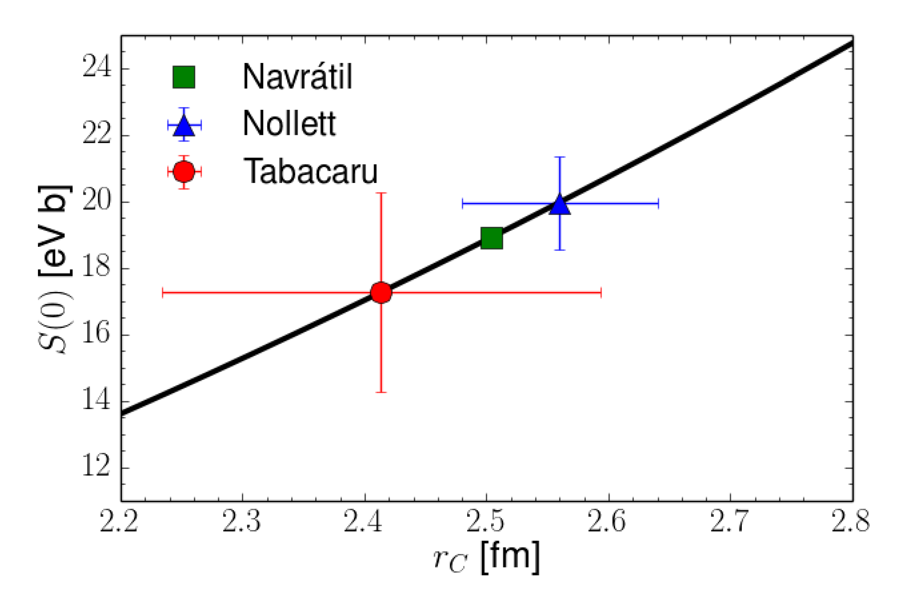
Charge Radius of ⁸B: Original Idea
Proton halo ⁸B: direct sensitivity to halo nucleon
Collinear-anticollinear laser spectroscopy using a frequency comb provides accurate isotope shifts
A05
Correlation
from Halo-EFT

Slide 16
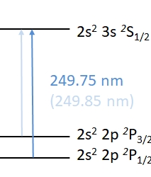
Charge Radius of ⁸B: New Approach
Neutral B
5 e⁻ System
higher efficiency expected
increased complexity of laser system

Slide 17
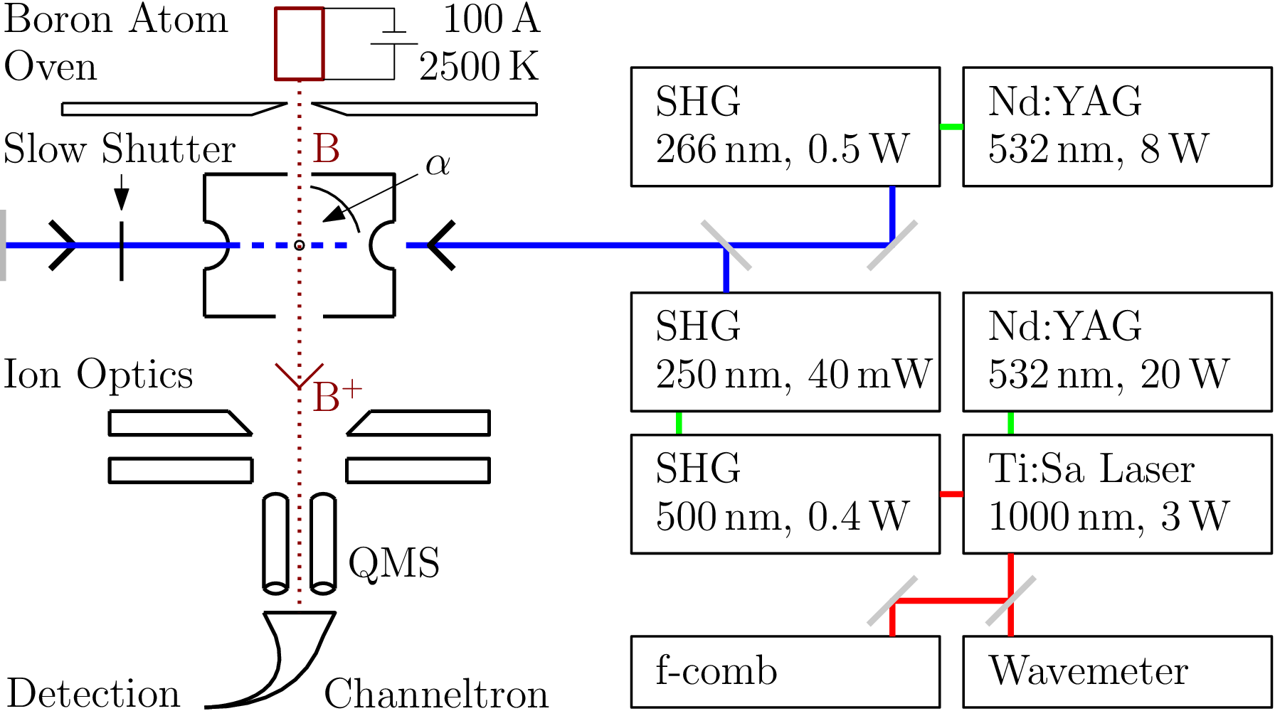
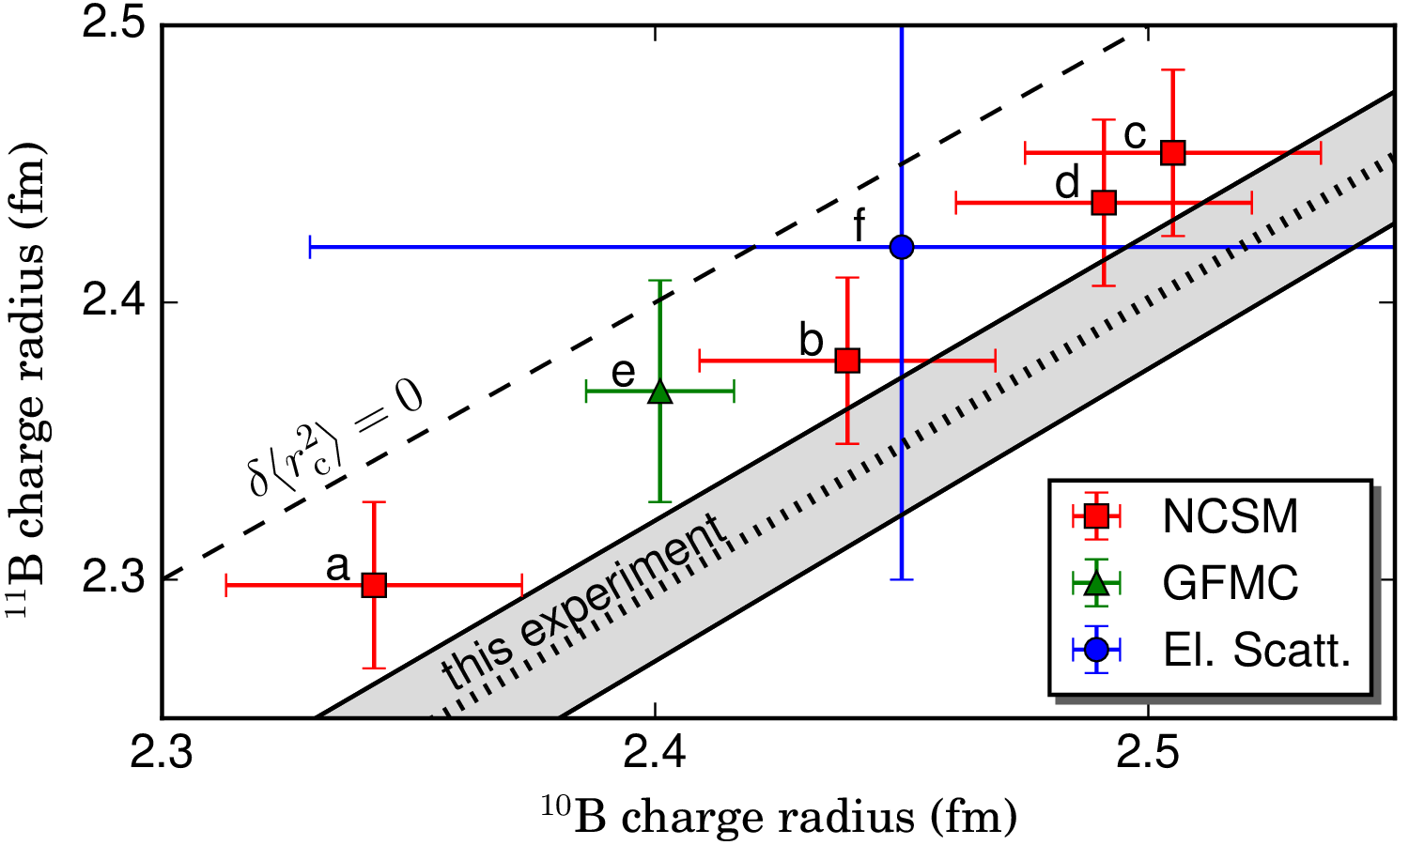
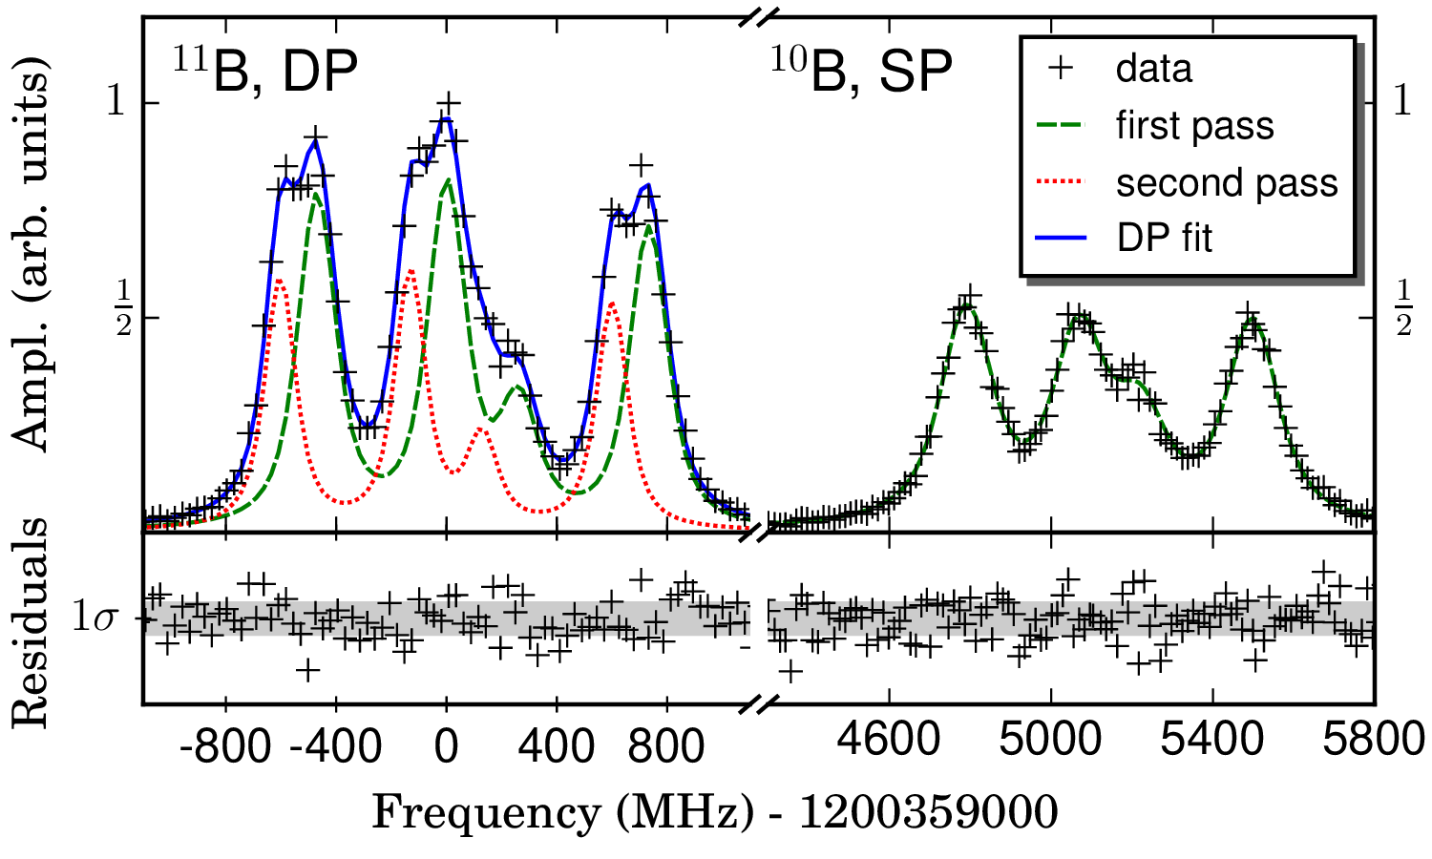
Test Experiment at TU Darmstadt with ^{10,11}B
B. Maaß et al., Phys Rev. Lett., under Review, A01 + A02, https://arxiv.org/abs/1901.06323

Slide 18
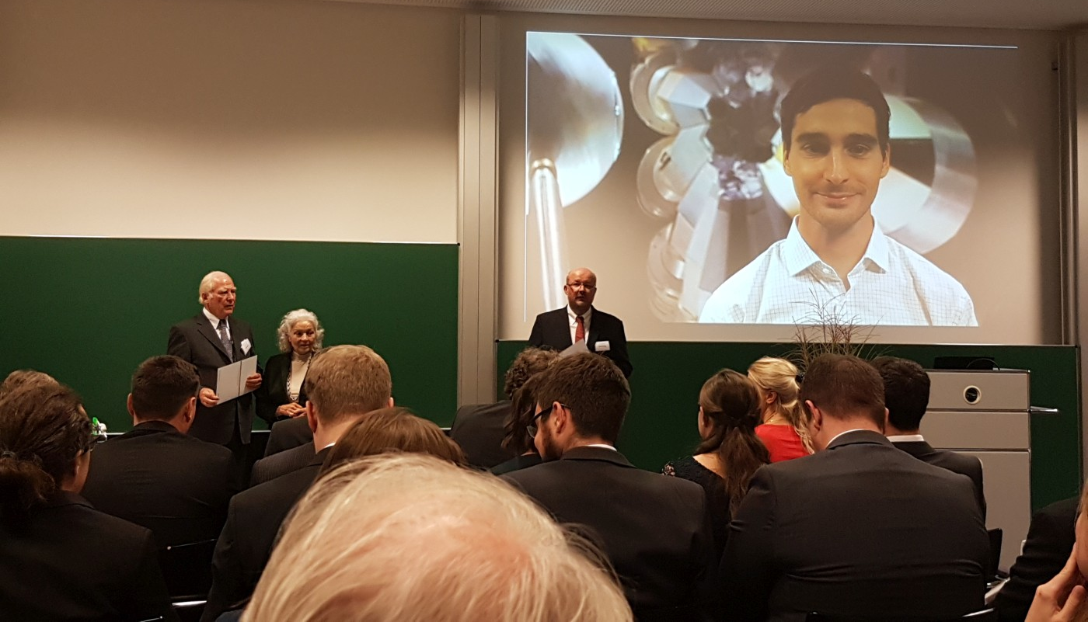
Giersch Excellence Award awarded to Bernhard Maaß
29.10.2018

Slide 19
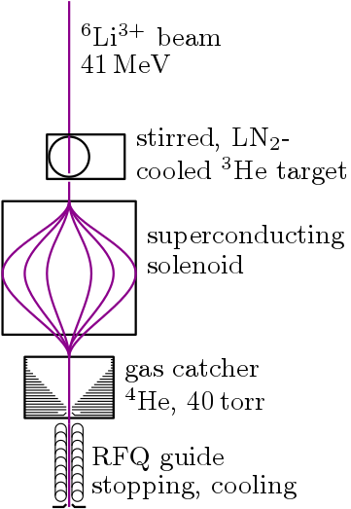
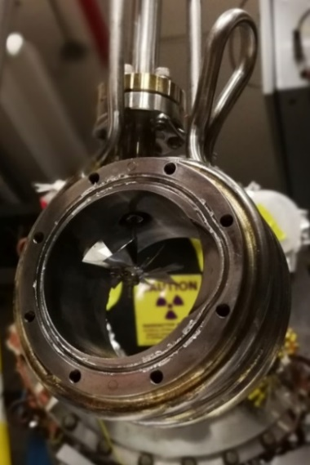
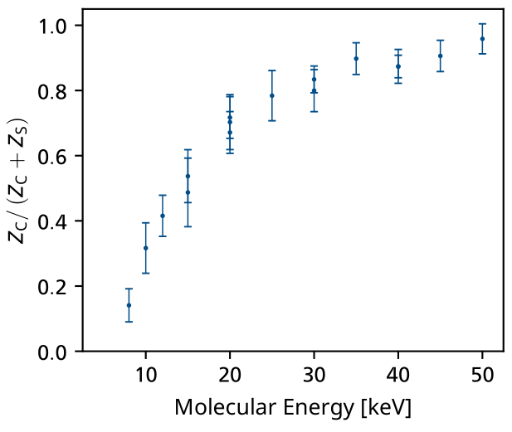
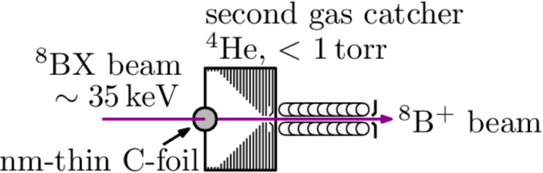
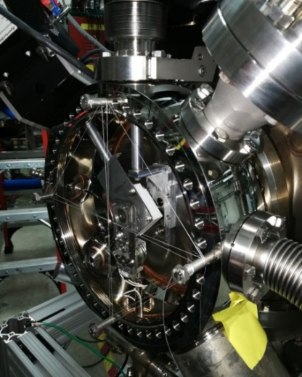
Progress in ⁸B Production and Preparation
Rates sufficient for Laser Spectroscopy: >10k/s
Formation of boron molecules in gas catcher ⁸BX⁺
Successful breakup/transmission tests in Nov 2018
Additional: Complementary experiments at GSI with ^{10,11}B⁴⁺ ions →
Bachelor Theses of Fabian Lenz, Manuel Simon
B. Maaß

Slide 20
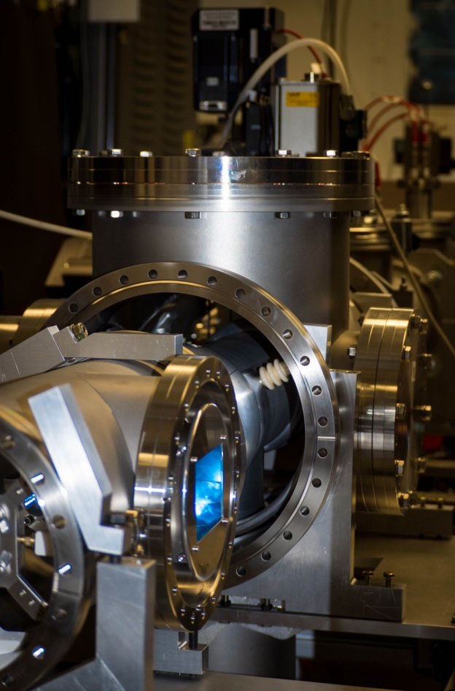
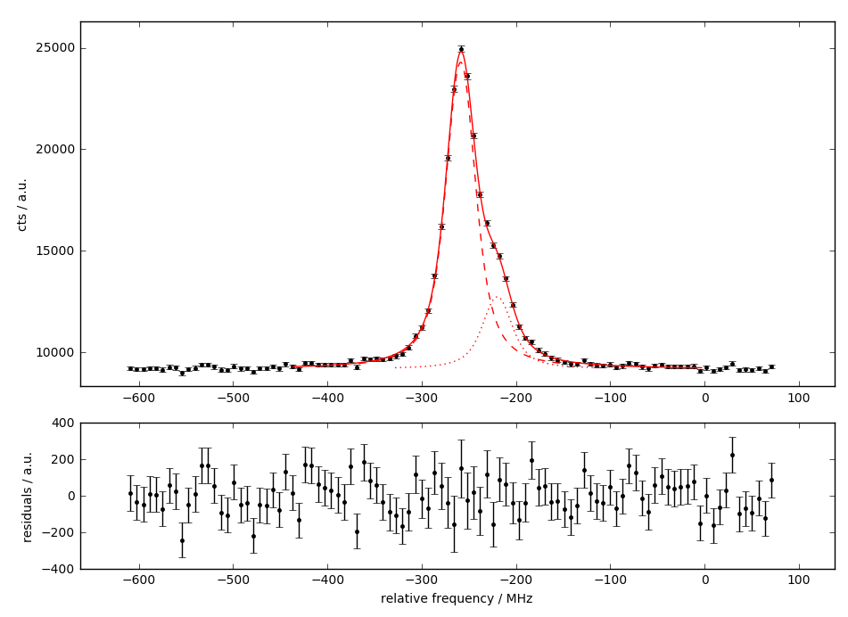
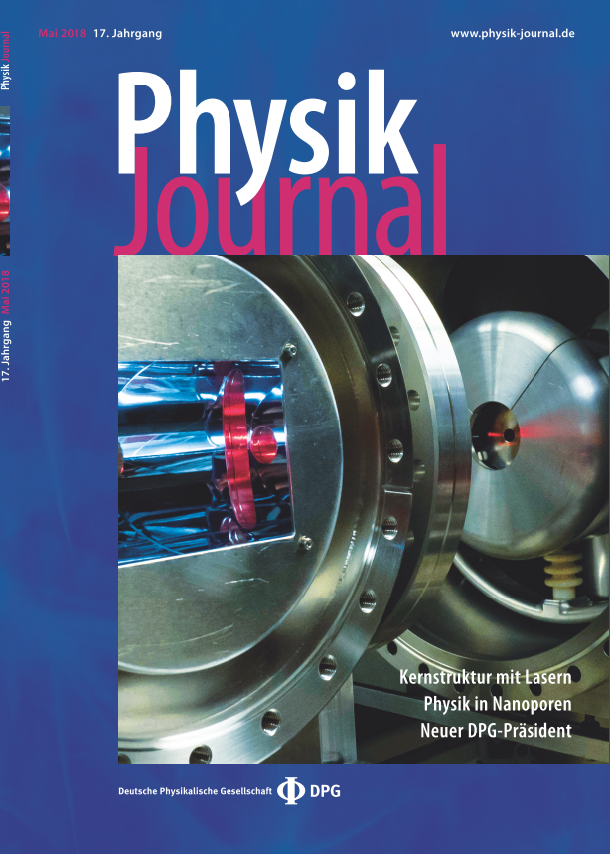
Setup Collinear Beamline at Argonne
Beamline at Argonne set up for Laser Spectroscopy
Nov 2018: Commissioning with Ca⁺
Preparation of HV System for Pd, later B
Development of Universal Ion Source for B, Pd (A03)
Charge Exchange Cell developed (A01 + A03)
New Detection System developed (A01 + A03)
B. Maaß

Slide 21

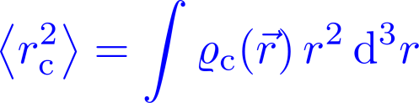
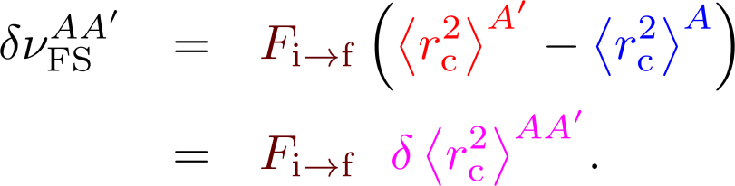
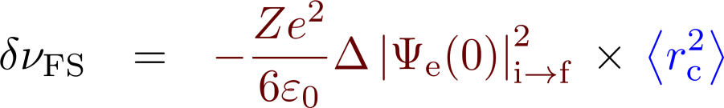

Into the Future: All-optical Charge Radii
E
E
r
r
p
p
So far theory only available for
H-like Systems
H, p+μ⁻, α+μ⁻ + e⁻
s
s
Mean-square charge radius
Electronic Factor
(→ Wavefunction)
Observable:
Change in mean-square charge radius
Nuclear
Size

Slide 22
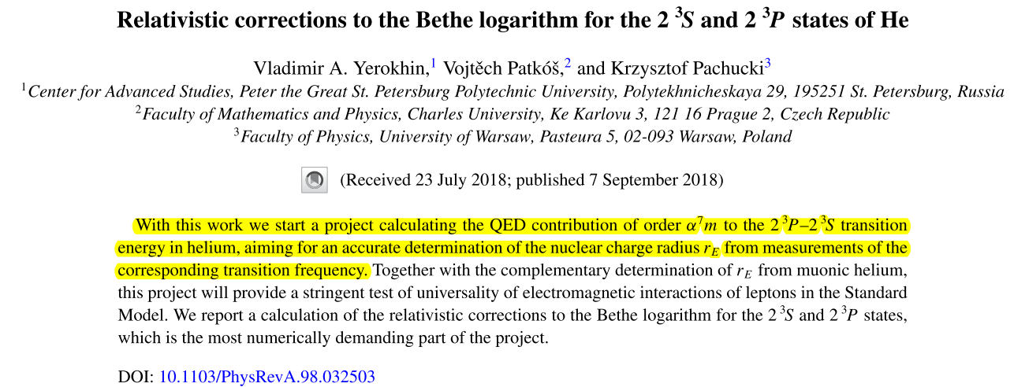
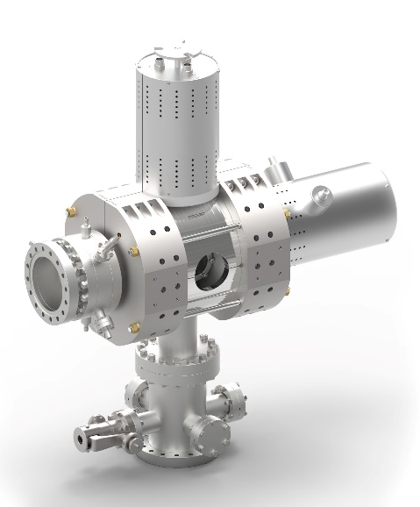
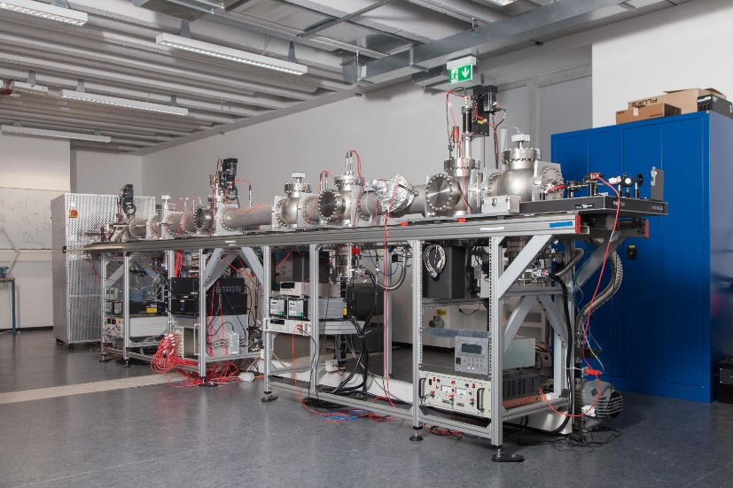

Into the Future: Theory & Setup
+
Dresden
EBIS-A

Slide 23
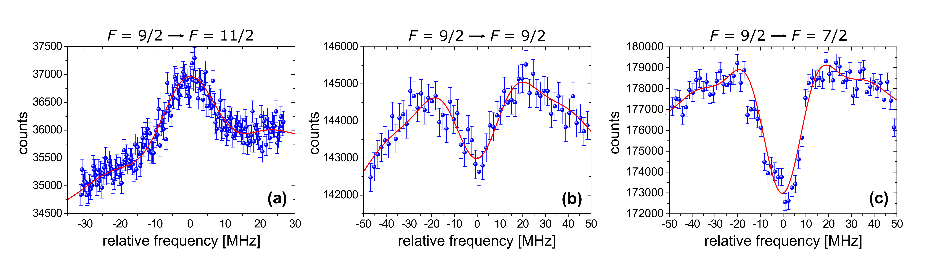
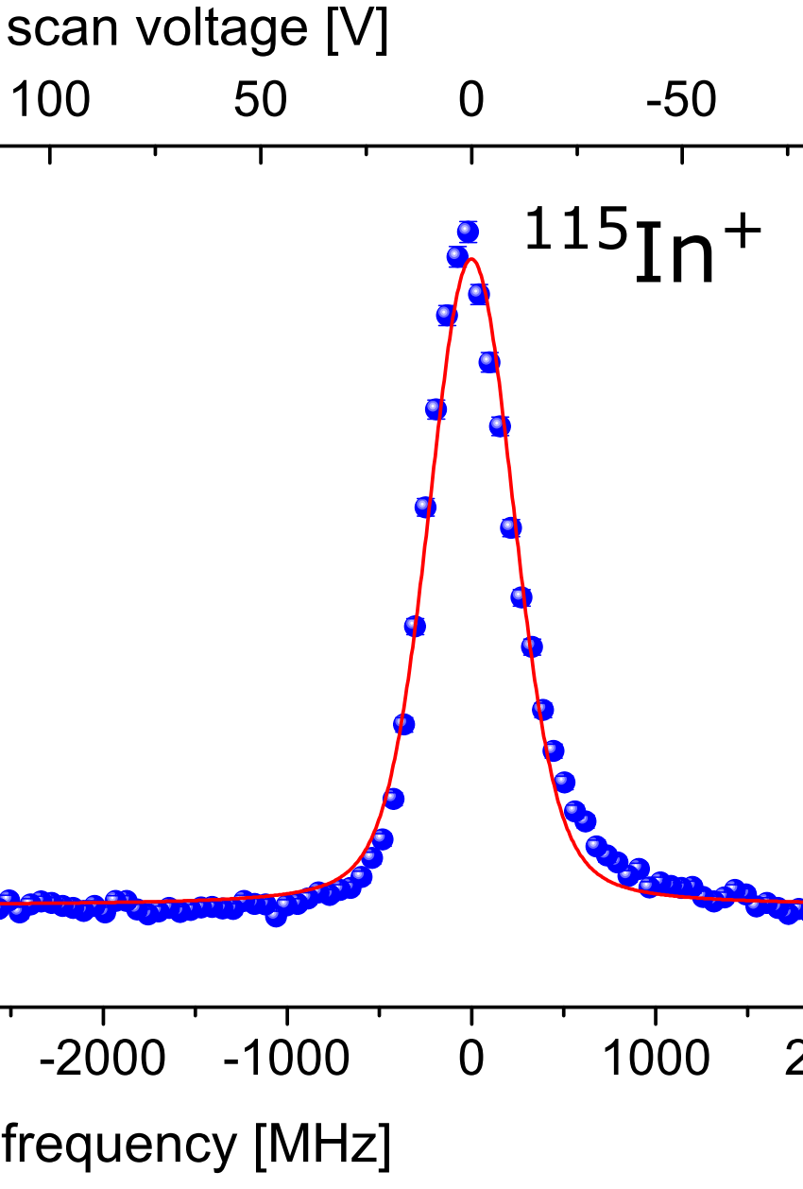
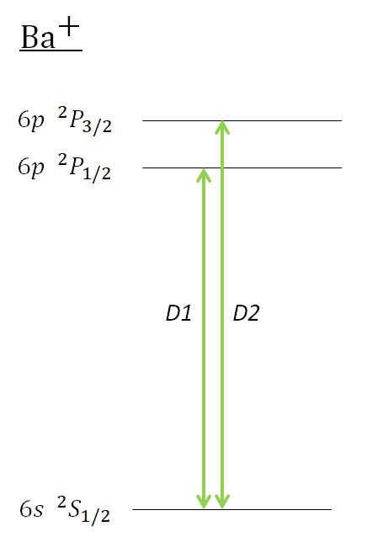
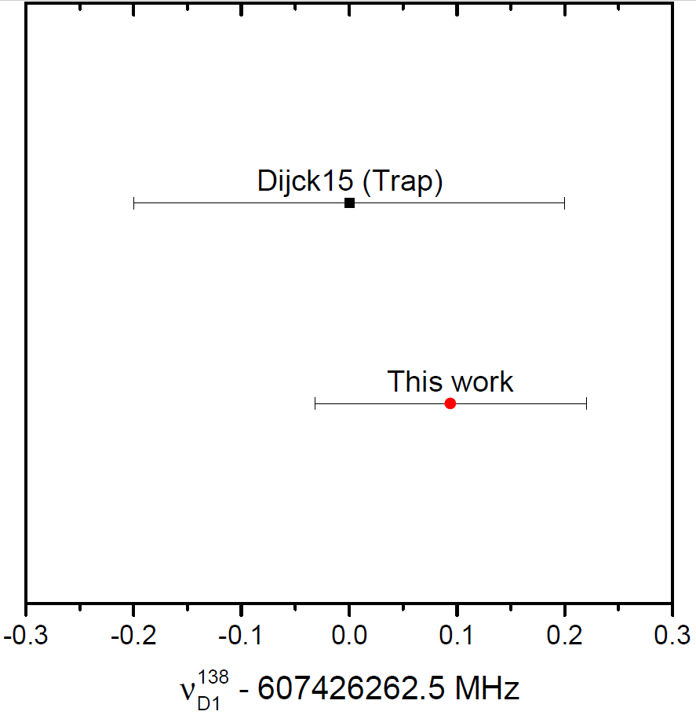
Spectroscopy – Proof of Principle
wide energy
distribution
Imprinted narrow spectral features ~ 14 MHz Linewidth → 400 kHz Accuracy
Dissertation Kristian König, Dezember 2018
Phillip Imgram, Master Thesis
P. Imgram et al., Phys Rev. A 99, 012511 (2019)
Collinear laser spectroscopy at KOALA allows the determination of transition frequencies and isotope shifts at the 100-200 kHz level, comparable with the accuracy reached in ion traps for E1 transitions.

Slide 24
A01: Publications
B. Maaß T. Hüther, K. König, Jörg Krämer, J. Krause, A. Lovato, P. Müller, K. Pachucki, M. Puchalski, R. Roth, R. Sánchez, F. Sommer, R. B. Wiringa, and W. Nörtershäuser, Phys Rev. Lett., under Review, A01 + A02, https://arxiv.org/abs/1901.06323
P. Imgram K. König J. Krämer T. Ratajczyk, R. A. Müller, A. Surzhykov W. Nörtershäuser, Collinear laser spectroscopy at ion-trap accuracy: Transition frequencies and isotope shifts in the 6s ²S_{1/2} → 6p ²P_{1/2,3/2} transitions in Ba⁺, Phys. Rev. A 99, 12511 (2019).
J. Isaak, D. Savran, B. Löher, T. Beck, M. Bhike, U. Gayer, Krishichayan, N. Pietralla, M. Scheck, W. Tornow, V. Werner, A. Zilges, M. Zweidinger,, The concept of nuclear photon strength functions: A model-independent approach via (γ,γ’γ’’) reactions, Phys. Lett. B 788, 225 (2019).
J. Birkhan, M. Miorelli, S. Bacca, S. Bassauer, C. A. Bertulani, G. Hagen, H. Matsubara, P. von Neumann-Cosel, T. Papenbrock, N. Pietralla, V. Yu. Ponomarev, A. Richter, A. Schwenk, and A. Tamii, Electric Dipole Polarizability of ⁴⁸Ca and Implications for the Neutron Skin, Phys. Rev. Lett. 118, 252501 (2017).

Slide 26
A03: Talks

Slide 27
A03: Press Releases

Slide 28
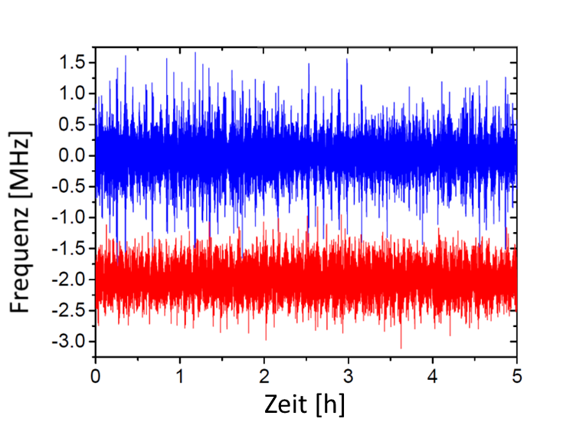
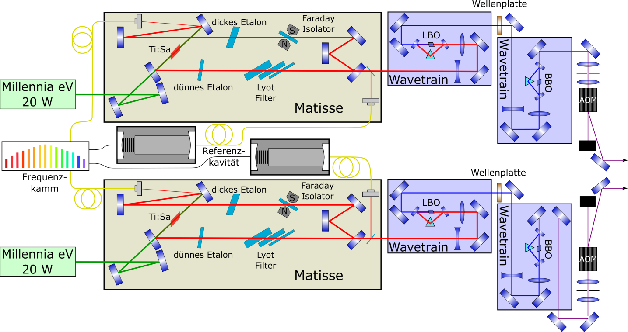
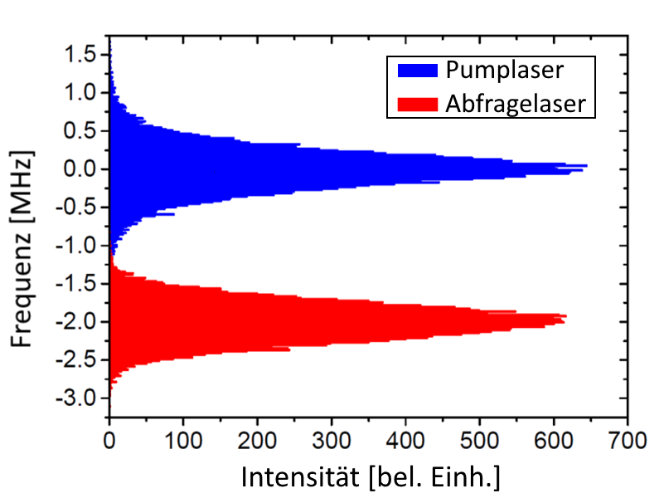
Setup: Laser System and Frequency Stabilization
Long-Term Stabilization on Frequency Comb
Standard Deviation < 100 kHz

