Slide 1
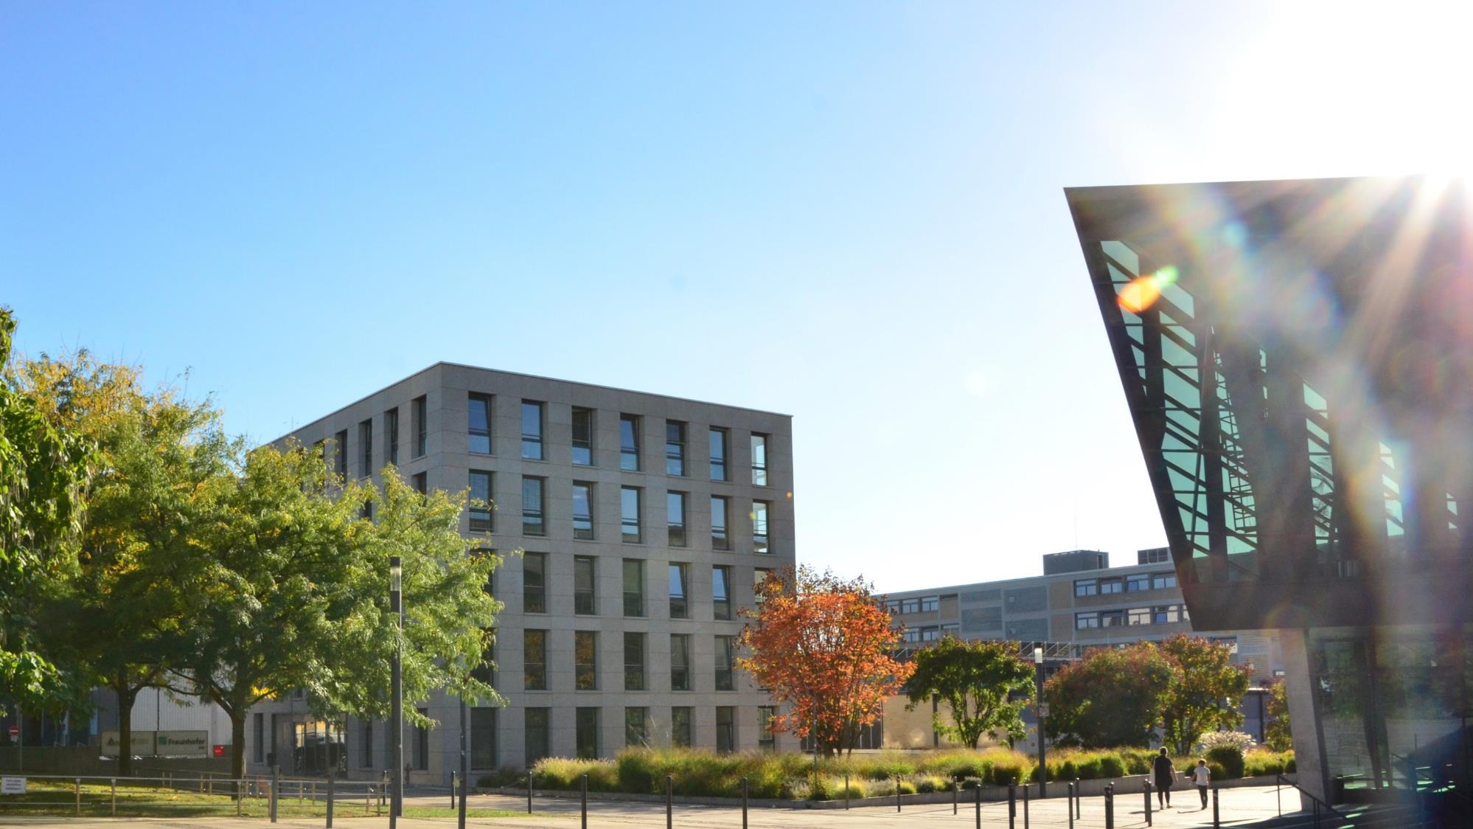

THE FIRST
ELECTRICAL ENGINEERS
Department of Electrical Engineering and Information Technology

Slide 2
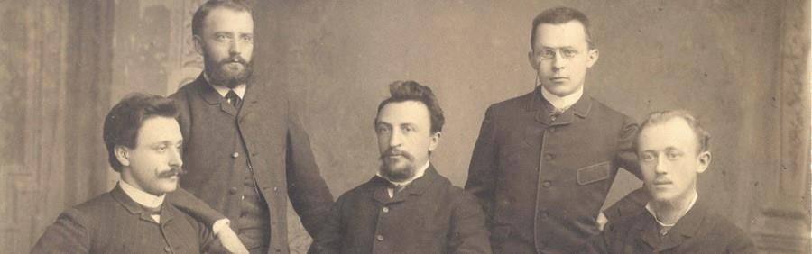
Our past
1882 Prof. Dr. Dr.-Ing. E.h. Erasmus Kittler (1852-1929) establishes the world's first Chair of Electrical Engineering at the TH Darmstadt

Slide 3
FIRST!
1882 Prof. Dr. Dr.-Ing. E.h. Erasmus Kittler (1852-1929) establishes the world's first Chair of Electrical Engineering at the TH Darmstadt

Slide 4
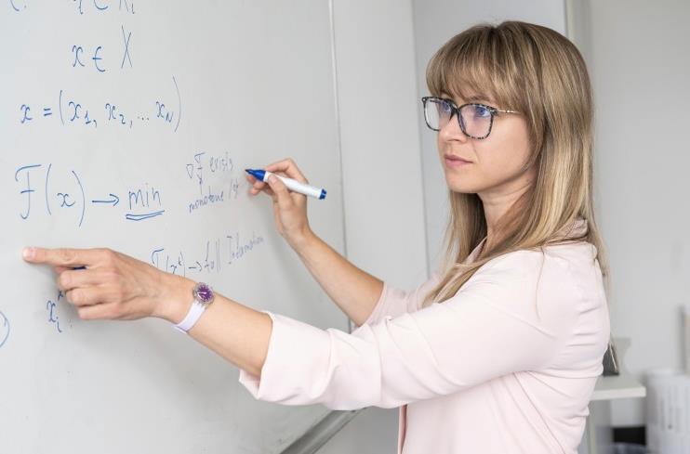
Many first academic Chairs in Germany
1894 Telecommunications
1914 High Voltage Technology
1954 Control Systems
Electromechanical Systems
1963 Power Electronics
1996 Renewable Energies
2013 Bioinspired Communication Systems
2022 Hardware for AI

Slide 5
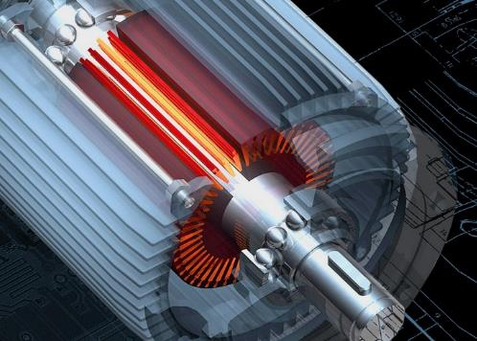
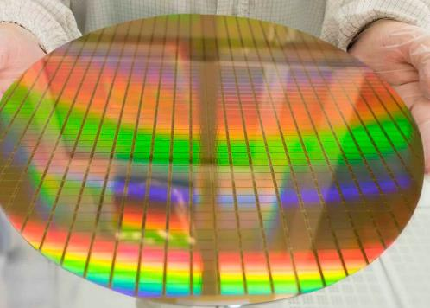
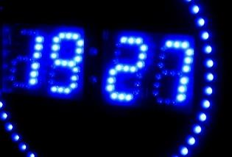
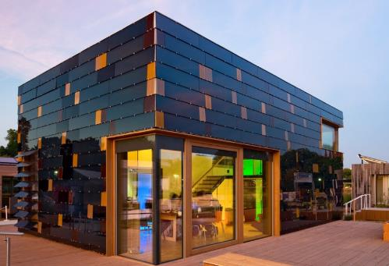
Innovation is our tradition
Modern three-phase motors
Radio-controlled clocks
Elektret microphone
Darmstadt solar houses
...

Slide 6
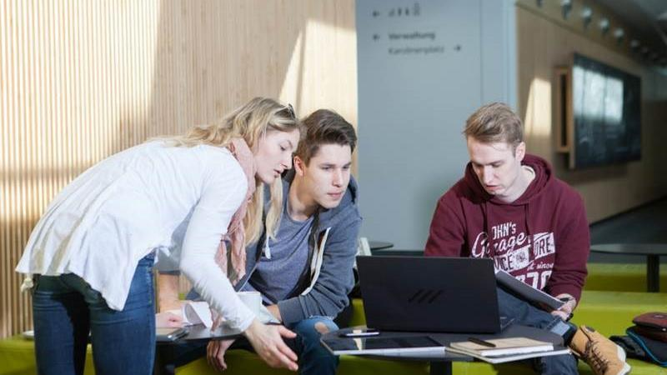
Facts and figures
34 (+1) Professors
~ 250 Research Assistants
~ 100 Administrative and Technical Staff
~ 2.000 Students
5 (+2) Bachelor Degree Programmes
5 (+3) Master Degree Programmes

Slide 7

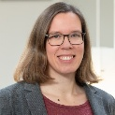

































Our Chairs
Prof. Dr.-Ing.
Jürgen Adamy
Prof. Dr. Anna C. Bakenecker
Prof. Dr. rer. nat. Oliver Boine-Frankenheim
Prof. Thomas P. Burg, Ph.D.
Prof. Dr.-Ing.
Yves Burkhardt
Prof. Dr.-Ing.
Herbert De Gersem
Prof. Dr.-Ing.
Rolf Findeisen
Prof. Dr. rer. nat. habil. Torsten Frosch
Prof. Dr.-Ing.
Christian Graeff
Prof. Dr.-Ing.
Gerd Griepentrog
Prof. Dr.-Ing.
Jutta Hanson
Prof. Dr.-Ing.
Christian Hochberger
Prof. Dr.-Ing.
Klaus Hofmann
Prof. Dr.-Ing.
Rolf Jakoby
Prof. Dr.-Ing.
Christoph Hoog Antink
Prof. Dr.-Ing.
Vahid Jamali
Prof. Dr.-Ing.
Tran Quoc Khanh
Prof. Dr.-Ing.
Anja Klein
Prof. Dr.-Ing.
Harald Klingbeil
Prof. Dr. sc.
Myriam Koch
Prof. Dr. techn.
Heinz Koeppl
Prof. Dr. mont.
Mario Kupnik
Prof. Dr. rer. nat. Markus Meinert
Prof. Dr.-Ing.
Michael Muma
Prof. Dr.-Ing.
Marius Pesavento
Prof. Dr. rer. nat. Sascha Preu
Prof. Dr.
Björn Scheuermann
Prof. Dr. rer. nat. Sebastian Schöps
Prof. Dr. rer. nat.
Andy Schürr
Prof. Dr. rer. nat.
Florian Steinke
Prof. Dr.-Ing.
Grace Li Zhang
Prof. Dr.-Ing.
Abdelhak M. Zoubir

Slide 8
Our Chairs
Control Methods and Intelligent Systems
Medical Engineering
Accelerator Physics
Integrated Micro- and Nanosystems
Electrical Drive Systems
Electromagnetic Field Theory
Control and Cyber-Physical Systems
Biophotonics – Biomedical Engineering
Radiotherapy Technology
Power Electronics and Control of Drives
Electrical Power Systems with Integration of Renewable Energies
Computer Systems
Integrated Electronic Systems
Microwave Engineeing
Artificially Intelligent Systems in Medicine
Resilient Communication Systems
Adaptive Lighting Systems and Visual Processing
Communications Engineering
Accelerator Technology
High Voltage Laboratories
Self-organizing Systems
Measurement and Sensor Technology
New Materials Electronics
Robust Data Science
Communication Systems
Terahertz Devices and Systems
Communication Networks
Prof. Dr. rer. nat. Sebastian Schöps
Real-Time Systems
Energy Information Networks and Systems
Hardware for Artificial Intelligence
Signal Processing

Slide 9
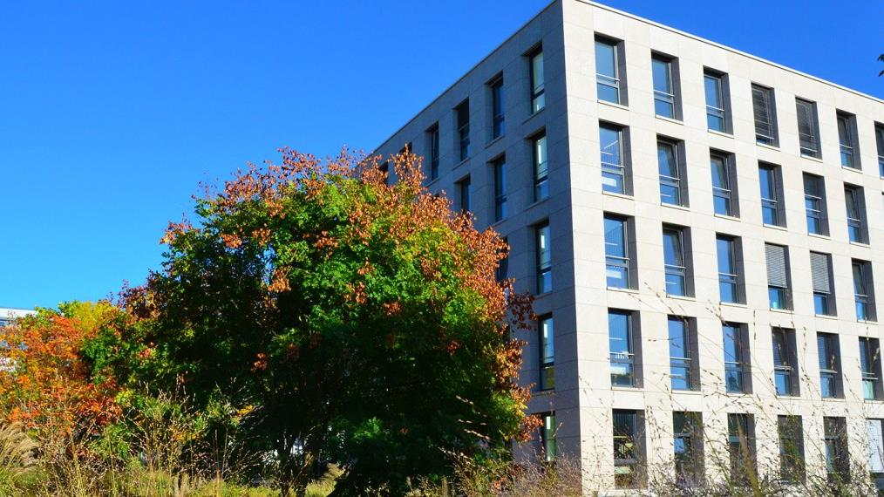
Our financing
11.02.2025
9

Slide 10
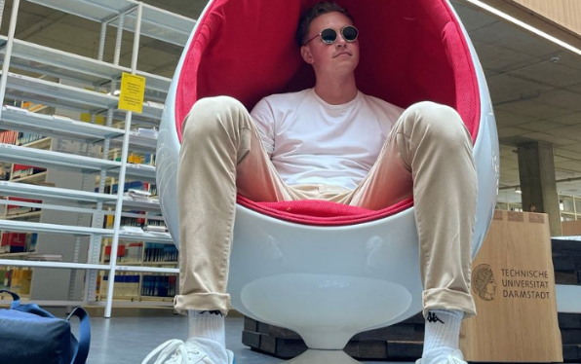
CHE Ranking 2019
1st place in the category "Support at the start of studies"
2nd place in the category "General study situation"
Overall in the top group of all electrical engineering degree programmes
11.02.2025

Slide 11
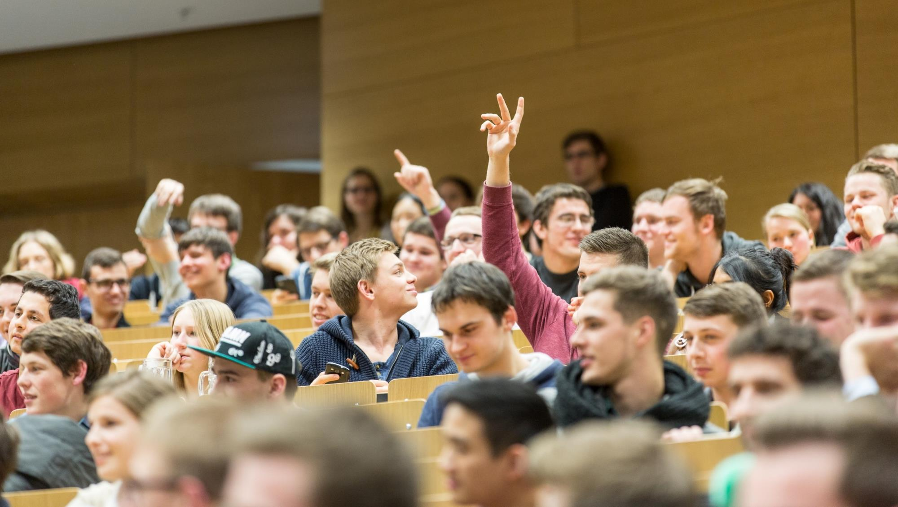
Our students
etit Students
(ca. 10% of TU)
ca. 25% Females
11.02.2025

Slide 12
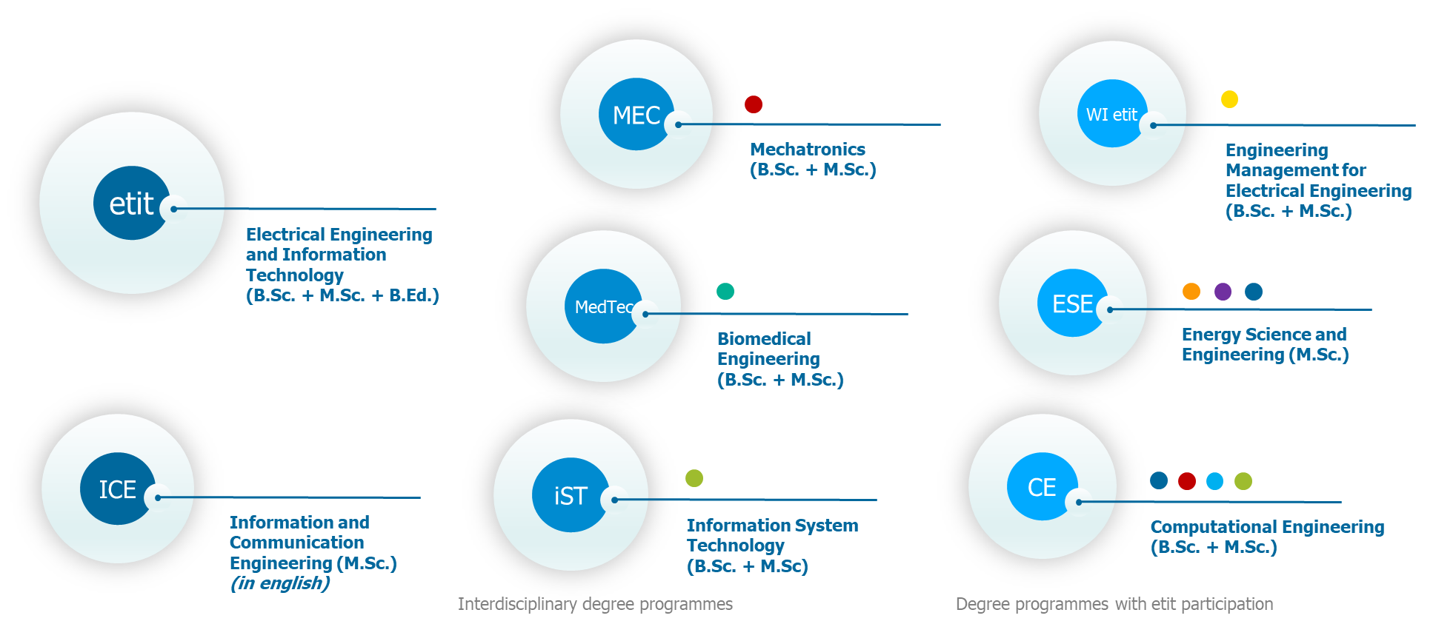
Our Degree programmes
adjacent degree programmes
Mechanical Engineering
Computer Science
Industrial Engineering
Civil Engineering
Mathematics
Chemistry
Architecture
Medicine
11.02.2025

Slide 13
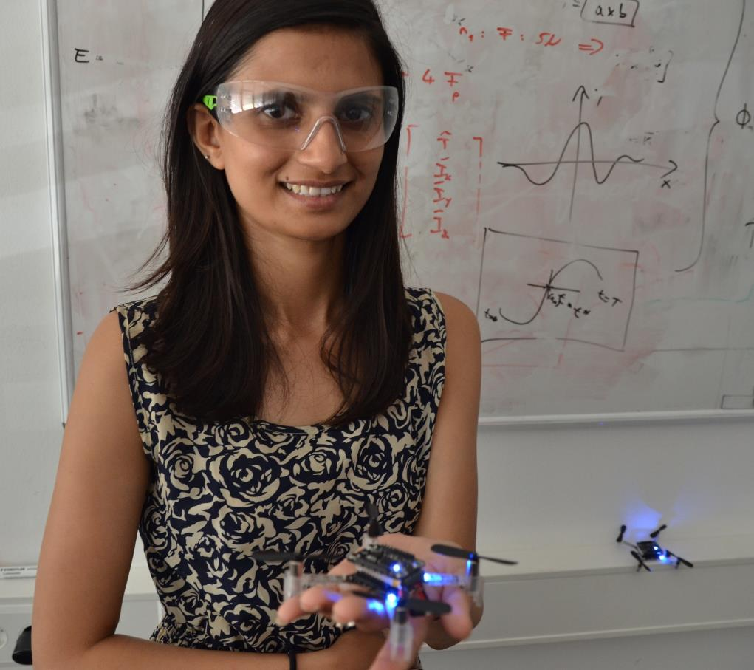
Specialisations in etit
General Electrical Engineering
Automation Systems
Computer Engineering
Computational Methods in Electrical Engineering
Electrical Power Engineering
Communication Technology and Sensor Systems
Sensors, Actuators and Electronics
Distributed Autonomous Systems
11.02.2025

Slide 14
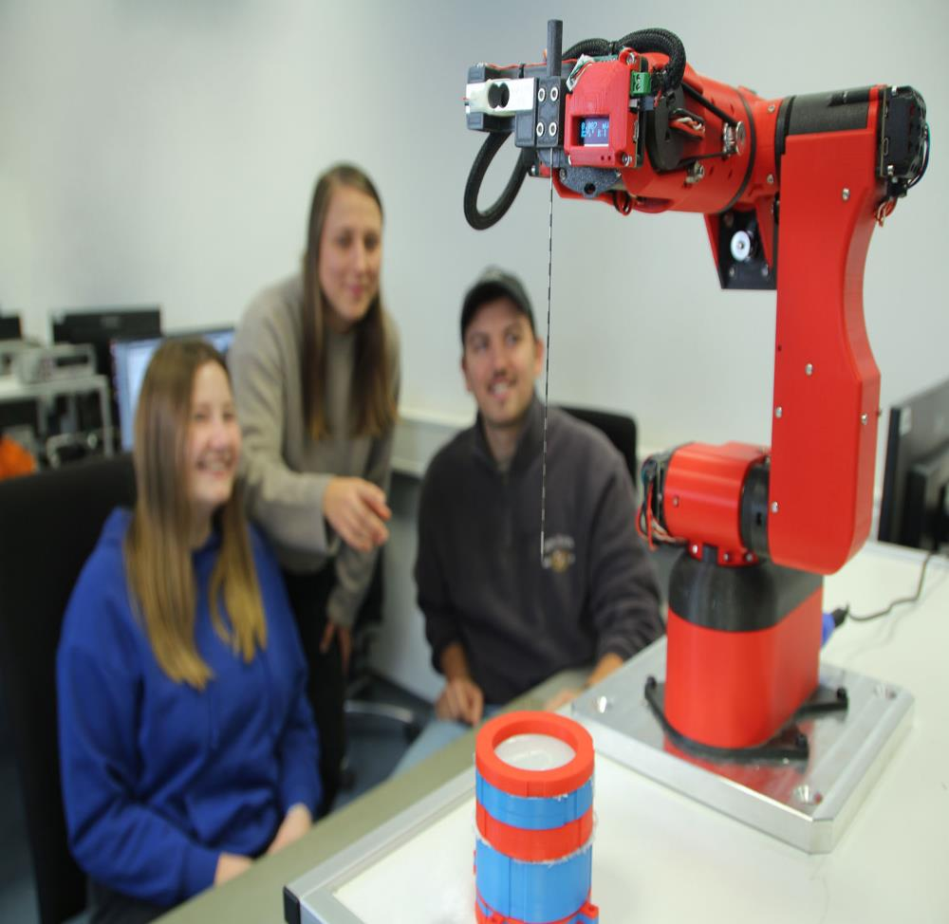
Our interdisciplinary degree programmes
Biomedical Engineering (B.Sc. / M.Sc.)
Electrical Engineering and Information Technology + Medicine
Mechatronics (B.Sc. / M.Sc.)
Electrical Engineering and Information Technology + Mechanical Engineering
Information Systems Engineering (B.Sc. / M.Sc.)
Electrical and Information Engineering + Computer Science
11.02.2025

Slide 15
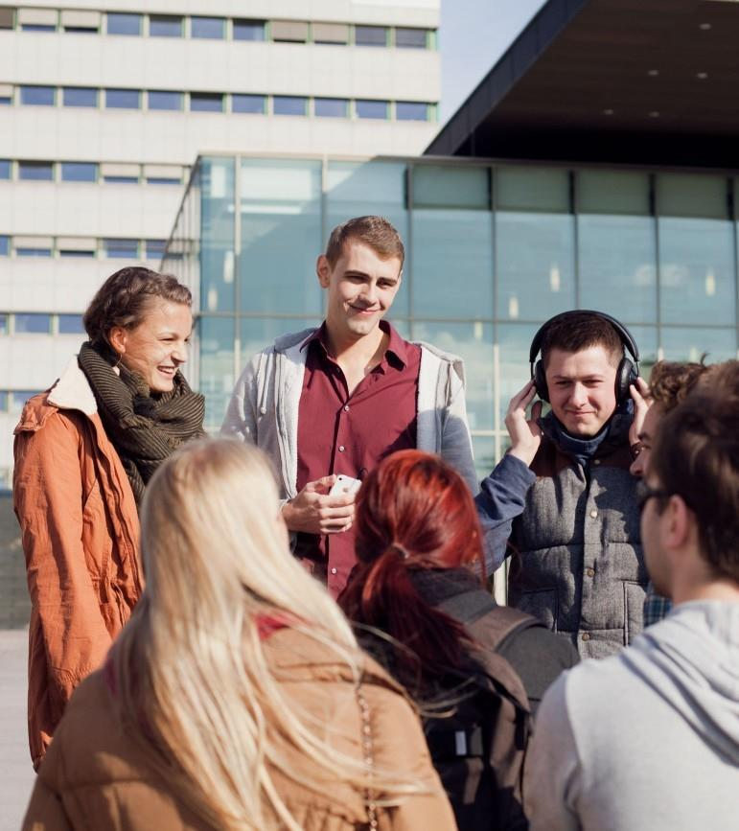
Partners all over the world
50+ European cooperation partners (ERASMUS+)
10+ Double-Degree agreements
30+ Non-European cooperation partners (bilateral programmes)
11.02.2025

Slide 16
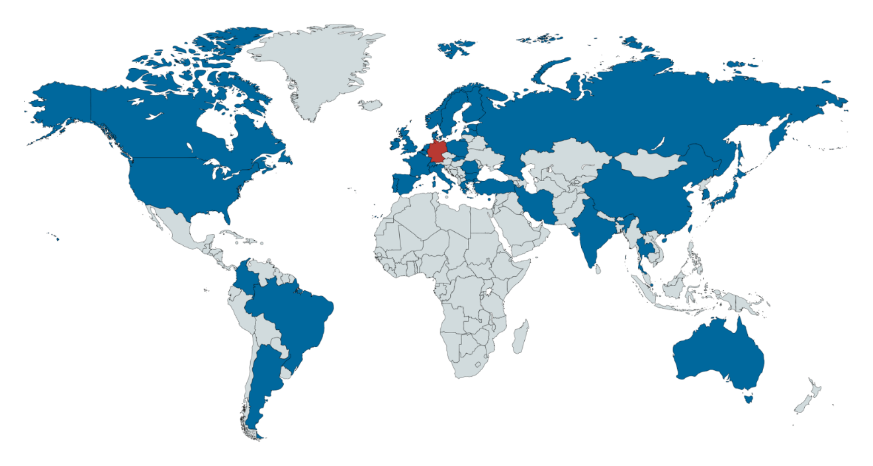







Double Degree
Agreements
NTNU Trondheim
KTH Stockholm
URI Rhode Island
CentraleSupélec Paris
ECN Nantes
ECL Lyon
Grenoble INP - UGA
ENSEA Paris
UPM Madrid
UPC Barcelona
UPV València
Universidad Pontificia Comillas
Politecnico di
Torino + Milano
USP São Paulo

Slide 17
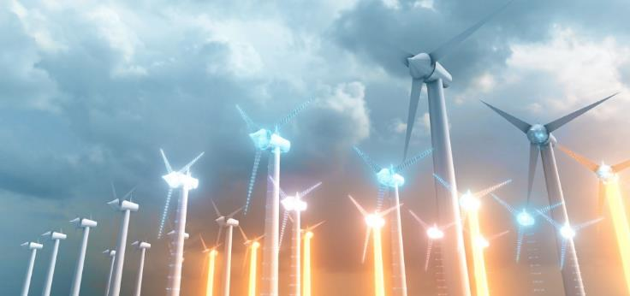


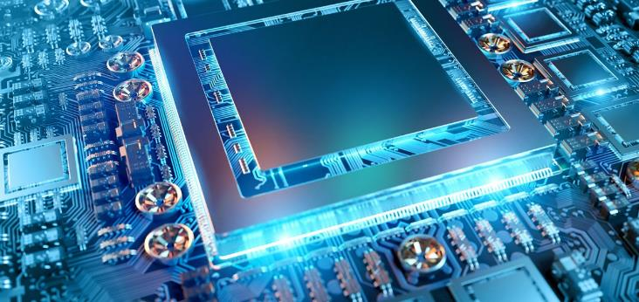
Main research areas
Energy
Networked Systems
Novel Component and System Components Concepts
Medical Engineering

Slide 18










Selected industrial cooperations

Slide 19
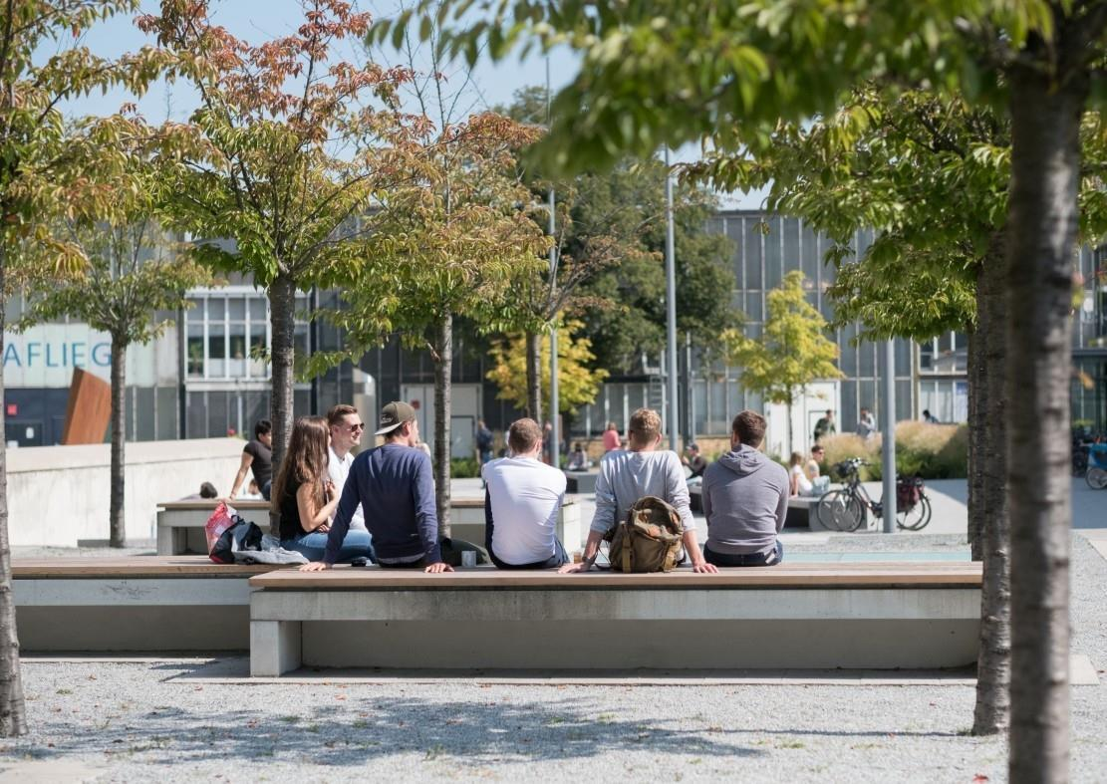
The TU Darmstadt
  One of the leading technical universities in Germany
  Germany's first autonomous university
  around 26,000 students
  one of the universities with the highest proportion of international students in Germany
  interdisciplinary in teaching and research
11.02.2025

Slide 20
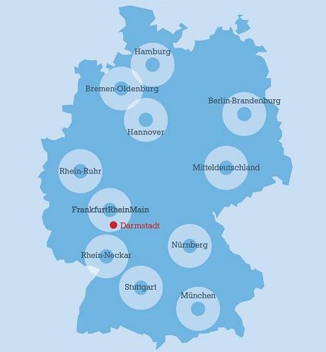
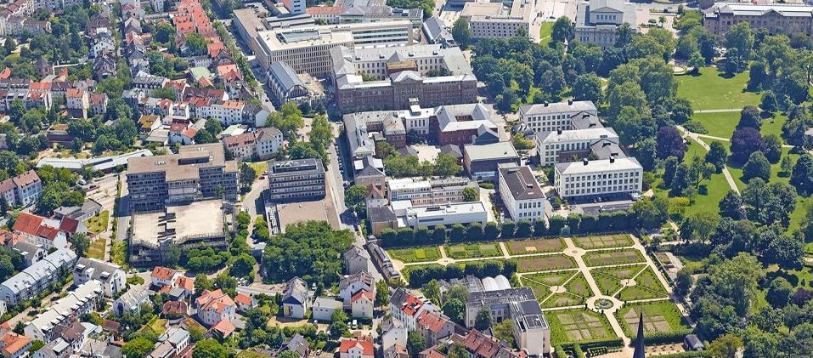
In the centre of the Rhine-Main metropolitan region

Slide 21





More information about us
Internet
Instagram
facebook
YouTube
Podcast
www.etit.de
Kanal: etittudarmstadt
fb.com/etitdarmstadt
youtube.com/etitdarmstadt
gleichstellung@etit

