Slide 1




Structure of exotic nuclei studied via laser spectroscopy at ISOLDE-CERN
Hanne Heylen
EP department, CERN
July 2018

Slide 2
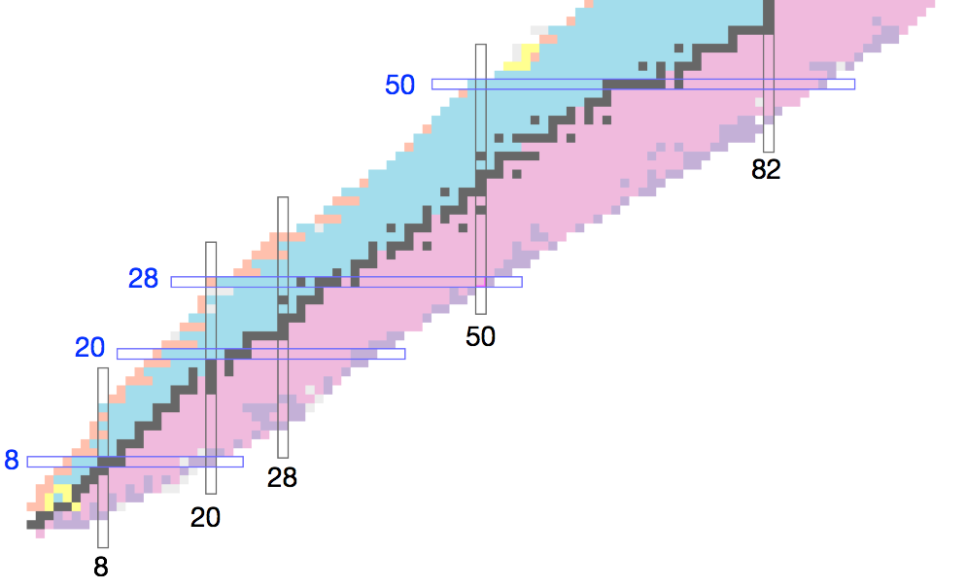
Introduction
Collinear laser spectroscopy (what, where, how?)
Recent Collaps results
Notes:
Exotic nuclei
Modification of nuclear shell structure
Test of nuclear models
Research at radioactive ion beam facilities
Interplay theory and experiment

Slide 3
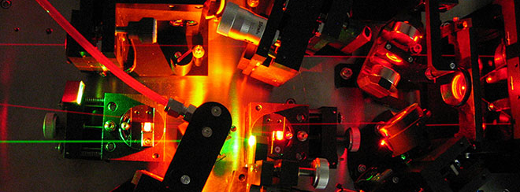
A. Collinear laser spectroscopy
sirah.com

Slide 4

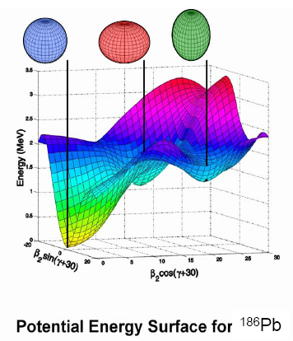
What?
Ground state properties …
Spin I
Magnetic moment μ
Quadrupole moment Q_{s}
Charge radii δ⟨r²⟩
… to study nuclear structure (see examples later)
  Wave function composition & configuration mixing
  Correlations and deformation
  Size
… and how it evolves towards exotic regions of the nuclear chart
Notes:
Different aspects of nuclear structure
CLS at RIB facilities
Within 1 experiment (so a couple of days)

Slide 5
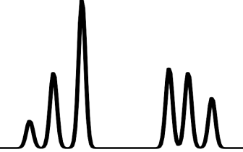
Laser spectroscopy basics
Nuclear information from probing atomic structure
Hyperfine splitting
atomic excited state
Counts
laser photon
fluorescence
atomic ground state
Laser frequency (MHz)
Notes:
Laser induced excitations between atomic levels, which can be detected by looking at the subsequent fluorence decay.
In the presence of a hyperfine structure

Slide 6
Laser spectroscopy basics
Nuclear information from probing atomic structure
Isotope shift
  Different mass and size (charge radius) of isotopes of the same elementt
Hyperfine splitting
  Proportional to nuclear moments, spin
Measure very precisly using collinear laser spectroscopy
Notes:
Laser induced excitations between atomic levels, which can be detected by looking at the subsequent fluorence decay.
In the presence of a hyperfine structure

Slide 7
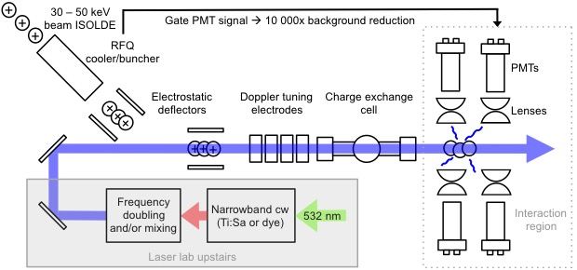
Collaps experimental set-up
High-resolution on 30 – 50 keV beams
        Δν_{D} ∝ 1/√ V_{acc}
Apply scanning voltage to doppler tune laser frequency onto resonance
Notes:
High resolution is really the key to the success of collinear laser spectroscopy

Slide 8
Collaps experimental set-up
Ionic or atomic beams
  Optional use of charge exchange cell
Bunched beams to go more exotic
    Minimum yield: ~10 000 ions/s
Notes:
Interplay between theory and experiment

Slide 9
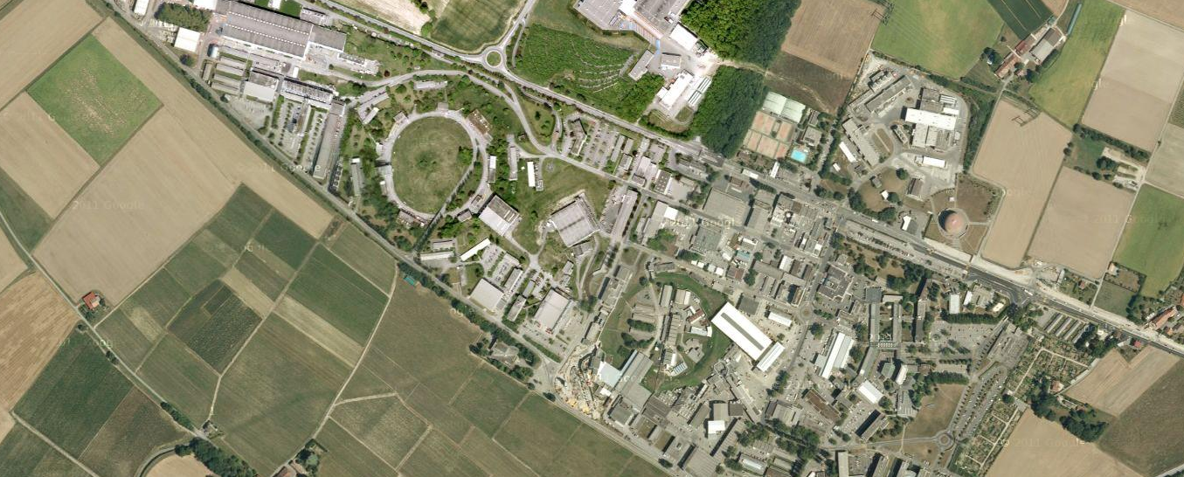


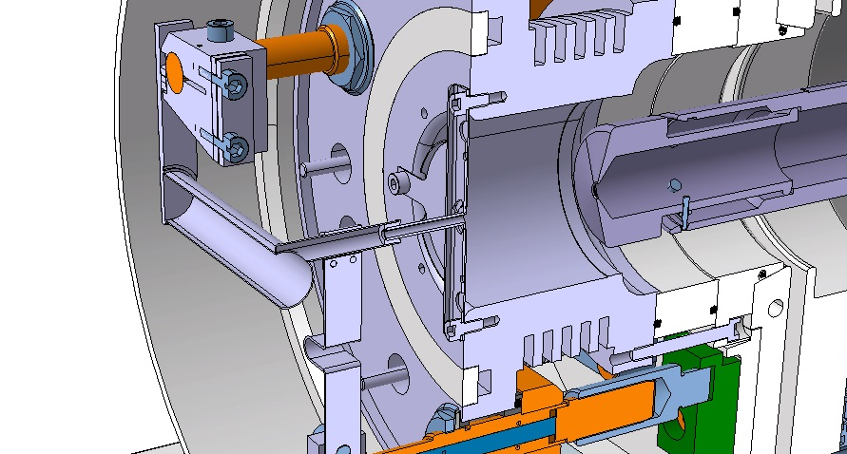
Isotope production at Isolde-Cern
ISOLDE
PSB
PS
LINAC2
Primary beam
Radioisotopes
1.4 GeV protons from PSB on thick target
Production of over 70 chemical elements and 1000 different isotopes
Experimental challenges:
  Low yields, high contamination
  Short half-lives
Ions
Vacuum
Air
*pictures and animation courtesy of M. Delonca, J.P. Ramos

Slide 10
B. Recent collaps results
Simple structures around Z = 50
Cd (Z = 48), Sn (Z = 50)
*Sb (Z = 51)
The Ni-region: across N = 40 and N = 50
Ni (Z = 28) – *Ge (Z = 32)
Onset of collectivity towards N = 40
Mn (Z = 25)
Single particle structure around Z = 20
K (Z = 19) – *Sc (Z = 21)
Island of inversion around N = 20
Mg (Z =12) – Al (Z = 13)
R. Neugart, J. Phys. G: Nucl. Part. Phys. 44 064002 (2017)

Slide 11
The Ni-region and above
Ge (Z = 32)
Ga (Z = 31)
Zn (Z = 30)
Cu (Z = 29)
28
Ni (Z = 28)
40
50
At and above the Z = 28 shell closure
  Transition from single-particle to collective behaviour
  Test nuclear models
Strength of the N = 40 subshell closure?
Persistence of N = 50 around ⁷⁸Ni?
Notes:
Interplay between theory and experiment

Slide 12
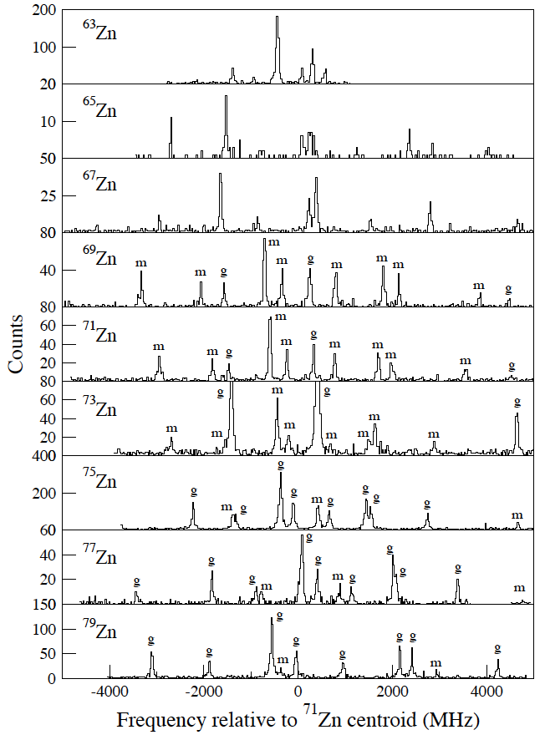
Zn (Z = 30) structure between N = 33 - 50
C. Wraith et al., PLB 771, 385 (2017)
Notes:
Interplay between theory and experiment

Slide 13
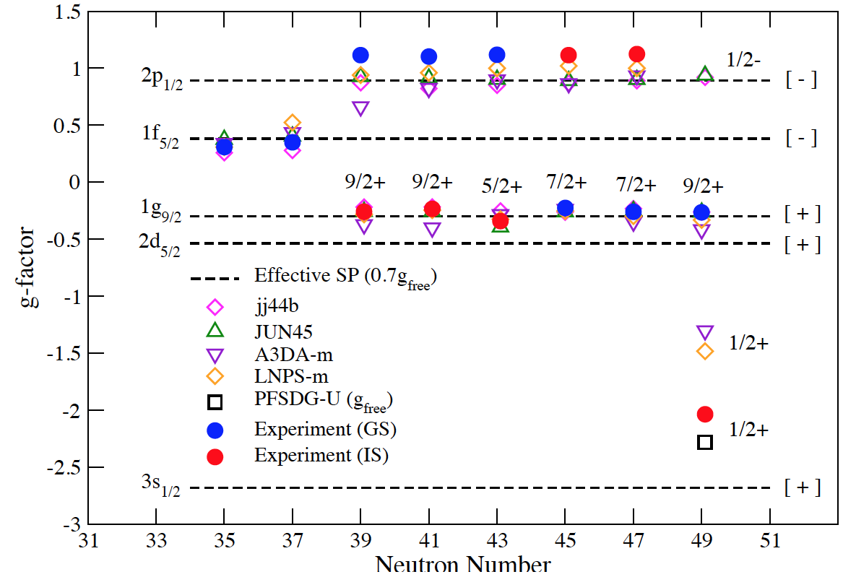
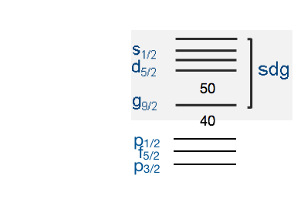
Zn (Z = 30) structure between N = 33 - 49
Even – odd Zn isotopes
g-factor (μ = g/I) shows leading neutron configuration
  Independent of nuclear spin/seniority
No excitations across N = 50 are necessary to reproduce g-factors
C. Wraith et al., PLB 771, 385 (2017)
Notes:
Textbook case for

Slide 14
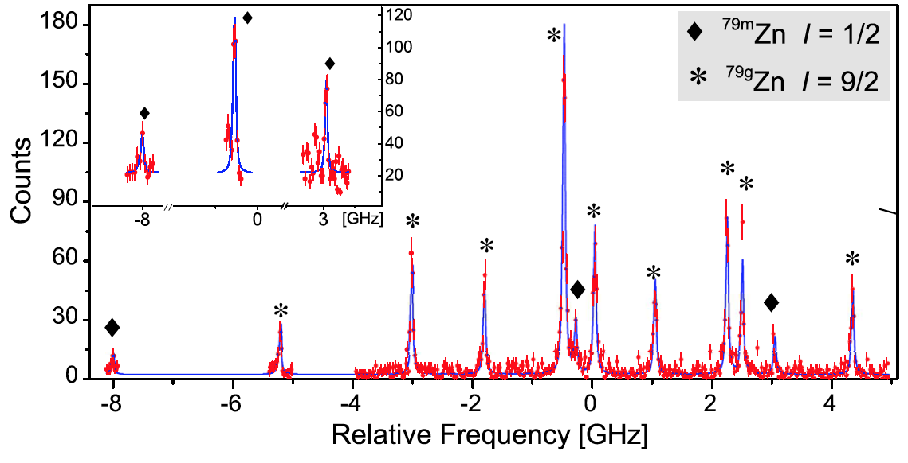
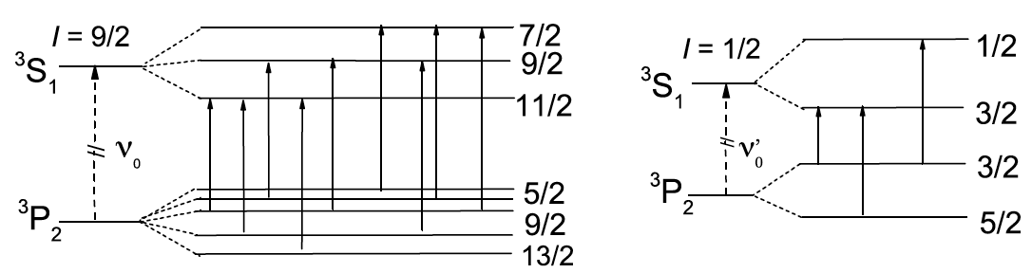
The isomer in ⁷⁹Zn (N = 49)
X. Yang, PRL 116, 182502 (2016)
Hyperfine spectrum demonstrates existence of 2 long-lived states in ⁷⁹Zn
  I = 1/2 isomer
Notes:
Interplay between theory and experiment

Slide 15
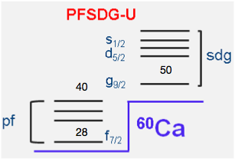
The isomer in ⁷⁹Zn (N = 49)
X. Yang, PRL 116, 182502 (2016)
Hyperfine spectrum demonstrates existence of 2 long-lived states in ⁷⁹Zn
  I = 1/2 isomer
Large negative g-factor only consistent with νs_{1/2}
  Intruder nature of isomer
  Positive parity
Notes:
Interplay between theory and experiment

Slide 16
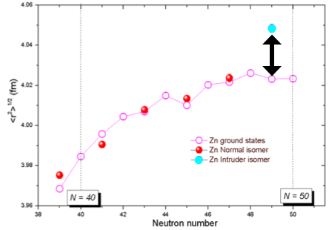
The isomer in ⁷⁹Zn (N = 49)
X. Yang, PRL 116, 182502 (2016)
Hyperfine spectrum demonstrates existence of I = 1/2 isomer in ⁷⁹Zn
Large negative g-factor only consistent with νs_{1/2}
  Intruder nature of isomer
  Positive parity
Large charge radius difference between 9/2⁺ gs and 1/2⁺ isomer
Notes:
Interplay between theory and experiment

Slide 17
Nuclear sizes above Z = 28
Experiment performed May 2018
T. Procter, PRC 86, 034329 (2012)
L. Xie, in preparation
M. Bissell, PRC 93, 064318 (2016)
S. Kaufmann, in preparation
Notes:
Interplay between theory and experiment

Slide 18
Around N = 40
Subtle influence of the N = 40 subshell gap disappears quickly above Z = 28
Anomalous inverted odd even staggering
  What happens in between Ga and Rb?
Notes:
Interplay between theory and experiment
Although eff orts are made to describe general trends of charge
radii using various nuclear models (mean-field theory, nuclear
shell model, ab -initio), an accurate description of local
fluctuations of charge radii along a given isotropic chain
remains a major challenge.

Slide 19
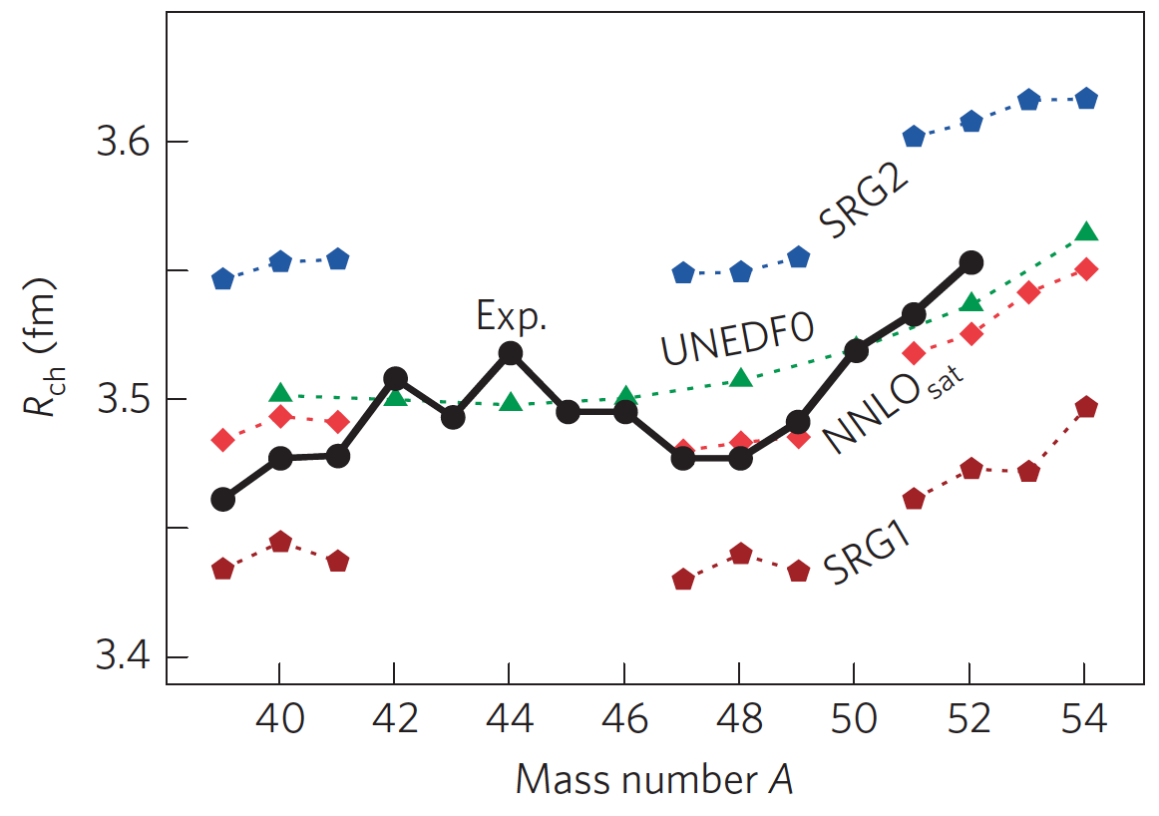
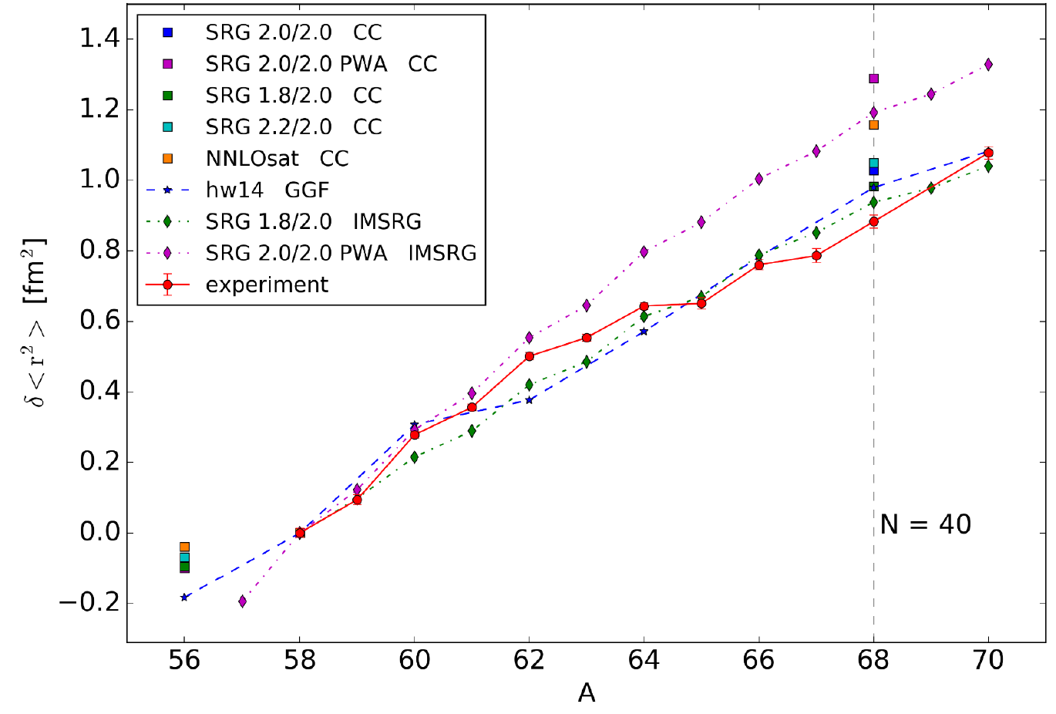
Radii and state-of-the-art models
Ca (Z = 20)
Ni (Z = 28)
⁶⁸Ni:
Neutron-rich
Charge radius and dipole polarizability experimentally known
R. Garcia Ruiz, Nat. Phys. 12, 594 (2016)
S. Kaufmann, in preparation
Notes:
With advances in chiral effective field theory (EFT) and the development of powerful many-body methods, nuclear structure theory has entered a new era in recent years.
Although wide-scale theoretical reproduction of nuclear
mean-square charge radii remains illusive
Description of nuclear charge radii has been always challenging
Fair reproduction but systematics

Slide 20
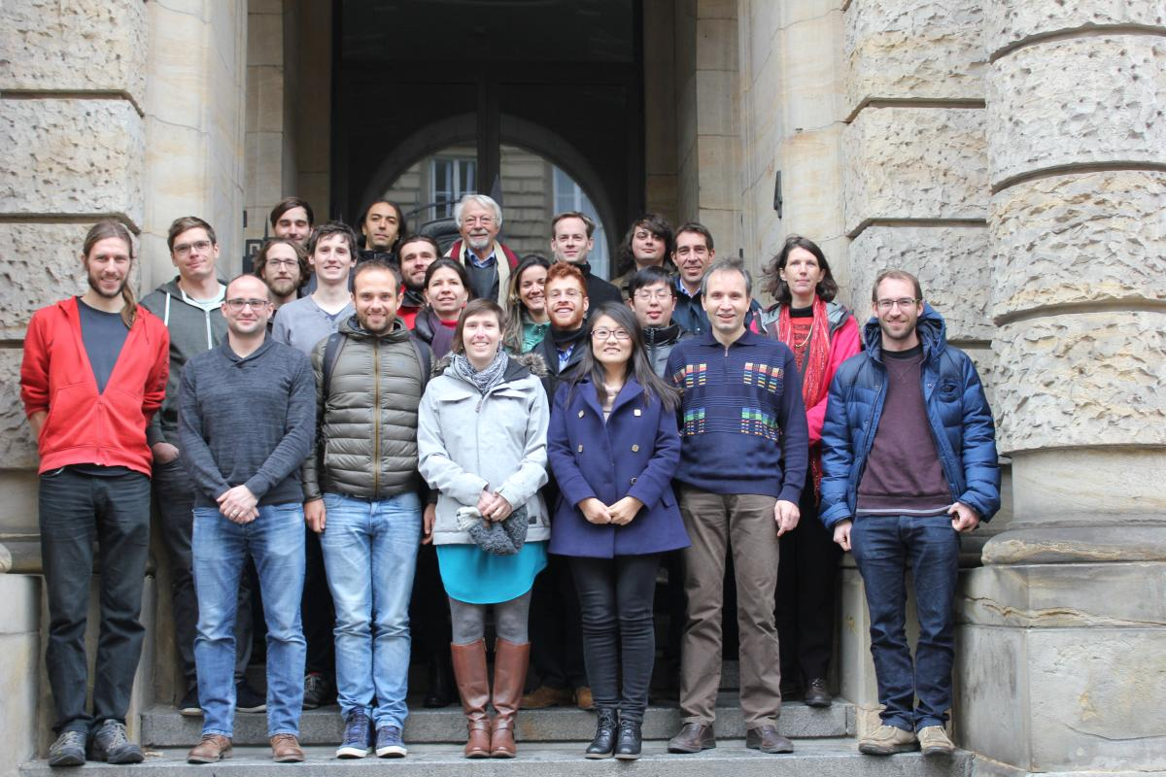
Conclusion
Collaps 2018
Laser spectroscopy is a versatile tool for nuclear structure research, providing
Nuclear spins
Magnetic moments
Quadrupole moments
Charge radii
EP department, CERN, Geneva (CH)
University of Manchester, Manchester (UK)
Max-Planck-Institut für Kernphysik, Heidelberg (DE)
University of Liverpool, Liverpool (UK)
IKS, KU Leuven, Leuven (BE)
TU Darmstadt, Darmstadt (DE)
Universität Mainz, Mainz (DE)
GSI, Darmstadt (DE)
Institut de Physique Nucléaire, Orsay (FR)
Peking University, Bejing (CN)
M.L. Bissell², K. Blaum³, B. Cheal⁴, R.F. Garcia Ruiz², W. Gins⁶, H. Heylen¹, A. Kannelakopoulos⁶, S. Kaufmann⁷, Á. Koszorús⁶, K. König⁷, J. Krämer⁷, B. Maaß⁶, S. Malbrunot-Etternauer¹, R. Neugart^{3,8}, G. Neyens^{1,6}, W. Nörtershäuser⁷, R. Sánchez⁹, F. Sommer⁷, L. Vazquez-Rodriguez¹⁰, L. Xie², X.F. Yang^{6,11}, D. Yordanov¹⁰, Z. Xu⁶
Notes:
Interplay between theory and experiment

