Slide 1
Open shell nuclei from the valence-space IMSRG
Jason D. Holt
SFB Workshop, 4 July 2018
Notes:
`

Slide 2
Ab Initio Approach
Aim of modern nuclear theory: Develop unified first-principles picture of structure and reactions

Slide 3
Ab Initio Approach: Interactions
Aim of modern nuclear theory: Develop unified first-principles picture of structure and reactions
- Nuclear forces (low-energy QCD)
- Electroweak physics
“The first, the basic approach, is to study the elementary particles, their properties and mutual interaction. Thus one hopes to obtain knowledge of the nuclear forces.”

Slide 4
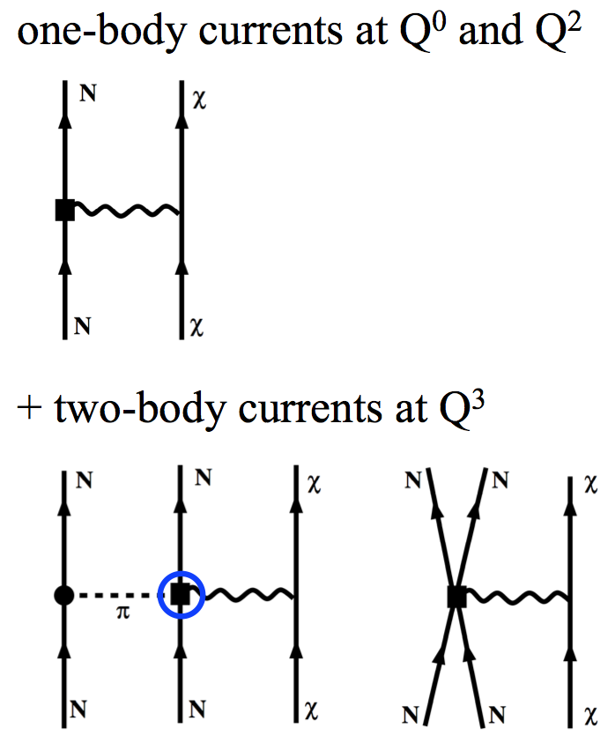
Effective Theory of Nuclear Forces
Chiral effective field theory: systematic expansion of nuclear interactions
Nucleons interact via contact and pion exchanges
Undetermined low-energy constants fit to 2,3,4-body data
Consistent treatment of NN, 3N, 4N… forces
Quantitative estimation of neglected orders possible
Consistent EW interactions
Quantifiable uncertainties possible
Best fitting strategy for ~30
undetermined couplings debated

Slide 5
Ab Initio Approach: Interactions
Aim of modern nuclear theory: Develop unified first-principles picture of structure and reactions
- Nuclear forces (low-energy QCD)
- Electroweak physics

Slide 6
Ab Initio Approach: Many-Body Methods
Aim of modern nuclear theory: Develop unified first-principles picture of structure and reactions
- Nuclear forces (low-energy QCD)
- Electroweak physics
- Nuclear many-body problem
“If the forces are known, one should, in principle, be able to calculate deductively the properties of individual nuclei.”

Slide 7
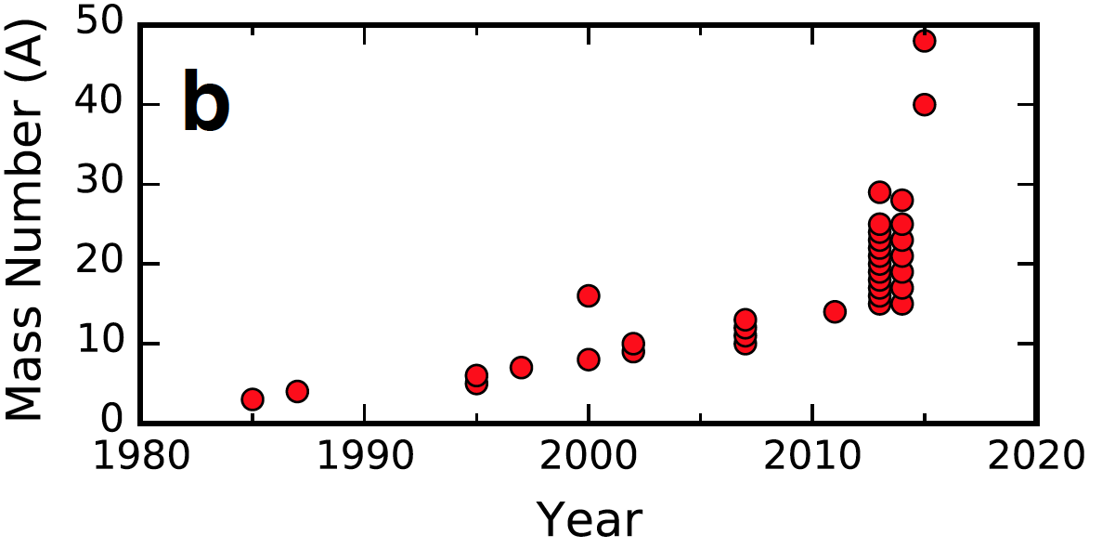

Chronological Reach of Ab Initio Many-Body Methods
Moore’s law: exponential growth in computing power
Methods for light nuclei (QMC, NCSM) scale exponentially with mass

Slide 8
Chronological Reach of Ab Initio Many-Body Methods
Moore’s law: exponential growth in computing power
Methods for light nuclei (QMC, NCSM) scale exponentially with mass
Mid 2000’s polynomial scaling methods developed (coupled cluster, in-medium SRG,…)
Explosion in reach of ab initio theory

Slide 9
Chronological Reach of Ab Initio Many-Body Methods
Moore’s law: exponential growth in computing power 2018: A>100
Methods for light nuclei (QMC, NCSM) scale exponentially with mass
Mid 2000’s polynomial scaling methods developed (coupled cluster, in-medium SRG,…)
Explosion in reach of ab initio theory

Slide 10
Breadth of Ab Initio Many-Body Methods
Aim of modern nuclear theory: Develop unified first-principles picture of structure and reactions
- Nuclear forces (low-energy QCD)
- Electroweak physics
- Nuclear many-body problem

Slide 11
Breadth of Ab Initio Many-Body Methods
Aim of modern nuclear theory: Develop unified first-principles picture of structure and reactions
- Nuclear forces (low-energy QCD)
- Electroweak physics
- Nuclear many-body problem
sdg
pf
sd

Slide 12
Breadth of Ab Initio Many-Body Methods
Aim of modern nuclear theory: Develop unified first-principles picture of structure and reactions
- Nuclear forces (low-energy QCD)
- Electroweak physics
- Nuclear many-body problem
sdg
pf
0νββ-decay candidates
open-shell, medium/heavy-mass, deformed
⁴⁸Ca, ⁷⁶Ge, ⁸²Se, ¹³⁰Te, ¹³⁶Xe within reach
sd

Slide 13
Valence-Space In-Medium SRG
Explicitly construct unitary transformation from sequence of rotations
All operators truncated at two-body level
Tsukiyama, Bogner, Schwenk, PRC 2012
Morris, Parzuchowski, Bogner, PRC 2015
Step 1: Decouple core
Step 2: Decouple valence space
Can we achieve accuracy
of large-space methods?

Slide 14
Ground States: From Oxygen to Nickel
ENO agrees to 1% with large-space methods (where calculations exist)
Extend beyond standard sd/pf shells
Agreement with experiment deteriorates for heavy chains (due to input Hamiltonian)
Significant gain in applicability with little/no sacrifice in accuracy
Low computational cost: ~1 node-day/nucleus
Stroberg et al., PRL (2017)

Slide 15
Ground States: From Oxygen to Nickel
Targeted valence space agrees to 1% with all large-space methods (where calculations exist)
Extend beyond standard sd/pf shells
Agreement with experiment deteriorates for heavy chains (due to input Hamiltonian)
Significant gain in applicability with little/no sacrifice in accuracy
Low computational cost: ~1 node-day/nucleus
Stroberg et al., PRL (2017)

Slide 16
Breadth of Ab Initio Many-Body Methods
Aim of modern nuclear theory: Develop unified first-principles picture of structure and reactions
- Nuclear forces (low-energy QCD)
- Electroweak physics
- Nuclear many-body problem
sdg
pf
0νββ-decay candidates
open-shell, medium/heavy-mass, deformed
⁴⁸Ca, ⁷⁶Ge, ⁸²Se, ¹³⁰Te, ¹³⁶Xe within reach
sd
Extends range to all nuclei up to N,Z≈50

Slide 17
Connection to Infinite Matter: Saturation as a Guide for Nuclei
Hebeler/Simonis NN+3N forces with reasonable saturation properties
1.8/2.0 (EM) reproduces closed shells through ⁷⁸Ni
Only underbound for neutron-rich oxygen
From G. Hagen
Simonis et al., PRC (2017)

Slide 18
Connection to Infinite Matter: Saturation as a Guide for Nuclei
Hebeler/Simonis NN+3N forces with reasonable saturation properties
1.8/2.0 (EM) reproduces closed shells through ⁷⁸Ni
Only underbound for neutron-rich oxygen
From G. Hagen
Simonis et al., PRC (2017)

Slide 19
Forces with good saturation
Isotopic chains: dramatic improvement with respect to experimental data

Slide 20
Forces with good saturation
Isotopic chains: dramatic improvement with respect to experimental data
How well does it work across broad regions of nuclei?

Slide 21
Ground-State Properties in sd-Shell: F (Z=9)
Explore ground-state properties throughout medium-mass region
Remarkable agreement with experiment
Probe dripline and beyond
Artifacts at neutron N=20 gap
Z=28
Z=20
Z=8
Z=2
JDH, Stroberg, et al., in preparation

Slide 22
Ground-State Properties in sd-Shell: Ne (Z=10)
Explore ground-state properties throughout medium-mass region
Remarkable agreement with experiment
Probe dripline and beyond
Artifacts at neutron N=20 gap
Z=28
Z=20
Z=8
Z=2
JDH, Stroberg, et al., in preparation

Slide 23
Ground-State Properties in sd-Shell: Na (Z=11)
Explore ground-state properties throughout medium-mass region
Remarkable agreement with experiment
Probe dripline and beyond
Artifacts at neutron N=20 gap
Z=28
Z=20
Z=8
Z=2
JDH, Stroberg, et al., in preparation

Slide 24
Ground-State Properties in sd-Shell: Mg (Z=12)
Explore ground-state properties throughout medium-mass region
Remarkable agreement with experiment
Probe dripline and beyond
Artifacts at neutron N=20 gap
Z=28
Z=20
Z=8
Z=2
JDH, Stroberg, et al., in preparation

Slide 25
Ground-State Properties in sd-Shell: Al (Z=13)
Explore ground-state properties throughout medium-mass region
Remarkable agreement with experiment
Probe dripline and beyond
Artifacts at neutron N=20 gap
Z=28
Z=20
Z=8
Z=2
JDH, Stroberg, et al., in preparation

Slide 26
Ground-State Properties in sd-Shell: Si (Z=14)
Explore ground-state properties throughout medium-mass region
Remarkable agreement with experiment
Probe dripline and beyond
Artifacts at neutron N=20 gap
Z=28
Z=20
Z=8
Z=2
JDH, Stroberg, et al., in preparation

Slide 27
Ground-State Properties in sd-Shell: P (Z=15)
Explore ground-state properties throughout medium-mass region
Remarkable agreement with experiment
Probe dripline and beyond
Artifacts at neutron N=20 gap
Z=28
Z=20
Z=8
Z=2
JDH, Stroberg, et al., in preparation

Slide 28
Ground-State Properties in sd-Shell: S (Z=16)
Explore ground-state properties throughout medium-mass region
Remarkable agreement with experiment
Probe dripline and beyond
Artifacts at neutron N=20 gap
Z=28
Z=20
Z=8
Z=2
JDH, Stroberg, et al., in preparation

Slide 29
Ground-State Properties in sd-Shell: Cl (Z=17)
Explore ground-state properties throughout medium-mass region
Remarkable agreement with experiment
Probe dripline and beyond
Artifacts at neutron N=20 gap
Z=28
Z=20
Z=8
Z=2
JDH, Stroberg, et al., in preparation

Slide 30
Ground-State Properties in sd-Shell: Ar (Z=18)
Explore ground-state properties throughout medium-mass region
Remarkable agreement with experiment
Probe dripline and beyond
Artifacts at neutron N=20 gap
Z=28
Z=20
Z=8
Z=2
JDH, Stroberg, et al., in preparation

Slide 31
Ground-State Properties in sd-Shell: K (Z=19)
Explore ground-state properties throughout medium-mass region
Remarkable agreement with experiment
Probe dripline and beyond
Artifacts at neutron N=20 gap
Z=28
Z=20
Z=8
Z=2
JDH, Stroberg, et al., in preparation

Slide 32
Ground-State Properties in pf-Shell: Ca (Z=20)
Explore ground-state properties throughout medium-mass region
Remarkable agreement with experiment
Probe dripline and beyond
Artifacts at neutron N=40 gap
Z=28
Z=20
Z=8
Z=2
JDH, Stroberg, et al., in preparation

Slide 33
Ground-State Properties in pf-Shell: Sc (Z=21)
Explore ground-state properties throughout medium-mass region
Remarkable agreement with experiment
Probe dripline and beyond
Artifacts at neutron N=40 gap
Z=28
Z=20
Z=8
Z=2
JDH, Stroberg, et al., in preparation

Slide 34
Ground-State Properties in pf-Shell: Ti (Z=22)
Explore ground-state properties throughout medium-mass region
Remarkable agreement with experiment
Probe dripline and beyond
Artifacts at neutron N=40 gap
Z=28
Z=20
Z=8
Z=2
JDH, Stroberg, et al., in preparation

Slide 35
Ab Initio Dripline Prediction
Ab initio prediction of
limits of nuclei
General agreement with model predictions
Significant differences arise for heavy nuclei
Holt, Stroberg, et al.,
p-shell dripline well predicted:
incorrect for well-known halo structures

Slide 36
Ab Initio Dripline Prediction
Ab initio prediction of
limits of nuclei
General agreement with model predictions
Proton dripline: very good agreement with experiment
Holt, Stroberg, et al.,
p-shell dripline well predicted:
incorrect for well-known halo structures

Slide 37
Ground-State Properties in pf-Shell: V (Z=23)
Explore ground-state properties throughout medium-mass region
Remarkable agreement with experiment
Probe dripline and beyond
Artifacts at neutron N=40 gap
Z=28
Z=20
Z=8
Z=2
JDH, Stroberg, et al., in preparation

Slide 38
Ground-State Properties in pf-Shell: Cr (Z=24)
Generally deformed, new data from ISOLTRAP
Z=28
Z=20
Z=8
Z=2
JDH, Stroberg, et al., in preparation

Slide 39
Ground-State Properties in pf-Shell: Mn (Z=25)
Explore ground-state properties throughout medium-mass region
Remarkable agreement with experiment
Probe dripline and beyond
Artifacts at neutron N=40 gap
Z=28
Z=20
Z=8
Z=2
JDH, Stroberg, et al., in preparation

Slide 40
Ground-State Properties in pf-Shell: Fe (Z=26)
Explore ground-state properties throughout medium-mass region
Remarkable agreement with experiment
Probe dripline and beyond
Artifacts at neutron N=40 gap
Z=28
Z=20
Z=8
Z=2
JDH, Stroberg, et al., in preparation

Slide 41
Ground-State Properties in pf-Shell: Ni (Z=28)
Explore ground-state properties throughout medium-mass region
Remarkable agreement with experiment
Probe dripline and beyond
Artifacts at neutron N=40 gap
Z=28
Z=20
Z=8
Z=2
JDH, Stroberg, et al., in preparation

Slide 42
Structure of Lightest Tin Isotopes
Extend ab initio to heavy-mass region: magicity of ¹⁰⁰Sn, controversial level ordering in ¹⁰¹Sn
Predicts doubly magic nature from
2⁺ energies and B(E2) systematics Both calculations predict 5/2+ ground state
Morris et al., PRL (2018)

Slide 43
Evolution of N=28,32,34 Magic Numbers: Spectroscopy
Predictions of evolution throughout from pf to sd shell
JDH, Stroberg, et al., in preparation

Slide 44
Evolution of N=28,32,34 Magic Numbers: Masses
Series of mass measurements ideal example of theory/experiment overlap
Current ab initio picture 2017
New TITAN Measurements of Ti
Probe “dawning” of N=32 magic number
Ab Initio from NN+3N
Generally good agreement, but predicts appearance too early
Future: Evolution to be measured in Ar, Cl at NSCL
Leistenschneider et al., PRL (2018)

Slide 45
Towards big questions: 0νββ-decay
Aim of modern nuclear theory: Develop unified first-principles picture of structure and reactions
- Nuclear forces (low-energy QCD)
- Electroweak physics
- Nuclear many-body problem
0νββ-decay candidates
open-shell, medium/heavy-mass, deformed
⁴⁸Ca, ⁷⁶Ge, ⁸²Se; ¹³⁰Te, ¹³⁶Xe within reach

Slide 46
Effective Valence-Space In-Medium SRG Operators
Explicitly construct unitary transformation from sequence of rotations
Step 1: Decouple core
Step 2: Decouple valence space
Step 3: Decouple additional operators

Slide 47
Properties of Medium-Mass Nuclei: Radii
Study charge radii across same isotopic chains:
2.0/2.0 (PWA) “best” results: overpredicts experiment, less pronounced trends
Clear discrepancy at ⁶⁸Ni: benchmark against CC and GGF in progress
sdg-shell
fp-shell

Slide 48
Properties of Medium-Mass Nuclei: Radii
Study charge radii across same isotopic chains:
2.0/2.0 (PWA) “best” results: overpredicts experiment, less pronounced trends
Clear discrepancy at ⁶⁸Ni: benchmark against CC and GGF in progress
sdg-shell
pf₅g₉-shell
sdg-shell
fp-shell
fp-shell

Slide 49
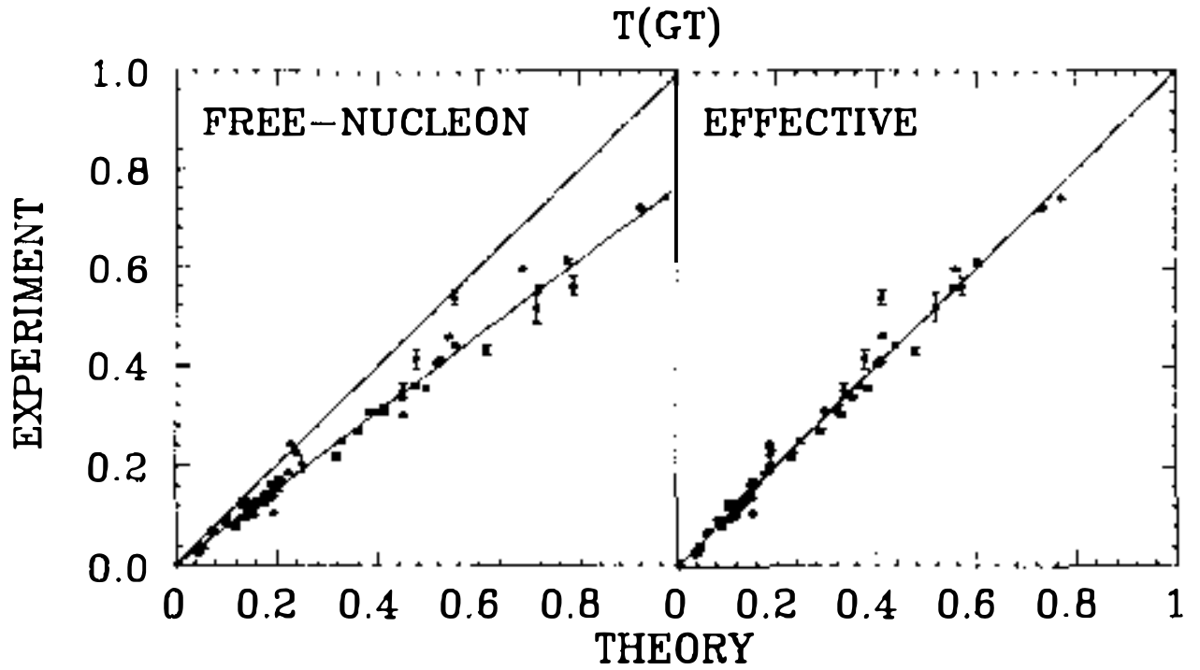
“Quenching” of g_{A} in Gamow-Teller Decays
Long-standing problem in weak decays: experimental values systematically smaller than theory
Large M_{GT}
in sd-shell
Brown, Wildenthal (1985)

Slide 50
“Quenching” of g_{A} in Gamow-Teller Decays
Long-standing problem in weak decays: experimental values systematically smaller than theory
Using agrees with data
Should g_{A} be quenched in medium?
Large M_{GT}
in sd-shell
Brown, Wildenthal (1985)

Slide 51
“Quenching” of g_{A} in Gamow-Teller Decays
Long-standing problem in weak decays: experimental values systematically smaller than theory
Using agrees with data
Should g_{A} be quenched in medium?
Missing wavefunction correlations
Large M_{GT}
in sd-shell
Brown, Wildenthal (1985)

Slide 52
“Quenching” of g_{A} in Gamow-Teller Decays
Long-standing problem in weak decays: experimental values systematically smaller than theory
Using agrees with data
O_{eff}
Should g_{A} be quenched in medium?
Missing wavefunction correlations
Renormalized VS operator?
Large M_{GT}
in sd-shell
Brown, Wildenthal (1985)

Slide 53
“Quenching” of g_{A} in Gamow-Teller Decays
Long-standing problem in weak decays: experimental values systematically smaller than theory
Using agrees with data
Should g_{A} be quenched in medium?
Missing wavefunction correlations
Renormalized VS operator?
Neglected two-body currents?
Large M_{GT}
in sd-shell
Brown, Wildenthal (1985)

Slide 54
“Quenching” of g_{A} in Gamow-Teller Decays
Long-standing problem in weak decays: experimental values systematically smaller than theory
Using agrees with data
Should g_{A} be quenched in medium?
Missing wavefunction correlations
Renormalized VS operator?
Neglected two-body currents?
Model-space truncations?
Explore in ab initio framework
Large M_{GT}
in sd-shell
Brown, Wildenthal (1985)

Slide 55
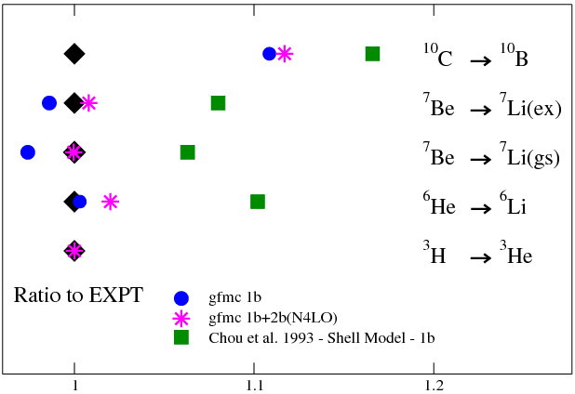
Two-body Currents in Light Nuclei
Chiral Effective Field Theory – electroweak currents consistent with nuclear forces
Inconsistent forces/currents: effect small, but clear increase from GFMC
Pastore et al., PRC (2018)

Slide 56
Two-body Currents in Light Nuclei
Chiral Effective Field Theory – electroweak currents consistent with nuclear forces
Consistent forces/currents: effect also small, but clear quenching in NCSM
Gysbers et al., in prep.
Pastore et al., PRC (2018)

Slide 57
Superallowed GT Transition in ¹⁰⁰Sn
Coupled cluster calculations of GT transition in ¹⁰⁰Sn from many chiral Hamiltonians
Converged in relatively small spaces
(See talk of G. Hagen, Friday)
Gysbers et al., submitted

Slide 58
Superallowed GT Transition in ¹⁰⁰Sn
Coupled cluster calculations of GT transition in ¹⁰⁰Sn from many chiral Hamiltonians
Large quenching effect from correlations
Without currents, large spread in results
Gysbers et al., submitted

Slide 59
Superallowed GT Transition in ¹⁰⁰Sn
Coupled cluster calculations of GT transition in ¹⁰⁰Sn from many chiral Hamiltonians
Large quenching effect from correlations
Without currents, large spread in results
Addition of 2BC further quenches and reduces spread in results
Gysbers et al., submitted

Slide 60
Superallowed GT Transition in ¹⁰⁰Sn
Coupled cluster calculations of GT transition in ¹⁰⁰Sn from many chiral Hamiltonians
Large quenching effect from correlations
Without currents, large spread in results
Addition of 2BC further quenches and reduces spread in results
Gysbers et al., submitted

Slide 61
Ab Initio GT Decays in Medium-Mass Region
VS-IMSRG calculations of GT transitions in sd, pf shells
Modest quenching from consistent ab initio wavefunctions and operators
Further modest quenching from 2BC
Ab initio calculations across the chart explain data with free-space g_{A}
Gysbers et al., submitted

Slide 62
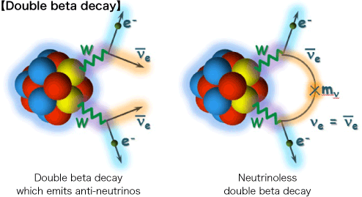
Ab Initio 2νββ-decay
Consistent many-body wfs/operators from chiral NN+3N forces (no 2b currents)
VS-IMSRG: decrease in final matrix element
Payne, Stroberg, JDH, et al., in prep

Slide 63
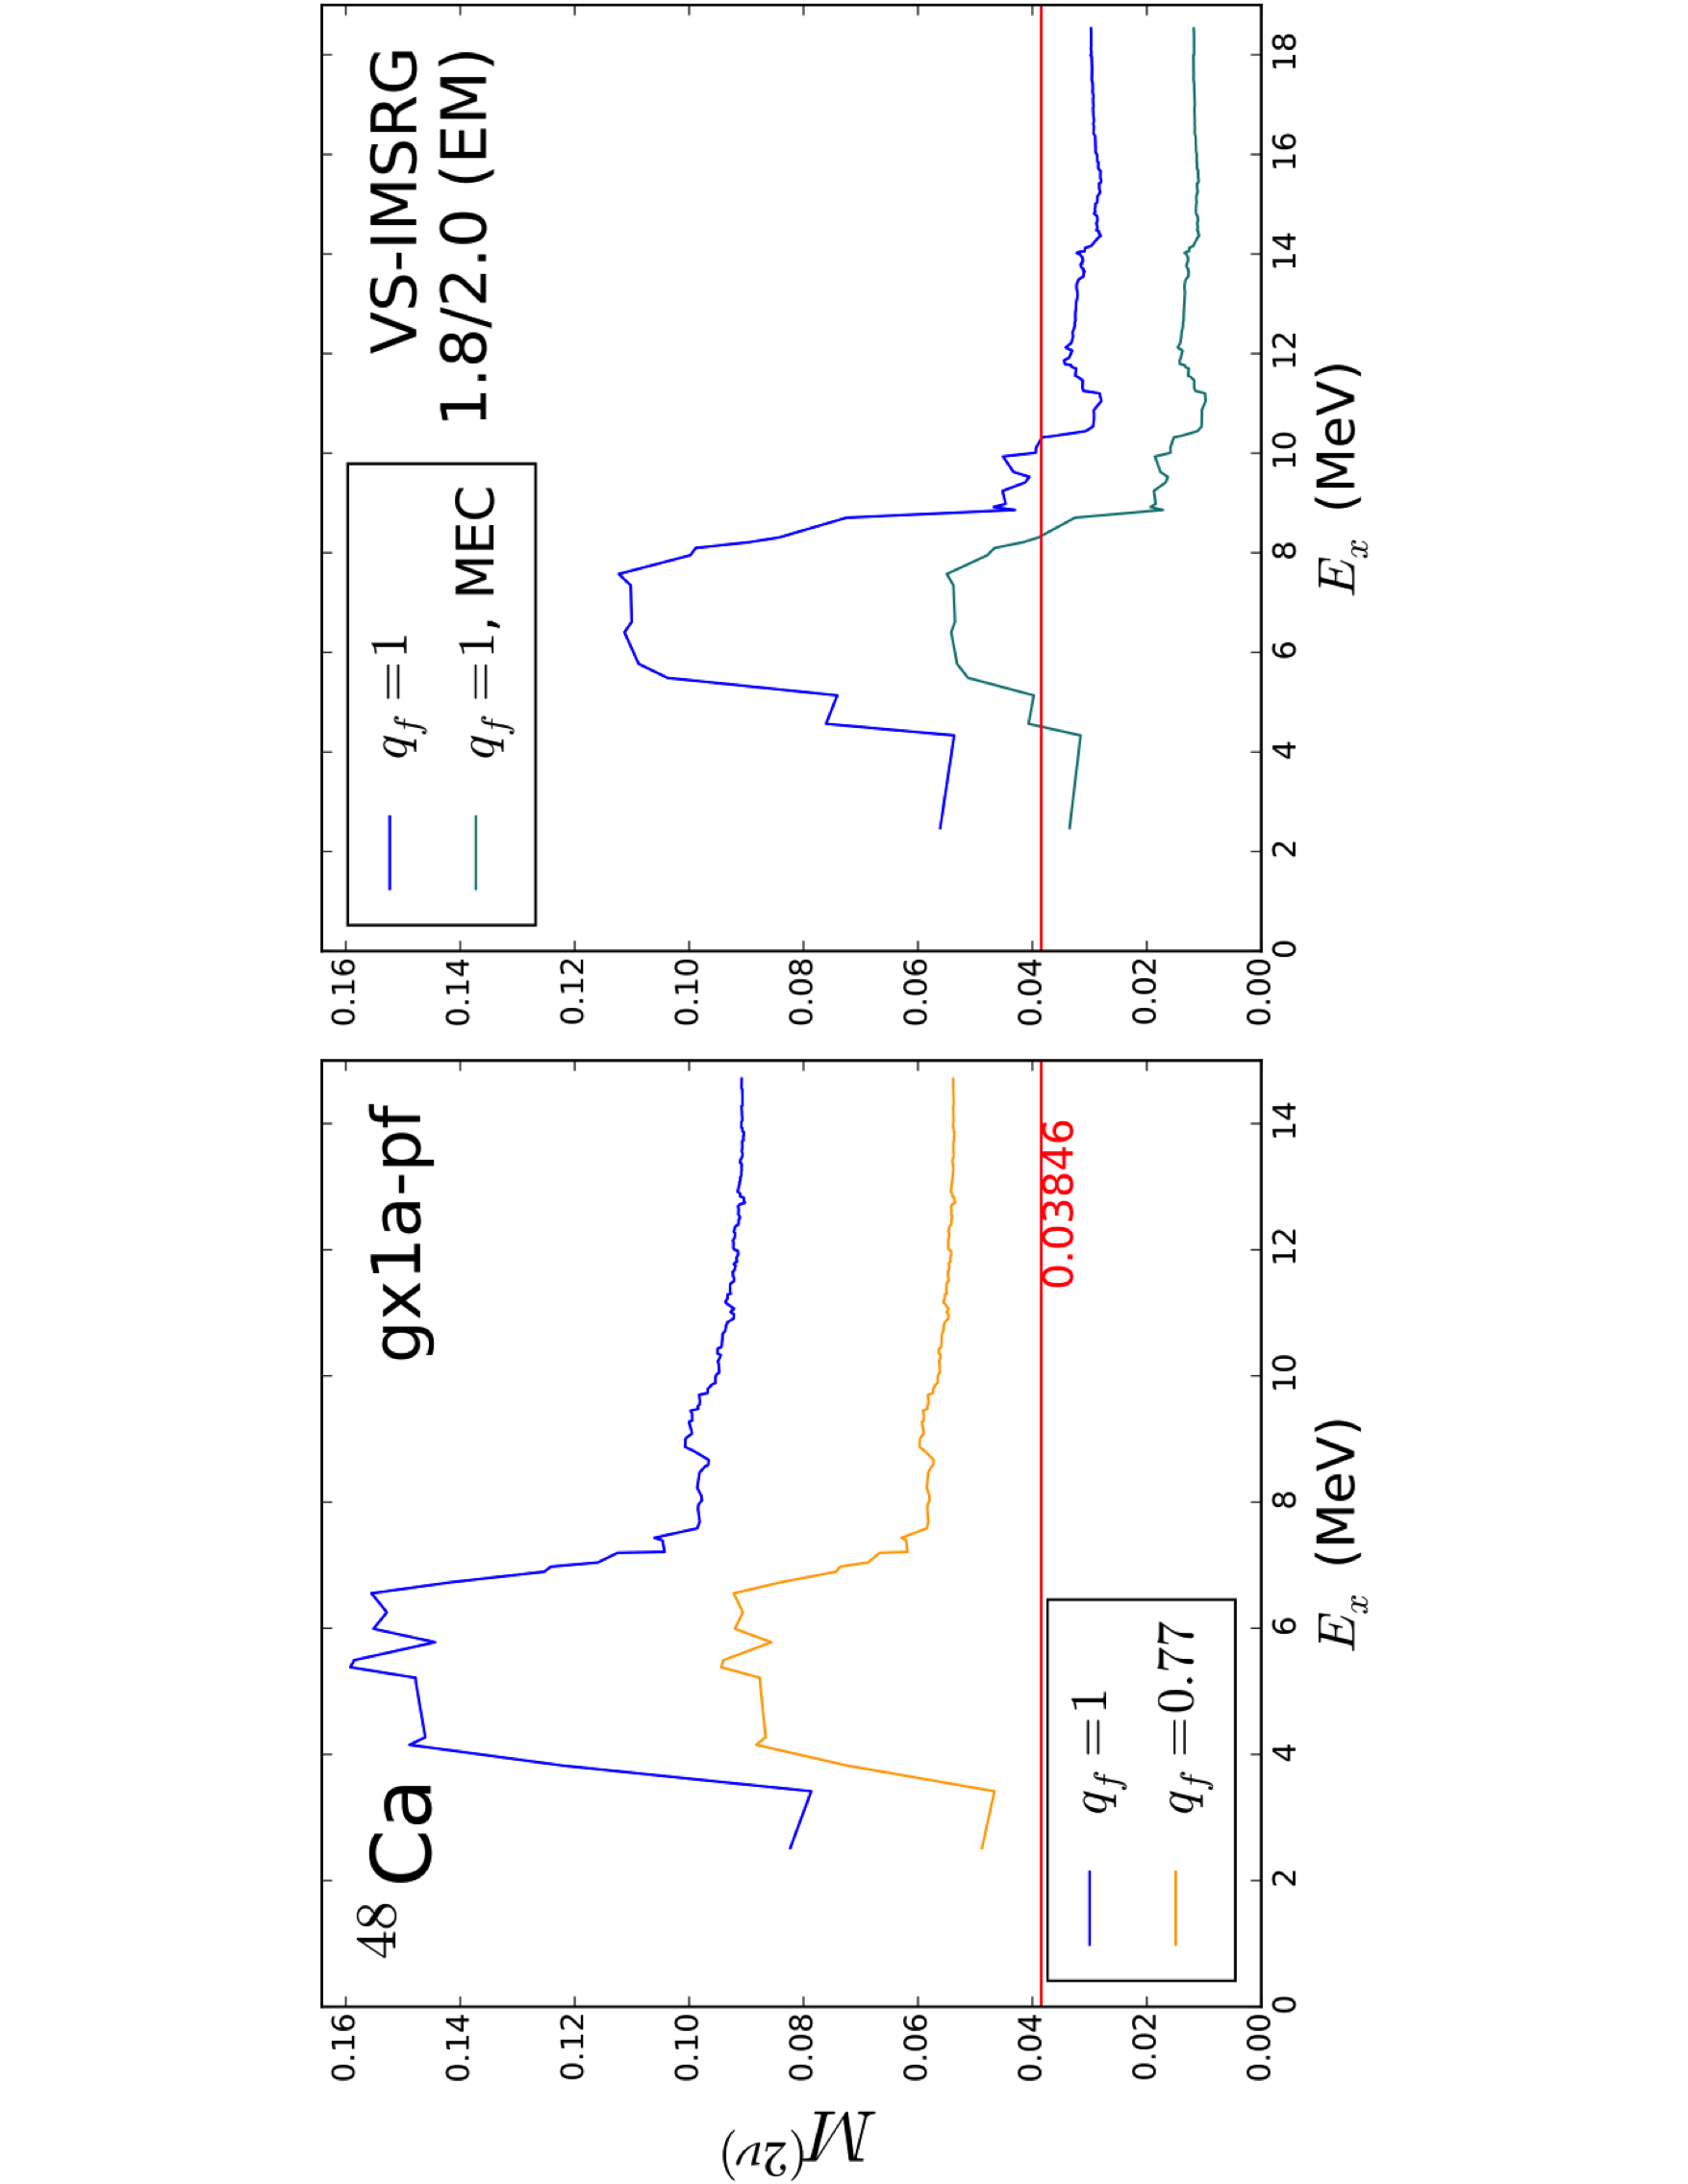
Ab Initio 2νββ-decay
Consistent many-body wfs/operators from chiral NN+3N forces (with 2b currents)
VS-IMSRG: decrease in final matrix element
Potential issues: valence-space limitations for 1+ states or missing correlations
Payne, Stroberg, JDH, et al., in prep

Slide 64
Gamow-Teller Strengths for A=48
GT strengths for ⁴⁸Ca(p,n)⁴⁸Sc and ⁴⁸Ti(n,p)⁴⁸Sc
Significant improvement with effects of 2BC
Resonances appear at too low energy

Slide 65
Gamow-Teller Strengths for A=48
Running GT strengths for ⁴⁸Ca(p,n)⁴⁸Sc and ⁴⁸Ti(n,p)⁴⁸Sc
Significant improvement with effects of 2BC – good agreement with experiment

Slide 66
Gamow-Teller Strengths for A=48
Running GT strengths for ⁴⁸Ca(p,n)⁴⁸Sc and ⁴⁸Ti(n,p)⁴⁸Sc
Significant improvement with effects of 2BC
Very good agreement with Ikeda Sum Rule calculated with CC theory
CC Theory

Slide 67
Role of Correlations?
Role of correlations addressed in CC theory
Including triples perturbatively increases value of NME
IMSRG(2) results similar to CCSD results – missing many-body correlations

Slide 68
Ab Initio 0νββ-decay
Consistent many-body wfs/operators from chiral NN+3N forces (no 2b currents)
General cancellation between Fermi and Tensor contributions

Slide 69
Ab Initio 0νββ-decay
Consistent many-body wfs/operators from chiral NN+3N forces (no 2b currents)
Final matrix element converged – significant decrease from phenomenology

Slide 70
Ab Initio 0νββ-decay
Ab initio: Consistent many-body wfs/operators from chiral NN+3N forces
⁴⁸Ca

Slide 71
Ab Initio 0νββ-decay
Ab initio: Consistent many-body wfs/operators from chiral NN+3N forces
Consistent prediction from independent method
Two-body currents in progress – typically decrease NME
⁴⁸Ca

Slide 72







Outlook
Fundamental physics
Effective electroweak operators: M1, GT,…
Effective 0νββ decay operator
WIMP-Nucleus scattering
Ab initio valence-shell Hamiltonians
First ab initio prediction of nuclear driplines
Cross-shell spaces underway: Island of inversion
Outstanding issues
Controlled IMSRG(3) approximation
E2 operators problematic
Continuum essential beyond stability
Too-high 2+ energies at closed shells
Quantify uncertainties
S. R. Stroberg
C. Payne
S. Leutheusser
D. Fullerton
O. Drozdowski
C. Gwak
P. Navrátil
J. Engel
H. Hergert
S. Bogner
J. Simonis
A. Schwenk
T. Morris
G. Hagen, T. Papenbrock
J. Menéndez

Slide 73
Connection to Infinite Matter: Saturation as a Guide for Nuclei
Hebeler/Simonis NN+3N forces with reasonable saturation properties
1.8/2.0 (EM) reproduces closed shells through ⁷⁸Ni
Only underbound for neutron-rich oxygen
From G. Hagen
Simonis et al., arXiv:1704.02915
Simonis et al., PRC (2017)

Slide 74
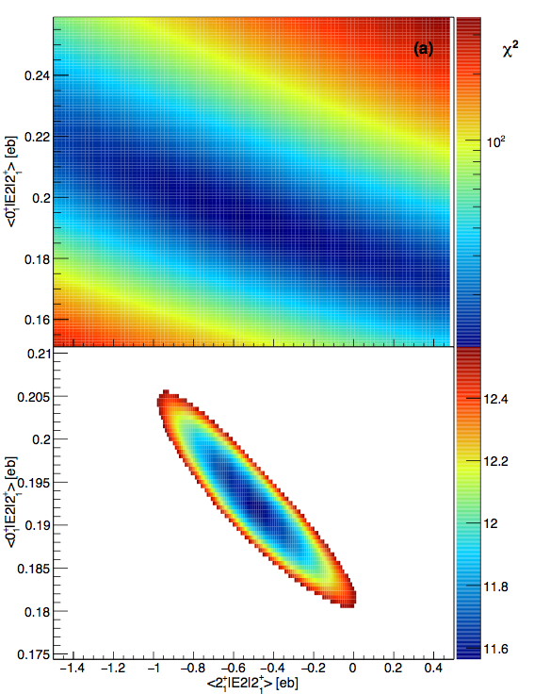
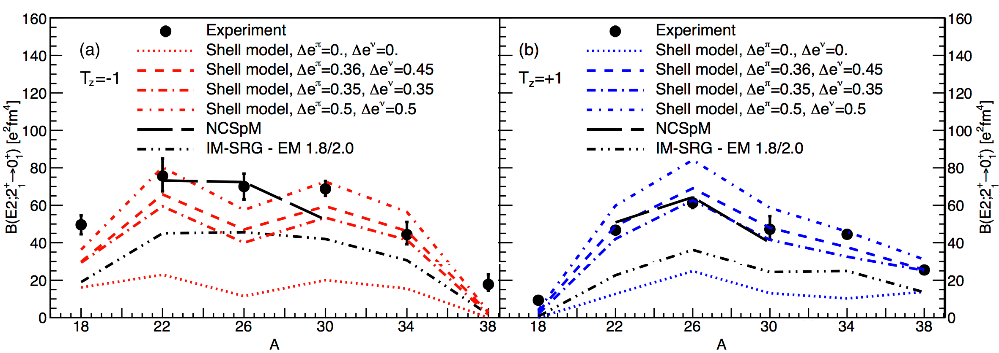
Testing microscopic descriptions of collectivity
Use GOSIA Coulomb-excitation code to extract matrix elements
Compare with NCSpM (LSU) and VS-IM-SRG (TRIUMF)
  NCSpM - does excellent job - expensive calculations
  VS-IM-SRG underpredicts strength - relatively inexpensive - qualitative description excellent
Henderson et al., PLB

Slide 75
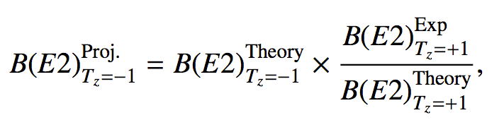
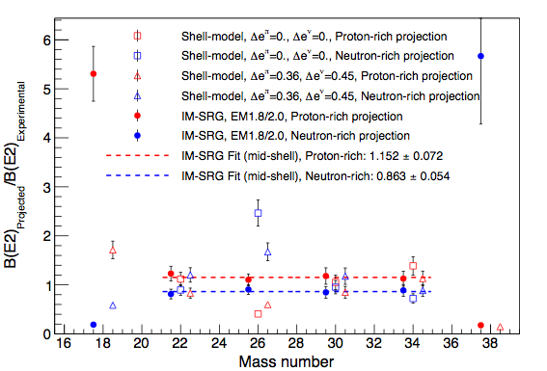
Testing microscopic descriptions of collectivity
Assess nature of missing VS-IM-SRG E2 strength:
If missing E2 strength isoscalar, expected “projected” B(E2) to match experiment
Projected B(E2) consistently 15% over/under predicted by VS-IM-SRG
  Missing strength has consistent isovector component
  Promising for future development
Shell model (USDB) shows no consistent behaviour

Slide 76

Ab Initio 0νββ-Decay Predictions in the Shell Model
Standard SM: phenomenological wavefunctions + bare operator
Ab initio SM: wavefunctions from chiral NN+3N forces + consistent effective operator
Ab initio energies in medium/heavy-mass region
Effective decay operator: decouple valence-space operator
Operator corrections
Two-body currents
✓
✓
S. Leutheusser (UBC/MIT)

Slide 77
Towards big questions: WIMP-Nucleus Scattering
Aim of modern nuclear theory: Develop unified first-principles picture of structure and reactions
- Nuclear forces (low-energy QCD)
- Electroweak physics
- Nuclear many-body problem
WIMP-nucleus direct detection candidates
open-shell, medium/heavy-mass, deformed
¹⁹F,²³Na,²⁷Al,²⁹Si,⁷³Ge; ¹²⁷I,^{129,131}Xe within reach

Slide 78
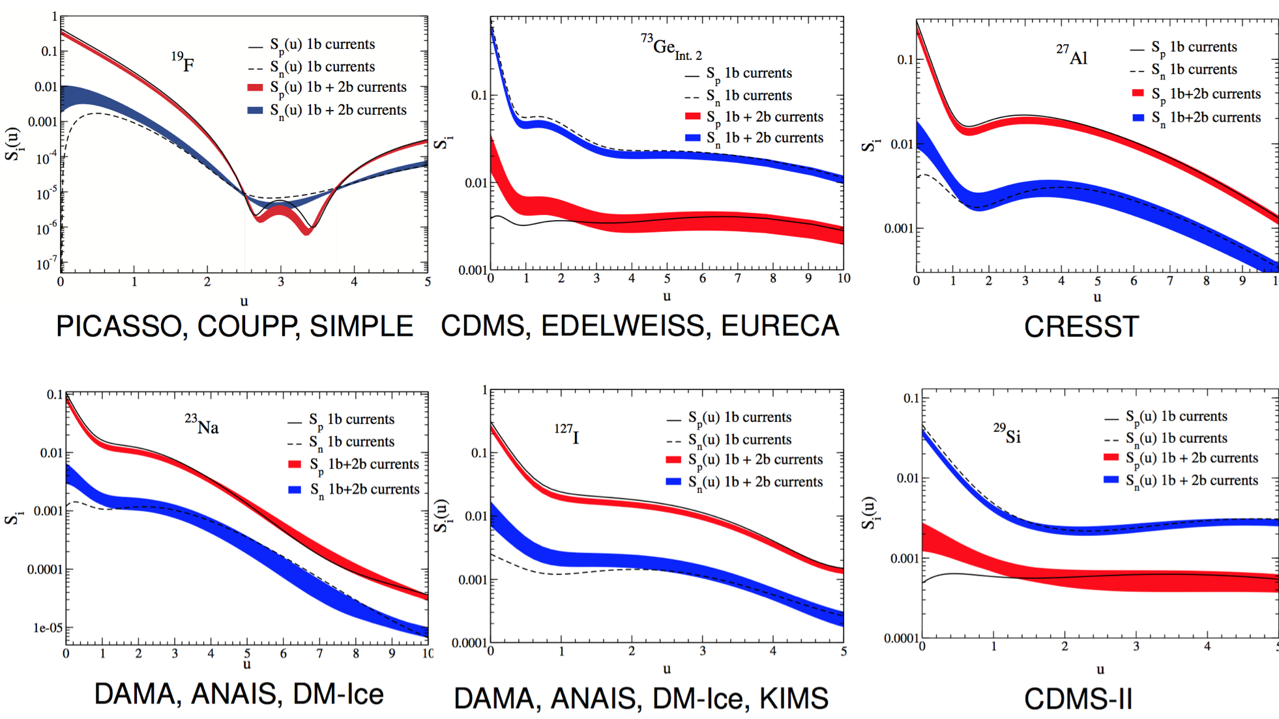
Spin-Dependent Structure Factors
Phenomenological wfs + bare operator (with two-body currents)
✓
Klos et al, PRD (2013)

Slide 79
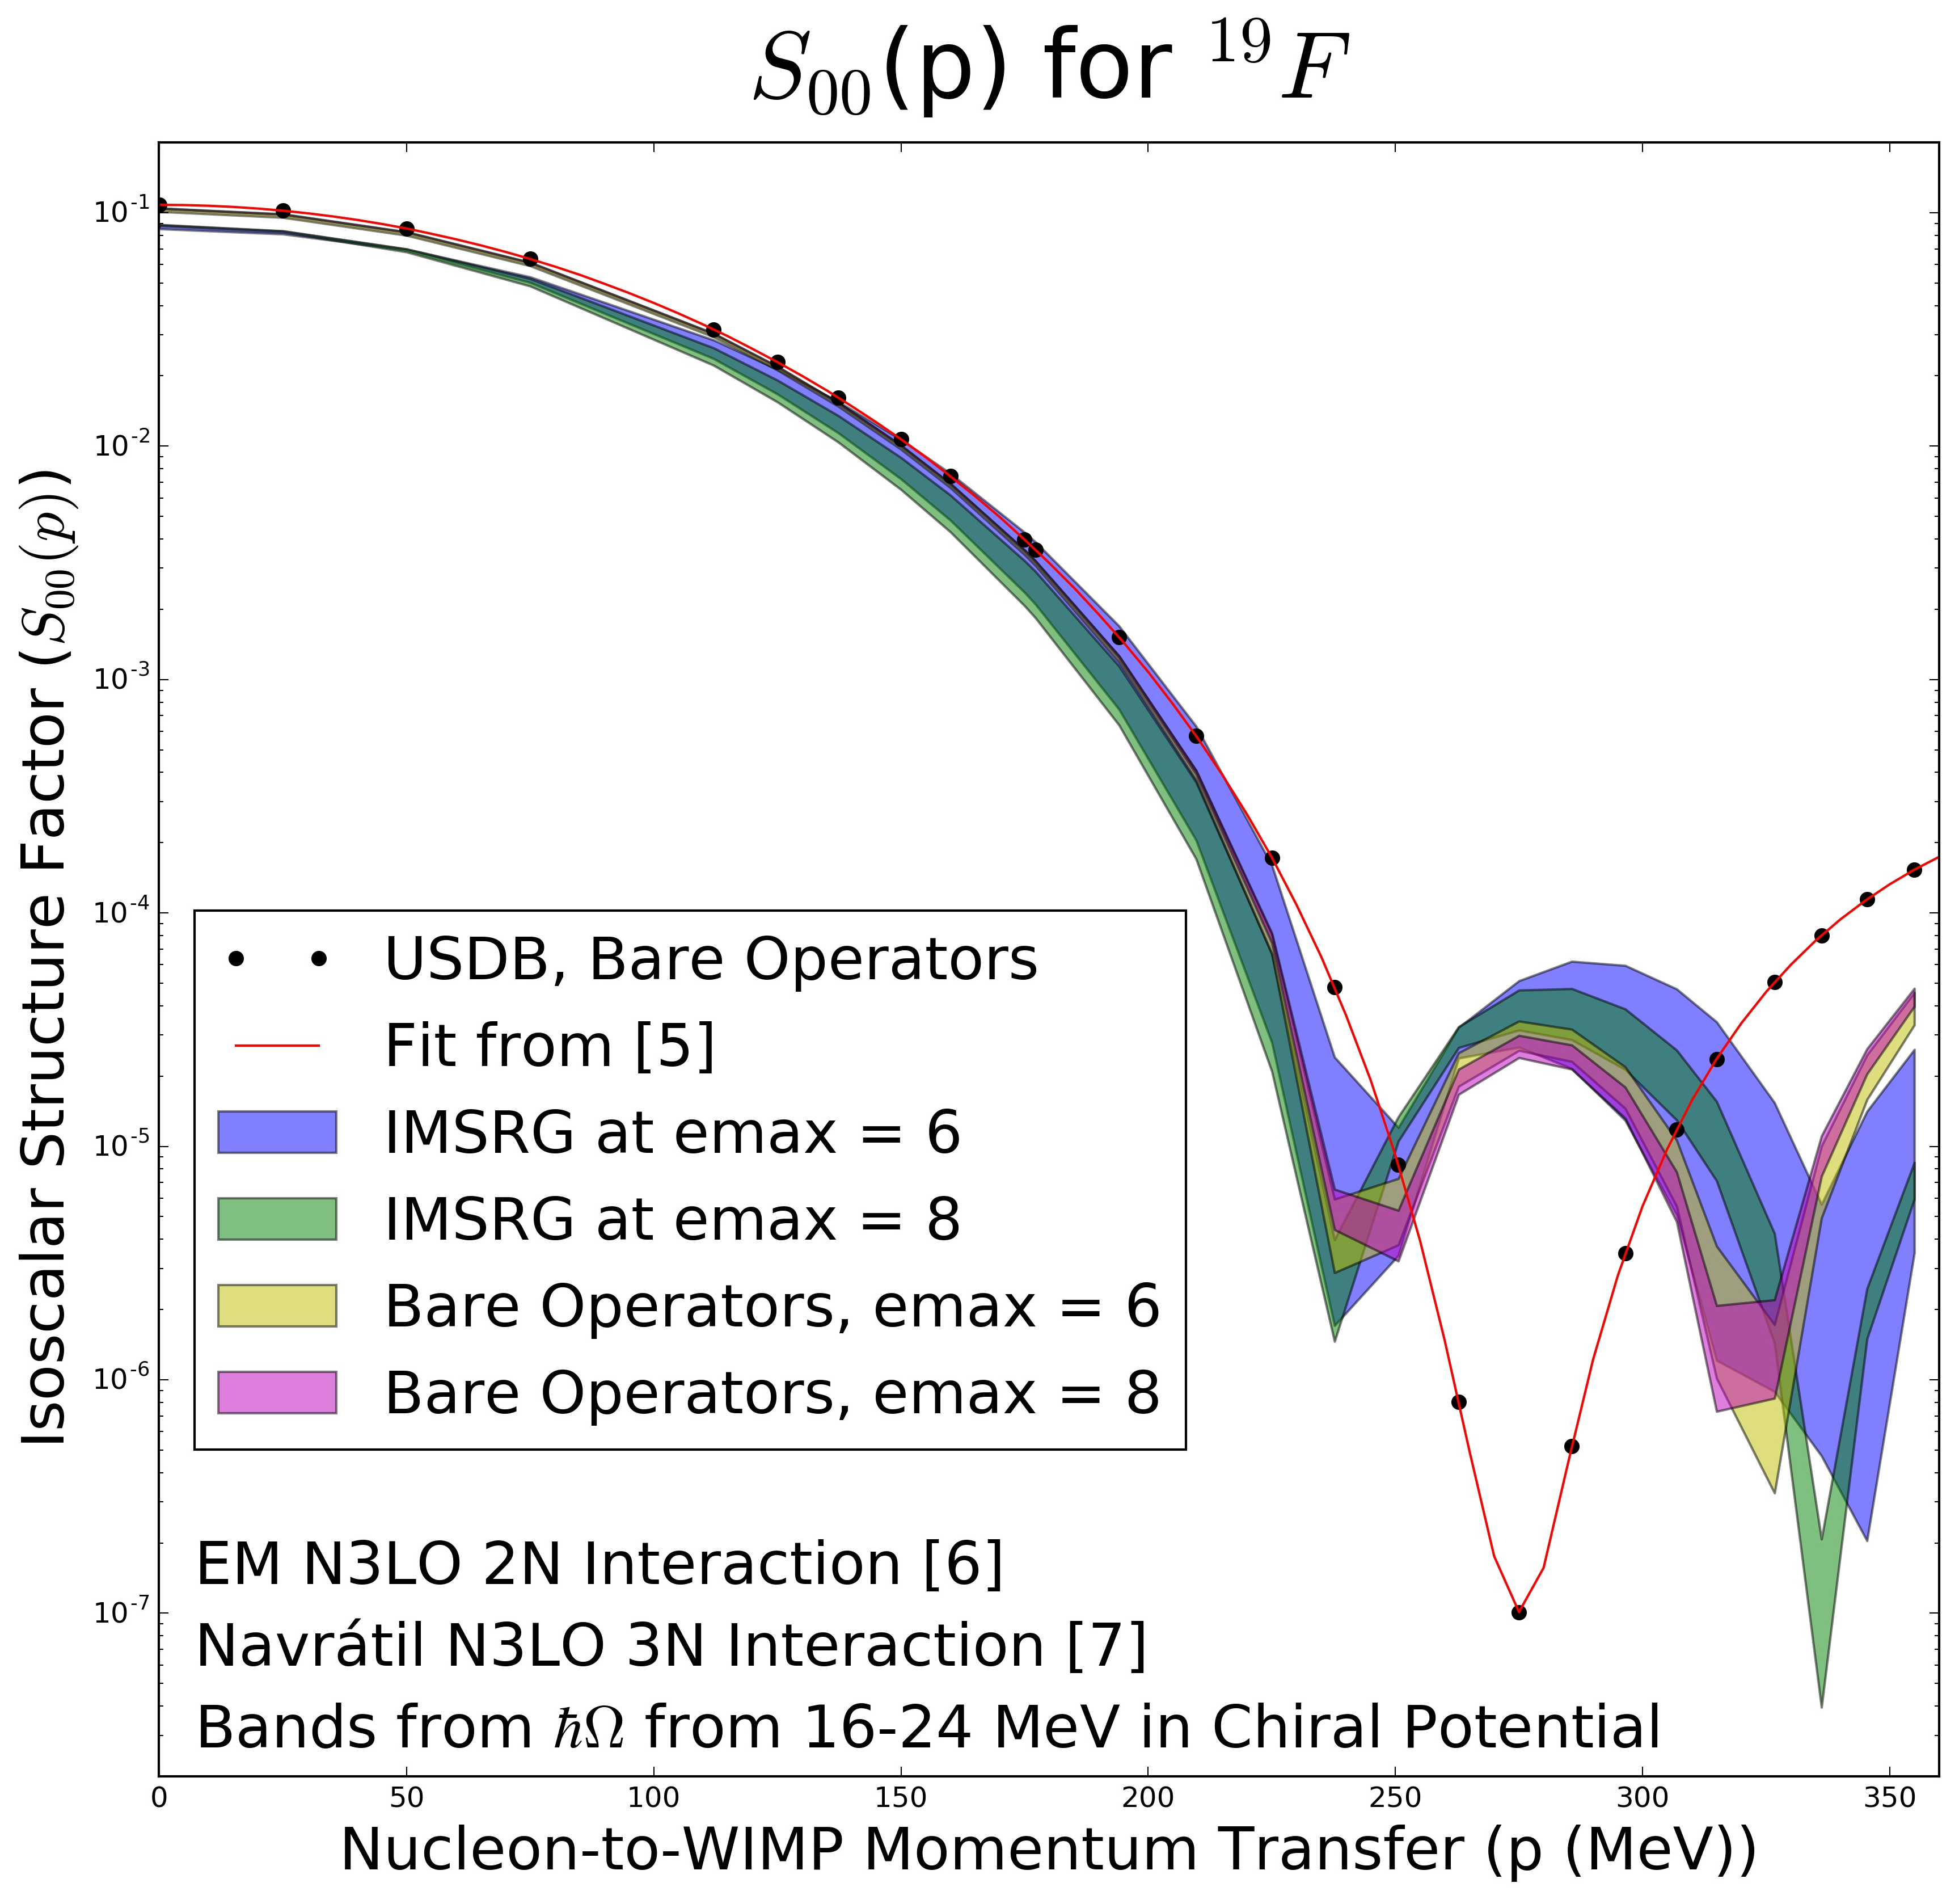
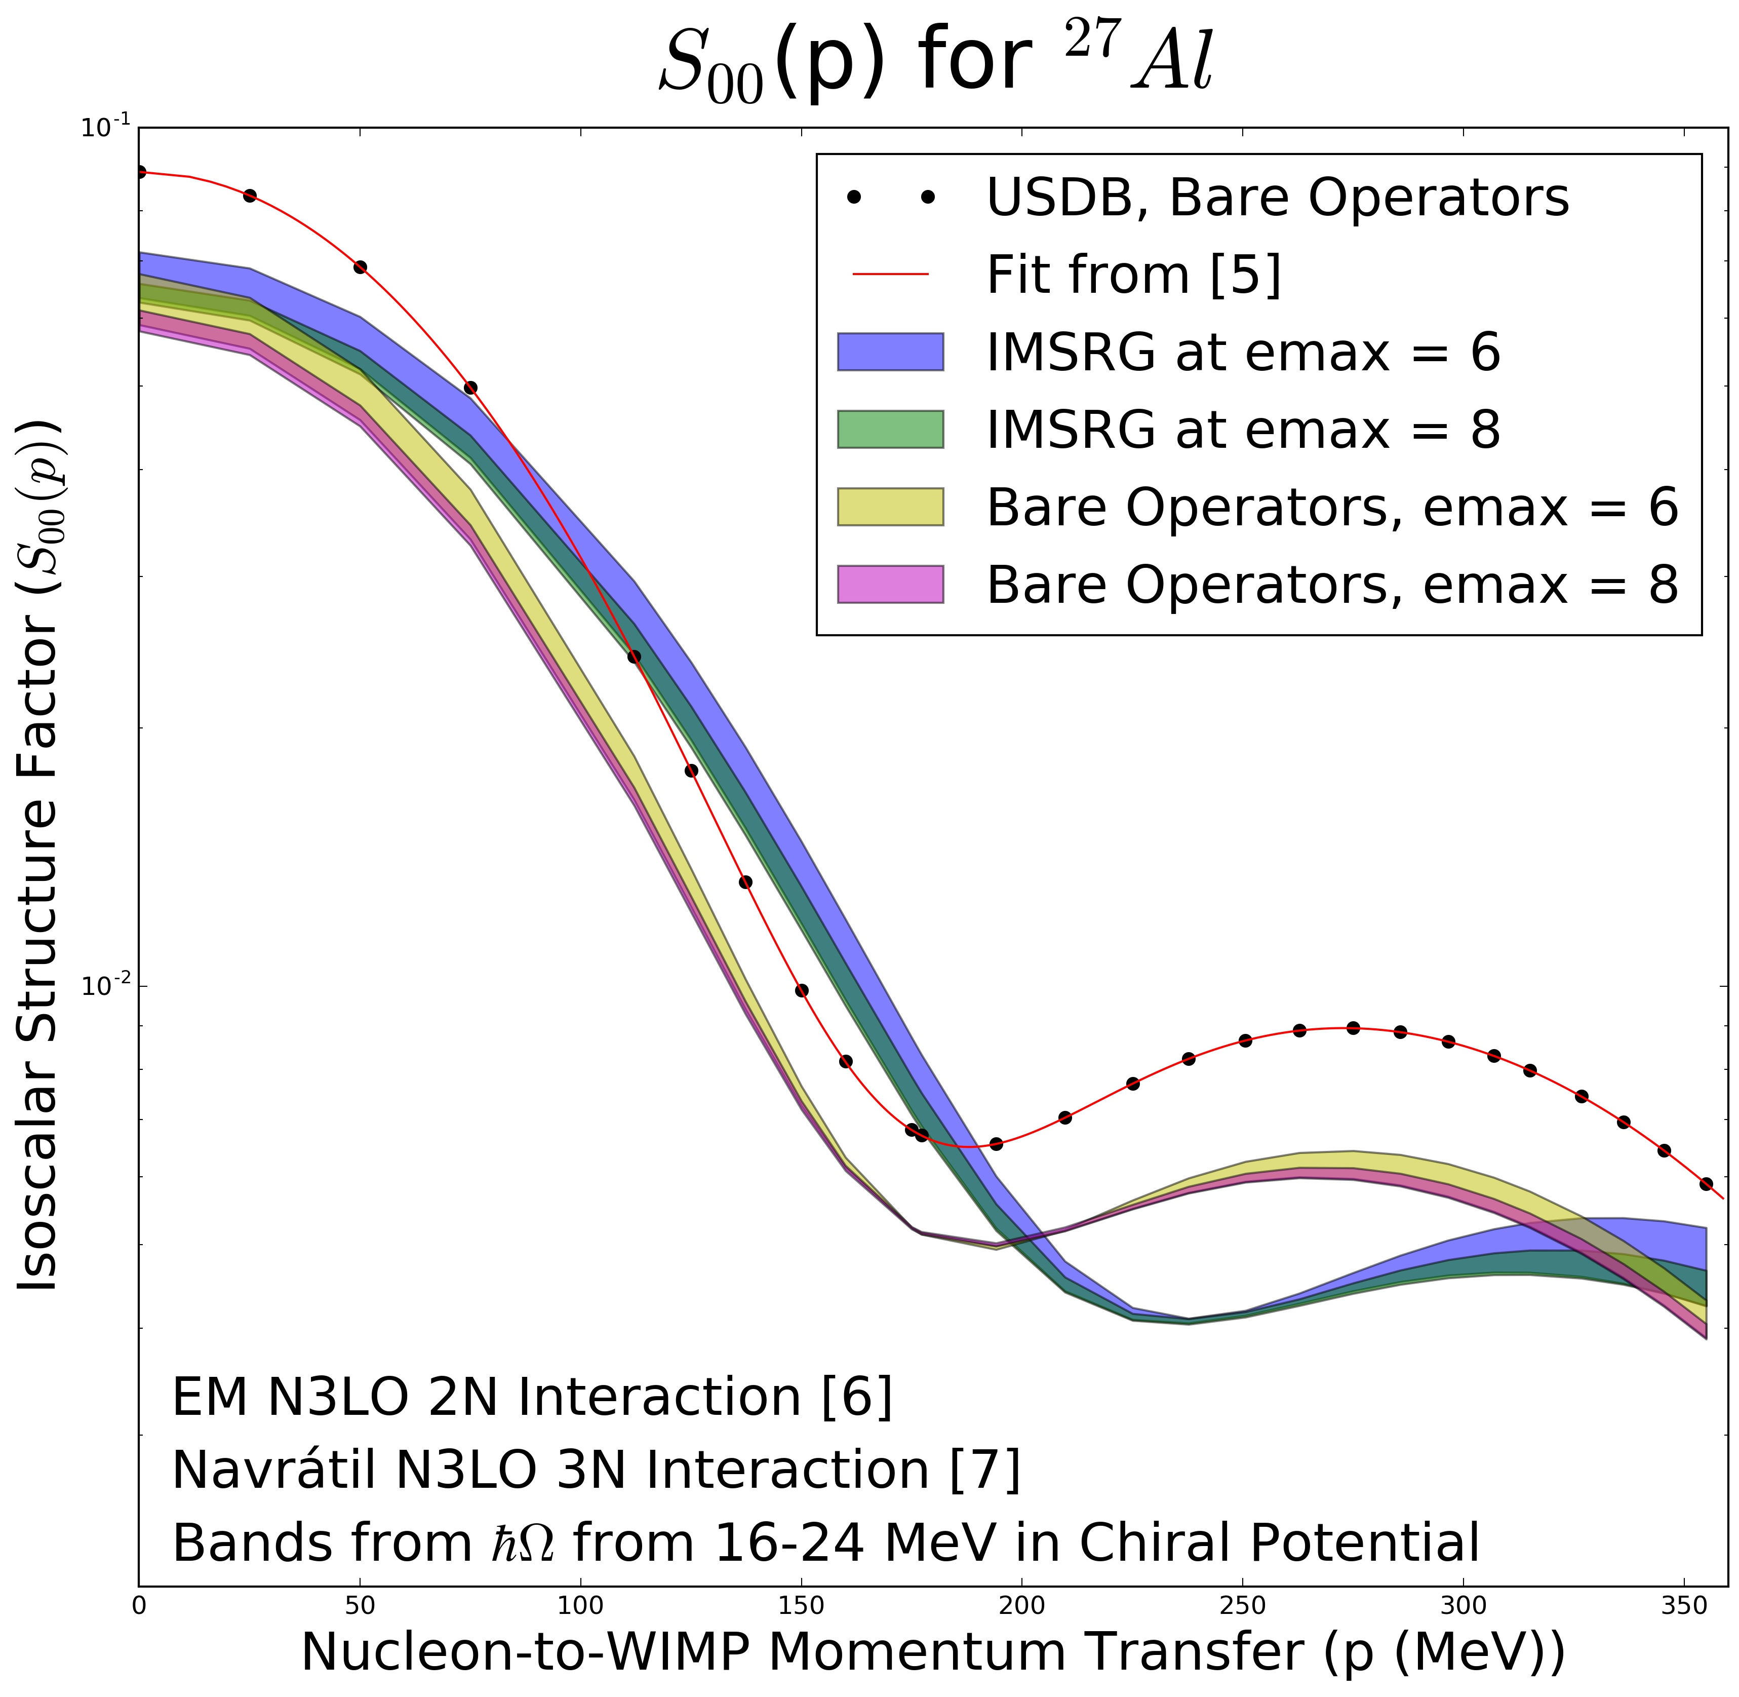
Ab Initio WIMP-Nucleus Response Functions (Isoscalar)
Ab initio: Consistent many-body wfs/operators from chiral NN+3N forces + 2b currents
Leutheusser, Stroberg, Holt

Slide 80
Ground-State Inversion: A Puzzle in ²²Na/⁴⁶Va
Long-standing puzzle: 3p+3n above ¹⁶O/⁴⁰Ca: same 1⁺/3⁺ inversion as in ¹⁰B
Clear improvement with targeted valence space approach – agreement with NCSM for ¹⁰B
Similar improvement in medium mass: first ab initio prediction of 3⁺/1⁺ ordering in ²²Na, ⁴⁶V
Stroberg et al., PRL (2017)

Slide 81
Towards big questions: 0νββ-decay
Aim of modern nuclear theory: Develop unified first-principles picture of structure and reactions
- Nuclear forces (low-energy QCD)
- Electroweak physics
- Nuclear many-body problem
0νββ-decay candidates
open-shell, medium/heavy-mass, deformed
⁴⁸Ca, ⁷⁶Ge, ⁸²Se; ¹³⁰Te, ¹³⁶Xe within reach

Slide 82
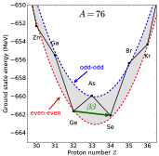
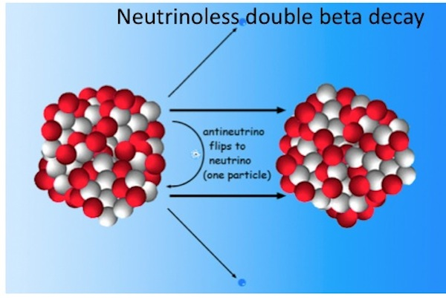
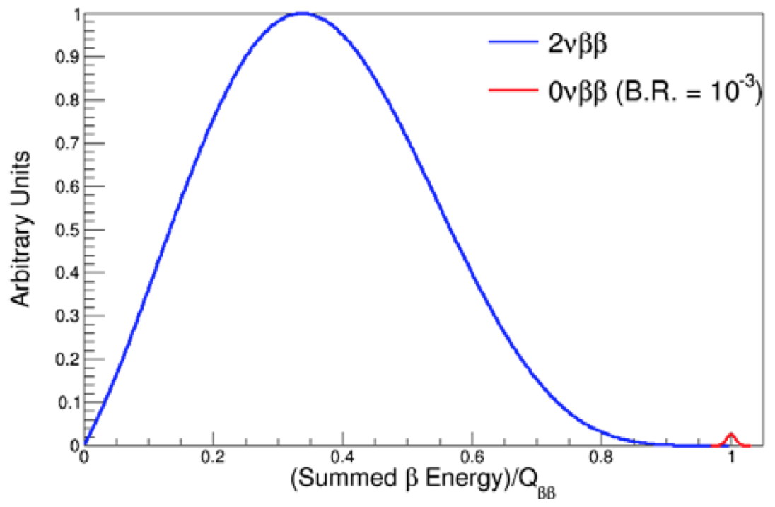
The Next Big Discovery: 0νββ-decay?
Neutrino own antiparticle 0νββ decay
Tremendous impact on BSM physics:
Lepton-number violating process
Majorana character of neutrino
Absolute neutrino mass scale

Slide 83
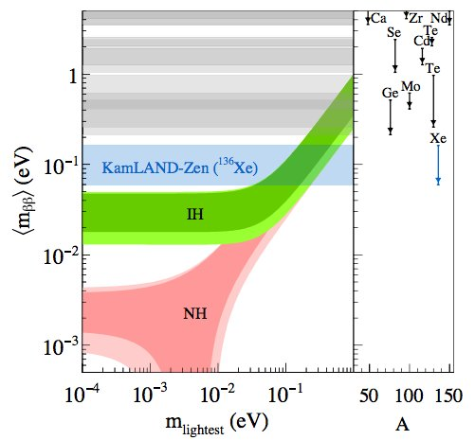
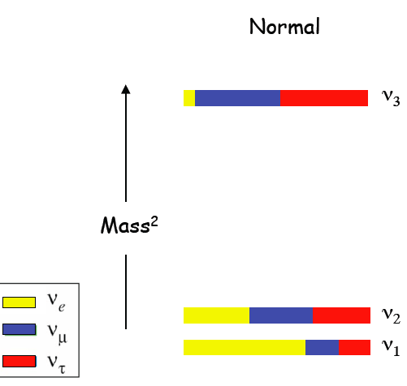
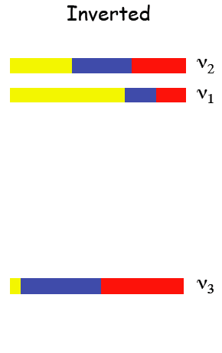
The Next Big Discovery: 0νββ-decay?
Progress in large-scale searches pushing towards IH
Essential ingredient:
Nuclear matrix element

Slide 84
The Next Big Discovery: 0νββ-decay?
Progress in large-scale searches pushing towards IH
Uncertainty from Nuclear Matrix Element; bands do not represent rigorous uncertainties
Essential ingredient:
Nuclear matrix element

Slide 85
0νββ-Decay Nuclear Matrix Element Status
All calculations to date from extrapolated phenomenological models; large spread in results
All models missing essential physics
Impossible to assign rigorous uncertainties
Engel, Menendez (2016)

Slide 86
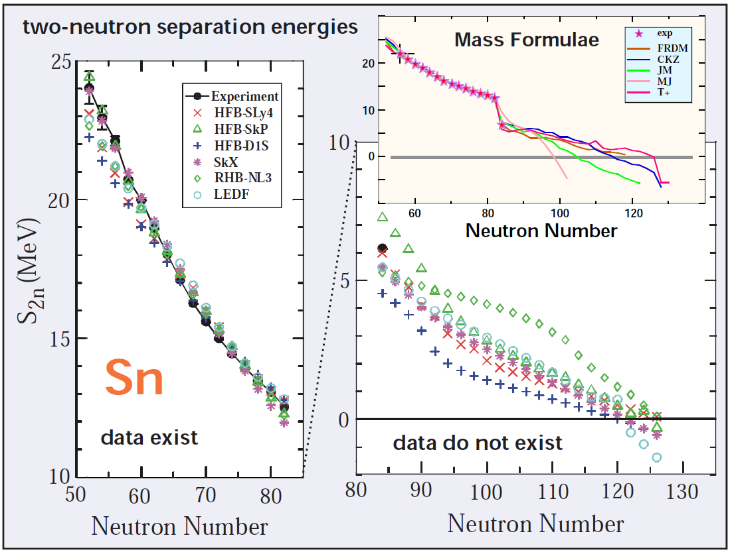
Predictions with Models
How well can nuclear models motivate experiments, predict beyond data?
Analogous picture in 0νββ decay
Double-beta decay matrix elements
Models can extrapolate unreliably
Spread in results ≠ meaningful uncertainty
Engel, Menendez

Slide 87
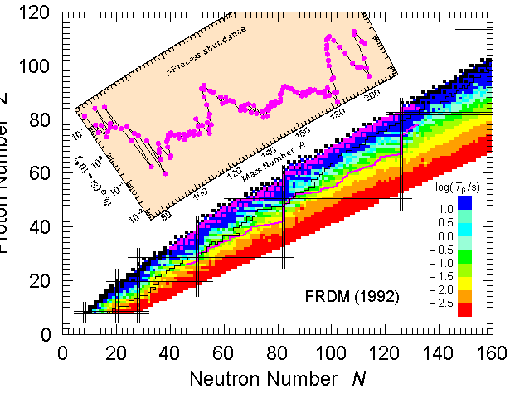
Reach of Ab Initio Methods
Aim of modern nuclear theory: Develop unified first-principles picture of structure and reactions
Approaching region of r-process (major region for future RIB facilities)
Masses and decay rates needed for nucleosynthesis simulations
Many will never be measured – requires input from
sdg
pf
0νββ-decay candidates
open-shell, medium/heavy-mass, deformed
⁴⁸Ca, ⁷⁶Ge, ⁸²Se, ¹³⁰Te, ¹³⁶Xe within reach
sd

Slide 88
Reach of Ab Initio Methods
Aim of modern nuclear theory: Develop unified first-principles picture of structure and reactions
Approaching region of r-process (major region for future RIB facilities)
Masses and decay rates needed for nucleosynthesis simulations
Many will never be measured – requires input from ab initio theory
sdg
pf
0νββ-decay candidates
open-shell, medium/heavy-mass, deformed
⁴⁸Ca, ⁷⁶Ge, ⁸²Se, ¹³⁰Te, ¹³⁶Xe within reach
sd

Slide 89
Testing New Interactions: N3LO NN+3N
New forces at N3LO NN+3N, fit to saturation point
Radii well reproduced, ground states underbound
Drischler et al., arXiv:1710.08220
Drischler et al., arXiv:1710.08220

Slide 90
Testing New Interactions: N3LO NN+3N
New forces at N3LO NN+3N, fit to saturation point
Radii well reproduced, ground states underbound
Drischler et al., arXiv:1710.08220

Slide 91
Effective Valence-Space In-Medium SRG Operators
Explicitly construct unitary transformation from sequence of rotations
Step 1: Decouple core
Step 2: Decouple valence space
Step 3: Decouple additional operators

Slide 92
Two-body Currents in Nuclei
Chiral Effective Field Theory – electroweak currents consistent with nuclear forces
Clear Importance in for M1 transitions in light nuclei

Slide 93
Predictions with Models
How well can nuclear models motivate experiments, predict beyond data?
Work well in regions where
informed by data

Slide 94
Predictions with Models
How well can nuclear models motivate experiments, predict beyond data?
Double-beta decay matrix elements
Often extrapolate unreliably
Spread in results = meaningful uncertainty?

Slide 95
0νββ-Decay Nuclear Matrix Element Status
All calculations to date from extrapolated phenomenological models; large spread in results
All models missing essential physics
Engel, Menendez (2016)

Slide 96
Connection to Infinite Matter: Saturation as a Guide
2015: Best NN+3N forces dramatically overbind in medium/heavy-mass systems
Best interactions not useful for predictions beyond oxygen
Binder et al, PLB (2015)

Slide 97
Connection to Infinite Matter: Saturation as a Guide
2017: NN+3N forces with good saturation properties
Only fit to 2-, 3-, 4-body data: reproduces experiment through ⁷⁸Ni
Experiment/Theory: what data is most useful for constraining chiral forces?
From G. Hagen
Simonis et al, PRC (2017)

Slide 98
Extrapolating Beyond Data
Stark contrast in extrapolations between model extrapolations and ab initio
All ab initio methods in good agreement when starting from same input NN+3N forces
Only informed by 2,3-body data

Slide 99
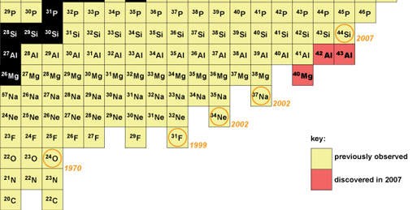
Major Issue: Where Are the Limits of Existence?
Where (and what) is the nuclear dripline?
Limits defined as last isotope with positive neutron separation energy
- Nucleons “drip” out of nucleus
Neutron dripline experimentally established to Z=8
Ab initio prediction
(2016)
Same result from same input NN+3N forces
Already well beyond where fit to data!

Slide 100
Ground-State Properties in sd-Shell: F (Z=9)
Explore ground-state properties throughout medium-mass region
Remarkable agreement with experiment
Probe dripline and beyond
Artifacts at neutron N=20 gap
Z=28
Z=20
Z=8
Z=2
JDH, Stroberg, et al., in preparation

Slide 101
Ground-State Properties in sd-Shell: Ne (Z=10)
Explore ground-state properties throughout medium-mass region
Remarkable agreement with experiment
Probe dripline and beyond
Artifacts at neutron N=20 gap
Z=28
Z=20
Z=8
Z=2
JDH, Stroberg, et al., in preparation

Slide 102
Ground-State Properties in sd-Shell: Na (Z=11)
Explore ground-state properties throughout medium-mass region
Remarkable agreement with experiment
Probe dripline and beyond
Artifacts at neutron N=20 gap
Z=28
Z=20
Z=8
Z=2
JDH, Stroberg, et al., in preparation

Slide 103
Ground-State Properties in sd-Shell: Mg (Z=12)
Explore ground-state properties throughout medium-mass region
Remarkable agreement with experiment
Probe dripline and beyond
Artifacts at neutron N=20 gap
Z=28
Z=20
Z=8
Z=2
JDH, Stroberg, et al., in preparation

Slide 104
Ground-State Properties in sd-Shell: Al (Z=13)
Explore ground-state properties throughout medium-mass region
Remarkable agreement with experiment
Probe dripline and beyond
Artifacts at neutron N=20 gap
Z=28
Z=20
Z=8
Z=2
JDH, Stroberg, et al., in preparation

Slide 105
Ground-State Properties in sd-Shell: Si (Z=14)
Explore ground-state properties throughout medium-mass region
Remarkable agreement with experiment
Probe dripline and beyond
Artifacts at neutron N=20 gap
Z=28
Z=20
Z=8
Z=2
JDH, Stroberg, et al., in preparation

Slide 106
Ground-State Properties in sd-Shell: P (Z=15)
Explore ground-state properties throughout medium-mass region
Remarkable agreement with experiment
Probe dripline and beyond
Artifacts at neutron N=20 gap
Z=28
Z=20
Z=8
Z=2
JDH, Stroberg, et al., in preparation

Slide 107
Ground-State Properties in sd-Shell: S (Z=16)
Explore ground-state properties throughout medium-mass region
Remarkable agreement with experiment
Probe dripline and beyond
Artifacts at neutron N=20 gap
Z=28
Z=20
Z=8
Z=2
JDH, Stroberg, et al., in preparation

Slide 108
Ground-State Properties in sd-Shell: Cl (Z=17)
Explore ground-state properties throughout medium-mass region
Remarkable agreement with experiment
Probe dripline and beyond
Artifacts at neutron N=20 gap
Z=28
Z=20
Z=8
Z=2
JDH, Stroberg, et al., in preparation

Slide 109
Ground-State Properties in sd-Shell: Ar (Z=18)
Explore ground-state properties throughout medium-mass region
Remarkable agreement with experiment
Probe dripline and beyond
Artifacts at neutron N=20 gap
Z=28
Z=20
Z=8
Z=2
JDH, Stroberg, et al., in preparation

Slide 110
Ground-State Properties in sd-Shell: K (Z=19)
Explore ground-state properties throughout medium-mass region
Remarkable agreement with experiment
Probe dripline and beyond
Artifacts at neutron N=20 gap
Z=28
Z=20
Z=8
Z=2
JDH, Stroberg, et al., in preparation

Slide 111
Ground-State Properties in pf-Shell: Ca (Z=20)
Explore ground-state properties throughout medium-mass region
Remarkable agreement with experiment
Probe dripline and beyond
Artifacts at neutron N=40 gap
Z=28
Z=20
Z=8
Z=2
JDH, Stroberg, et al., in preparation

Slide 112
Ground-State Properties in pf-Shell: Sc (Z=21)
Explore ground-state properties throughout medium-mass region
Remarkable agreement with experiment
Probe dripline and beyond
Artifacts at neutron N=40 gap
Z=28
Z=20
Z=8
Z=2
JDH, Stroberg, et al., in preparation

Slide 113
Ground-State Properties in pf-Shell: Ti (Z=22)
Explore ground-state properties throughout medium-mass region
Remarkable agreement with experiment
Probe dripline and beyond
Artifacts at neutron N=40 gap
Z=28
Z=20
Z=8
Z=2
JDH, Stroberg, et al., in preparation

Slide 114
Ab Initio 0νββ-Decay Predictions from Valence-Space IMSRG
Conventional SM: phenomenological wavefunctions
Ab initio SM: wavefunctions from chiral NN+3N forces
Ab initio energies in medium/heavy-mass region
  Valence-space IM-SRG for all medium-mass nuclei

Slide 115
Ab Initio 0νββ-Decay Predictions from Valence-Space IMSRG
Conventional SM: phenomenological wavefunctions
Ab initio SM: wavefunctions from chiral NN+3N forces
Ab initio energies in medium/heavy-mass region
  Valence-space IM-SRG for all medium-mass nuclei
  Deformation challenging for large-space methods

Slide 116
Ab Initio 0νββ-Decay Predictions from Valence-Space IMSRG
Conventional SM: phenomenological wavefunctions
Ab initio SM: wavefunctions from chiral NN+3N forces
Ab initio energies in medium/heavy-mass region
  Valence-space IM-SRG for all medium-mass nuclei
  Deformation challenging for large-space methods
  First ab initio calculation of ⁷⁶Ge/⁷⁶Se
✓

Slide 117
Ab Initio 0νββ-Decay Predictions in the Shell Model
Conventional SM: phenomenological wavefunctions + bare operator
Ab initio SM: wavefunctions from chiral NN+3N forces + consistent effective operator
Ab initio energies in medium/heavy-mass region
Effective decay operator: decouple valence-space operator (analogous to Hamiltonian)
M_{eff}
✓
V_{eff}
M_{eff}
Payne, Stroberg, JDH, Menendez, in preparation

Slide 118
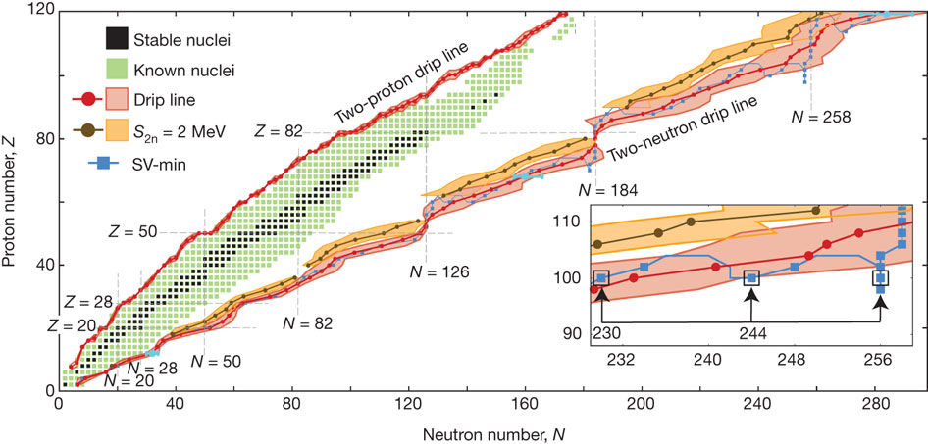
Dripline Prediction from Density Functional Theory
Recent prediction of entire dripline from DFT methods
Uncertainties obtained from varying input functionals
Erler et al, Nature (2011)
Gwak (UBC)

Slide 119
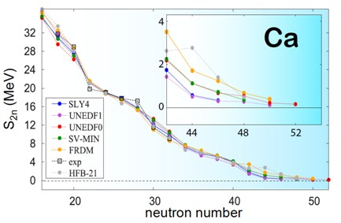
Dripline in Calcium Isotopes: Phenomenology vs. Ab Initio
Stark contrast between ab initio and phenomenological predictions
Is there a “Calcium Anomaly” similar to oxygen?

Slide 120
Dripline in Calcium Isotopes: Phenomenology vs. Ab Initio
Stark contrast between ab initio and phenomenological predictions
Is there a “Calcium Anomaly” similar to oxygen?
Future: dripline to A≈90 to be reached by future RIB facilities! Ni?

Slide 121
Ground-State Properties in pf-Shell: Ni (Z=28)
Explore ground-state properties throughout medium-mass region
Remarkable agreement with experiment
Probe dripline and beyond
Currently extended to ⁸⁰Ni
Z=28
Z=20
Z=8
Z=2
JDH, Stroberg, et al., in preparation

Slide 122
Ground-State Properties Sn (Z=50)
Tin region from 80Zr core: using Importance-Truncated Shell Model
IMSRG fails to decouple valence space for heavier tin isotopes: reached limit?
Z=50
Z=28
Z=20

Slide 123
Magic Numbers in the Calcium Isotopes: Masses
Series of mass measurements ideal example of theory/experiment overlap
Current ab initio picture 2017
TITAN Measurement @ TRIUMF
Flat trend from ⁵⁰⁻⁵²Ca
Mass ⁵²Ca 1.74 MeV from AME
ISOLTRAP Measurement @ CERN
Sharp decrease past ⁵²Ca
Unambiguous closed-shell ⁵²Ca
Test predictions of various models
Ab Initio from NN+3N
Excellent agreement with new data
Reproduces closed-shell ^{48,52}Ca
Weak closed sell signature past ⁵⁴Ca
Future: New RIKEN data
coming soon!
3+ laboratories contributed within few years
Compelling story of exp/theory interplay

Slide 124
Evolution of N=28,32,34 Magic Numbers: Masses
Series of mass measurements ideal example of theory/experiment overlap
Current ab initio picture 2017
New TITAN Measurements of Ti
Probe “dawning” of N=32 magic number
Ab Initio from NN+3N
Generally good agreement, but predicts appearance too early
Future: Evolution to be measured in Ar, Cl at NSCL

Slide 125
Magic Numbers in the Calcium Isotopes: Spectroscopy
Picture of shell structure in calcium ~2012
?
?
Phenomenological Models
Large gap at N=28,32; discrepancy at N=34 (beyond data)
Ab initio theories
Predict all magic numbers; consistent prediction at N=34
Notes:
Just as in atomic physics atoms exhibit closed shell properties when atomic orbitals are filled, so do nuclei
Atomic – more regular - nuclei more intricate structure due to complicated interaction

Slide 126
Magic Numbers in the Calcium Isotopes: Spectroscopy
Picture of shell structure in calcium 2014: New measurement from RIKEN
Phenomenological Models
Readjusted with appearance of new data
Ab initio theories
Correctly predicted excitation energy of N=34
Notes:
Just as in atomic physics atoms exhibit closed shell properties when atomic orbitals are filled, so do nuclei
Atomic – more regular - nuclei more intricate structure due to complicated interaction

Slide 127
Ab Initio 0νββ-Decay Predictions in the Shell Model
Conventional Shell Model: phenomenological wavefunctions
Ab initio valence-space: wavefunctions based on NN+3N forces from chiral EFT
Ab initio energies in medium/heavy-mass region

Slide 128
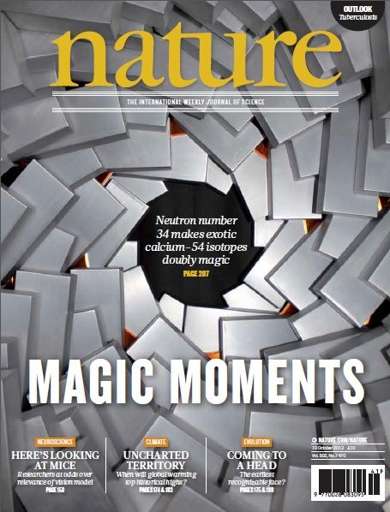
Classic Picture of Nuclear Shell Structure
Picture of shell structure in calcium 2014: New measurement from RIKEN
Phenomenological Models
Readjusted with appearance of new data
Ab initio theories
Correctly predicted excitation energy of N=34
Notes:
Just as in atomic physics atoms exhibit closed shell properties when atomic orbitals are filled, so do nuclei
Atomic – more regular - nuclei more intricate structure due to complicated interaction

Slide 129
Magic Numbers in the Calcium Isotopes: Spectroscopy
Current ab initio picture in Ca/Ni: 2017
Future: New RIKEN data
coming soon!
Ab initio theories
Similar stories in Ni isotopes?
Notes:
Just as in atomic physics atoms exhibit closed shell properties when atomic orbitals are filled, so do nuclei
Atomic – more regular - nuclei more intricate structure due to complicated interaction

Slide 130
Evolution of N=28,32,34 Magic Numbers: Spectroscopy
Current ab initio picture 2017: Predictions of evolution throughout sd shell

Slide 131
Magic Numbers in the Calcium Isotopes: Charge Radii
Charge radii of ^{49,51,52}Ca, obtained from laser spectroscopy experiments at ISOLDE, CERN
Unexpected large charge radius questions the magicity of ⁵²Ca
Theoretical models all underestimate the charge radius
Ab-initio calculations reproduce the trend of charge radii
R. F. Garcia Ruiz et al, Nature Physics (2016)

Slide 132
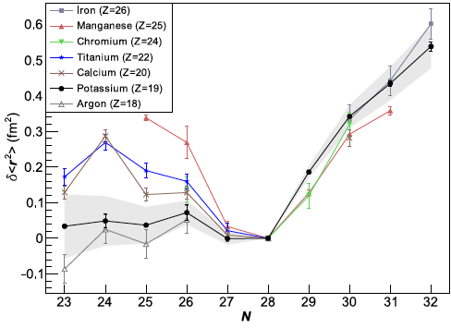
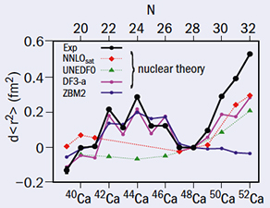
Evolution of Magic Numbers: Radii
Charge radii measured by COLLAPS in K isotopes shows similar trend
Future: further measurements of neutron-rich charge radii near magic numbers needed!

Slide 133
Major Nuclear Structure Issues
Aim of modern nuclear theory: Develop unified first-principles picture of structure and reactions
- Nuclear forces (low-energy QCD)
- Electroweak physics
- Nuclear many-body problem
Major Nuclear Structure Issues
1) How do nuclei, processes emerge from fundamental interactions of nature?
2) What are the limits of existence of matter? Is there an underlying mechanism?
3) How do magic numbers evolve?
Astrophysics, fundamental symmetries connections (mostly) not discussed
“The nuclear magic numbers are kind of giving way — the dogma begins to break down and the rules of the game have to be expanded.”

Slide 134
Major Nuclear Structure Issues
Aim of modern nuclear theory: Develop unified first-principles picture of structure and reactions
- Nuclear forces (low-energy QCD)
- Electroweak physics
- Nuclear many-body problem
Major Nuclear Structure Issues
1) How do nuclei, processes emerge from fundamental interactions of nature?
2) What are the limits of existence of matter? Is there an underlying mechanism?
3) How do magic numbers evolve? Is there a new paradigm for magic numbers?
Astrophysics, fundamental symmetries connections (mostly) not discussed
“The nuclear magic numbers are kind of giving way — the dogma begins to break down and the rules of the game have to be expanded.”

Slide 135
Major Nuclear Structure Issues
Aim of modern nuclear theory: Develop unified first-principles picture of structure and reactions
- Nuclear forces (low-energy QCD)
- Electroweak physics
- Nuclear many-body problem
Major Nuclear Structure Issues
1) How do nuclei, processes emerge from fundamental interactions of nature?
2) What are the limits of existence of matter? Is there an underlying mechanism?
3) How do magic numbers evolve? Is there a new paradigm for magic numbers?
4) How do novel quantum phenomena (skins, halos, etc) arise in nuclei?
Astrophysics, fundamental symmetries connections (mostly) not discussed

Slide 136
Super Allowed Gamow-Teller Decay of ¹⁰⁰Sn
Coupled-Cluster calculations factor of 3 too large without MEC

Slide 137
Super Allowed Gamow-Teller Decay of ¹⁰⁰Sn
Coupled-Cluster calculations factor of 3 too large without MEC
Future needs: precision measurements o of large GT matrix elements ³⁴S, ⁴⁸Ni, ¹⁰⁰Sn
Significant suppression from MEC

Slide 138
Ab Initio 0νββ-Decay Predictions
Standard SM: phenomenological wavefunctions + bare operator
Ab initio SM: wavefunctions from chiral NN+3N forces + consistent effective operator
Ab initio energies in medium/heavy-mass region
Effective decay operator: decouple valence-space operator
✓
C. Payne (UBC)
⁴⁸Ca | Bare GT | 0.79 | Bare F | 0.14
 | IMSRG/CC | 0.48/0.45 | IMSRG/CC | 0.16/0.11

Slide 139
Theory for Next-Generation RIB Facilities
Fundamental physics
Effective electroweak operators: M1, GT,...
Effective 0νββ decay operator
WIMP-Nucleus scattering
Superallowed transitions
Ab initio valence-shell Hamiltonians
ab initio prediction of nuclear driplines/r-process
Islands of inversion, new magic numbers
Outstanding issues
Controlled many-body approximation
E2 operators problematic
Continuum essential beyond stability
Quantify uncertainties
Experimental overlap
Best data for constraining nuclear forces
New measurements of driplines
Data on magic numbers in exotic nuclei
Precision data on GT transitions

Slide 140
Reach of Ab Initio Methods
Aim of modern nuclear theory:
Develop unified first-principles picture
of structure and reactions
- Nuclear forces (low-energy QCD)
- Electroweak physics
- Nuclear many-body problem
Outstanding issues/limitations
Large valence-space dimensions
Large size of 3N force files
sdg
pf
0νββ-decay candidates
open-shell, medium/heavy-mass, deformed
⁴⁸Ca, ⁷⁶Ge, ⁸²Se, ¹³⁰Te, ¹³⁶Xe within reach
sd

Slide 141
Reach of Ab Initio Methods
Aim of modern nuclear theory:
Develop unified first-principles picture
of structure and reactions
- Nuclear forces (low-energy QCD)
- Electroweak physics
- Nuclear many-body problem
Outstanding issues/limitations
Large valence-space dimensions
Large size of 3N force files
Extend drip line predictions
Approaching region of r-process
sdg
pf
0νββ-decay candidates
open-shell, medium/heavy-mass, deformed
⁴⁸Ca, ⁷⁶Ge, ⁸²Se, ¹³⁰Te, ¹³⁶Xe within reach
sd

Slide 142
Ab Initio GT Transitions from Valence-Space IMSRG
General one-body tensor operators for valence-space IMSRG: Gamow-Teller
First ab initio valence-space calculations of GT transition rates
Small renormalization effect
Stroberg, et al.

Slide 143
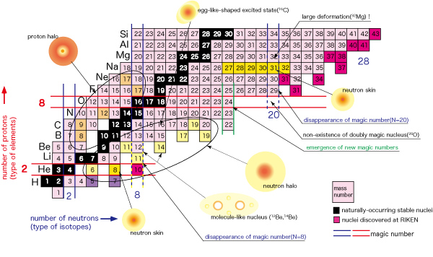


Tremendous Progress in Light Nuclei
What are the properties of proton/neutron-rich matter (Halo structures)?
Ab initio reactions for astrophysics and energy generation
Collective phenomena from first principles?
12 fm
7 fm
Notes:
Orient us to regions of interest and big problems I’ll hope to answer
Know as we move away from valley of stab, textbook picture of nuclear structure doesn’t hold
Understanding the unexplored region and the evolution of structure as we move into it constitutes one of the central challenges of modern science

Slide 144
Gamow-Teller Quenching Across the Chart
Coupled-Cluster calculations of GT decay including two-body currents
Describes quenching well from light systems to Sn – IMSRG calculations in progress

Slide 145
Ab Initio 0νββ-Decay Predictions from Valence-Space IMSRG
Conventional SM: phenomenological wavefunctions
Ab initio SM: wavefunctions from chiral NN+3N forces
Ab initio energies in medium/heavy-mass region
  Valence-space IM-SRG for all medium-mass nuclei

Slide 146
Ab Initio 0νββ-Decay Predictions in the Shell Model
Conventional Shell Model: phenomenological wavefunctions
Ab initio valence-space: wavefunctions based on NN+3N forces from chiral EFT
Ab initio energies in medium/heavy-mass region

Slide 147
Ab Initio 0νββ-Decay Predictions from Valence-Space IMSRG
Conventional SM: phenomenological wavefunctions
Ab initio SM: wavefunctions from chiral NN+3N forces
Ab initio energies in medium/heavy-mass region
  Valence-space IM-SRG for all medium-mass nuclei
  Deformation challenging for large-space methods

Slide 148
Ab Initio 0νββ-Decay Predictions from Valence-Space IMSRG
Conventional SM: phenomenological wavefunctions
Ab initio SM: wavefunctions from chiral NN+3N forces
Ab initio energies in medium/heavy-mass region
  Valence-space IM-SRG for all medium-mass nuclei
  Deformation challenging for large-space methods
  First ab initio calculation of ⁷⁶Ge/⁷⁶Se
✓

Slide 149
Ab Initio 0νββ-Decay Predictions in the Shell Model
Conventional SM: phenomenological wavefunctions + bare operator
Ab initio SM: wavefunctions from chiral NN+3N forces + consistent effective operator
Ab initio energies in medium/heavy-mass region
Effective decay operator: decouple valence-space operator (analogous to Hamiltonian)
M_{eff}
✓
V_{eff}
M_{eff}

Slide 150
Ab Initio 0νββ-Decay Predictions in the Shell Model
Standard SM: phenomenological wavefunctions + bare operator
Ab initio SM: wavefunctions from chiral NN+3N forces + consistent effective operator
Ab initio energies in medium/heavy-mass region
Effective decay operator: decouple valence-space operator
✓
C. Payne (UBC)
⁴⁸Ca | Bare GT | 0.79 | Bare F | 0.14
 | IMSRG/CC | 0.48/0.45 | IMSRG/CC | 0.16/0.11

Slide 151
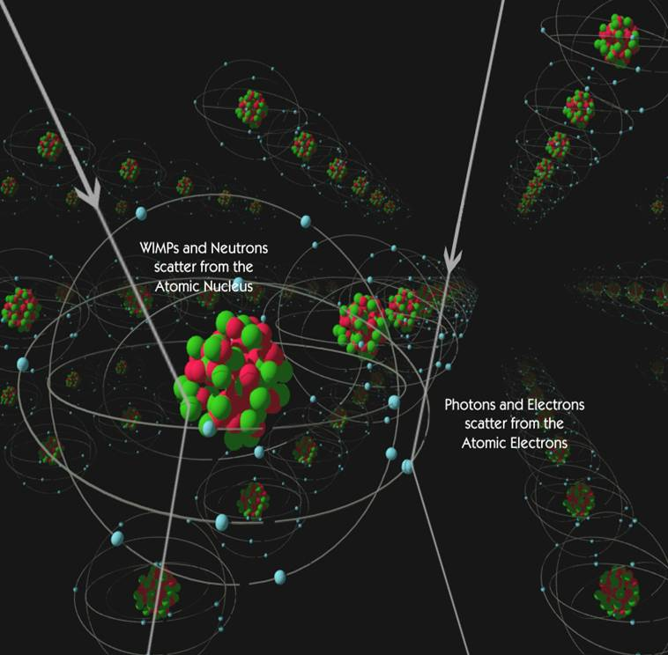
Ab Inito WIMP-Nucleus Scattering
Standard SM: phenomenological wavefunctions + bare operator
Ab initio SM: wavefunctions from chiral NN+3N forces
Ab initio energies in medium/heavy-mass region
✓

Slide 152
Ab Inito WIMP-Nucleus Scattering
Standard SM: phenomenological wavefunctions + bare operator
Ab initio SM: wavefunctions from chiral NN+3N forces + consistent effective operator
Ab initio energies in medium/heavy-mass region
Effective scattering operator: decouple valence-space operator
✓
✓

Slide 153

Ab Initio 0νββ-Decay Predictions in the Shell Model
Standard SM: phenomenological wavefunctions + bare operator
Ab initio SM: wavefunctions from chiral NN+3N forces + consistent effective operator
Ab initio energies in medium/heavy-mass region
Effective decay operator: decouple valence-space operator
Operator corrections
Two-body currents
✓
S. Leutheusser (UBC/MIT)

Slide 154
Ab Initio 0νββ-Decay Predictions in the Shell Model
Standard SM: phenomenological wavefunctions + bare operator
Ab initio SM: wavefunctions from chiral NN+3N forces + consistent effective operator
Ab initio energies in medium/heavy-mass region
Effective decay operator: decouple valence-space operator
Operator corrections
Two-body currents
Exotic exchange mechanisms
Free-space SRG evolution of operators
✓
C. Payne (UBC)
S. Leutheusser (UBC/MIT)
M. Horoi
P. Navrátil, S. Quaglioni

Slide 155
Ab Initio 0νββ-Decay Predictions in the Shell Model
Standard SM: phenomenological wavefunctions + bare operator
Ab initio SM: wavefunctions from chiral NN+3N forces + consistent effective operator
Ab initio energies in medium/heavy-mass region
Effective decay operator: decouple valence-space operator
Operator corrections
Two-body currents
Exotic exchange mechanisms
Free-space SRG evolution of operators
Insights from particle physics
✓
S. Leutheusser (UBC/MIT)
M. Horoi
P. Navrátil, S. Quaglioni

Slide 156
Ab Inito WIMP-Nucleus Scattering
Standard SM: phenomenological wavefunctions + bare operator (with two-body currents)
✓
Klos, Menendez, Gazit, Schwenk, PRD (2013)

Slide 157
Neutrinoless Double-Beta (0νββ) Decay
Neutrino own antiparticle nuclei undergo 0νββ decay
Tremendous impact on BSM physics:
Confirm Majorana character of neutrino
Lepton-number violation (by two units)

Slide 158
The Nuclear Matrix Element
Recent calculations of NME: pronounced differences between phenomenological models
Shell model (SM): exact correlations
in truncated single-particle space
QRPA, IBM: schematic correlations
in larger single-particle space
No model includes all relevant physics
Engel, Menendez

Slide 159
The Nuclear Matrix Element
Recent calculations of NME: pronounced differences between phenomenological models
Shell model (SM): exact correlations
in truncated single-particle space
QRPA, IBM: schematic correlations
in larger single-particle space
No model includes all relevant physics
Phenomenology can extrapolate unreliably
Engel, Menendez

Slide 160
Ab Initio 0νββ-Decay Predictions in the Shell Model
Conventional Shell Model: phenomenological wavefunctions

Slide 161
Magic Numbers in the Calcium Isotopes: Masses
Series of mass measurements ideal example of theory/exp overlap
Addition of 3N forces predicted shell closure in ⁴⁸Ca
TITAN Measurement
Flat trend from ⁵⁰⁻⁵²Ca
Mass ⁵²Ca 1.74 MeV from AME
ISOLTRAP Measurement
Sharp decrease past ⁵²Ca
Unambiguous closed-shell ⁵²Ca
Test predictions of various models
Ab Initio from NN+3N
Excellent agreement with new data
Reproduces closed-shell ^{48,52}Ca
Weak closed sell signature past ⁵⁴Ca
DFT
No reproduction of S_{2n} structure
Wienholtz et al., Nature (2013)

Slide 162
Ab Initio 0νββ-Decay Predictions in the Shell Model
Conventional Shell Model: phenomenological wavefunctions
Ab initio valence-space: wavefunctions based on NN+3N forces from chiral EFT
Ab initio energies in medium/heavy-mass region

Slide 163

The Nuclear Many-Body Problem
Nucleus strongly interacting many-body system – full A-body problem impossible
Large space: controlled approximations to full Schrödinger Equation
Valence space: diagonalize effective valence-space Hamiltonian
In-Medium SRG
Coupled Cluster
Green’s Function
Perturbation Theory
Large-space approach
Valence-space approach
Limited range:
Closed shell ±1
Even-even (spherical)
Limited properties:
Ground states
Some excited states
All nuclei near
closed shells
All properties
Ground states
Excited states
Transitions
Deformation

Slide 164
Normal Ordering
Normal order NN+3N Hamiltonian wrt some reference state (eg, uncorrelated HF)
Naïve first attempt: Take NO reference to be inert core (3N only between core/valence)
One valence-space Hamiltonian for, eg, entire sd-shell

Slide 165
Ground States: Oxygen Isotopes
Large/valence-space methods with same SRG-evolved NN+3N-full forces
Agreement between all methods with same input forces
Discrepancy between valence/large-space results
NN+3N-full
Bogner et al., PRL 2014
Hebeler, JDH, Menéndez, Schwenk, ARNPS 2015

Slide 166
Targeted Normal Ordering
Targeted Normal Ordering: take nearest closed shell as reference slater determinant
Still decouple sd valence space in IMSRG: several VS Hamiltonians

Slide 167
Ground States: Oxygen Isotopes
Large/valence-space methods with same SRG-evolved NN+3N-full forces
Agreement between all methods with same input forces
Discrepancy between valence/large-space results
NN+3N-full
Bogner et al., PRL 2014
Hebeler, JDH, Menéndez, Schwenk, ARNPS 2015

Slide 168
Ground States: Oxygen Isotopes
Large/valence-space methods with same SRG-evolved NN+3N-full forces
Agreement between all methods with same input forces
Capture 3N forces between valence nucleons
“Targeted normal ordering” results agree well with large-space methods
NN+3N-full
NN+3N-full
Hebeler, JDH, Menéndez, Schwenk, ARNPS 2015

Slide 169
Ab Initio 0νββ-Decay Predictions in the Shell Model
Conventional SM: phenomenological wavefunctions + bare operator
Ab initio SM: wavefunctions from chiral NN+3N forces + consistent effective operator
Ab initio energies in medium/heavy-mass region
Effective decay operator: decouple valence-space operator (analogous to Hamiltonian)
M_{eff}
✓
V_{eff}
M_{eff}
Payne, Stroberg, Engel, JDH, in preparation

Slide 170
Effective Operator from Perturbation Theory
First attempts to quantify physics of effective operator from MBPT
Nonperturbative method necessary
⁴⁸Ca | Bare | 0.77
 | Effective | 1.30
M_{eff}
⁷⁶Ge | Bare | 3.12
 | Effective | 3.77
⁸²Se | Bare | 2.73
 | Effective | 3.62
Lincoln et al., PRL 2013
JDH and Engel, PRC 2013
Kwiatkowski et al., PRC 2014
Overall ~25-30% increase for ⁷⁶Ge, ⁸²Se; 75% for ⁴⁸Ca

Slide 171
Valence-Space In-Medium SRG 0νββ-Decay Operator
Explicitly construct unitary transformation from sequence of rotations
Step 1: Decouple core
Step 2: Decouple valence space
Step 3: Decouple additional operators

Slide 172
Ab Initio GT Transitions from Valence-Space IMSRG
General one-body tensor operators developed for valence-space IMSRG: Gamow-Teller
First ab initio valence-space calculations of GT transition rates
Small renormalization effect, but (mostly) reasonable agreement with experiment
Stroberg et al., in prep

Slide 173
Results

Slide 174
eMax convergence in Ca (Z=20)
Explore ground-state properties throughout medium-mass region
Remarkable agreement with experiment
Probe dripline and beyond
Artifacts at neutron N=20 gap
Z=28
Z=20
Z=8
Z=2
JDH, Stroberg, et al., in preparation

Slide 175
eMax convergence in Ca (Z=20)
Explore ground-state properties throughout medium-mass region
Remarkable agreement with experiment
Probe dripline and beyond
Artifacts at neutron N=20 gap
Z=28
Z=20
Z=8
Z=2
JDH, Stroberg, et al., in preparation

Slide 176
Puzzle: High 2+ Energies in Doubly Magic Nuclei
High first excited states in ⁴⁸Ca, ⁵⁶Ni, ¹⁰⁰Sn
Clue: CC 2p2h gives very similar results – significant improvement from 3p3h
Ca

Slide 177
¹⁰⁰Sn: “A Nucleus of Superlatives” _{– G. Hagen}
Diagonalization impossible for sdg valence space: Importance-Truncated Shell Model
Ground and first excited states nearly degenerate (as in experiment)

Slide 178
¹⁰⁰Sn: “A Nucleus of Superlatives” _{– G. Hagen}
Diagonalization impossible for sdg valence space: Importance-Truncated Shell Model
Ground and first excited states nearly degenerate (as in experiment)
Ground-state flip in ¹⁰³Sn

Slide 179
¹⁰⁰Sn: “A Nucleus of Superlatives” _{– G. Hagen}
Diagonalization impossible for sdg valence space: Importance-Truncated Shell Model
Preliminary calculations expect 105Te ground state to be 5/2+
Subtle normal-ordering change flips ground state

Slide 180
¹⁰⁰Sn: “A Nucleus of Superlatives” _{– G. Hagen}
Puzzle in first excited state in 100Sn
IT-SM calculations break down past 115Sn
Reasonable agreement for 2+ energies

Slide 181
¹⁰⁰Sn: “A Nucleus of Expletives” _{– J. Holt}
Puzzle in first excited state in 100Sn
IT-SM calculations break down past 115Sn
Reasonable agreement for 2+ energies

Slide 182
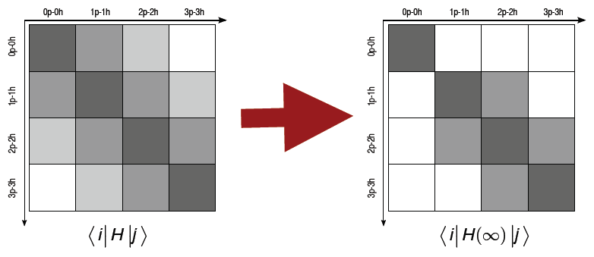
Magnus Expansion
Magnus expansion: explicitly construct unitary transformation
Solve flow equation for:
Leads to commutator expression for evolved Hamiltonian
Nested commutator series – in practice truncate numerically
All calculations truncated at normal-ordered two-body level IMSRG(2)

Slide 183
Deformation in Ab Initio Framework
Prediction of ground-state and gamma bands
Compare with phenomenology in sd-shell nuclei
Stroberg et al., in prep

