Slide 1

Progress Towards Electron-Gamma-Coincidence Experiments
G. Steinhilber, T. Klaus, P. von Neumann-Cosel, N. Pietralla,
V. Ponomarev, J. Wambach
Principle of (e,e‘γ)
Theoretical considerations
Gamma-decay of GDR
Vorticity
Status and Achievements
Schedule
Summary
Supported by DFG within CRC 1245

Slide 2
Outline
Principle of (e,e‘γ)
Theoretical considerations
Gamma-decay of GDR
Vorticity
Status and Achievements
Schedule
Summary

Slide 3
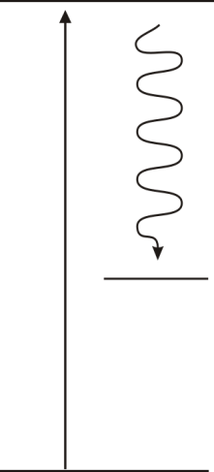
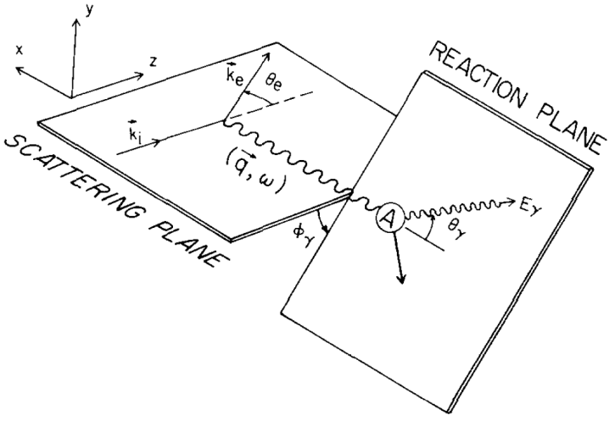
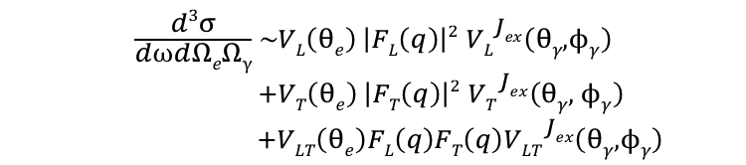
Principle of (e,e’γ)
Inelastic nuclear excitation by electron scattering and coincident detection of prompt γ-decay
E_{γ}
E_{x}
PWBA:
$$\begin{aligned}\frac{d3σ}{d⍵dΩeΩγ} \sim VL\left(θe\right) \left|FL\left(q\right)\right|2 {VL}_{}^{Jex}\left(θγ, ϕγ\right) \\ +VT\left(θe\right) \left|FT\left(q\right)\right|2 {VT}_{}^{Jex}\left(θγ, ϕγ\right) \\ +VLT\left(θe\right)FL\left(q\right)FT\left(q\right){VLT}_{}^{Jex}\left(θγ, ϕγ\right)\end{aligned}$$
D.G. Ravenhall et al., Ann. Physics, 178 (1987)

Slide 4



(e,e’γ) Physics
Investigate structure and damping of GDR
    Gamma-decay properties not well known
    Gamma-branching largely unknown
    Lack of measurements with high energy resolution
Access new probe for nuclear currents
    Shift of angular distribution
Channel selectivity in (e,e') reaction
    Gate on E1, M1 and E2 transitions
    Select excited , , states
$$1_{}^{−}$$
$$1_{}^{+}$$
$$2_{}^{+}$$

Slide 5
Outline
Principle of (e,e‘γ)
Theoretical considerations
Gamma-decay of GDR
Vorticity
Status and Achievements
Schedule
Summary

Slide 6
Theoretical Considerations
“Electric dipole excitation of ²⁰⁸Pb by polarized electron impact“,
D.H. Jakubassa-Amundsen and V.Yu. Ponomarev,
Eur. Phys. Jour. A 52 (2016) 48
“Coincident excitation and radiative decay in electron-nucleus collisions“,
D.H. Jakubassa-Amundsen and V.Yu. Ponomarev,
Phys. Rev. C 95 (2017) 024310
“Bremsstrahlung background in inelastic electron-nucleus collisions”,
D.H. Jakubassa-Amundsen and A. Krugmann,
J. Phys. G: Nucl. Part. Phys. 44 (2017) 045103
Comment on:
"Spreading widths of giant resonances in spherical nuclei: Damped transient response", V.Yu. Ponomarev,
Phys. Rev. C 97 (2018) 59801

Slide 7
Outline
Principle of (e,e‘γ)
Theoretical considerations
Gamma-decay of GDR
Vorticity
Status and Achievements
Schedule
Summary

Slide 8
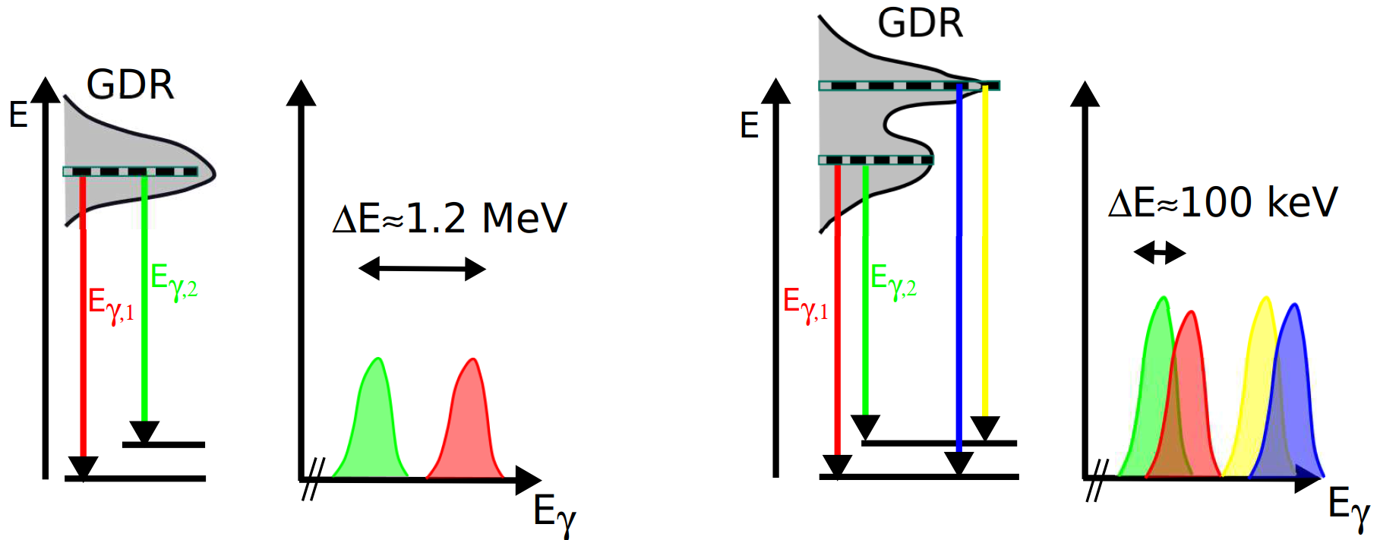
Decay of Resonances
spherical nuclei
deformed nuclei
K=1
K=0
Study variation of direct vs. statistical decay as a function of E_{x}
→ fine structure of GDR

Slide 9
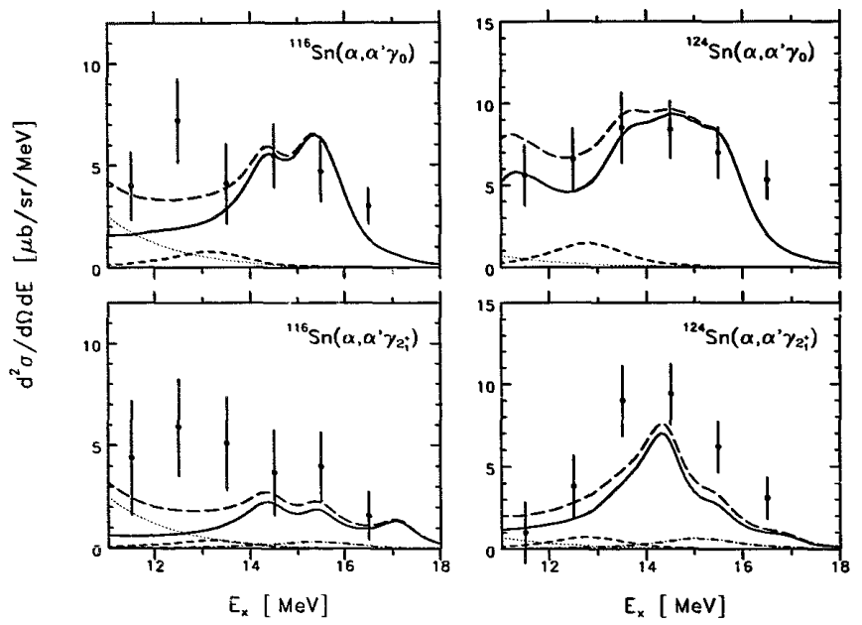
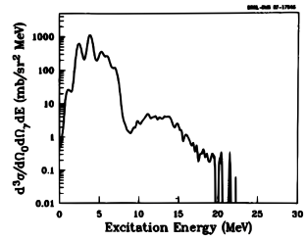


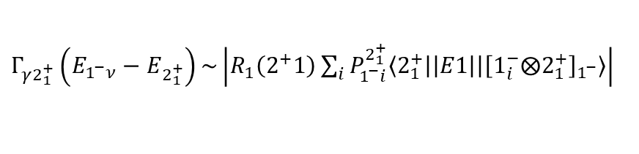
Decay of Resonances
GDR γ-decay branching: ≈ 1 %
J. R. Beene et al., Phys Rev. C (1990)
Relative branching from GDR to almost
as strong as to ground state
A. Krasznahorkay et al., Phys. Rev. Lett. 66 (1991)
GDR built on
V.Yu. Ponomarev et al., Nucl. Phys. (1992)
Investigate γ-decay of GDR in ^{112,124}Sn
²⁰⁸Pb(¹⁷O,¹⁷O'γ)
$$2_{1}^{+}$$
$$2_{1}^{+}$$
$Γ_{γ2_{1}^{+}}\left(E_{1^{−}ν}−E_{2_{1}^{+}}\right)\sim \left|R_{1}\left(2^{+}1\right)\sum_{i}{P_{1^{−}i}^{2_{1}^{+}}\left\langle 2_{1}^{+} | \left|E1\right| | {\left[1_{i}^{−}⨂2_{1}^{+}\right]}_{1^{−}}\right\rangle }\right|$

Slide 10
Outline
Principle of (e,e‘γ)
Theoretical considerations
Gamma Decay of GDR
Vorticity
Status and Achievements
Schedule
Summary

Slide 11
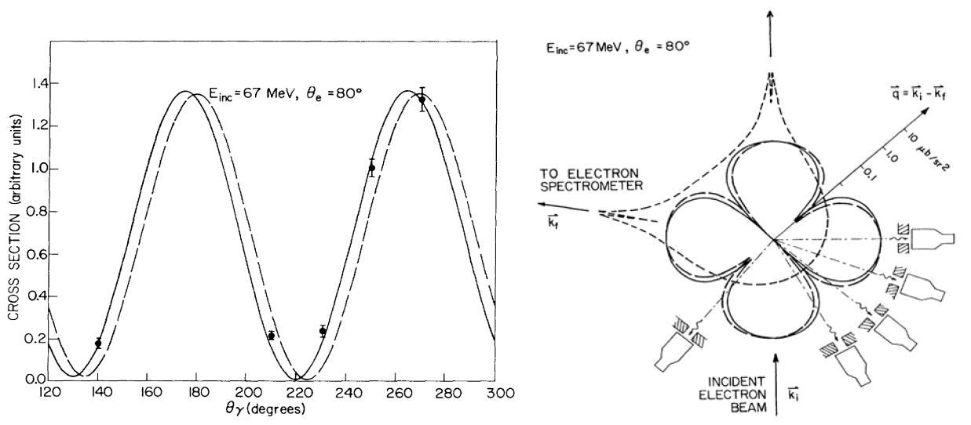



Rotation of the Angular Distribution
Pioneer experiment: rotation of angular distribution of in ¹²C
Determine relative shift → phase of F_{L} and F_{T}
Investigate rotation of angular distribution of and in ⁹²Zr
$$2_{1}^{+}$$
$$2_{1,2}^{+}$$
$$3_{1}^{−}$$
C. N. Papanicolas et al., Phys. Rev. Lett. 54 (1985)

Slide 12
Outline
Principle of (e,e‘γ)
Theoretical considerations
Gamma-decay of GDR
Vorticity
Status and Achievements
Schedule
Summary

Slide 13
Needs
Electron beam
    Halo free
Electron spectrometer
    High acceptance
Gamma detectors
    Fast timing
Data Acquisitions (DAQ)
    Spectrometer (B02, M. Singer, Talk by J. Isaak)
    Gamma detector array

Slide 14
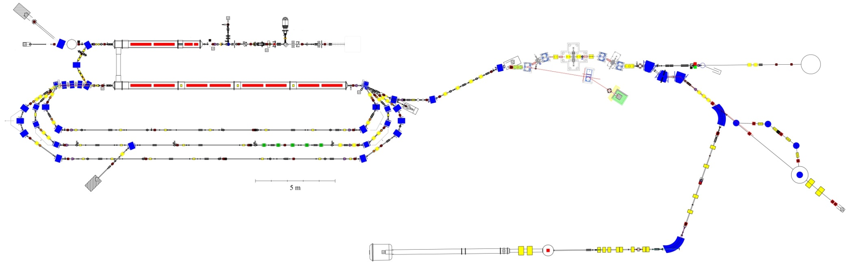
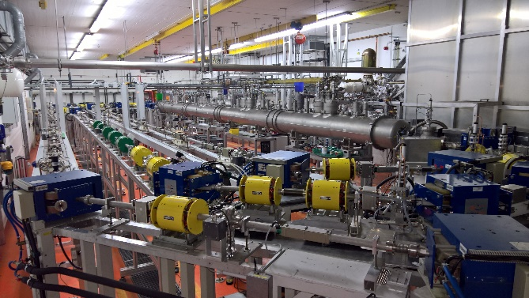

S-DALINAC
Injector
Scraper
Gun
NEPTUN
Main Accelerator
QClam
Lintott
M. Arnold, Dissertation, TU Darmstadt (2016)
Also supported
by GRK 2128
GALATEA

Slide 15
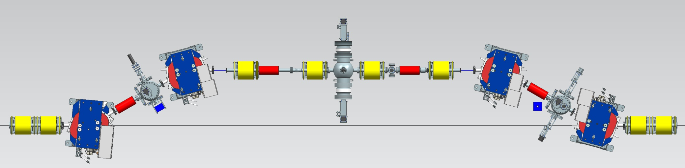

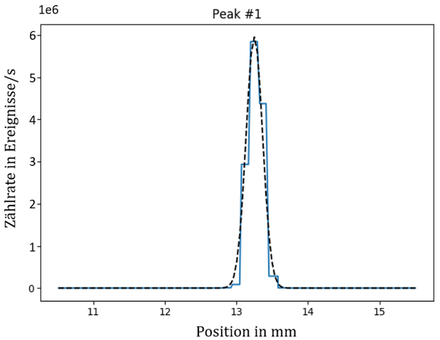
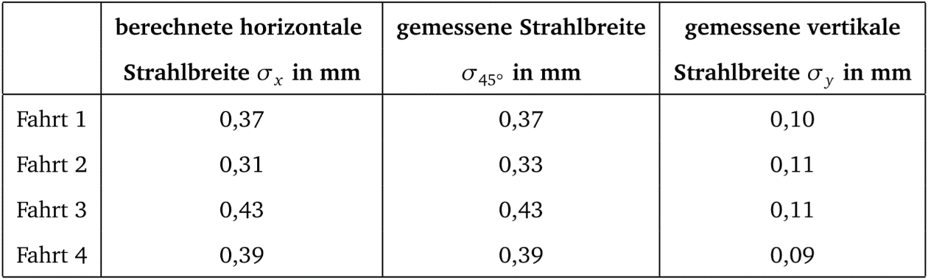
Scraper
y halo
scraper
energy
scraper
x,y halo
scraper
e⁻
3m
L. Jürgensen, Dissertation (2018)
M. Dutine, M.Sc. Thesis (2018)

Slide 16
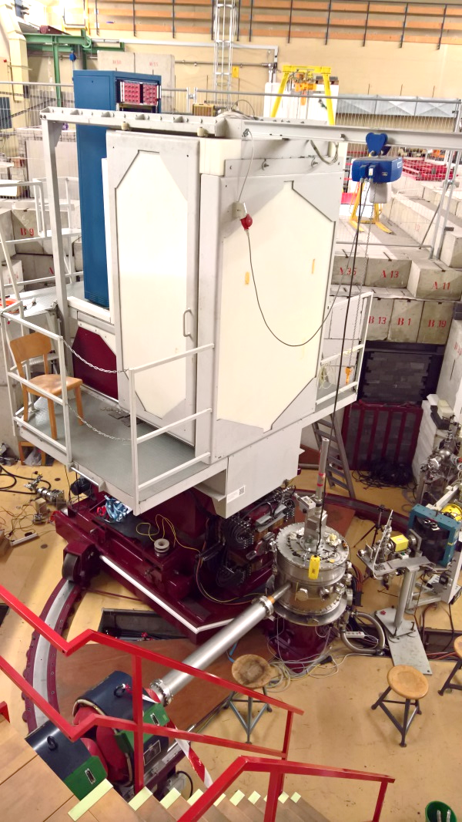
QClam Spectrometer
Max. momentum: 200 MeV/c
Momentum acceptance: Δp/p = ± 10 %
Solid angle: 35 msr
Scattering angles:
25°-155°, 180° (B02, J. Isaak)
Energy resolution: ΔE/E ≈ 10⁻⁴
⇨ Well suited for coincidence experiments
e

Slide 17
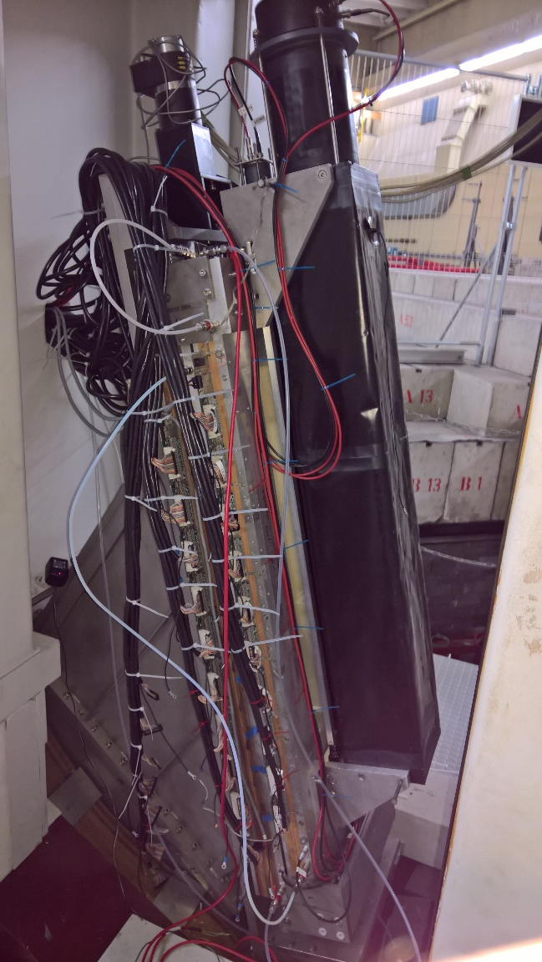
QClam Status
Drift chambers refurbished and inserted
(A. D’Alessio)
Cooling water completed
Electric cabling completed
Power supply remote control
Target ladder remote control
New Vacuum sensors
(QClam and Lintott)
New turbopumps, vacuum completed
⇨ Ready for raw data taking
1250 mm
e

Slide 18
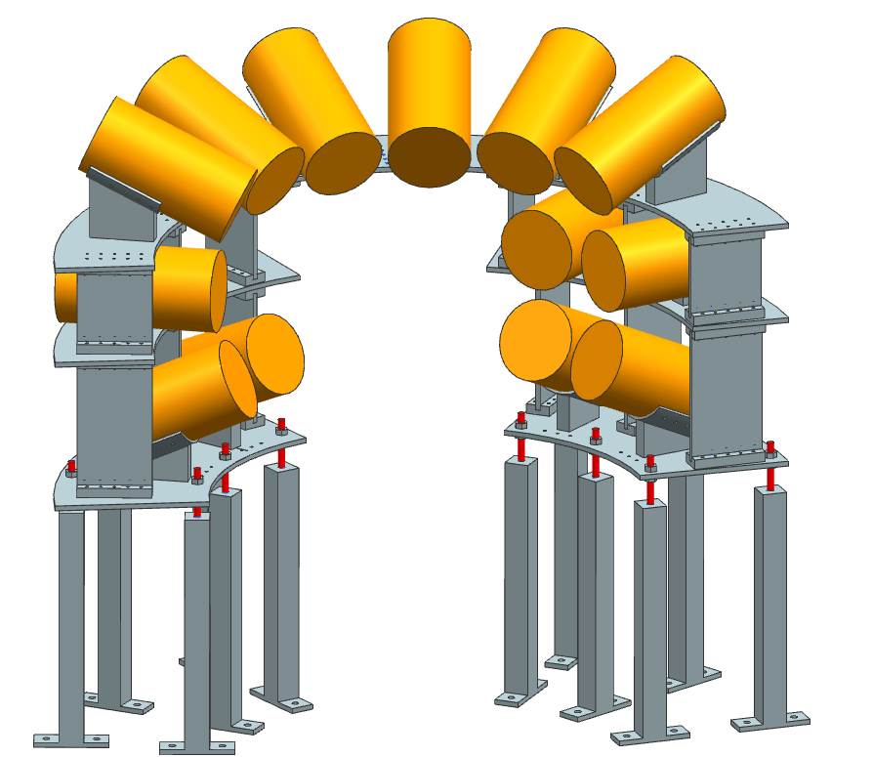
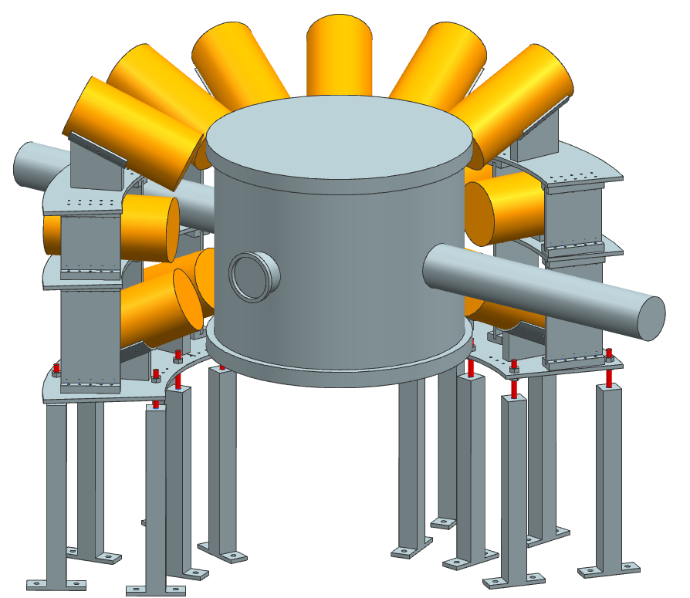
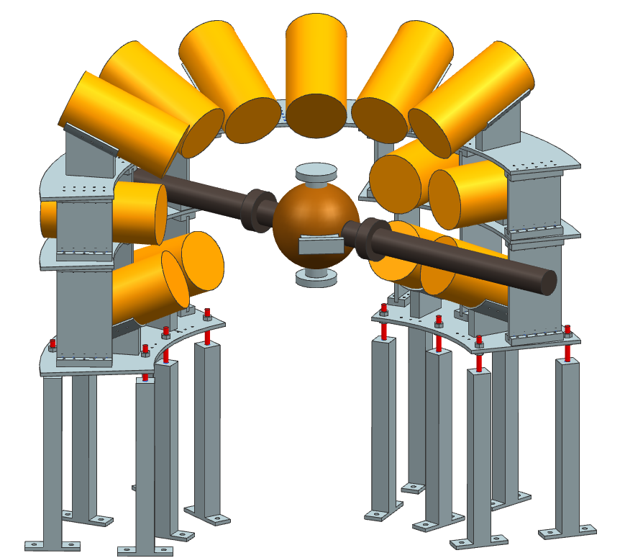
LaBr Setup
LaBr detector array suitable for
    Cylindric scattering chamber
    → 13 detectors
    → Solid angle: 2.4%
    Ball scattering chamber
    → 17 detectors
    → Solid angle: 3.2%
Detectors predominantly at backward angles
→ improved Peak/Background ratio
e‘
e
875 mm

Slide 19
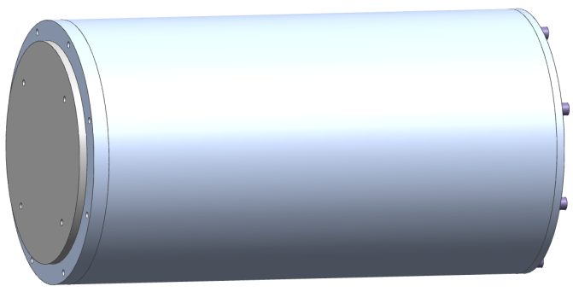
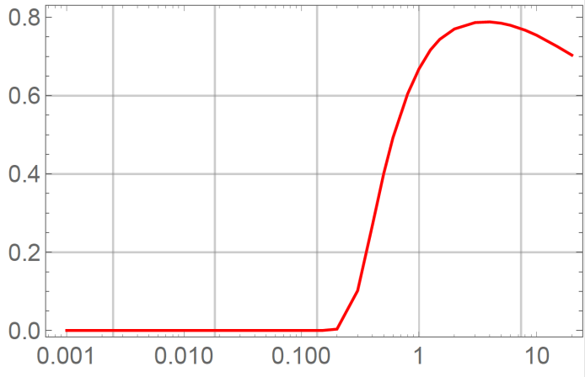
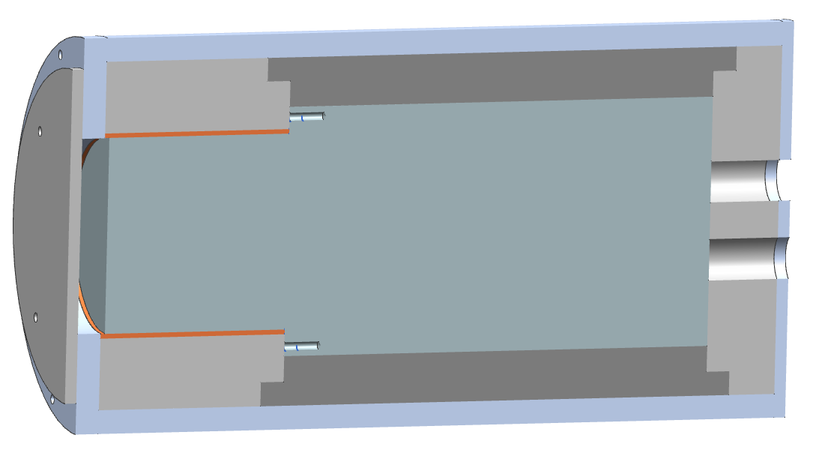

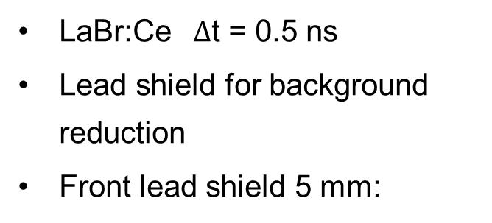
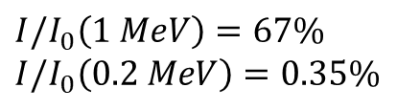
LaBr Detector Housings
LaBr:Ce $∆$t = 0.5 ns
Lead shield for background reduction
Front lead shield 5 mm:
317 mm
166 mm
Data from NIST
Pb front shield
Al housing
$$I/I_{0}$$
LaBr
PMT
E_{γ} (MeV)
$I/I_{0}\left(1 MeV\right)=67\%$
$I/I_{0}\left(0.2 MeV\right)=0.35\%$
Cu shielding
Pb shielding

Slide 20
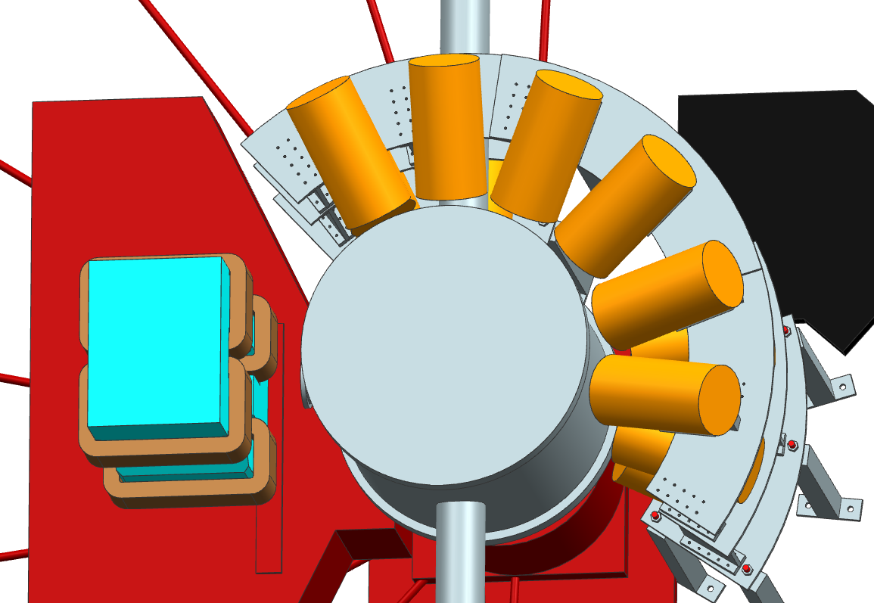

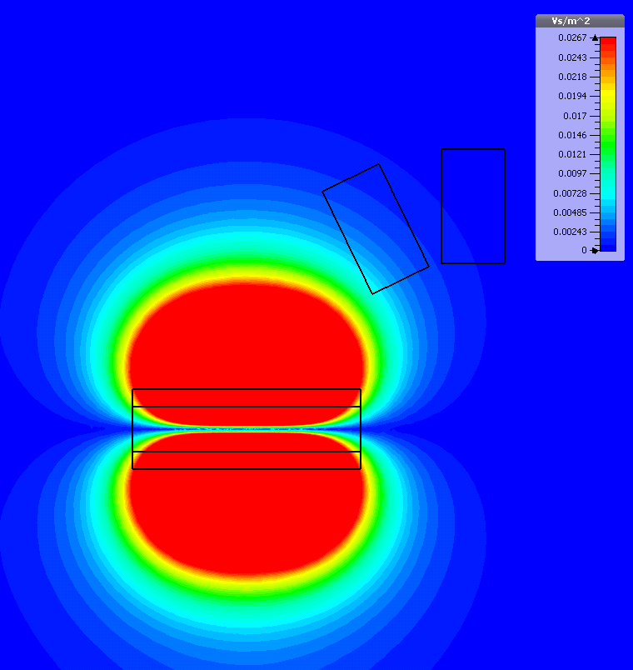
Influence of QClam Quadrupole
QClam quadrupole close to the detectors (PMTs)
CST simulation → max. ≈ 3 mT at PMT
Test using permanent magnet
No magnetic shielding necessary
θ_{e}= 90°
²²Na
2 mT
2.5 mT
3 mT
e‘
1275 keV
e‘
e
e

Slide 21
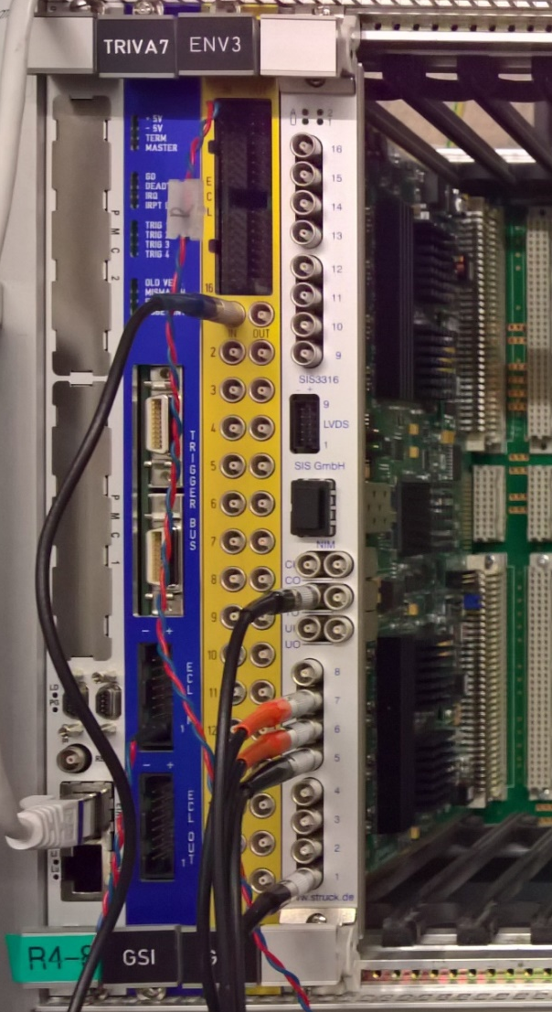
LaBr Data Acquisition
DAQ established
    Adapted from GALATEA
    MBS based DAQ
    Δt ≈ 60 ps
    ROOT based data analysis
DAQ tests
    Lab tests
    Beamtime 2017 at Lintott
    Neutron source activation measurement

Slide 22
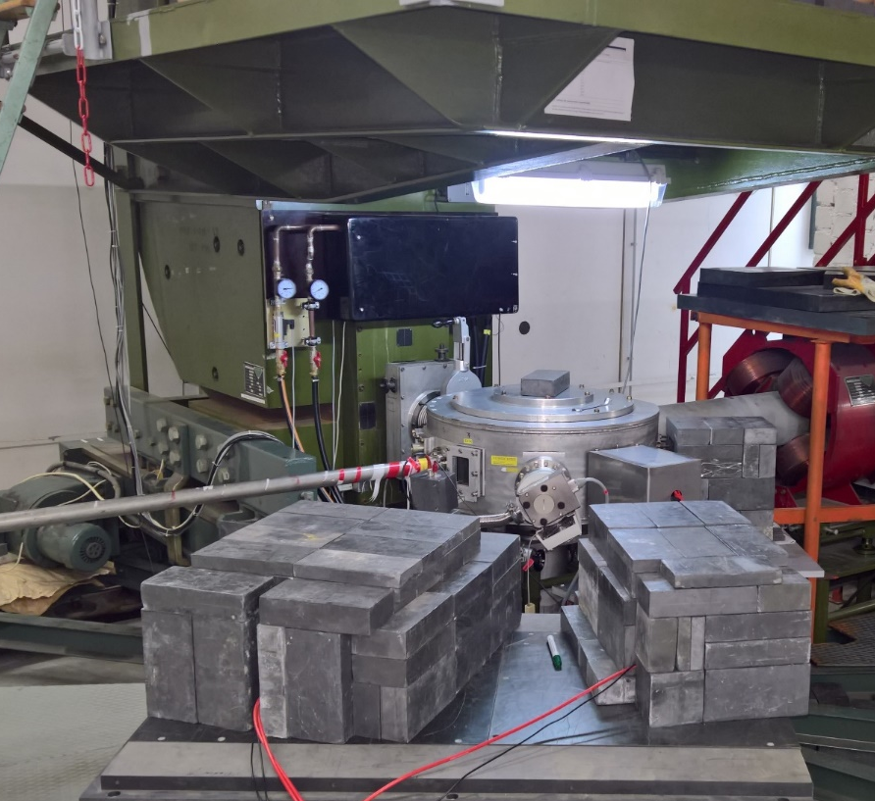
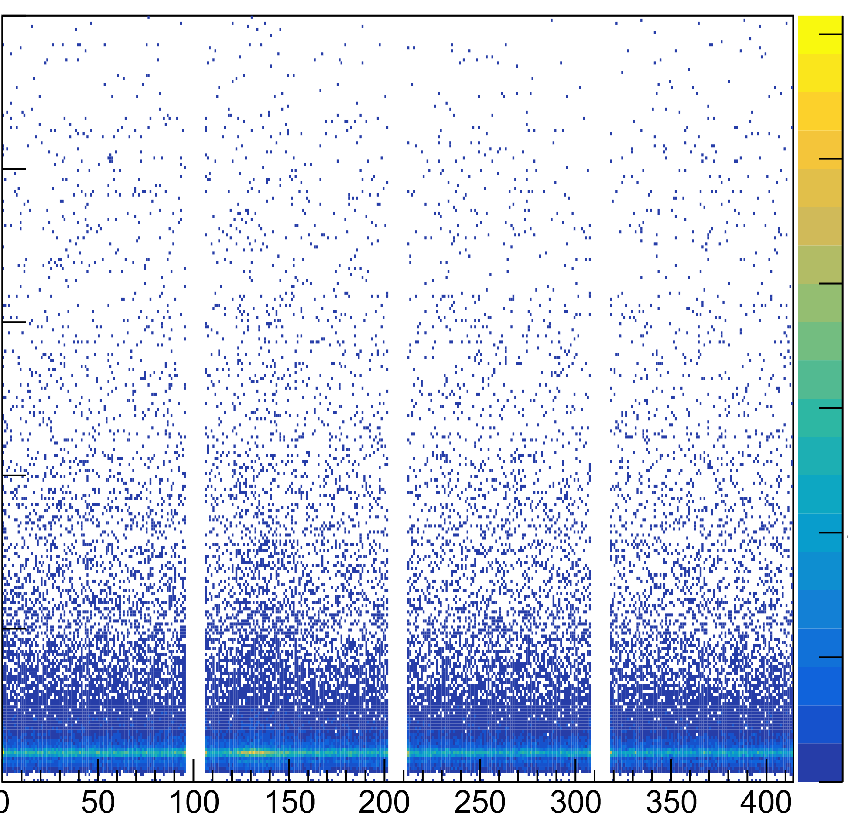
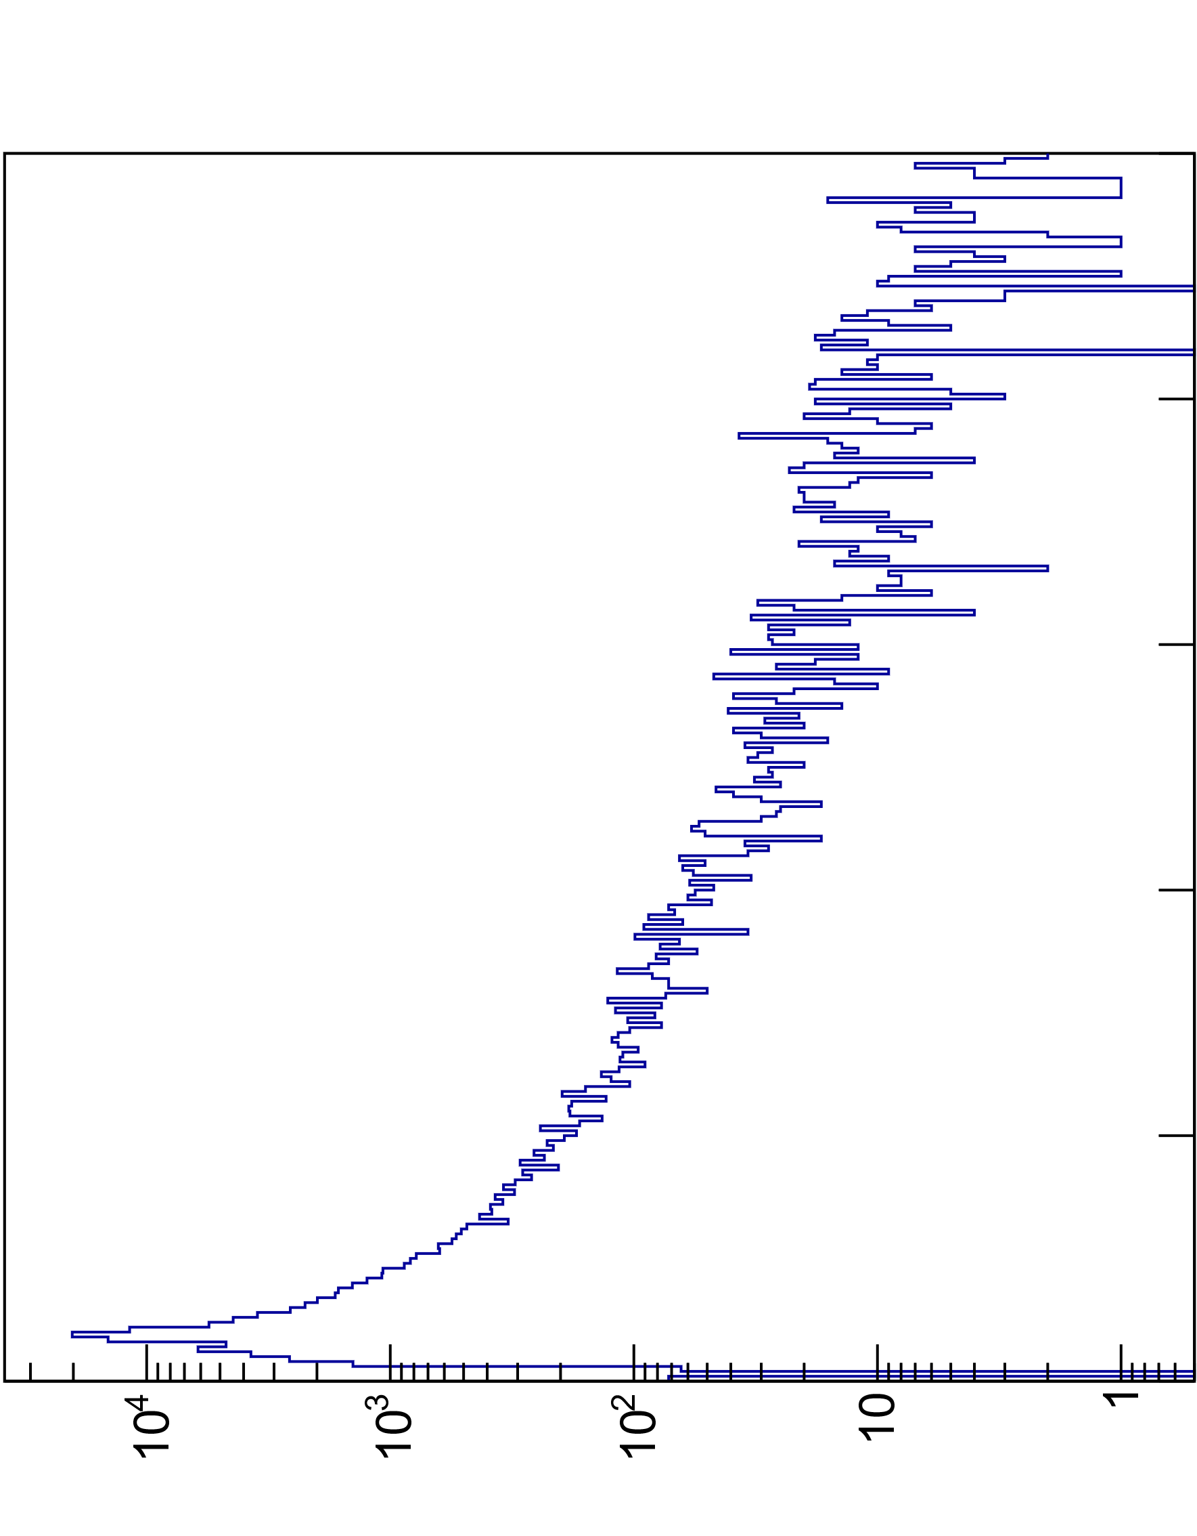
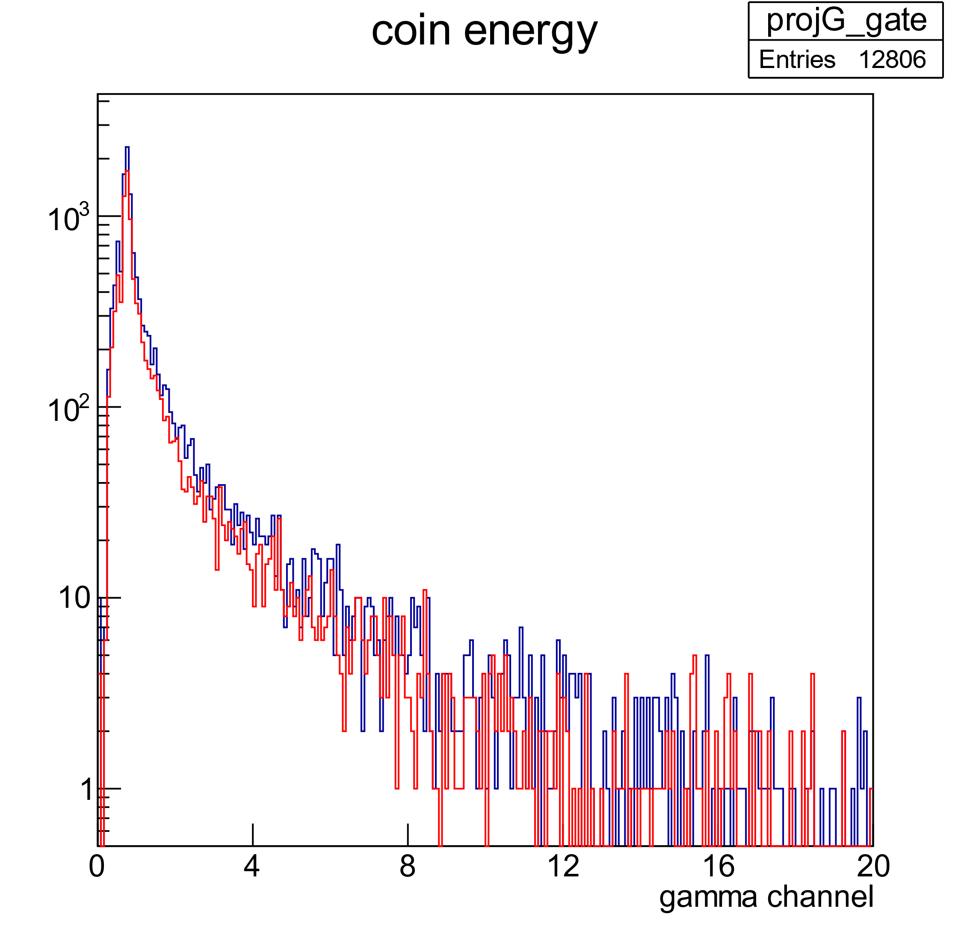
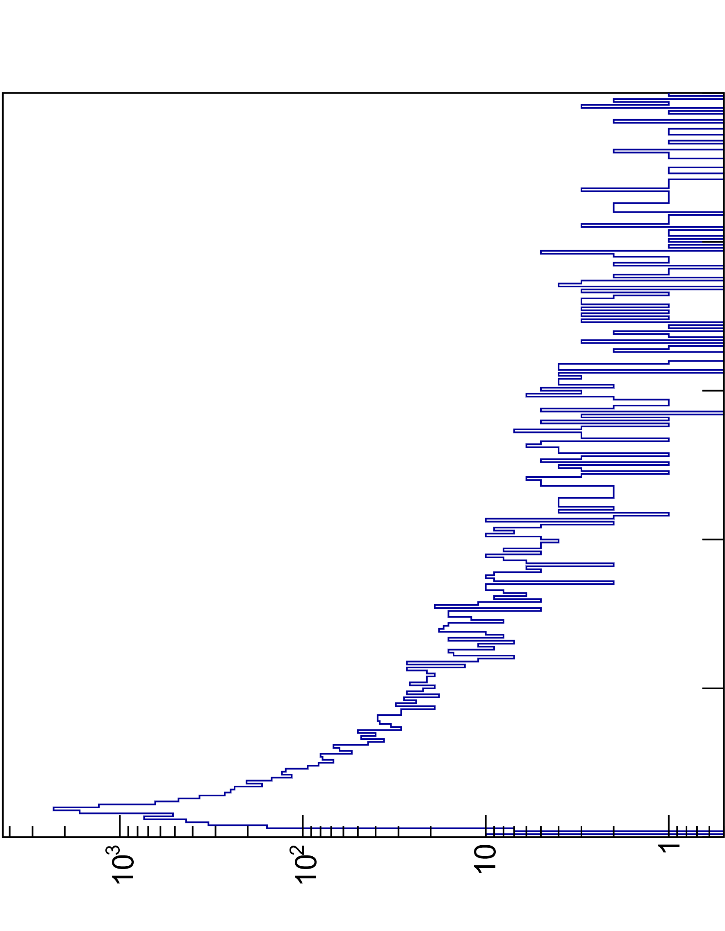
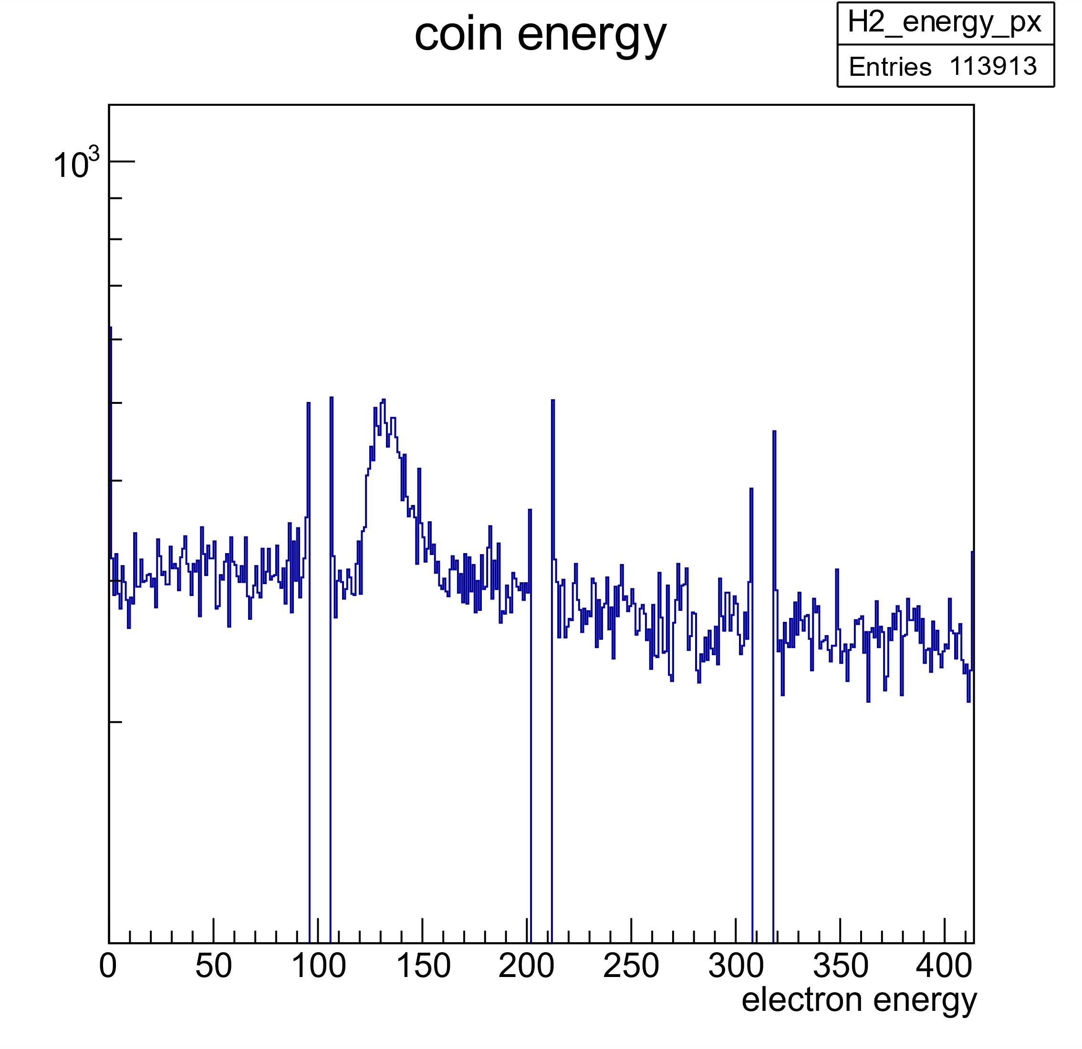

Test at Lintott
¹²C(e,e‘γ)
E_{e}=42 MeV
120
100
80
E_{γ} (MeV)
60
e‘
40
e
20
0
counts
$$2_{1}^{+}$$
1.2 m
counts
LaBr DAQ tested at Lintott
Data from e and γ successfully merged
No coincidence events due to low efficiency
E_{e} (channel)

Slide 23
Outline
Principle of (e,e‘γ)
Theoretical considerations
Gamma-decay of GDR
Vorticity
Status and Achievements
Schedule
Summary

Slide 24
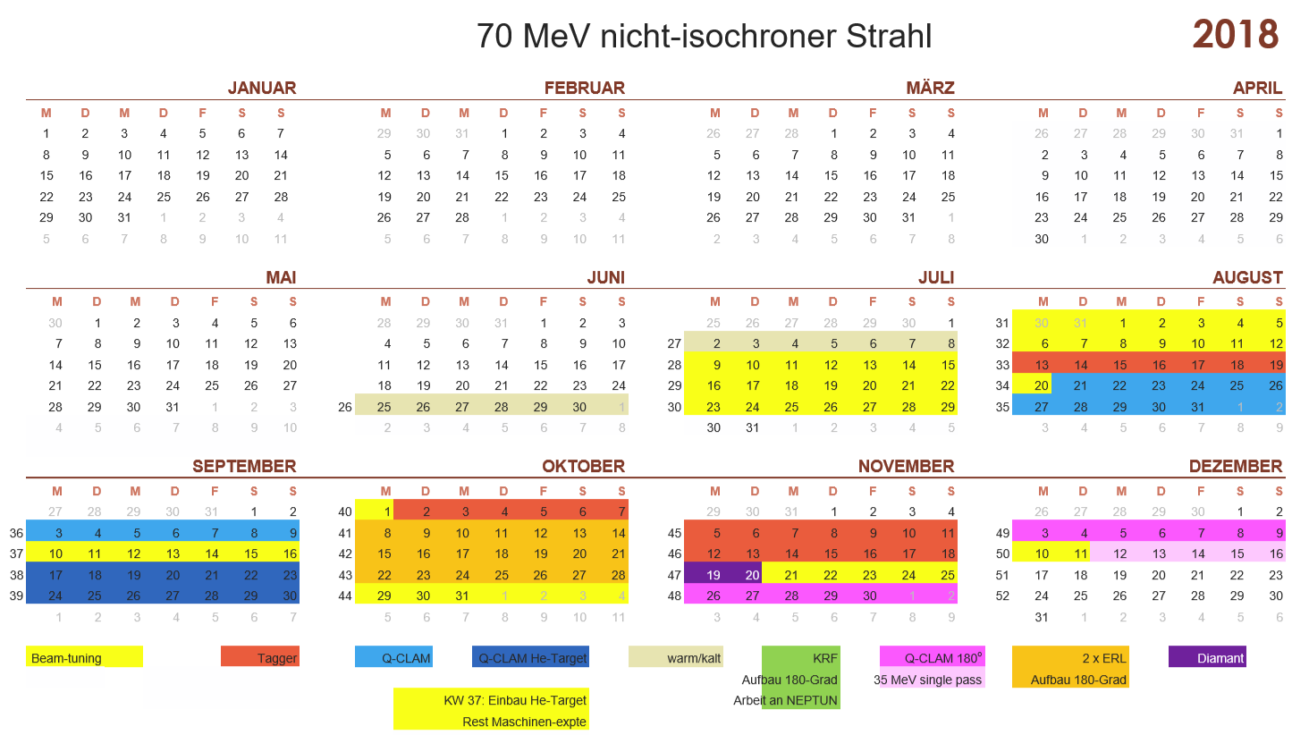
Schedule
Parasitic tests during QClam commissioning
LaBr detector array set up by Jan. 2019
Commissioning tests during ¹⁴C experiment (A03, M. Mathy) in Feb./Mar. 2019
(e,e’γ)-production April 2019

Slide 25
Outline
Principle of (e,e‘γ)
Gamma Decay of GDR
Vorticity
Status and Achievements
Schedule
Summary

Slide 26
Summary
Beam ü
Halo scraper ü
Spectrometer ü
DAQ ü
Commissioning: pending (start Sept. 2018)
Array set-up: Jan. 2019
First production run: April 2019

Slide 27
Thank you for your attention!

Slide 29
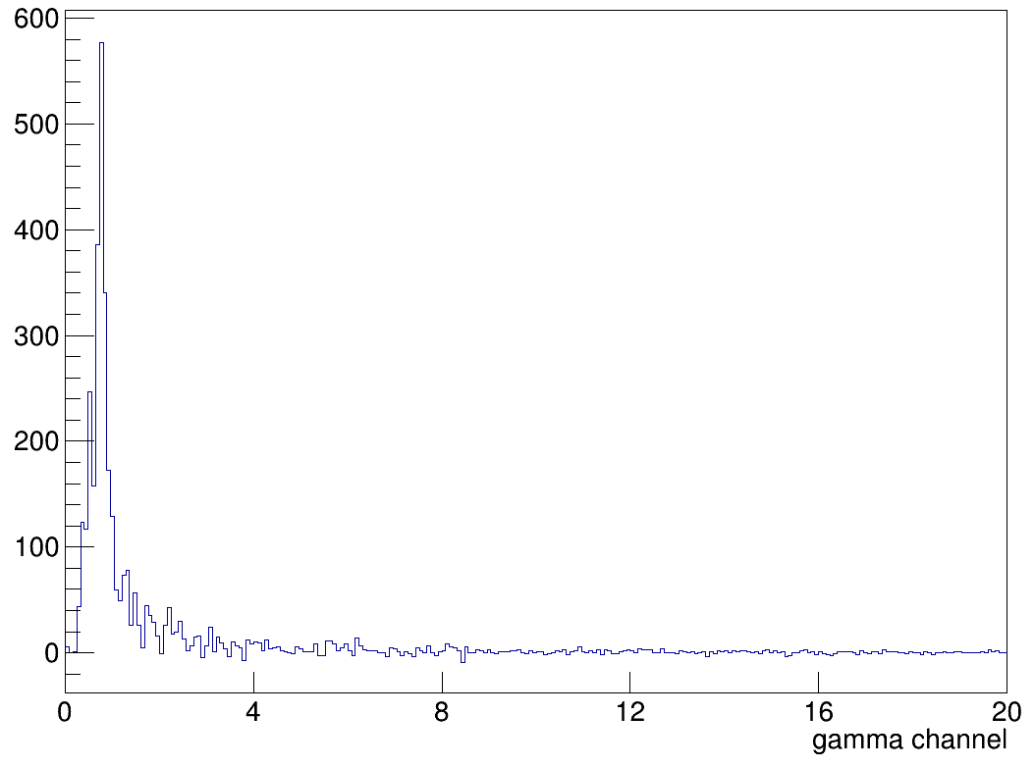
counts
E_{γ} (MeV)

Slide 30
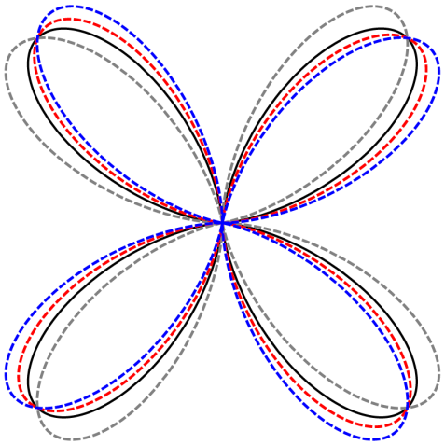
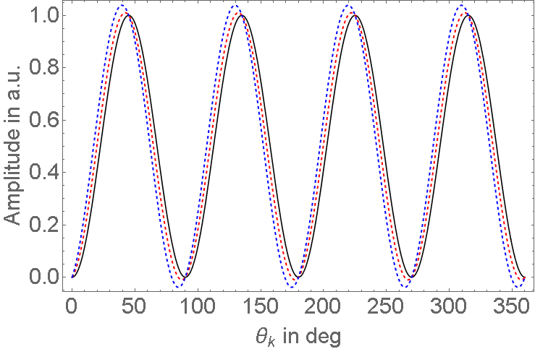
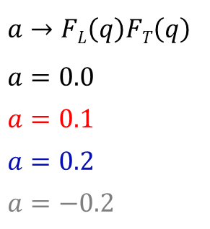
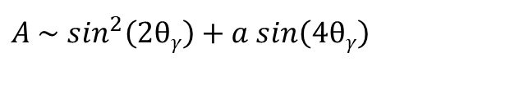
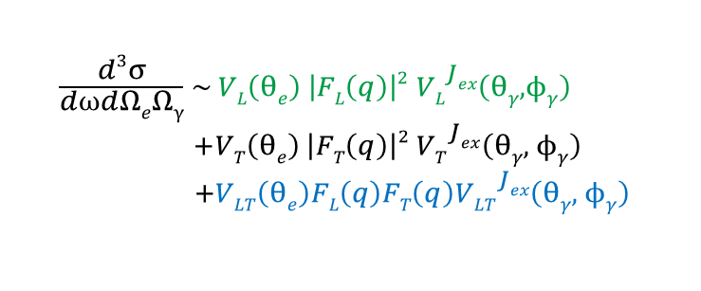

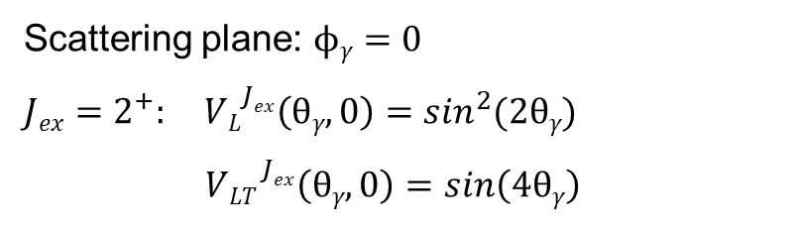
Rotation of the Angular Distribution
$A \sim \sin^{2}\left(2θγ\right)+a sin\left(4θγ\right)$
$$\begin{aligned}\frac{d3σ}{d⍵dΩeΩγ} \sim VL\left(θe\right) \left|FL\left(q\right)\right|2 {VL}_{}^{Jex}\left(θγ, ϕγ\right) \\ +VT\left(θe\right) \left|FT\left(q\right)\right|2 {VT}_{}^{Jex}\left(θγ, ϕγ\right) \\ +VLT\left(θe\right)FL\left(q\right)FT\left(q\right){VLT}_{}^{Jex}\left(θγ, ϕγ\right)\end{aligned}$$
$$\vec{q}$$
$a→FL\left(q\right)FT\left(q\right)$
$a=0.0$
$a=0.1$
$a=0.2$
$a=−0.2$
Scattering plane: $ϕγ=0$
$Jex=2^{+}: {VL}_{}^{Jex}\left(θγ, 0\right)=\sin^{2}(2θγ)$
${ VLT}_{}^{Jex}\left(θγ, 0\right)=sin\left(4θγ\right)$
Notes:
Furthermore, we like to investigate the rotation of the Angular distribution of the gamma decay of excited states. Here we again have the cross section for the e, e prime gamma reaction in PWBA, with the scattering angle for the electron "theta e" and the scattering angles "theta gamma" and "phi gamma". The cross section is separated into three terms. These are the longitudinal, the transversal and a mixed term consisting of the longitudinal and the transversal form factors. Each term has a contribution of the electron which is given by the kinematics of the scattering process, contribution of the formfactor and of the emitted gamma radiation, which is the part we are interested in for this experiment. In general longitudinal form factor is at least one order of magnitude larger than the transversal form factor. Hence the summand containing only the transversal form factor can be neglected. For a transition of an exited 2 plus state the contributions of the gamma decay in the scattering plane – so we are only considering the azimuthal part - are given by these two equations. For a fixed electron scattering angle the differential cross section is proportional to this. This figure is showing the angular distribution relative to the momentum transfer axis for different values of a in the scattering plane. An increasing positive factor a shifts the angular distribution clockwise, a change of the sign of a leads to a counter clockwise rotation. This figure shows the amplitude as a function of the polar angle of the photon emission. Here also the shift can clearly be seen.

