Slide 1





Using Natural Language Processing to Develop Instructional Content
Michael Heilman
Language Technologies Institute
Carnegie Mellon University
REAP Collaborators:
Maxine Eskenazi, Jamie Callan, Le Zhao, Juan Pino, et al.
Question Generation Collaborator:
Noah A. Smith

Slide 2
Motivating Example
Situation: Greg, an English as a Second Language (ESL) teacher, wants to find a text that…
  is in grade 4-7 reading level range,
  uses specific target vocabulary words from his class,
  discusses a specific topic, international travel.

Slide 3

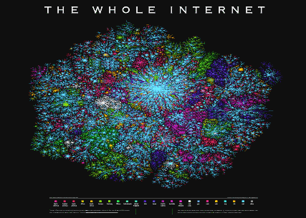









Sources of Reading Materials
Internet, etc.
Textbook
Notes:
First published 1836

Slide 4
Why aren’t teachers using Internet text resources more?
Teachers are smart
Teachers work hard.
Teachers are computer-savvy.
Using new texts raises some important challenges…

Slide 5
Why aren’t teachers using Internet text resources more?
My claim: teachers need better tools…
to find relevant content,
to create exercises and assessments.
Natural Language Processing (NLP) can help.

Slide 6
Working Together
 | NLP | Educators | NLP + Educators
Rate of text analysis | Fast | Slow | Fast
Error rate when creating educational content | High | Low | Low

Slide 7
So, what was the talk about?
It was about how tailored applications of Natural Language Processing (NLP) can help educators create instructional content.
It was also about the challenges of using NLP in applications.

Slide 8
Outline
Introduction
Textbooks vs. New Resources
Text Search for Language Instructors
Question Generation (QG)
Concluding Remarks

Slide 9
Textbooks | New Resources
Fixed, limited amount of content. | Virtually unlimited content on various topics.

Slide 10
Textbooks | New Resources
Fixed, limited amount of content. | Virtually unlimited content on various topics.
Filtered for reading level, vocabulary, etc. | Unfiltered.

Slide 11
Textbooks | New Resources
Fixed, limited amount of content. | Virtually unlimited content on various topics.
Filtered for reading level, vocabulary, etc. | Unfiltered.
Include practice exercises and assessments. | No exercises.
REAP Search Tool
Automatic Question Generation

Slide 12
Outline
Introduction
Textbooks vs. New Resources
Text Search for Language Instructors
  Motivation
  NLP components
  Pilot study
Question Generation
Concluding Remarks
REAP Collaborators:
Maxine Eskenazi, Jamie Callan, Le Zhao, Juan Pino, et al.

Slide 13
The Goal
To help English as a Second Language (ESL) teachers find reading materials
  For a particular curriculum
  For particular students

Slide 14
Back to the Motivating Example
Situation: Greg, an ESL teacher, wants to find texts that…
  Are in grade 4-7 reading level range,
  Use specific target vocabulary words from class,
  Discuss a specific topic, international travel.
First Approach: Searching for “international travel” on a commercial search engine…

Slide 15

Typical Web Result
Search
Commercial search engines are not built for educators.

Slide 16
Desired Search Criteria
Text length
Writing quality
Target vocabulary
Search by high-level topic
Reading level

Slide 17
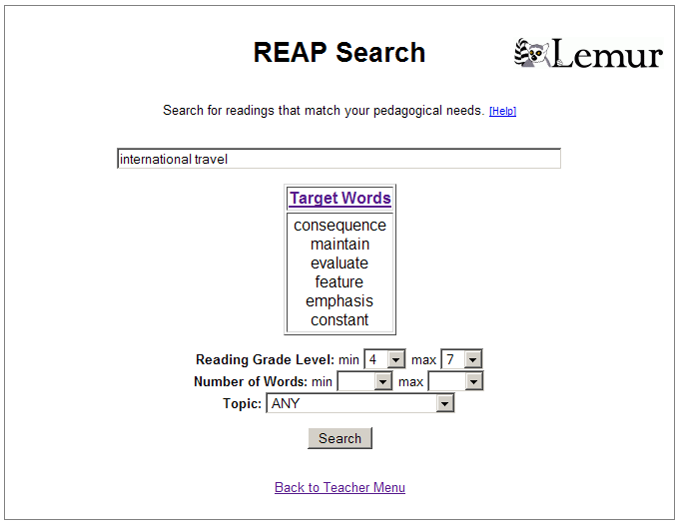
Familiar query box for specifying keywords.
Extra options for specifying pedagogical constraints.
User clicks Search and sees a list of results…

Slide 18
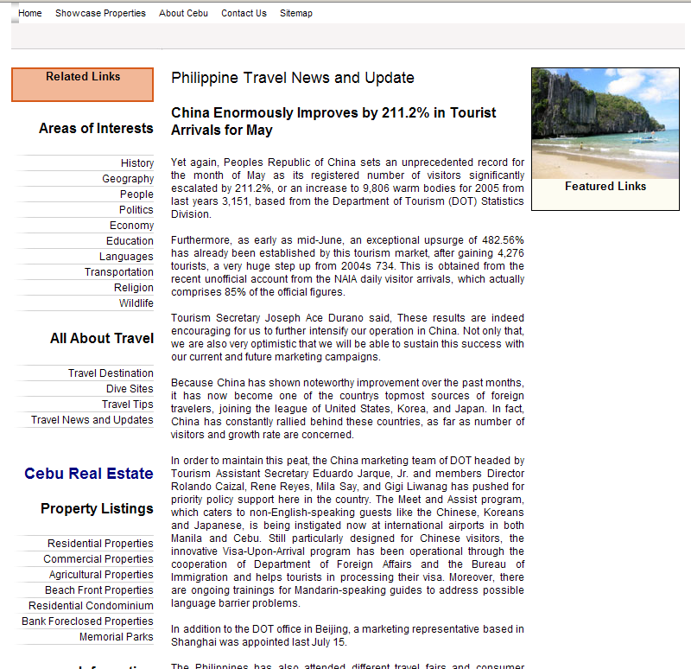
REAP Search Result

Slide 19
Outline
Introduction
Textbooks vs. New Resources
Text Search for Language Instructors
  Motivation
  NLP components
  Pilot study
Question Generation
Concluding Remarks

Slide 20
Digital Library Creation
NLP
(e.g., to predict reading levels)
Web
Query-based
Web Crawler
Filtering & Annotation
Digital Library (built with Lemur toolkit)
Search Interface
Note: These steps occur offline.
Heilman, Zhao, Pino, and Eskenazi. 2008. Retrieval of reading materials for vocabulary and reading practice. 3rd Workshop on NLP for Building Educational Applications.

Slide 21
Predicting Reading Levels
clause
Simple syntactic structure
==> low reading level
Verb Phrase
Noun Phrase
Noun Phrase
Verb (past)
…Joseph liked dinosaurs….

Slide 22
Predicting Reading Levels
clause
Simple syntactic structure
==> low reading level
Verb Phrase
Noun Phrase
Noun Phrase
Infrequent lexical items
==> high reading level
Verb (past)
...Thoreau apotheosized nature….
We can use statistical NLP techniques to estimate weights from data.
We need to adapt NLP for specific tasks.
(e.g., to specify important linguistic features)

Slide 23
Potentially Useful Features for Predicting Reading Levels
Number of words per sentence
Number of syllables per word
Depth/complexity of syntactic structures
Specific vocabulary words
Specific syntactic structures
Discourse structures
…
For speed and scalability,
we used a vocabulary-based approach
(Collins-Thompson & Callan, 05)
Flesch-Kincaid, 75; Stenner et al. 88; Collins-Thompson & Callan, 05; Schwarm & Ostendorf 05; Heilman et al., 07; inter alia

Slide 24
Outline
Introduction
Textbooks vs. New Resources
Text Search for Language Instructors
  Motivation
  NLP components
  Pilot study
Question Generation
Concluding Remarks

Slide 25
Pilot Study
Participants
  2 instructors and 50+ students
  Pittsburgh Science of Learning Center’s English LearnLab
  Univ. of Pittsburgh’s English Language Institute
Typical Usage
  Before class, teachers found texts using the tool
  Students read texts individually
  Also, the teachers led group discussions
  8 weeks, 1 session per week

Slide 26
Evidence of Student Learning
Students scored approximately 90% on a post-test on target vocabulary words
Students also studied the words in class.
There was no comparison condition.
More research is needed

Slide 27
Teacher’s Queries
  47
  unique queries
  =
  2.04
  queries to find a useful text (on average)
  23
selected texts used in courses
The digital library contained 3,000,000 texts.
Notes:
Ideally we would like to have one query or less per selected text…

Slide 28
Teacher’s Queries
Teachers found high-quality texts, but often had to relax their constraints.
Exaggerated Example:
7th grade reading-level
600-800 words long
9+ vocabulary words from curriculum
keywords: “construction of Panama Canal”
6-9th grade reading-level
less than 1,000 words long
3+ vocabulary words
topic: history

Slide 29
Teacher’s Queries
Teachers found high-quality texts, but often had to relax their constraints.
Possible future work:
Improving the accuracy of the NLP components
Scaling up the digital library

Slide 30
Related Work
System | Reference | Description
REAP Tutor | Brown & Eskenazi, 04 | A computer tutor that selects texts for students based on their vocabulary needs (also, the basis for REAP search).
WERTi | Amaral, Metcalf, & Meurers, 06 | An intelligent automatic workbook that uses Web texts to teach English grammar.
SourceFinder | Sheehan, Kostin, & Futagi, 07 | An authoring tool for finding suitable texts for standardized test items.
READ-X | Miltsakaki & Troutt, 07 | A tool for finding texts at specified reading levels.

Slide 31
REAP Search…
Applies various NLP and text retrieval technologies.
Enables teachers to find pedagogically appropriate texts from the Web.
For more recent developments in the REAP project, see http://reap.cs.cmu.edu.

Slide 32
Segue
So, we can find high quality texts.
We still need exercises and assessments…

Slide 33
Outline
Introduction
Textbooks vs. New Resources
Text Search for Language Instructors
Question Generation
Concluding Remarks
Question Generation Collaborator:
Noah A. Smith

Slide 34
The Goal
Input: educational text
Output: quiz

Slide 35
The Goal
Input: educational text
Output: quiz
Output: ranked list of candidate questions to present to a teacher

Slide 36
Our Approach
Sentence-level factual questions
Acceptable questions (e.g., grammatical ones)
Question Generation (QG) as a series of sentence structure transformations
Heilman and Smith. 2010. Good Question! Statistical Ranking for Question Generation. In Proc. of NAACL/HLT.

Slide 37
Outline
Introduction
Textbooks vs. New Resources
Text Search for Language Instructors
Question Generation
  Challenges
  Step-by-step example
  Question ranking
  User interface
Concluding Remarks

Slide 38
Complex Input Sentences
Lincoln, who was born in Kentucky, moved to Illinois in 1831.
Intermediate Form: Lincoln was born in Kentucky.
Where was Lincoln born?
Step 1:
Extraction of Simple Factual Statements

Slide 39


Constraints on Question Formation
Darwin studied how species evolve.
Who studied how species evolve?
*What did Darwin study how evolve?
Step 1:
Extraction of Simple Factual Statements
Step 2:
Transformation into Questions
Rules that encode linguistic knowledge

Slide 40

Vague and Awkward Questions, etc.
Lincoln, who was born in Kentucky…
Weak predictors:
# proper nouns,
who/what/where…,
sentence length,
etc.
Where was Lincoln born?
Lincoln, who faced many challenges…
What did Lincoln face?
Step 1:
Extraction of Simple Factual Statements
Step 2:
Transformation into Questions
Step 3:
Statistical Ranking
Model learned from human-rated
output from steps 1&2

Slide 41
Step 0: Preprocessing with NLP Tools
Stanford parser
  To convert sentences into syntactic trees
Supersense tagger
  To label words with high level semantic classes (e.g., person, location, time, etc.)
Coreference resolver
  To figure out what pronouns refer to
Klein & Manning, 03
Ciaramita & Altun, 06
http://www.ark.cs.cmu.edu/arkref
Each may introduce errors that lead to bad questions.

Slide 42
Outline
Introduction
Textbooks vs. New Resources
Text Search for Language Instructors
Question Generation
  Challenges
  Step-by-step example
  Question ranking
  User interface
Concluding Remarks

Slide 43
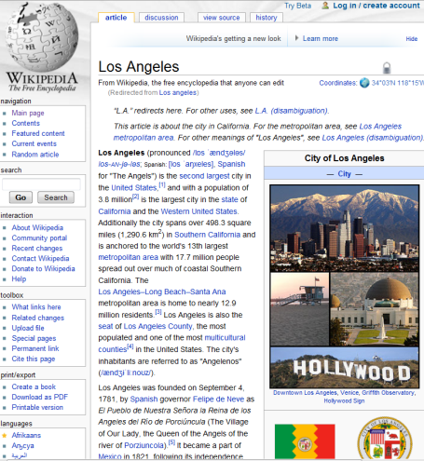
(other candidates)
…
…
During the Gold Rush years in northern California, Los Angeles became known as the "Queen of the Cow Counties" for its role in supplying beef and other foodstuffs to hungry miners in the north.
During the Gold Rush years in northern California, Los Angeles became known as the "Queen of the Cow Counties" for its role in supplying beef and other foodstuffs to hungry miners in the north.
Preprocessing
Extraction of Simplified
Factual Statements
…
…
Los Angeles became known as the "Queen of the Cow Counties" for its role in supplying beef and other foodstuffs to hungry miners in the north.

Slide 44
Los Angeles became known as the "Queen of the Cow Counties" for its role in supplying beef and other foodstuffs to hungry miners in the north.
Los Angeles became known as the "Queen of the Cow Counties" for its role in supplying beef and other foodstuffs to hungry miners in the north.
Answer Phrase Selection
…
…
Los Angeles became known as the "Queen of the Cow Counties" for (Answer Phrase: its role in…)
Los Angeles became known as the "Queen of the Cow Counties" for (Answer Phrase: its role in…)
Main Verb Decomposition
Los Angeles did become known as the "Queen of the Cow Counties" for
(Answer Phrase: its role in…)
Subject Auxiliary Inversion
Did Los Angeles become known as the "Queen of the Cow Counties" for
(Answer Phrase: its role in…)

Slide 45
Did Los Angeles become known as the "Queen of the Cow Counties" for
(Answer Phrase: its role in…)
Movement and Insertion of Question Phrase
What did Los Angeles become known as the "Queen of the Cow Counties" for?
…
…
…
Question Ranking
1. What became known as…?
2. What did Los Angeles become known as the "Queen of the Cow Counties" for?
3. Whose role in supplying beef…?
4. …

Slide 46
Existing Work on QG
Reference | Description
Wolfe, 1977 | Early work on the topic.
Mitkov & Ha, 2005 | Template-based approach based on surface patterns in text.
Heilman & Smith, 2010 | Over-generation and statistical ranking.
Mannem, Prasad, & Joshi, 2010 | QG from semantic role labeling analyses.
inter alia

Slide 47
Outline
Introduction
Textbooks vs. New Resources
Text Search for Language Instructors
Question Generation
  Challenges
  Step-by-step example
  Question ranking
  User interface
Concluding Remarks

Slide 48
Question Ranking
We use a statistical ranking model to avoid vague and awkward questions.

Slide 49

Logistic Regression of Question Quality
x: features of the question
(binary or real-valued)
w: weights
(learned from labeled questions)
To rank, we sort by
)

Slide 50
Surface Features
Question words (who, what, where…)
  e.g., if “What…”
Negation words
Sentence lengths
Language model probabilities
  a standard feature to measure fluency

Slide 51
Features based on Syntactic Analysis
Grammatical categories
  Counts of parts of speech, etc.
  e.g., if 3 proper nouns,
Transformations
  e.g., extracted from relative clause
“Vague noun phrase”
  distinguishes phrases like “the president” from “Abraham Lincoln” or “the U.S. president during the Civil War”

Slide 52
Feature weights
We estimate weights from a training dataset of human-labeled output from steps 1 & 2.
Feature (x_{j}) | Weight (w_{j})
Question starts with “when” | 0.323
Past tense | 0.103
Number of proper nouns | 0.052
Negation words in the question | -0.144
… | …

Slide 53
Evaluation
We generated questions about texts from Wikipedia and the Wall Street Journal.
Human judges rated the output.
27% of unranked questions were acceptable.
52% of the top-ranked fifth were acceptable.
Heilman and Smith, 2010.

Slide 54
System Output
(from a text about Copenhagen)
What is the home of the Royal Academy of Fine Arts?
  (Answer: the 17th-century Charlottenborg Palace)
Who is the largest open-air square in Copenhagen?
  (Answer: Kongens Nytorv, or King’s New Square)
What is also an important part of the economy?
  (Answer: ocean-going trade)
About one third of bad questions result from preprocessing errors.
The system still makes many errors.

Slide 55
Outline
Introduction
Textbooks vs. New Resources
Text Search for Language Instructors
Question Generation
  Challenges
  Step-by-step example
  Question ranking
  User interface
Conclusion

Slide 56
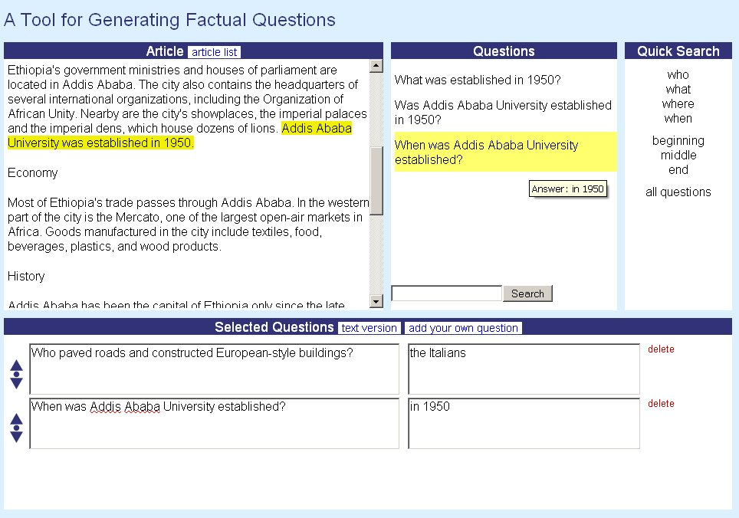
source text
ranked question candidates
shortcuts
keyword search box
user-selected questions (editable)
option to add your own question

Slide 57
User Feedback
Adding one’s own questions is important
  “Deeper” questions
  Reading strategy questions
Easy-to-use interface
Differing opinions about specific features
  e.g., search, document-level vs. sentence-level
Shareable questions

Slide 58
Outline
Introduction
Textbooks vs. New Resources
Text Search for Language Instructors
Question Generation
Concluding Remarks

Slide 59
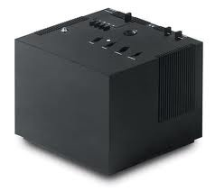
NLP is not a black box
NLP must be adapted for specific applications.
  Labeled data and linguistic knowledge are often needed.
  Of course, applications for other languages are possible….
One must consider how to handle errors.

Slide 60

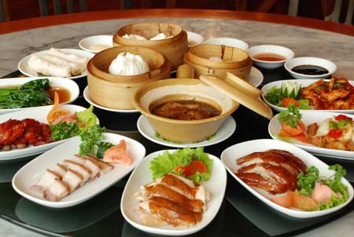
An Analogy: Chinese food in America
Good
Fast
Cheap
You pick 2

Slide 61
An Analogy: Natural Language Processing
high accuracy
broad domain (not just for a single topic)
fully automatic
Educators need to check the output.

Slide 62

Some Example Applications
 | Google Translate | Phone systems (e.g., for banking) | This research
high accuracy
broad domain
fully automatic

Slide 63
Summary
Vast resources of text are available.
We can develop NLP tools to help teachers use those resources.
  NLP is not magic (e.g., we need to handle errors).
Specific applications:
  Search tool for reading materials
  Factual question generation tool
Question Generation demo: http://www.ark.cs.cmu.edu/mheilman/questions

Slide 65
References
M. Heilman, L. Zhao, J. Pino, and M. Eskenazi. 2008. Retrieval of reading materials for vocabulary and reading practice. In Proc. of the 3rd Workshop on Innovative Use of NLP for Building Educational Applications.
M. Heilman and N. A. Smith. 2010. Good Question! Statistical Ranking for Question Generation. In Proc. of NAACL/HLT.
M. Heilman, A. Juffs, and M. Eskenazi. 2007. Choosing reading passages for vocabulary learning by topic to increase intrinsic motivation. In Proc. of AIED.
K. Collins-Thompson and J. Callan. 2005. Predicting reading difficulty with statistical reading models. Journal of the American Society for Information Science and Technology.

Slide 66
Prior Work on Readability
Measure | Year | Lexical Features | Grammatical Features
Flesch-Kincaid | 1975 | Syllables per word | Sentence length
Lexile (Stenner, et al.) | 1988 | Word frequency | Sentence length
Collins-Thompson & Callan | 2004 | Individual words | -
Schwarm & Ostendorf | 2005 | Individual words & sequences of words | Sentence length, distribution of POS, parse tree depth, …
Heilman, Collins-Thompson, & Eskenazi | 2008 | Individual words | Syntactic sub-tree features
Notes:
Picked baselines that are widely used:
-FK in word processing applications
-Lexical in K-12 schools
-Language Modeling in the REAP system
Heilman et al 2007 focused a lot on readability for ESL. Constructions were extracted from an ESL grammar textbook.
Schwarm and Ostendorf 2005: didn’t have easy access.
Experimented with some of their grammatical features in preliminary tests.
It would certainly be interesting to perform that comparison.

Slide 67
Curriculum Management Interface
Enables teachers to…
  Search for texts,
  Order presentation of texts,
  Set time limits,
  Choose vocabulary to highlight,
  Add practice questions.

Slide 68
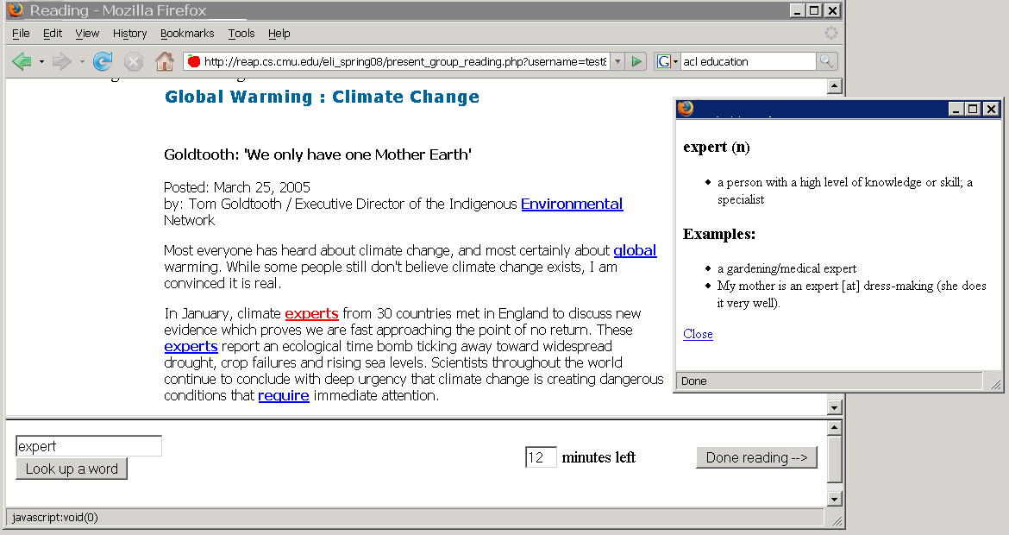
Learner Support: Reading Interface
Students click on target words for definitions
Target words specified by the teacher are highlighted.
Optional timer helps with classroom management.
Definitions available for non-target words as well.

Slide 69
Corpora
 | English Wikipedia | Simple English Wikipedia | Wall Street Journal (PTB Sec. 23) | Total
Texts | 14 | 18 | 10 | 42
Questions | 1,448 | 1,313 | 474 | 3,235
Training
Testing
2,807 questions
36 texts
428 questions
6 texts

Slide 70

Evaluation Metric
Percentage of top-ranked test set questions that were rated acceptable by human annotators

Slide 71
Ranking Results
Testing
Noisy at top ranks.

Slide 72
Selecting and Revising Questions
(location)
(person)
(location)
…Jefferson, the third President of the U.S.,
selected Aaron Burr as his Vice President….
(person)
(person)
Where was the third President of the U.S.?
Who was the third President of the U.S.?
revision by a user

