Slide 1
Department 18 Electrical Engineering and Information Technology The first electrical engineers…

Slide 2
Our Past
History
1882
Prof. Dr. Dr.-Ing. E. h.
Erasmus Kittler (1852-1929)
TH Darmstadt
First Chair for Electrical Engineering worldwide

Slide 3
Innovation is our tradition
History
etit helped shape the world…
RADAR Early Warning System
Modern three-phase motors
Radio-controlled clock
Elektret microphone
Electric vehicles
CMOS Cameras for space travel
Solar houses in Darmstadt
First Chairs and Degree Programmes
Notes:
RADAR-Frühwarnsystem: Theodor Schultes entwickelt 1935 das weltweit erste RADAR-Frühwarnsystem. Er studierte von 1921 bis 1926 Elektrotechnik und promoviert 1934 in der Physik.
MODERNE DREHSTROMMOTOREN: Karl Hasse erfindet 1968 die feldorientierte Regelung. Sie ist Grundlage aller modernen Drehstrommotoren, wie sie z. B. im ICE, bei Windkraftgeneratoren und in Automobilen mit Hybridantrieb verwendet werden.
FUNKUHR: Wolfgang Hilberg, von 1972-2000 Professor der TU Darmstadt, erfindet 1967 die Funkuhr und entwickelt die wesentlichen Elemente und Prototypen dieser Uhr an der TU Darmstadt. Der erste dieser Prototypen liegt heute im Deutschen Museum in München.
ELEKTRETMIKROPHON: Gerhard Sessler erfindet zusammen mit James E. West das Folien-Elektretmikrophons (1962) Das Elektretmikrophon ist das weltweit gebräuchlichste Mikrophon und wird u.a. in Handys und Kassettenrekorder eingebaut.
ELEKTROFAHRZEUGE: Das Elektrofahrzeug „Pinky“ gewinnt die Weltmeisterschaft der Solarmobile 1990, 1991 und 1992. „Pinky“ steht heute im Deutschen Museum in München.
CMOS KAMERAS: 1988: Werner Langheinrich und Ottmar Kindl entwickeln die CMOS-Niedrigsttemperatur-Technologie für die Kameras des Infrared Space Observatory (ISO) der ESA.
SOLARHÄUSER: 2007 Thomas Hartkopf, Professor der TU Darmstadt und Vorstandsmitglied der EnBW, und sein Team entwickeln die energietechnischen Systeme der beiden Darmstädter Solarhäuser, die in den Jahren 2007 und 2009 den Solar Decathlon der USA gewinnen.
Erste Lehrstühle: Siehe nächste Folie

Slide 4
Many first academic Chairs in Germany
History
Historie
Telecommuni-cations
1894
High Voltage Technology
1914
Electro-mechanical Systems
1963
Power Electronics
1963
Renewable Energies
1996
Bioinspired Communications Systems
2013
Control Systems
1954
Notes:
2013: Bioinspirierte Kommunikationssysteme (Prof. Heinz Köppl)
1996: Regenerative Energien (Thomas Hartkopf)
1963: Stromrichtertechnik
1963: Elektromechanische Konstruktionen (Curt Brader)
1954: Regelungstechnik (Winfried Oppelt)
1914: Hochspannungstechnik (Waldemar Petersen, Nachfolger Kittlers von 1914-1933, begründet die Hochspannungstechnik und erfindet die Erdschluss-Löschspule.)
1894: Nachrichtentechnik (Karl Wirtz)

Slide 5
Figures and facts
The Department
26 (+3)
Professors
$\sim$250
Research Assistants
~250
Research Assistants
$\sim$100
Administrative and technical staff
~100
Administrative and technical staff
$\sim$ 2.000
Students
~ 2.000
Students
5 (+2)
Bachelor degree programmes
5 (+3)
Master degree programmes
01.10.2019
Notes:
Professoren:
Grundständige Professuren + (Junior-, Industrie- Kooperations-, Gastprofessuren)
Studiengänge:
Von etit verwaltet + (mit signifikanter etit Beteiligung, aber Verwaltung liegt bei anderen Fachbereichen, Studienbereichen)

Slide 6
Our research groups
Der Fachbereich
Adaptive Systems for Processing of Speech and Audio Signals
Accelerator Physics
Accelerator Technology
Bioinspired Communication Systems
Computational Electromagnetics
Real-Time Systems
Electrical Power Supply with Integration of Renewable Energies
Electrical Energy Conversion
Energy Information Networks & Systems
New Materials
Electronics
High Voltage Technology
Integrated Electronic Systems
Integrated Micro-Nano-Systems
Communications Engineering
Power Electronics and Control of Drives
Light Technology
Mathematische Modellierung Elektromagnetischer Felder
Measurement and Sensor Technology
Microwave Engineering
Multimedia Communications
Communication Systems
Photonics and Optical Communications
Computer Systems
Control Methods and Robotics
Control Systems and Mechatronics
Signal Processing
Multimodal Energy Systems
Terahertz Devices and Systems
Electromagnetic Field Theory

Slide 7
Our finances
The Department
Der Fachbereich
Government funding Institutional funding

Slide 8
Our largest industrial collaborators in 2017
The Department
Notes:
Auswahlkriterien: tbd

Slide 9
Our students
Studying

Slide 10
CHE Ranking 2019 – etit results
Studying
Overall Ranking: in leading group of German universities (evaluation by students as well as evaluation by facts / statistical data)
#1 in category „support in freshman level“
#2 in overall ranking „general conditions for students“
Notes:
Biomedical Engineering

Slide 11
Our degree programmes
Studying
adjacent degree programmes
Mechanical Engineering
Mathematics
Computer Science
Chemistry
Industrial Engineering
Architecture
Civil Engineering
Medicine
MEC
WI etit
etit
Mechatronics
(B.Sc. + M.Sc.)
Engineering Management for Electrical Engineering
(B.Sc. + M.Sc.)
Electrical Engineering and Information Technology
(B.Sc. + M.Sc. + B.Ed.)
MedTec
ESE
Biomedical Engineering
(B.Sc. + M.Sc.)
Energy Science and Engineering (M.Sc.)
ICE
iST
CE
Information and Communication Engineering (M.Sc.)
(in english)
Information System Technology
(B.Sc. + M.Sc)
Computational Engineering (B.Sc. + M.Sc.)
Interdisciplinary degree programmes
Degree programmes with etit participation

Slide 12
etit: Specialisations
Studying
AUT
Automation
DT
Computer Engineering
Electrical Engineering and
Information Technology
SAE Sensors, Actuators
and Electronics
KTS Communication and Sensor Networks
EET
Electrical Power Engineering
CED
Computational Electrodynamics

Slide 13
Our interdisciplinary degree programmes
Studying
B.Sc./M.Sc.
Information
System
Technology
Electrical Engineering and
Information Technology
Computer Science
B.Sc./M.Sc.
Mechatronics
B.Sc./M.Sc.
Biomedical
Engineering
Electrical Engineering and
Information Technology
Mechanical Engineering
Electrical Engineering and
Information Technology
Medicine

Slide 14
A selection of our honours and awards
Research
Prof. Dr.-Ing.
Alex Gershman
Prof. Dr.-Ing.
Hans Hartnagel
Prof. Dr.-Ing.
Rolf Isermann
Wolfgang Paul Award (2001)
IEEE Fellow (2006)
Max Planck Research Award (1990)
Rufus Oldenburger Medal (2010)
Prof. Dr.-Ing.
Gerhard Sessler
Prof. Dr.-Ing.
Ralf Steinmetz
Prof. Dr.-Ing.
Thomas Weiland
Prof. Dr.-Ing.
Abdelhak Zoubir
National Hall of Fame der USA (1999)
Benjamin Franklin Medal (2010)
Maxwell Award (2012)
AAC Gold Medal (2015)
Bundesverdienstkreuz am Bande (2016)
ITG-Fellow (2017)
IEEE Fellow (2001)
ACM Fellow (2002)
ACM SIGMM Award (2008)
ITG Fellow (2017)
Gottfried Wilhelm Leibniz-Preis (1987)
IEEE Fellow (2011)
IEEE Fellow (2008)

Slide 15
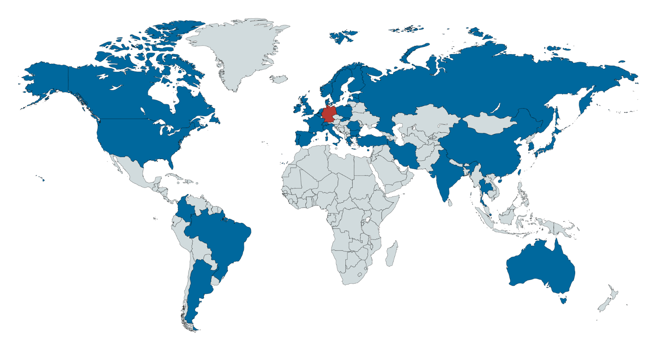
International: Partners all around the world
International

Slide 16
International: Partners all around the world
International
50+
European Cooperations partners
(ERASMUS+)
30+
Non-european Cooperations partners
(bilateral programmes)
10+
Double-Degree
partners

Slide 17
International: Double Degree partners
International
URI Rhode Island
UPM Madrid
UPC Barcelona
UPV València
Universidad Pontificia Comillas
KTH Stockholm
USP Sao Paulo
CentraleSupélec Paris
ECN Nantes
ECL Lyon
INPG Grenoble
NTNU Trondheim
POLITO Torino

Slide 18
The TU Darmstadt
Umfeld
Germany's first autonomous university
about 26,000 students
one of the universities with the highest proportion of international students in Germany
interdisciplinary in teaching and research
One of the leading technical universities in Germany

Slide 19
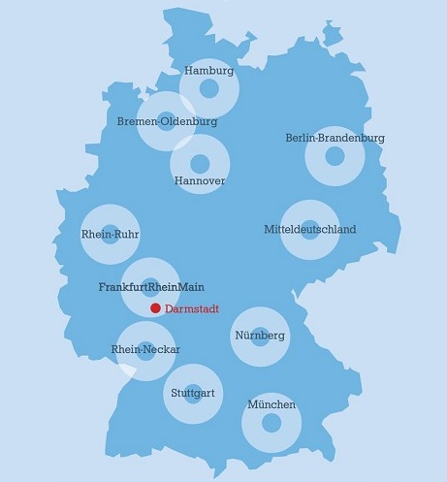
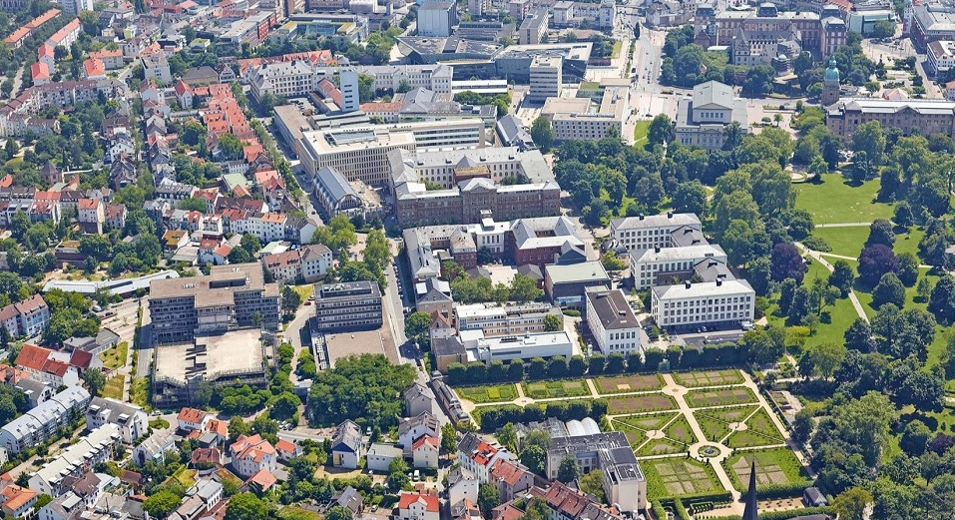
In the heart of the Frankfurt-Rhine-Main metropolitan region
Umfeld
Notes:
Die Rhein-Main-Universitäten
Enge Kooperation in Forschung und Lehre (z.B. MedTec)
Darmstadt: City of Science
European Space Operations Centre der ESA
GSI-Helmholtzzentrum für Schwerionenforschung
3 Fraunhofer Institute
3 Hochschulen / Universitäten

Slide 20
Our online presence
etit online
Internet
Instagram
facebook
YouTube
twitter
www.etit.de
Kanal: etitdarmstadt
fb.com/etitdarmstadt
youtube.com/etitdarmstadt
twitter.com/etitdarmstadt

