Slide 1

High Resolution Measurements of
Boiling Heat Transfer
Martin Freystein
Institute of Technical Thermodynamics, TU Darmstadt
Personal Skills and Boiling Experience
Single Bubble Pool Boiling
Bubble Coalescence and moving contact line evaporation during flow boiling in a single minichannel

Slide 2
Personal Boiling Experience
Motivation
Boiling always played an important role
(from undergraduate to doctorate)
2007 Semester Abroad at Brunel University West London, UK
„Heat transfer in single phase and flow boiling in microchannels“
(Supervisor: Prof. T. Karayiannis, Prof. D.B.R. Kenning)
2009 Diploma Thesis, University of Hanover „Boiling Heat Transfer of Refrigerants on Horizontal Tubes“
(Supervisor: Prof. A. Luke, Prof. D. Mewes)
2010 Parabolic Flight Campaigns (Research Associate), TU Darmstadt
(since) „Single bubble pool boiling under the influence of reduced gravity“
(Co-Worker: Prof. P. Stephan, Prof. P. di Marco)
2011 Project Leader (Joint Research Project ESA&JAXA)
(since) „Flow boiling in mini-/microchannels under the influence of reduced gravity“
(Co-Worker: Prof. P. Stephan, Prof. O. Kawanami, Prof. A. Pattamatta)

Slide 3
Personal Skills
Motivation
Extensive Experience in the Design and Commissioning of experimental setups
Sound knowledge of temperature measurement techniques
(in particular high speed IR-thermography)
Organisational skills (Parabolic Flight campaigns)
Excellent knowledge of the fundamentals of heat and mass transfer due to
assistance in lectures and design of exams
Design of Parabolic Flight setup with modern techniques in collaboration with
Chemical Department (sputtering of CrNi layers) and Institute of Production Tools
(Laser-Sintering technique for microchannel test section)

Slide 4
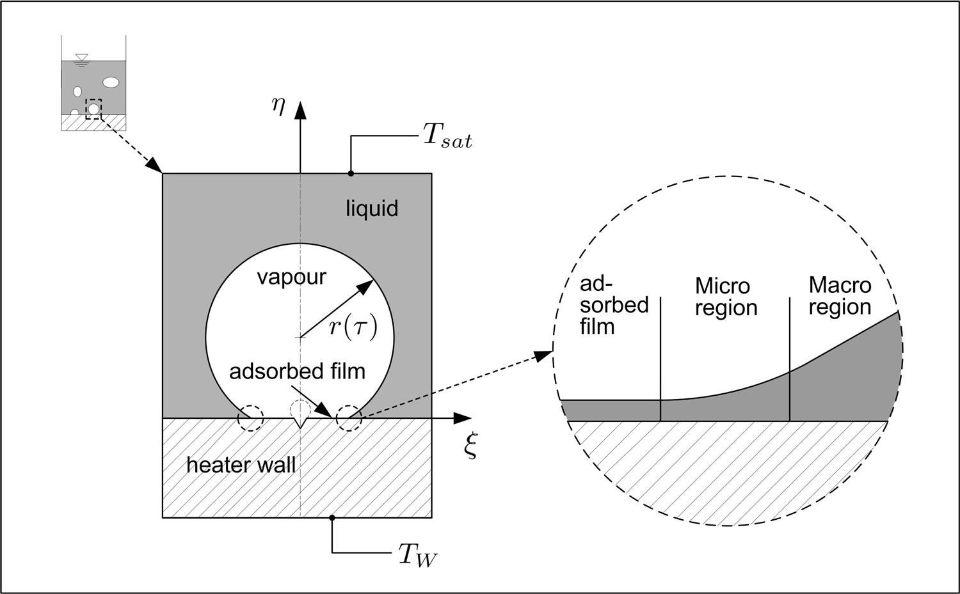
Introduction
Motivation
Extensive use of flow boiling in many technical applications
High complexity of heat transfer and flow phenomena coupled with a free phase boundary during flow boiling
Numerous (semi-)empirical
correlations to describe
boiling only valid in very
narrow parameter fields
Underlying physical
processes not sufficiently
understood
Multiple length-scales
High
Evaporation
rate
Transverse flow
[P. Stephan]

Slide 5
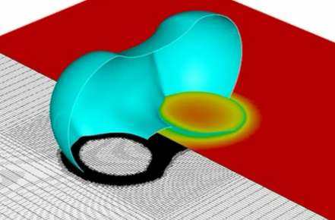
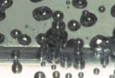
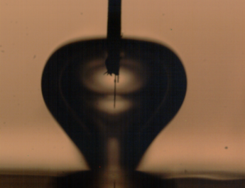
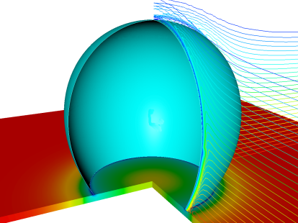
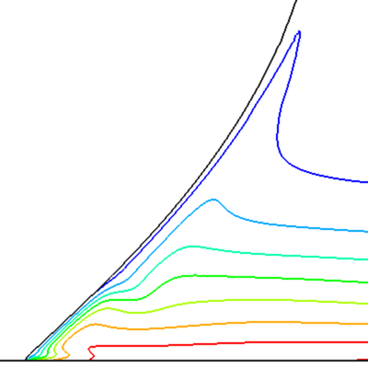
Multiple scales of interest
Motivation
CHF
Multiple bubble regime
Single bubble regime
Dynamic contact line behavior
and wetting characteristics
Typical length scale
„Nano“
„Micro“
„Meso“
„Macro“
[P. Stephan]

Slide 6
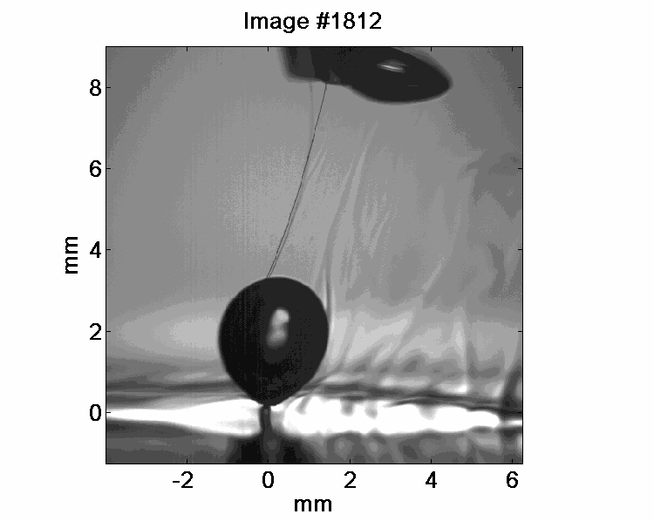

Scientific approach
Research at TTD
Generic Experiment
Numerical Simulation
Validation
Higher resolution
[N. Schweizer]
[B. Shu]
Experimental and Numerical Work:
Single bubble pool boiling, pool boiling with numerous nucleation sites, single meniscus evaporation, flow boiling in minichannels, evaporation of single and multiple droplets,…

Slide 7
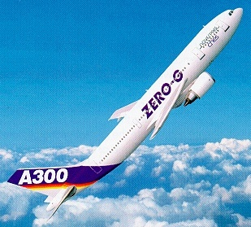
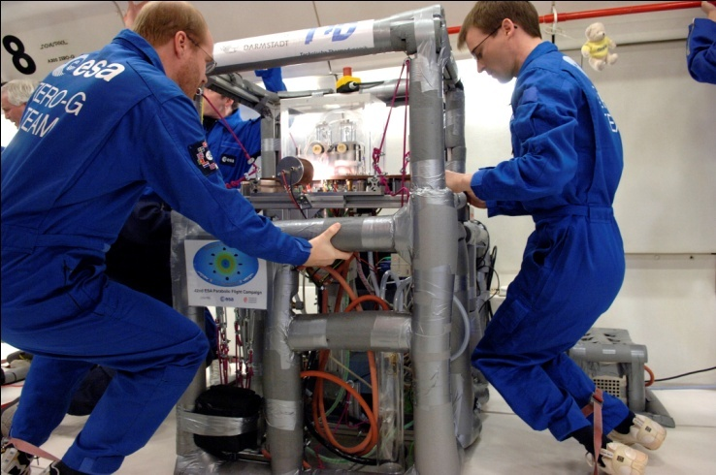
Measurement technique
Background
High Speed Infrared Thermography
Measurement technique developed to investigate
the temperature and heat flux distribution near the
three phase contact line
Validation of contact line model
(Stephan/Busse, IJHMT 1992)
Single bubble pool boiling experiments under
normal and microgravity conditions
(E. Wagner 2008 (Diss.), N. Schweizer 2010 (Diss))
Eight Parabolic Flight Campaigns (2004 – today)
[Novespace]

Slide 8
Measurement technique
Method (Flow boiling)
PMMA window
Working fluid FC-72
Flow
Generated bubbles
Heating foil
25μm
Black coating

Slide 9
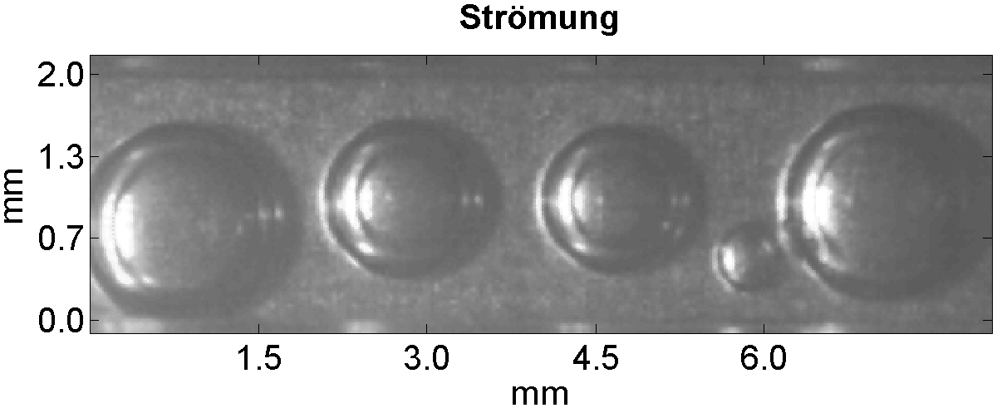
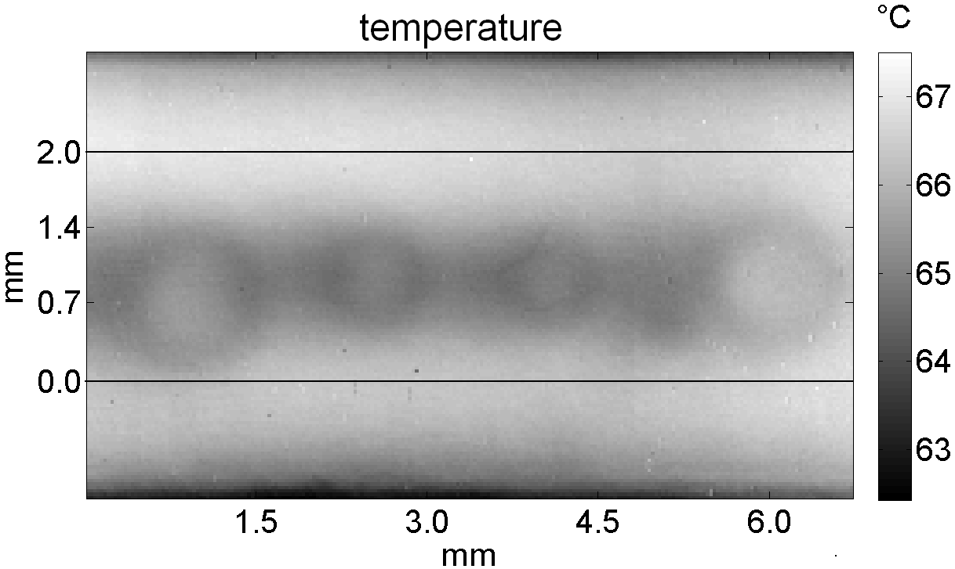
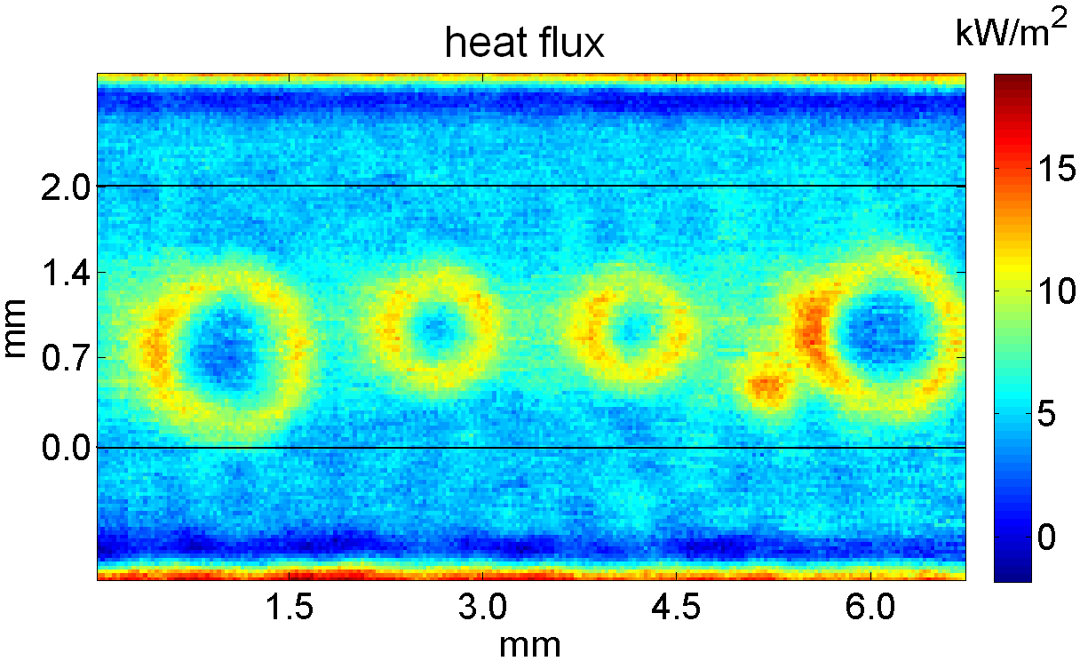
Measurement technique
Method (Flow boiling)
b/w camera
1000 fps
≈17x17 µm²
IR camera
1000 fps
≈30x30 µm²

Slide 10
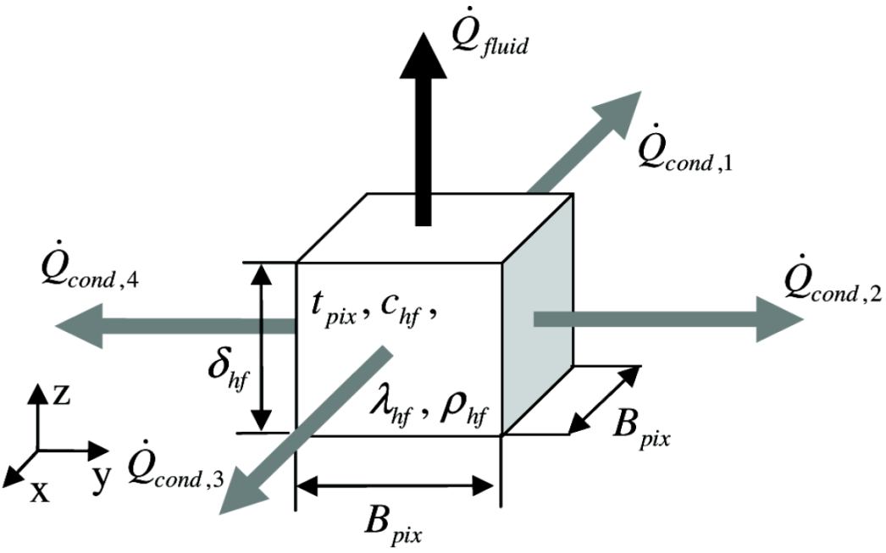
Measurement technique
Data Reduction
Calculation of local heat flux into the fluid ?!
Discretization of the heating foil into pixel elements from the IR camera
Temperature gradients known from IR measurement
Backside of foil is assumed to be adiabatic
Energy balance of the element gives the unknown wall heat flux into the fluid
Energy balance of a single pixel element

Slide 11
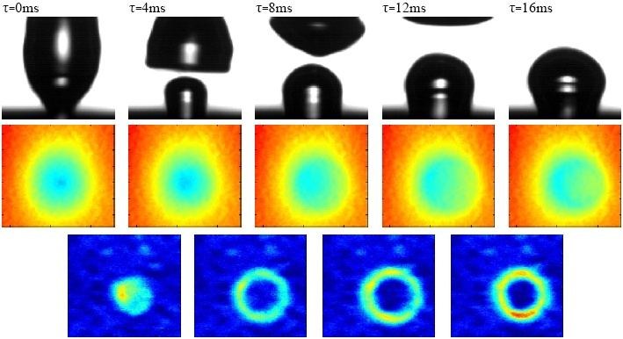
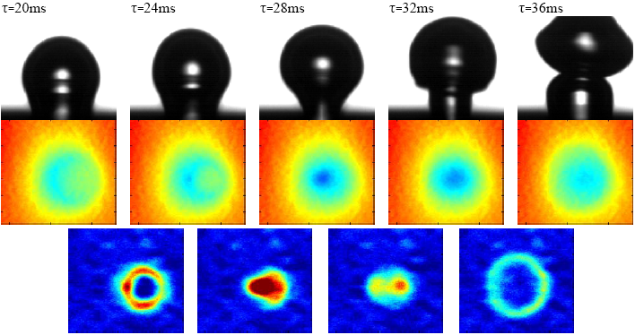
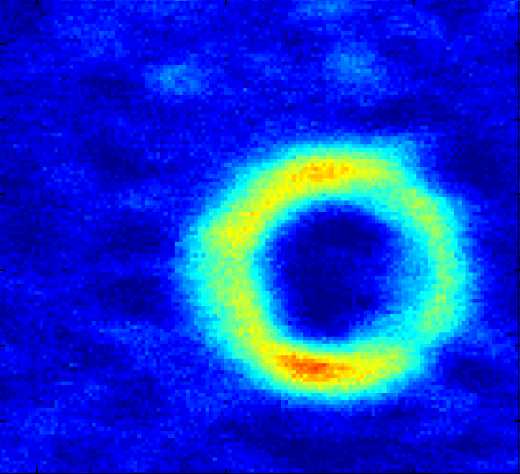
Experimental results
Single bubble cycle
Bubble cycle in zero g (42nd ESA PFC 2006)
Heat source: 6700 W/m²
Bulk liquid temperature: 38.4°C
[N. Schweizer]
Contact line can be clearly identified as region of high local heat transfer
Larger departure diameter and frequency in reduced gravity is increasing the
resolution and comparison with numerical results is much easier

Slide 12
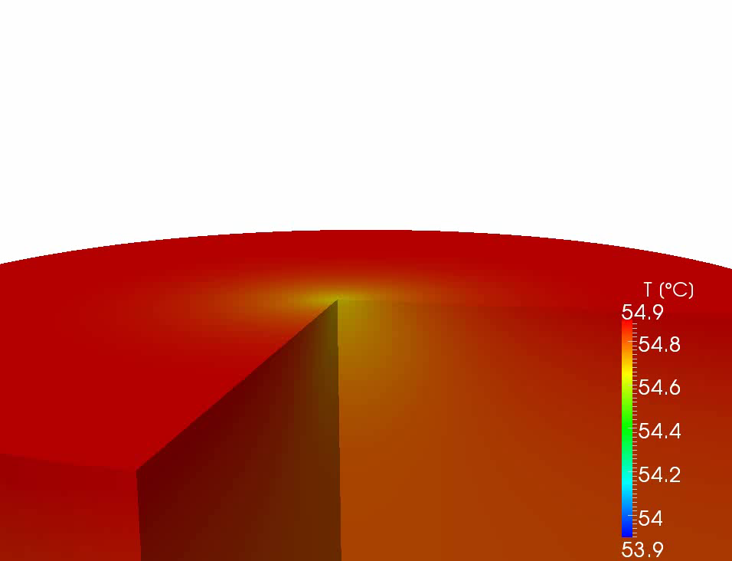
Numerical results
Single bubble cycle
Bubble cycle:
38 ms
(13 ms growth + 25 ms waiting)
Fluid: HFE-7100 (T_{sat} = 39.8°C)
Heating power: q = 5.4 kW/m²
CaF heater: thickness 2 mm
[C. Kunkelmann]

Slide 13
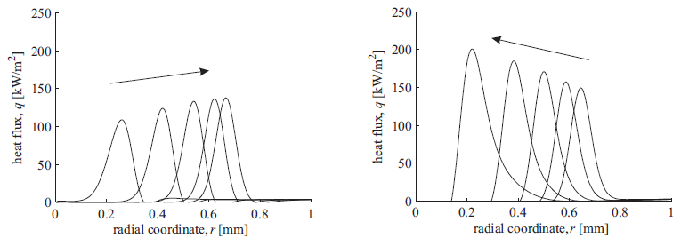
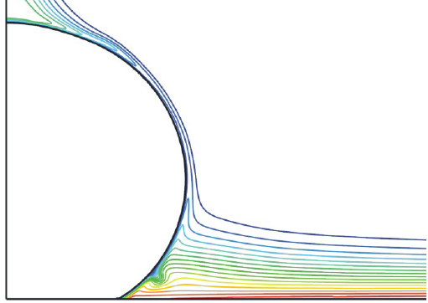
Numerical results
Local wall heat flux near contact line
growing bubble (receding c.l.)
detaching bubble (advancing c.l.)
time
time
q
Kunkelmann, PhD Dissertation, TU Darmstadt
http://tuprints.ulb.tu-darmstadt.de/2731
Experimental results show the same characteristic
No information about physical effect for the
increase in local wall heat flux
r

Slide 14
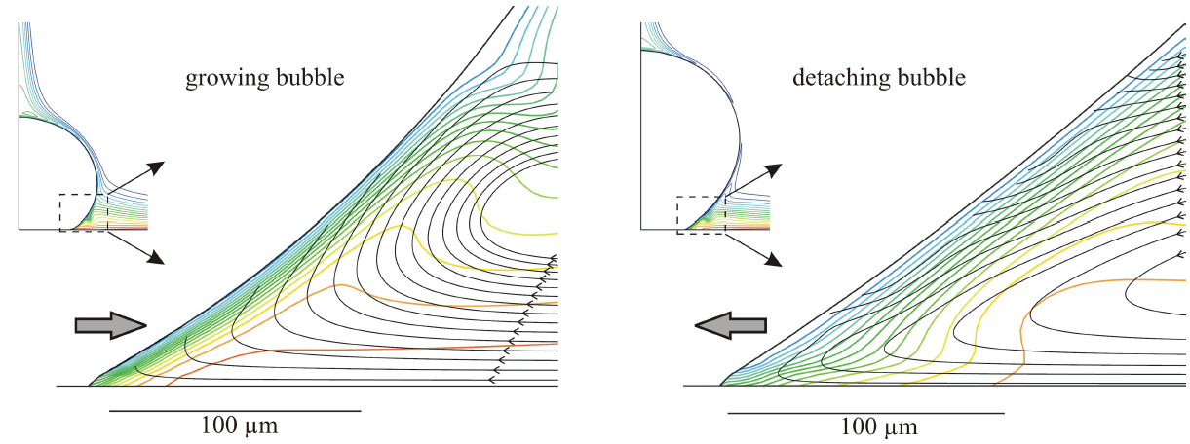
Numerical results
Local temperature and flow near contact line
growing bubble (receding c.l.)
detaching bubble (advancing c.l.)
Kunkelmann, PhD Dissertation, TU Darmstadt
http://tuprints.ulb.tu-darmstadt.de/2731
Opposite liquid flow direction near contact line position for receding and advancing
Micro convection enhances the heat transfer for the advancing contact line

Slide 15
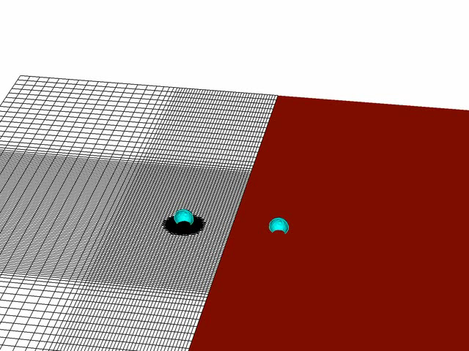
Numerical results
Bubble merger
Kunkelmann, PhD Dissertation, TU Darmstadt
http://tuprints.ulb.tu-darmstadt.de/2731

Slide 16
Pool boiling ↔ Flow boiling
Pool boiling
High local heat transfer at contact line region can be clearly identified
Validation data for numerical methods available due to Parabolic Flights
First insight into micro convection near contact line
Flow Boiling
Transfer of high speed infrared measurement technique
Basic physical phenomena of heat transfer in small length scales
(most of published work with focus on global measurements of heat transfer and pressure drop → derived correlations for only a very limited parameter range)
Validation of heat transfer models (e.g. Three-zone model)
Experimental data for the validation of numerical results

Slide 17
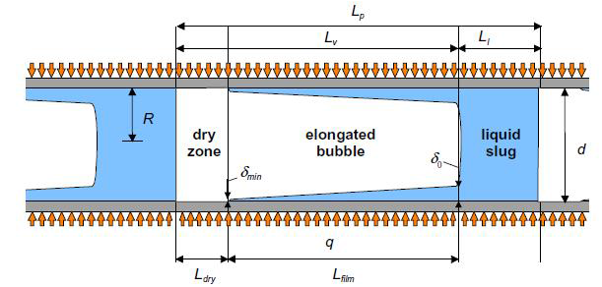
Flow boiling
Three-zone model
[J. Thome]
Periodic sequence of liquid slug, thin film evaporation and dry zone
Validation of the model ?!

Slide 18
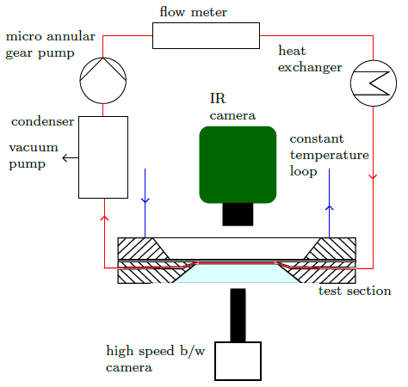
Flow boiling
Fluid loop
Fluid: FC-72
Pressure: 1 bar
T_{sat}: 56.6°C
Channel: 2x2 mm²
0.5x2 mm²

Slide 19
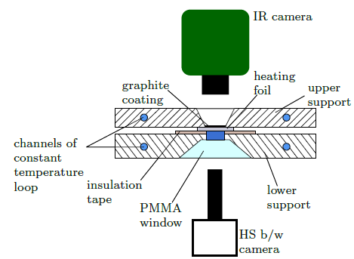
Flow boiling
Test section

Slide 20
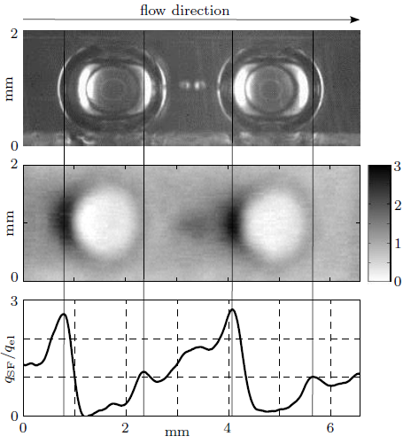
Flow boiling
Bubbly flow
Three phase contact line can be clearly identified by area of high local heat flux
Bubbles are sliding over the heating surface
Temporal development of average heat flux in the middle cross section of the field of view allows the detection of the liquid vapor interface
Contact line heat transfer at the back of the bubble higher
→ as seen in pool boiling (num.&exp.)

Slide 21
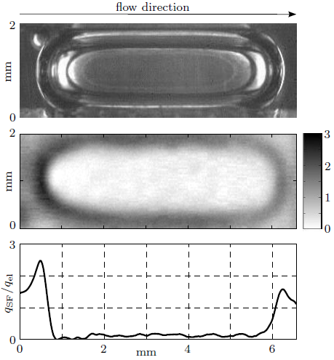
Flow boiling
Slug flow / elongated bubble
Size of bubbles confined by channel geometry
Contour of bubble can be clearly identified by high heat flux areas near the three phase contact line
Heat transfer at the back higher
(as already seen for bubbly flow)
No long thin film region visible
Conclusion
Three-zone model not valid ?!

Slide 22
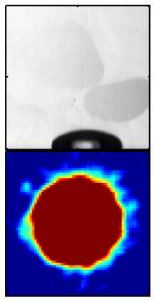
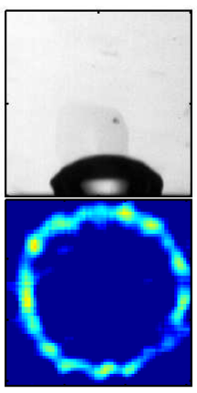
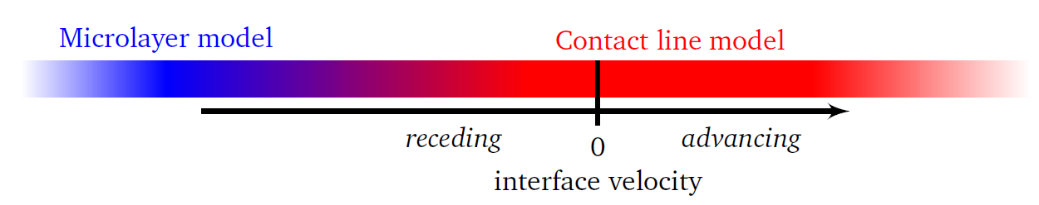
Microlayer vs. Contact line
More influencing parameters
Contact angle
heat of vapor
…
[A. Sielaff]
[A. Sielaff]

Slide 23
Microlayer vs. Contact line
Thin liquid evaporation for flow boiling of FC-72 not visible (or very short region)
Results of pool boiling indicate that the models are not competing but equivalent
(only for different parameters) [PhD Thesis A. Sielaff, 2014]
Experimental results showing microlayer evaporation mostly with water
Contact line behaviour with electronic liquids (FC-72, HFE-7100,…)
Due to heating foil technique and limited heating power during parabolic flight,
FC-72 is used as working fluid
Comparison and validation of three-zone model for a wide parameter range
not yet possible
Analogy between pool boiling and flow boiling phenomena ?

Slide 24
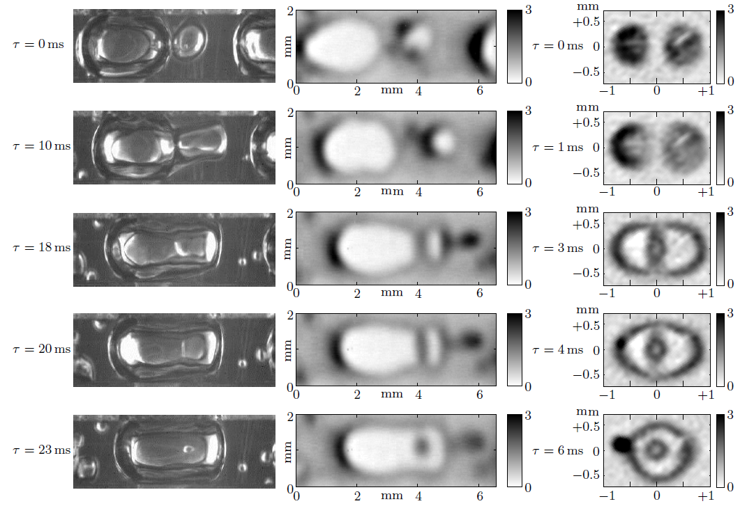
Flow boiling (analogy)
Bubble merger with residual droplet

Slide 25
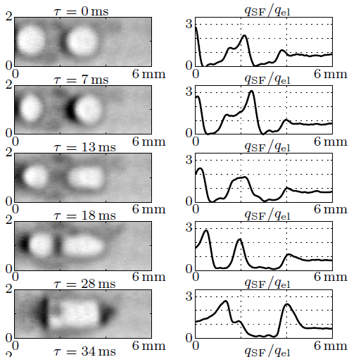
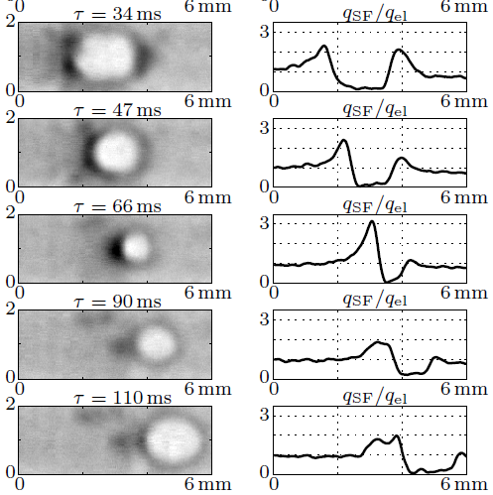
Flow boiling (analogy)
Coalescence with pulsating bubble

Slide 26
Summary
Three-zone model
Measurement technique successfully adapted to flow boiling experiments
Analogy between pool and flow boiling can be seen for moving contact lines,
coalescing bubbles or residual droplets
First step to the validation of models (change of working fluid planned 2015/16)
Development of new heater comparable to a technical heating surface
(IR-transparent substrate with a 100nm thick sputtered CrNi heating layer)

Slide 27
Acknowledgements
Coalescence with pulsating bubble
European Space Agency (ESA) providing the possibility to carry out the experiments under low gravity conditions during the 53rd, 55th and 58th ESA Parabolic Flight Campaigns and Novespace for their support during the experiment preparation.

